Slide 1
KLE Society’s Degree College Bachelor of Computer Application Nagarbhavi, Bangalore
“Secure Keyword Search and Data Sharing Mechanism for Cloud Computing”
Submitted By:
Under the Guidance of:
Kala K (206MSB7035)
Manjula G (206MSB7049)
Bhavani R (206MSB7016)
Arpitha J C
Assistant Professor

Slide 2
Contents
Abstract
Introduction
Existing System
Proposed System
System Architecture
System Requirements
Modules
System Design
Conclusion
References

Slide 3
ABSTRACT
The cloud infrastructure reduced the costs of hardware and software resources. To ensure security, the data is encrypted. Searching and sharing the plain data, it is challenging to search and share the data after encryption and it is a critical task for the cloud service provider as the users expect the cloud to conduct a quick search and return the result without losing data. To overcome these problems, we propose a ciphertext-policy attribute-based mechanism with keyword search and data sharing (CPAB-KSDS). The proposed solution supports both attribute-based keyword search and attribute-based data sharing. Additionally, the keyword can be updated during the sharing phase without interacting with the PKG and we describe the notion of CPAB-KSDS as well as its security model. Besides,we prove that it is against chosen ciphertext attack and chosen keyword attack.

Slide 4
INTRODUCTION
Cloud Computing is the on demand delivery of IT resources over the internet with pay-as-you-go pricing.
The term Cloud refers to a network or the internet. It is a technology that uses remote servers on the internet to store , manage and access data online rather than local drives. The data can be anything such as files , images , documents , audio , video and more.
Cloud computing is the on demand availability of computer system resources. Especially data storage (cloud storage) and computing power without direct active management by the user.

Slide 5
EXISTING SYSTEM:
A KP-ABPRE with keyword search scheme was designed to search for a certain ciphertext and re-encrypt it. The PKG in this scheme controls the access policy in a traditional key policy, and the data owner loses the ability to assign access policy on his encrypted data.
One additional issue with the work is that the data owner must interact with the PKG and request the PKG. Moreover, it is the delegator that needs to share the data with the delegatee, which is unrelated with the PKG.
DISADVANTAGES OF EXISTING SYSTEM:
Prior work did not demonstrate that the existing attribute based mechanisms could both support keyword search and data sharing in one scheme without resorting to PKG.
There is no guarantee that the service provider could return the correct partial decryption ciphertext.

Slide 6
PROPOSED SYSTEM:
A ciphertext-policy attribute-based mechanism with keyword search and data sharing (CPAB-KSDS) for encrypted cloud data. The searching and sharing functionality are enabled in the ciphertext-policy setting.
Its proved that it is against chosen ciphertext attack(CCA) and chosen keyword attack(CKA)security in the random oracle model.
ADVANTAGES OF PROPOSED SYSTEM:
Allows the data owner to search and share the encrypted health report without the unnecessary decryption process.
Supports keyword updating during the data sharing phase.
More importantly, does not need the exist of the PKG, either in the phase of data sharing or keyword updating.
The data owner can fully decide who could access the data he encrypted.

Slide 7
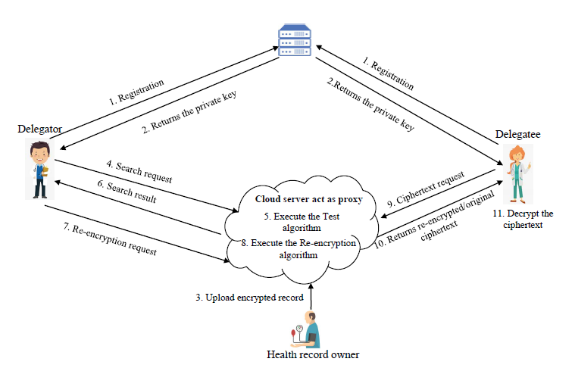
SYSTEM ARCHITECTURE:

Slide 8
SYSTEM REQUIREMENTS:
HARDWARE REQUIREMENTS:
System : Pentium i5 Processor
Hard Disk : 500 GB.
Monitor : 15.6’’ LED
Input Devices : Keyboard, Mouse
Ram : 2 GB
SOFTWARE REQUIREMENTS:
Operating system : Windows 11.
Coding Language : JAVA.
Tool : Netbeans 8.2
Database : MYSQL

Slide 9
MODULES:
Health Record Owner
Delegator
Delegate
Cloud Server
PKG

Slide 10
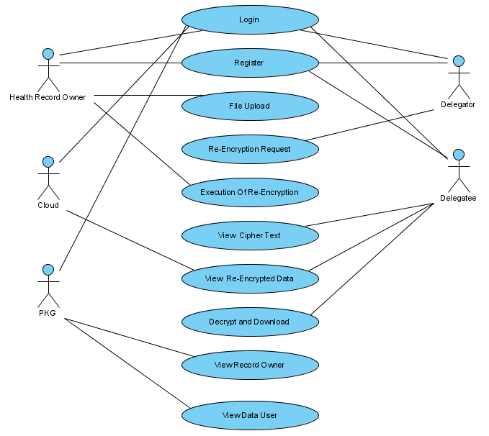
USE CASE DIAGRAM:

Slide 11
DATA FLOW DIAGRAM:
Data Owner
Registration
Login
Data User
LEVEL 0

Slide 12
LEVEL 1
Data Owner
Files Upload
Test Algorithm
Data User
Cloud Server

Slide 13
CONCLUSION AND FUTURE ENHANCEMENT
In this work, a new notion of ciphertext-policy attribute-based mechanism (CPAB-KSDS) is introduced to support keyword searching and data sharing. The proposed scheme is demonstrated efficient and practical in the performance and property comparison. This paper provides an affirmative answer to the open challenging problem pointed out in the prior work, which is to design an attribute-based encryption with keyword searching and data sharing without the PKG during the sharing phase.
Furthermore, our work CPAB-KSDS proposing a new scheme to support more expressive keyword search.

Slide 14
REFERENCES
[1] A. Sahai and B. Waters, “Fuzzy identity-based encryption,” in Annual International Conference on the Theory and Applications of Cryptographic Techniques, pp. 457–473, Springer, 2005.
[2] V. Goyal, O. Pandey, A. Sahai, and B. Waters, “Attribute-based encryption for fine-grained access control of encrypted data,” in Proceedings of the 13th ACM conference on Computer and communications security, pp. 89–98, Acm, 2006.
[3] J. Bethencourt, A. Sahai, and B. Waters, “Ciphertext-policy attribute based encryption,” in Security and Privacy, 2007. SP’07. IEEE Symposium on, pp. 321–334, IEEE, 2007.
[4] B. Waters, “Ciphertext-policy attribute-based encryption: An expressive, efficient, and provably secure realization,” in International Workshop on Public Key Cryptography, pp. 53–70, Springer, 2011.
[5] Nik-U, “Pbc package,” Online: https://github.com/Nik-U/pbc, 2015.
[6] B. Lynn et al., “Pbc library,” Online: http://crypto.stanford.edu/pbc,2006.

Slide 15


