Slide 1
Computer based Optimization Technique
Brief History
Introduction to the Course
Course Curriculum
A small problem

Slide 2
Brief History
It is both Arts and Science
It has started in World War-II (since 1930s) and then soon become very popular in mathematics, Industry, economics, management, and all most in any fields.
Primary application areas include forecasting, production, scheduling, inventory control and project management
It is also known as “Operation Research”, “Decision Science”, and Optimization Technique
Optimization technique is the scientific study of operations for the purpose of making better decisions

Slide 3
Objective
Decision making and improve its quality.
• Identify optimum solution.
• Integrating the systems.
• Improve the objectivity of analysis.
• Minimize the cost and maximize the profit.
• Improve the productivity.
• Success in competition and market leadership

Slide 4
Different Methods
1.Simulation methods
  It gives ability to conduct sensitive study to -
(a) search for improvements and
(b) test the improvement ideas that are being made.
2. Data-analysis methods
  The goal is to aid the decision-maker in detecting actual patterns and inter-connections in the data set and
  Use of this analysis for making solutions.
  This method is very useful in Public Health.
3. Optimization methods.
  Here goal is to enable the decision makers to identify and locate the very best choice, where innumerable feasible choices are available and comparing them is difficult.

Slide 5
Process
1. Identification of program problem.
  Most critical step in the process.
  Unless problem is clearly defined it is impossible to develop good solutions.
2. Identification of possible reasons and solutions .
  Once the problem has been identified , it is the job of the program implementer and researcher to determine the reasons for the problem and generate possible solutions
3.Testing of potential solution
4.Result utilization
  It is necessary to decide how its results are meant to be used.
5.Results dissemination
  Results dissemination are done in the form of seminars or by meeting with decision makers.

Slide 6
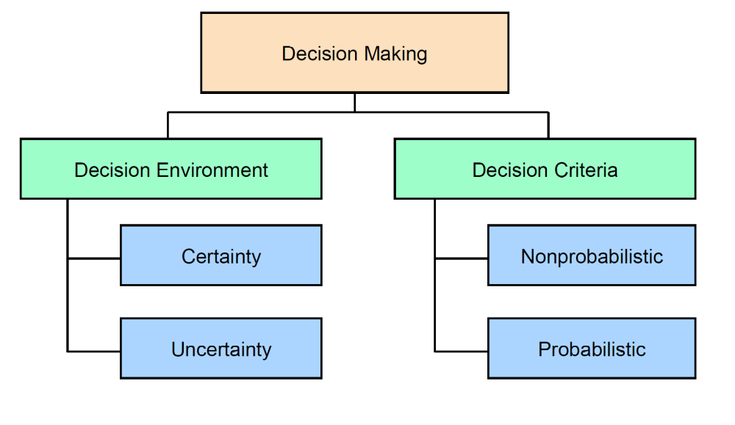
Decision Making Overview

Slide 7
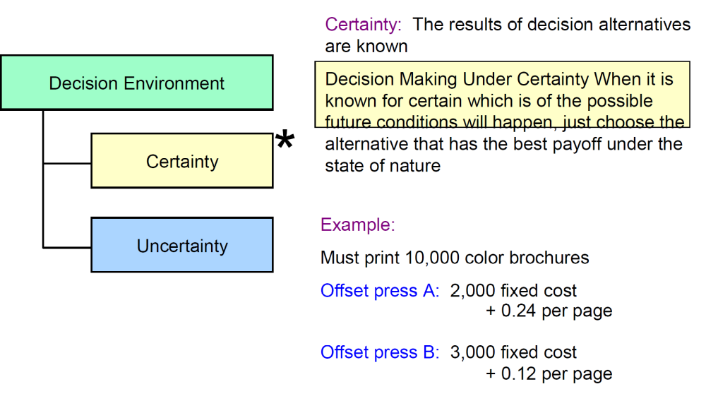
Decision Environment

Slide 8
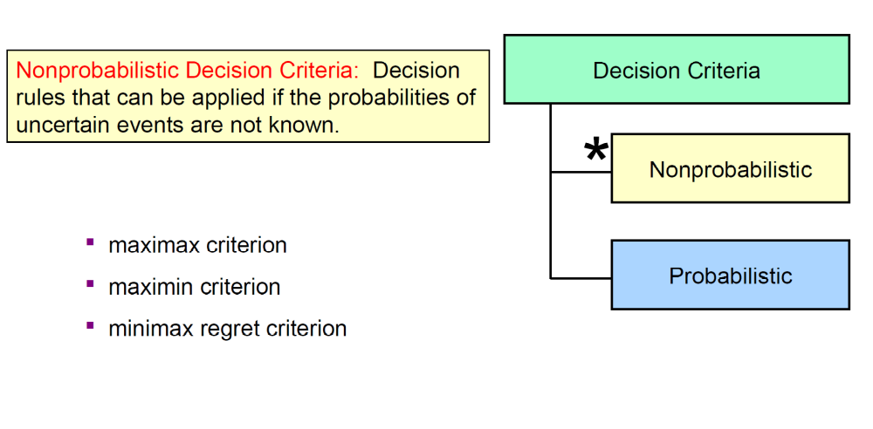
Decision Criteria

Slide 9
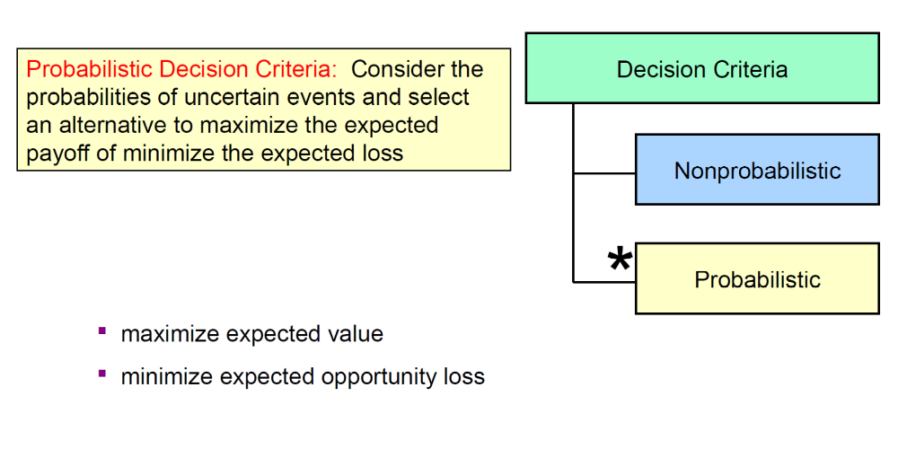
Decision Criteria

Slide 10
Pay-off
The payoffs of a decision analysis problem are the benefits or rewards that result from selecting a particular decision alternative
Maximax, Minimax and Minimax regret (opportunity loss)
 | Strong Economy | Stable Economy | Weak Economy
Large Store | 200 | 50 | -100
Average Store | 100 | 100 | -50
Small Store | 50 | 30 | 25

Slide 11
Linear Programming Problem (LPP)
Objective function
Constraints
  Unequal
    Greater than equal
    Less than equal
  Equal
Solution Approach
  Graphical
  Simplex Method

