Slide 1
Computer based Optimization Technique
Lecture-IX
Job Sequencing Problem
Mathematical Formulation of General Sequencing Problem
N-Jobs and 2-Machines (Johnson’s Method)
N-Jobs and 3-Machines
2-Jobs and M-Machines
N-Jobs and M-Machines

Slide 2
Job Sequencing Problem
Suppose there are n jobs to perform, each of which requires processing on some or all of the m different machines
The cost can be measured for any given sequence of jobs at each machine
Objective is to find the sequence of jobs to be executed among (n!)^{m} theoretically possible sequences such that the total cost is minimum
  If we take m = 5 and n = 5, the number of total possibilities are (5!)⁵ 25,000,000,000

Slide 3
Definitions
Suppose that there are n jobs (1,2,3,…n), each has to be processed one at a time at each of m machines A,B,C…. The order of processing each job through machines is given (Job 1 will be processed through A,C,B,D and Job 2 can be A,D,C,B).
The time that each job each job requires in each machine is known
The problem is to find a sequence among (n!)^{m} of all possible sequences for processing jobs so that total elapsed time for all jobs will be minimum

Slide 4
Mathematical Representations
A_{i} = Time for Job i on machine A
B_{i} = Time for job i on machine B etc.
T = Time from start of first job to completion of last job
The problem is to determine a sequence of jobs (i₁, i₂, i₃, …i_{n}) for each machine where (j₁, j₂, j₃ …j_{m}) is the combination which will minimize T

Slide 5
Terminology and Notations
Number of machines: Service facilities through a job must pass through for its completion
Processing order: It refers to the order in which various machines are required for completing the job
Processing time: It means the time required by each job in each machine
Idle time on a machine: The time for which the machine remains idle
Total Elapsed time: The time duration between the starting of first job till the end of last job
No Passing rule: No machine can be skipped

Slide 6
Principal Assumptions
No machine can process more than one job at a time
Each operation once start must be completed
Each job can be processed by one machine at a time
Time intervals for processing are independent of the order in which operations are performed
There is only one of each type of machine
A job is processes as soon as possible subject to ordering requirements
All jobs are ready to start processing

Slide 7
Solution to Sequencing Problem
N jobs and two machines A and B, all jobs are processed in the order of A,B
N jobs and three machines A, B and C, all jobs processed in the order A,B, and C
Two jobs and m machines. Each job is to be processed through the machine in a prescribed order
Problems with n jobs and m machines

Slide 8
N jobs and Two Machines
(Johnson’s Algorithm)
 | Jobs
Machines | 1 | 2 | 3 | 4 |  | N
A | A₁ | A₂ | A₃ | A₄ |  | A_{n}
B | B₁ | B₂ | B₃ | B₄ |  | B_{n}
Step-1: Select the minimum processing time occurring in the list A₁..A_{n} and B₁…B_{n}. If there is a tie either one can be chosen
Step-2: If the minimum processing time is A_{r}, select the r^{th} job first. If it is B_{s}, select the s_{th} job as last job
Step-3: There are now n - 1 jobs left to be ordered. Reconstruct the table with reduced set of jobs and corresponding processing times
Step-4: Repeat Step-1 thru 3 until all jobs are ordered.

Slide 9
Example
Job | 1 | 2 | 3 | 4 | 5
Machine A | 5 | 1 | 9 | 3 | 10
Machine B | 2 | 6 | 7 | 8 | 4
2
Job | 1 | 3 | 4 | 5
Machine A | 5 | 9 | 3 | 10
Machine B | 2 | 7 | 8 | 4
2 |  |  |  | 1
Minimum Total Completion time and idle time of each machine also. How?

Slide 10
Total Elapsed Time Calculation
Job | Machine A | Machine B
2 | 0 --- 1 | 1 --- 7
4 | 1 --- 4 | 7 --- 15
3 | 4 --- 13 | 15 --- 22
5 | 13 --- 23 | 23 --- 27
1 | 23 --- 28 | 28 --- 30

Slide 11
N-Jobs and 3-Machines
This is difficult to solve for general class
Only three machines (A,B and C are involved)
Each job is processed in the prescribed A,B,C order only
Transfer of jobs are not permitted
Exact expected processing time in each machine for each job is known
Jobs | Machine-A | Machine-B | Machine-C
1 | A₁ | B₁ | C₁
2 | A₂ | B₂ | C₂
….. | ….. | ….. | …..
n | A_{n} | B_{n} | C_{n}

Slide 12
Optimal Solution
So far no general direct procedure is available
Johnson’s method can be used ony if any or both of the following conditions are satisfied
  The minimum time on Machine A >= the Maximum time in machine B
  The minimum time on Machine C >= the maximum time in machine B
Reformulate the problem with an equivalent n-jobs and 2-machine problem (fictitious machines G and H with corresponding time as
        G_{i} = A_{i} + B_{i}
        H_{i} = B_{i} + C_{i}

Slide 13
Example
Jobs | Machine-A | Machine-B | Machine-C
1 | 8 | 5 | 4
2 | 10 | 6 | 9
3 | 6 | 2 | 8
4 | 7 | 3 | 6
5 | 11 | 4 | 5
Min(A_{i}) = 6, Max (B_{i}) = 6 Min(C_{i}) = 4 (Rule-1 is satisfied)
Jobs | Machine-G | Machine-H
1 | 13 | 9
2 | 16 | 15
3 | 8 | 10
4 | 10 | 9
5 | 15 | 9

Slide 14
2-Jobs and m-Machines
There are m machines (A1, A2, …, Am) and only two jobs (Job1 and Job 2)
The ordering of jobs through these m machines are previously known. The ordering may not be same for both the jobs
The expected processing time of each job in all m machines are known A₁¹, A₂¹, …A_{m}¹ and A₁², A₂²,..A_{m}²
Again the general direct method is not available
The ordering of processing of jobs may be different
  Job-1 (A, B, C, D and E)
  Job-2 (C, D, A, E and B)

Slide 15
Graphical Method
Job 1 | Seq. of Machine | A | B | C | D | E
 | Time | 2 | 3 | 4 | 6 | 2
Job 2 | Seq. of Machine | C | A | D | E | B
 | Time | 4 | 5 | 3 | 2 | 6
Step-1: Draw two axes, where horizontal (x) axis represents processing time on Job 1 and vertical (y) axis denote processing time on job 2
Step-2: Lay out the machine time for two jobs on the corresponding axes as given in the processing order
  Machine A makes 2 hrs for job 1 and 5 hrs for job 2. Rectangle PQRS is for machine A. Similarly construct rectangles for machine B, C, D, and E.

Slide 16
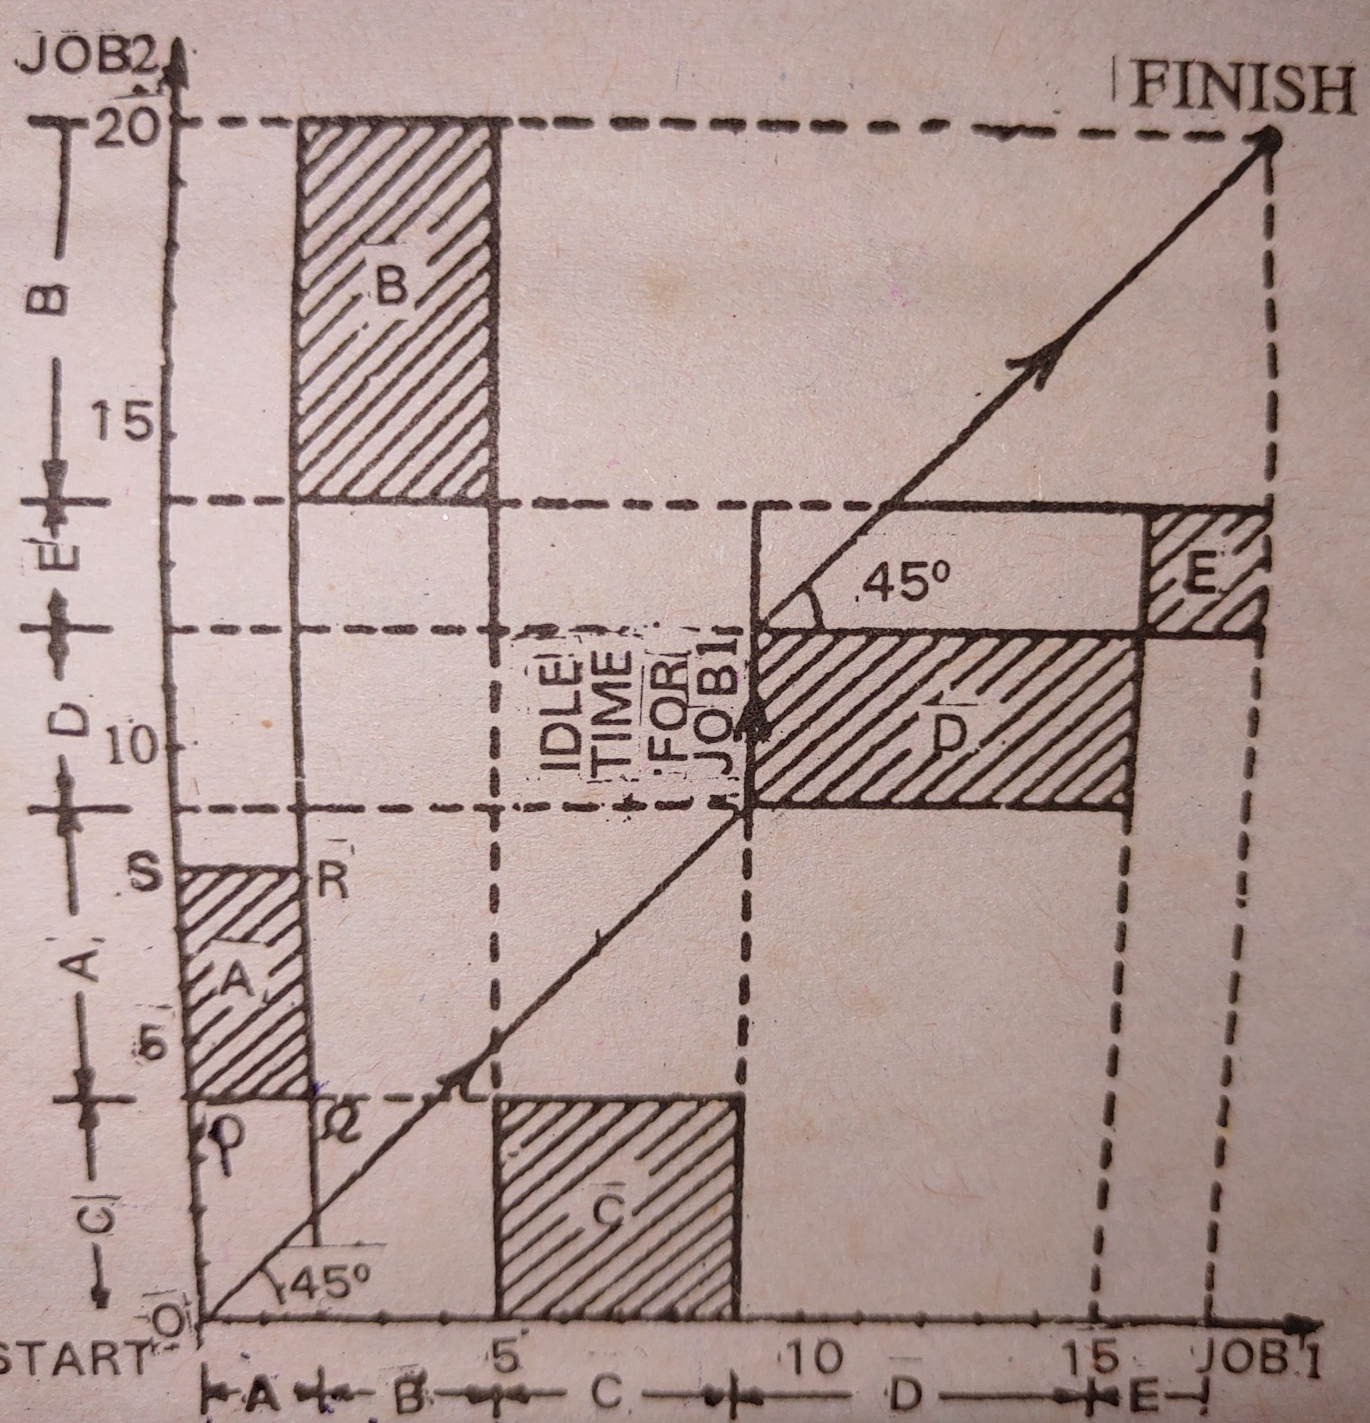

Slide 17
Graphical Method Contd..
Step-3: Starting from the origin O and moving through various states of completion points until ‘Finish’ is reached.
  Moving right means Job 1 is processing (job 2 is idle), moving up means job 2 is processing (job 1 is idle) and moving diagonal means both jobs are processing (No job is idle)
  Both the jobs cannot be processed in the same machine simultaneously
Step-4: Find optimal path: The path which minimizes the idle time for job 1 and idle time for job 2. Choose a path in which the diagonal movements are maximum
Step-5: Find the total elapsed time

Slide 18
N-jobs and m-machines Sequencing Problem
There are n jobs and m machines and processing order is fixed (M₁, M₂, M₃, …M_{m}), T_{ij} denote tiem required by i^{th} machine to complete j^{th} job.
Step-1:
  Find Min(T_{1j}) and Min(T_{mj})
  Find Max(T_{2j}, T_{3j} ……T_{(m-1),j} for j = 1,2,3,…n
Step-2: Check whether
  1. Min(T_{1j}) >= Max(T_{ij}) for i= 2, 3, …., m-1
  Or 2. Min(T_{mj}) >= Max(T_{ij}) for i= 2, 3, …., m-1
  If none is satisfied, the method fails, Stop.

Slide 19
N-Jobs and m-Machine Sequencing prolem contd..
Step-3: Convert the m-machine problem into 2-machine problem considering two fictitious machines G and H, such that
  T_{Gj} = T_{1j} + T_{2j} + ….. + T_{m-1,j}
  T_{Hj} = T_{2j} + T_{3j} + ….. + T_{m,j}
Step-4: Determine the optimal sequence using Johnson method

Slide 20
Example
Machine | Job-A | Job-B | Job-C | Job-D | Job-E
M₁ | 11 | 13 | 9 | 16 | 17
M₂ | 4 | 3 | 5 | 2 | 6
M₃ | 6 | 7 | 5 | 8 | 4
M₄ | 15 | 8 | 13 | 9 | 11
Min (T_{1j}) = 9, Min(T_{4j}) = 8, Max(T_{2j}) = 6, Max(T_{3j}) = 8
condition Min(T_{1j}) (9) >= Max(T_{2j}) (6) and Max(T_{3j}) (8) is satisfied
and condition Min(T4j) (8) >= Max(T2j) (6) and Max(T3j) (8) is satisfied
Machine | Job-A | Job-B | Job-C | Job-D | Job-E
M1 | 21 | 23 | 19 | 26 | 27
M2 | 25 | 18 | 23 | 19 | 21
Optimal Sequencing: C A E D B

Slide 21
Total Elapsed Time Calculation
Jobs | M₁ | M₂ | M₃ | M₄
C | 0-9 | 9-14 | 14-19 | 19-32
A | 9-20 | 20-24 | 24-30 | 32-45
E | 20-36 | 36-42 | 42-46 | 46-57
D | 36-52 | 52-54 | 54-62 | 62-71
B | 52-65 | 65-68 | 68-75 | 75-83

