Slide 1
Process Synchronization

Slide 2
Multiple Processes
Operating System design is concerned with the management of processes and threads:
    Multiprogramming
    Multiprocessing
    Distributed Processing

Slide 3
Concurrency & Shared Data
Concurrent processes may share data to support communication, info exchange,...
Threads in the same process can share global address space
Concurrent sharing may cause problems
For example: lost updates

Slide 4
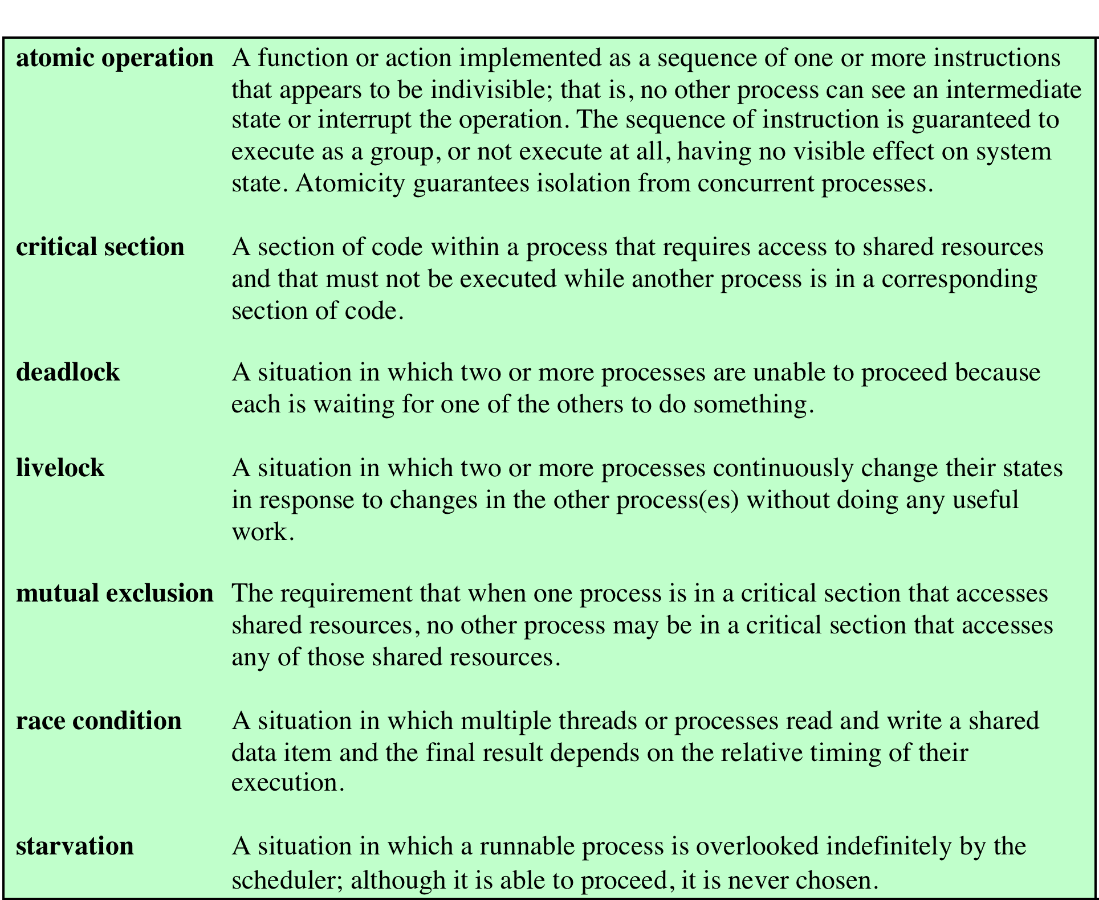
Key
Terms
Concurrency
Table 5.1 Some Key Terms Related to Concurrency
Notes:
Key terms related to concurrency.

Slide 5
Difficulties of Concurrency
Sharing of global resources
Difficult for the OS to manage the allocation of resources optimally
Difficult to locate programming errors as results are not deterministic and reproducible

Slide 6
Race Condition
Occurs when multiple processes or threads read and write shared data items
The final result depends on the order of execution
      the “loser” of the race is the process that updates last and will determine the final value of the variable

Slide 7
Operating System Concerns
Design and management issues raised by the existence of concurrency:
  The OS must:
      be able to keep track of various processes
      allocate and de-allocate resources for each active process
      protect the data and physical resources of each process against interference by other processes
      ensure that the processes and outputs are independent of the processing speed

Slide 8
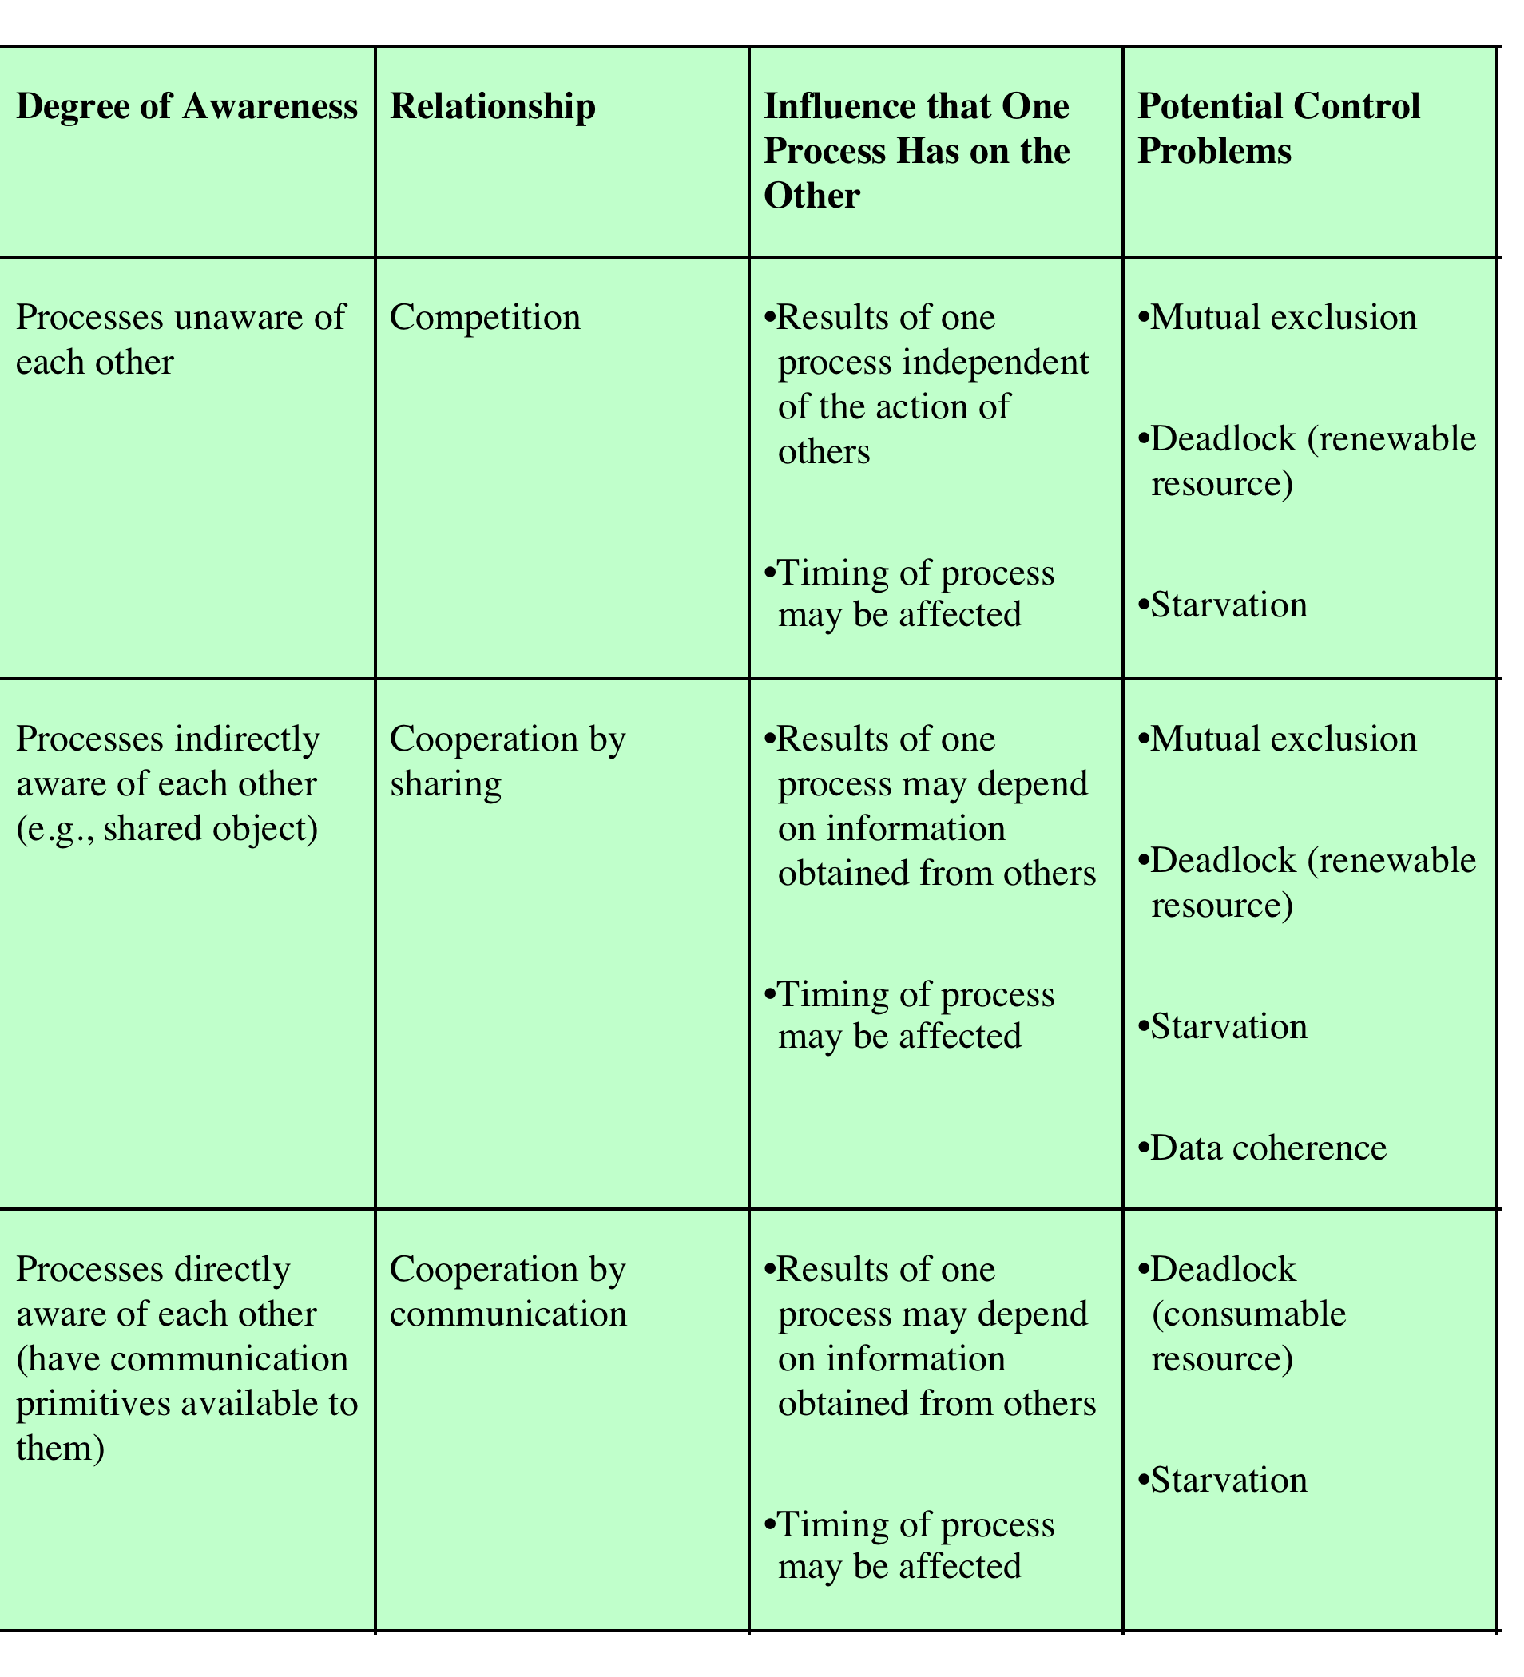
P I
R N
O T
C E
E R
S A
S C
T
I
O
N
Notes:
8

Slide 9
Resource Competition
Concurrent processes come into conflict when they use the same resource (competitively or shared)
  for example: I/O devices, memory, processor time, clock
Three control problems must be faced
  Need for mutual exclusion
  Deadlock
  Starvation
Sharing processes also need to address coherence

Slide 10
Need for Mutual Exclusion
If there is no controlled access to shared data, processes or threads may get an inconsistent view of this data
The result of concurrent execution will depend on the order in which instructions are interleaved.
Errors are timing dependent and usually not reproducible.

Slide 11
An Example
Assume P1 and P2 are executing this code and share the variable a
Processes can be preempted at any time.
Assume P1 is preempted after the input statement, and P2 then executes entirely
The character echoed by P1 will be the one read by P2 !!
static char a;
void echo()
{
cin >> a;
cout << a;
}

Slide 12
What’s the Problem?
This is an example of a race condition
Individual processes (threads) execute sequentially in isolation, but concurrency causes them to interact.
We need to prevent concurrent execution by processes when they are changing the same data. We need to enforce mutual exclusion.

Slide 13
The Critical Section Problem
When a process executes code that manipulates shared data (or resources), we say that the process is in its critical section (CS) for that shared data
We must enforce mutual exclusion on the execution of critical sections.
Only one process at a time can be in its CS (for that shared data or resource).

Slide 14
The Critical Section Problem
Enforcing mutual exclusion guarantees that related CS’s will be executed serially instead of concurrently.
The critical section problem is how to provide mechanisms to enforce mutual exclusion so the actions of concurrent processes won’t depend on the order in which their instructions are interleaved

Slide 15
The Critical Section Problem
Processes/threads must request permission to enter a CS, & signal when they leave CS.
Program structure:
  entry section: requests entry to CS
  exit section: notifies that CS is completed
  remainder section (RS): code that does not involve shared data and resources.
The CS problem exists on multiprocessors as well as on uniprocessors.

Slide 16
Mutual Exclusion and Data Coherence
Mutual Exclusion ensures data coherence if properly used.
Critical Resource (CR) - a shared resource such as a variable, file, or device
Data Coherence:
  The final value or state of a CR shared by concurrently executing processes is the same as the final value or state would be if each process executed serially, in some order.

Slide 17
Deadlock and Starvation
Deadlock: two or more processes are blocked permanently because each is waiting for a resource held in a mutually exclusive manner by one of the others.
Starvation: a process is repeatedly denied access to some resource which is protected by mutual exclusion, even though the resource periodically becomes available.

Slide 18
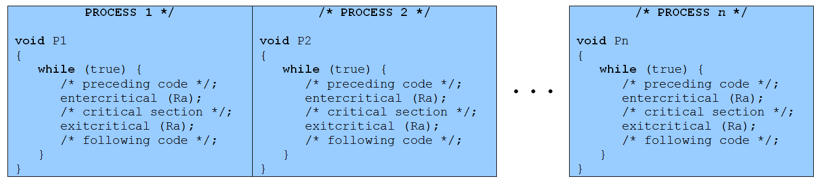
Mutual Exclusion

Slide 19
Requirements for Mutual Exclusion
Mutual Exclusion: must be enforced
Non interference: A process that halts must not interfere with other processes
No deadlock or starvation
Progress: A process must not be denied access to a critical section when there is no other process using it
No assumptions are made about relative process speeds or number of processes
A process remains inside its critical section for a finite time only

Slide 20
Mutual Exclusion:
Hardware Support
  Interrupt Disabling
uniprocessor system
disabling interrupts guarantees mutual exclusion
  Disadvantages:
  the efficiency of execution could be noticeably degraded
  this approach will not work in a multiprocessor architecture

Slide 21
Solution to Critical-Section Problem
Mutual Exclusion. If process P_{i} is executing in its critical section, then no other processes can be executing in their critical sections.
Progress. If no process is executing in its critical section and there exist some processes that wish to enter their critical section, then the selection of the processes that will enter the critical section next cannot be postponed indefinitely.
Bounded Waiting. A bound must exist on the number of times that other processes are allowed to enter their critical sections after a process has made a request to enter its critical section and before that request is granted.
      Assume that each process executes at a nonzero speed
      No assumption concerning relative speed of the n processes.

Slide 22
Initial Attempts to Solve Problem
Only 2 processes, P₀ and P₁
General structure of process P_{i} (other process P_{j})
do {
entry section
critical section
exit section
reminder section
} while (1);
Processes may share some common variables to synchronize their actions.

Slide 23
Algorithm 1
Shared variables:
  int turn;
  initially turn = 0
  turn = i ⇒ P_{i} can enter its critical section
Process P_{i}
do { while (turn != i) ;
critical section
turn = j;
reminder section
} while (1);
Satisfies mutual exclusion, but not progress

Slide 24
Algorithm 2
Shared variables
  boolean flag[2];
  initially flag [0] = flag [1] = false.
  // flag [i] = true ⇒ P_{i} ready to enter its critical section
Process P_{i}
do {
flag[i] := true;
while (flag[j]) ; critical section
flag [i] = false;
remainder section
} while (1);
Satisfies mutual exclusion, but not progress requirement.

Slide 25
Algorithm 3
Combined shared variables of algorithms 1 and 2.
Process P_{i}
do {
flag [i]:= true;
turn = j;
while (flag [j] and turn = j) ;
critical section
flag [i] = false;
remainder section
} while (1);
Meets all three requirements; solves the critical-section problem for two processes.

Slide 26
Bakery Algorithm
Critical section for n processes
Before entering its critical section, process receives a number. Holder of the smallest number enters the critical section.
If processes P_{i} and P_{j} receive the same number, if i < j, then P_{i} is served first; else P_{j} is served first.
The numbering scheme always generates numbers in increasing order of enumeration; i.e., 1,2,3,4,5...

Slide 27
Bakery Algorithm
Notation <≡ lexicographical order (ticket #, process id #)
  (a,b) < (c,d) if a < c or if a = c and b < d
  max (a₀,…, a_{n-1}) is a number, k, such that k ≥ a_{i} for i - 0,
  …, n – 1
Shared data
boolean choosing[n];
int number[n];
Data structures are initialized to false and 0 respectively

Slide 28
Bakery Algorithm
do {
choosing[i] = true;
number[i] = max(number[0], number[1], …, number [n – 1])+1;
choosing[i] = false;
for (j = 0; j < n; j++) {
while (choosing[j]) ;
while ((number[j] != 0) && (number[j],j) < number[i].i)) ;
}
critical section
number[i] = 0;
remainder section
} while (1);

Slide 29
Synchronization Hardware
Test and modify the content of a word atomically
.
boolean TestAndSet(boolean &target) {
boolean rv = target;
target = true;
return rv;
}

Slide 30
Mutual Exclusion with Test-and-Set
Shared data:
boolean lock = false;
Process P_{i}
do {
while (TestAndSet(lock)) ;
critical section
lock = false;
remainder section
}

Slide 31
Synchronization Hardware
Atomically swap two variables.
void Swap(boolean &a, boolean &b) {
boolean temp = a;
a = b;
b = temp;
}

Slide 32
Mutual Exclusion with Swap
Shared data (initialized to false):
boolean lock;
Process P_{i}
do {
key = true;
while (key == true)
Swap(lock,key);
critical section
lock = false;
remainder section
}

Slide 33
Semaphores
Synchronization tool that does not require busy waiting.
Semaphore S – integer variable
can only be accessed via two indivisible (atomic) operations
wait (S):
while S≤ 0 do no-op;
S--;
signal (S):
S++;

Slide 34
Critical Section of n Processes
Shared data:
semaphore mutex; //initially mutex = 1
Process Pi:
do {
wait(mutex);
critical section
signal(mutex);
remainder section
} while (1);

Slide 35
Semaphore Implementation
Define a semaphore as a record
typedef struct {
int value;
struct process *L;
} semaphore;
Assume two simple operations:
  block suspends the process that invokes it.
  wakeup(P) resumes the execution of a blocked process P.

Slide 36
Implementation
Semaphore operations now defined as
wait(S):
S.value--;
if (S.value < 0) {
add this process to S.L;
block;
}
signal(S):
S.value++;
if (S.value <= 0) {
remove a process P from S.L;
wakeup(P);
}

Slide 37
Semaphore as a General Synchronization Tool
Execute B in P_{j} only after A executed in P_{i}
Use semaphore flag initialized to 0
Code:
P_{i} P_{j}
 
A wait(flag)
signal(flag) B

Slide 38
Deadlock and Starvation
Deadlock – two or more processes are waiting indefinitely for an event that can be caused by only one of the waiting processes.
Let S and Q be two semaphores initialized to 1
P₀ P₁
wait(S); wait(Q);
wait(Q); wait(S);
 
signal(S); signal(Q);
signal(Q) signal(S);
Starvation – indefinite blocking. A process may never be removed from the semaphore queue in which it is suspended.

Slide 39
Two Types of Semaphores
Counting semaphore – integer value can range over an unrestricted domain.
Binary semaphore – integer value can range only between 0 and 1; can be simpler to implement.
Can implement a counting semaphore S as a binary semaphore.

Slide 40
Linux/Unix Semaphore
Synchronization primitive (integer value)
In kernel and use to synchronized the access to shared memory
Set of semaphore operation guaranteed for atomic
Should not be used to exchange large amount of data
semget(), semop() there is no direct wait() and signal() from system call

Slide 41
Sample code (sample2.tar) semaph.c
Server (mainshmserv.c)
  Create a sh mem
  Attach to it
  Create 2 semaphores
    Client will start first (1)
    Server initialized to 0
  Wait to get a request (by reading a filename from a shared mem)
  Open a file and write content into a shared mem
Client (mainshmcli.c)
  Get a share
  Attach to it
  Get a semaphore
  Write a filename
  Inform a server to start via server semaphore
  Wait to get a turn to read a file content

Slide 42
Mutual Exclusion: H/w Support
  Special Machine Instructions
    Compare&Swap Instruction
        also called a “compare and exchange instruction”
        a compare is made between a memory value and a test value
        if the old memory value = test value, swap in a new value to the memory location
        always return the old memory value
        carried out atomically in the hardware.

Slide 43
Mutual Exclusion: Hardware Support
  Compare&Swap Instruction
    Pseudo-code definition of the hardware instruction:
      compare_and_swap (word, test_val, new_val)
      if (word ==test_val)
      word = new_val;
      return new_val

Slide 44
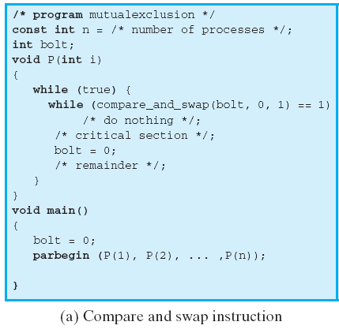
Compare and Swap Instruction
word = bolt
test_val = 0
new_val = 1
If bolt is 0 when the C&S is executed, the condition is false and P enters its critical section. (leaves bolt = 1)
If bolt = 1 when C&S executes, P continues to execute the while loop. It’s busy waiting ( or spinning)

Slide 45
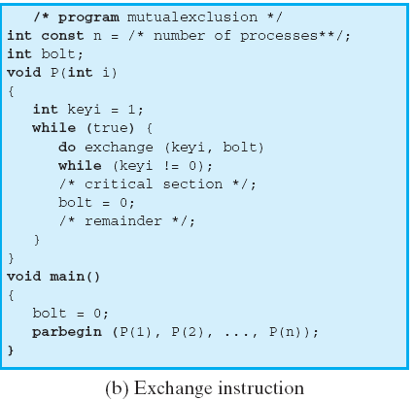
Exchange Instruction
Notes:
Figure shows a mutual exclusion protocol based on the use of an exchange instruction. A shared variable bolt is initialized to 0. Each process uses a local variable key that is initialized to 1. The only process that may enter its critical section is one that finds bolt equal to 0. It excludes all other processes from the critical section by setting bolt to 1. When a process leaves its critical section, it resets bolt to 0, allowing another process to gain access to its critical section.

Slide 46
Special Machine Instruction:
Advantages
Applicable to any number of processes on either a single processor or multiple processors sharing main memory
Simple and easy to verify
It can be used to support multiple critical sections; each critical section can be defined by its own variable
Notes:
The use of a special machine instruction to enforce mutual exclusion has a number of advantages:
• It is applicable to any number of processes on either a single processor or multiple processors sharing main memory.
• It is simple and therefore easy to verify.
• It can be used to support multiple critical sections; each critical section can be defined by its own variable.

Slide 47
Special Machine Instruction:
Disadvantages
Busy-waiting is employed, thus while a process is waiting for access to a critical section it continues to consume processor time
Starvation is possible when a process leaves a critical section and more than one process is waiting: Selection is arbitrary
Deadlock is possible if priority-based scheduling is used
Notes:
There are some serious disadvantages:
• Busy waiting is employed: Thus, while a process is waiting for access to a critical section, it continues to consume processor time.
Starvation is possible: When a process leaves a critical section and more than one process is waiting, the selection of a waiting process is arbitrary. Thus, some process could indefinitely be denied access.
• Deadlock is possible: Consider the following scenario on a single-processor system. Process P1 executes the special instruction (e.g., compare & swap, exchange ) and enters its critical section. P1 is then interrupted to give the processor to P2, which has higher priority. If P2 now attempts to use the same resource as P1, it will be denied access because of the mutual exclusion mechanism. Thus, it will go into a busy waiting loop. However, P1 will never be dispatched
because it is of lower priority than another ready process, P2.
Because of the drawbacks of both the software and hardware solutions just outlined, we need to look for other mechanisms.

Slide 48

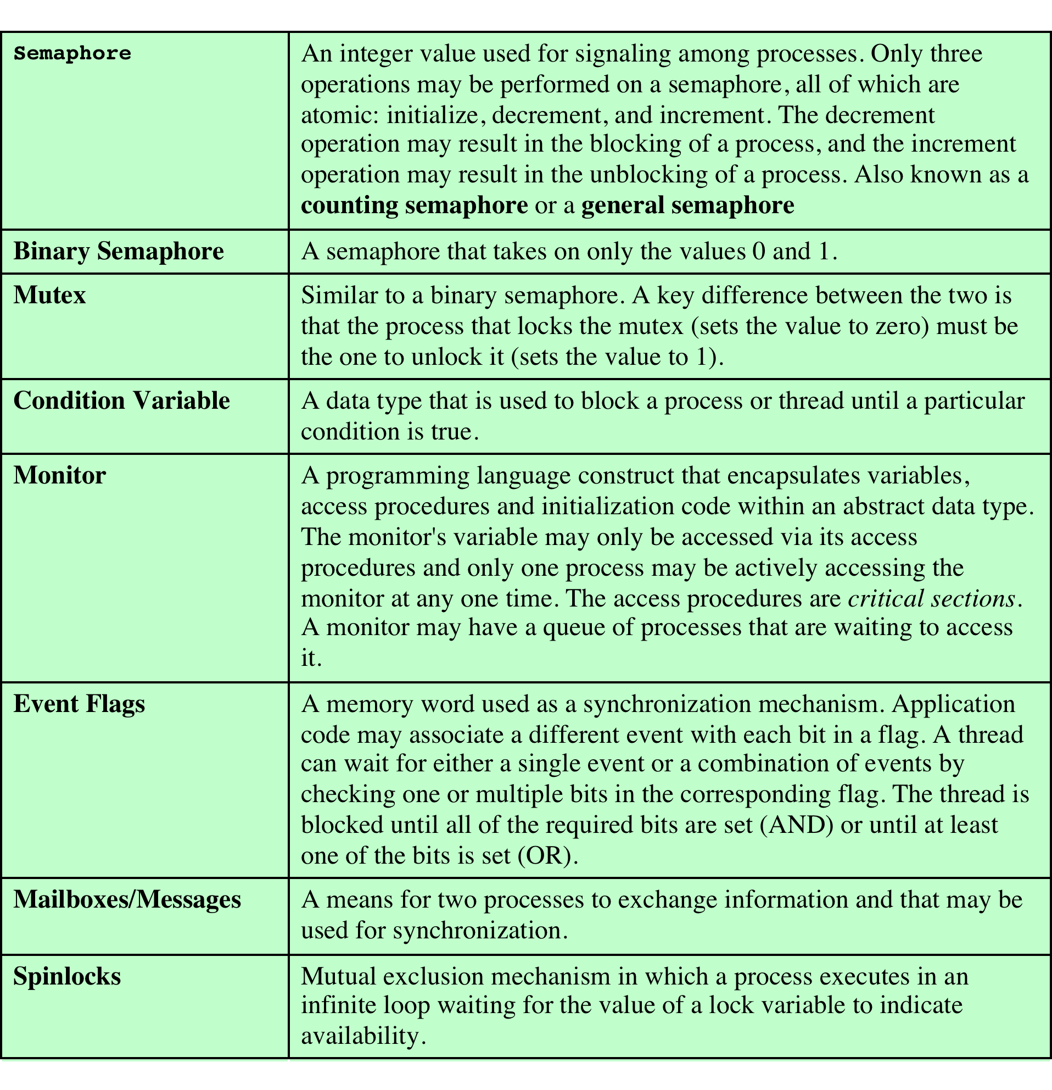
Common Concurrency Mechanisms
Notes:
We now turn to OS and programming language mechanisms that are used to provide concurrency. Table 5.3 summarizes mechanisms in common use. We begin, in this section, with semaphores. The next two sections discuss monitors and message passing. The other mechanisms in Table 5.3 are discussed when treating specific operating system examples, in Chapters 6 and 13 .

Slide 49
Semaphore
There is no way to inspect or manipulate semaphores other than these three operations
A variable that has an integer value upon which only three operations are defined:
May be initialized to a nonnegative integer value
The semWait operation decrements the value
The semSignal operation increments the value
Notes:
The fundamental principle is this: Two or more processes can cooperate by means of simple signals, such that a process can be forced to stop at a specified place until it has received a specific signal. Any complex coordination requirement can be satisfied by the appropriate structure of signals. For signaling, special variables called semaphores are used. To transmit a signal via semaphore s , a process executes the primitive semSignal(s) . To receive a signal via semaphore s , a process executes the primitive semWait(s) ; if the corresponding signal has not yet been transmitted, the process is suspended until the transmission takes place.
To achieve the desired effect, we can view the semaphore as a variable that has an integer value upon which only three operations are defined:
1. A semaphore may be initialized to a nonnegative integer value.
2. The semWait operation decrements the semaphore value. If the value becomes negative, then the process executing the semWait is blocked.
Otherwise, the process continues execution.
3. The semSignal operation increments the semaphore value. If the resulting value is less than or equal to zero, then a process blocked by a semWait operation,
if any, is unblocked. Other than these three operations, there is no way to inspect or manipulate semaphores.
We explain these operations as follows. To begin, the semaphore has a zero or positive value. If the value is positive, that value equals the number of processes that can issue a wait and immediately continue to execute. If the value is zero, either by initialization or because a number of processes equal to the initial semaphore value have issued a wait, the next process to issue a wait is blocked, and the semaphore value goes negative. Each subsequent wait drives the semaphore value further into minus territory. The negative value equals the number of processes waiting to be unblocked. Each signal unblocks one of the waiting processes when the semaphore value is negative.

Slide 50
Consequences
There is no way to know before a process decrements a semaphore whether it will block or not
There is no way to know which process will continue immediately on a uniprocessor system when two processes are running concurrently
You don’t know whether another process is waiting so the number of unblocked processes may be zero or one
Notes:
[DOWN08] points out three interesting consequences of the semaphore definition:
• In general, there is no way to know before a process decrements a semaphore whether it will block or not.
After a process increments a semaphore and another process gets woken up, both processes continue running concurrently. There is no way to know which process, if either, will continue immediately on a uniprocessor system.
• When you signal a semaphore, you don’t necessarily know whether another process is waiting, so the number of unblocked processes may be zero or one.

Slide 51
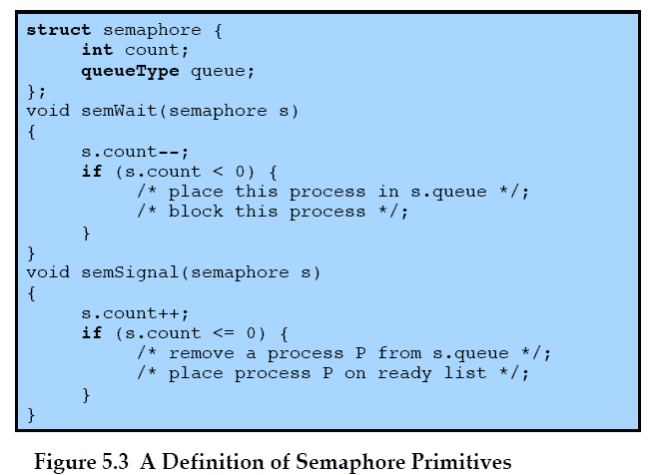
Semaphore Primitives
Notes:
Figure 5.3 suggests a more formal definition of the primitives for semaphores. The semWait and semSignal primitives are assumed to be atomic.

Slide 52
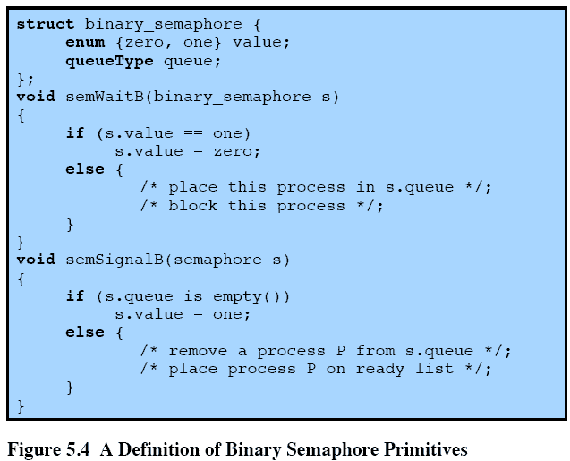
Binary Semaphore Primitives
Notes:
A more restricted version, known as the binary semaphore , is defined in Figure 5.4 . A binary semaphore may only take on the values 0 and 1 and can be defined by the
following three operations:
1. A binary semaphore may be initialized to 0 or 1.
2. The semWaitB operation checks the semaphore value. If the value is zero, then the process executing the semWaitB is blocked. If the value is one, then the value is changed to zero and the process continues execution.
3. The semSignalB operation checks to see if any processes are blocked on this semaphore (semaphore value equals 0). If so, then a process blocked by a semWaitB operation is unblocked. If no processes are blocked, then the value of the semaphore is set to one.
In principle, it should be easier to implement the binary semaphore, and it can be shown that it has the same expressive power as the general semaphore (see Problem 5.17). To contrast the two types of semaphores, the nonbinary semaphore is often referred to as either a counting semaphore or a general semaphore .
A concept related to the binary semaphore is the mutex . A key difference between the two is that the process that locks the mutex (sets the value to zero) must be the one to unlock it (sets the value to 1). In contrast, it is possible for one process to lock a binary semaphore and for another to unlock it.

Slide 53
Strong/Weak Semaphores
A queue is used to hold processes waiting on the semaphore
Strong Semaphores
the process that has been blocked the longest is released from the queue first (FIFO)
Weak Semaphores
the order in which processes are removed from the queue is not specified
Notes:
For both counting semaphores and binary semaphores, a queue is used to hold processes waiting on the semaphore. The question arises of the order in which processes are removed from such a queue. The fairest removal policy is first-in-first-out (FIFO): The process that has been blocked the longest is released from the queue first; a semaphore whose definition includes this policy is called a strong semaphore . A semaphore that does not specify the order in which processes are removed from the queue is a weak semaphore .

Slide 54
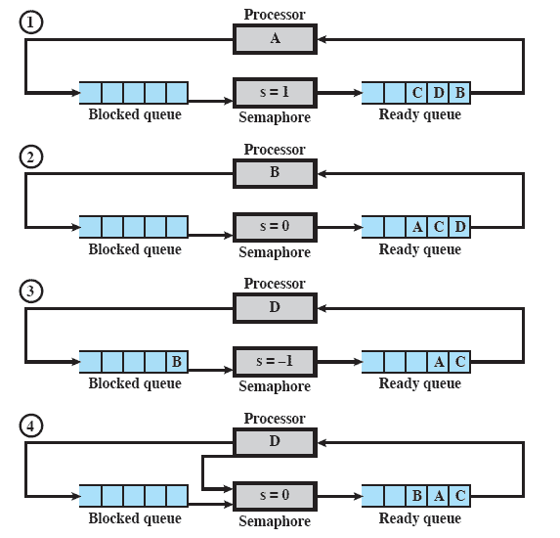
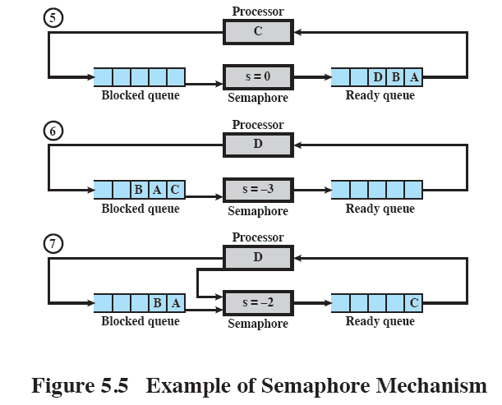
Example of Semaphore Mechanism
Notes:
Figure 5.5 , based on one in [DENN84], is an example of the operation of a strong semaphore. Here processes A, B, and C depend on a result from process D. Initially (1), A is running;
B, C, and D are ready; and the semaphore count is 1, indicating that one of D’s results is available. When A issues a semWait instruction on semaphore s , the semaphore decrements to 0, and A can continue to execute; subsequently it rejoins the ready queue. Then B runs (2), eventually issues a semWait instruction, and is blocked, allowing D to run (3). When D completes a new result, it issues a semSignal instruction, which allows B to move to the ready queue (4). D rejoins the ready queue and C begins to run (5) but is blocked when it issues a semWait instruction. Similarly, A and B run and are blocked on the semaphore, allowing D to resume execution (6). When D has a result, it issues a semSignal , which transfers C to the ready queue. Later cycles of D will release A and B from the Blocked state.

Slide 55
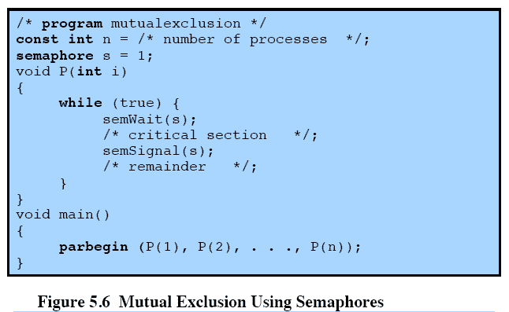
Mutual Exclusion
Notes:
For the mutual exclusion algorithm discussed in the next subsection and illustrated in Figure 5.6 , strong semaphores guarantee freedom from starvation, while weak semaphores do not. We will assume strong semaphores because they are more convenient and because this is the form of semaphore typically provided by operating systems.
Figure 5.6 shows a straightforward solution to the mutual exclusion problem using a semaphore s (compare Figure 5.1 ). Consider n processes, identified in the array P ( i ), all of which need access to the same resource. Each process has a critical section used to access the resource. In each process, a semWait(s) is executed just before its critical section. If the value of s becomes negative, the process is blocked. If the value is 1, then it is decremented to 0 and the process immediately enters its critical section; because s is no longer positive, no other process will be able to enter its critical section.
The semaphore is initialized to 1. Thus, the first process that executes a semWait will be able to enter the critical section immediately, setting the value of s to 0. Any other process attempting to enter the critical section will find it busy and will be blocked, setting the value of s to –1. Any number of processes may attempt entry; each such unsuccessful attempt results in a further decrement of the value of s . When the process that initially entered its critical section departs, s is incremented and one of the blocked processes (if any) is removed from the queue of blocked processes associated with the semaphore and put in a Ready state. When it is next scheduled by the OS, it may enter the critical section.

Slide 56
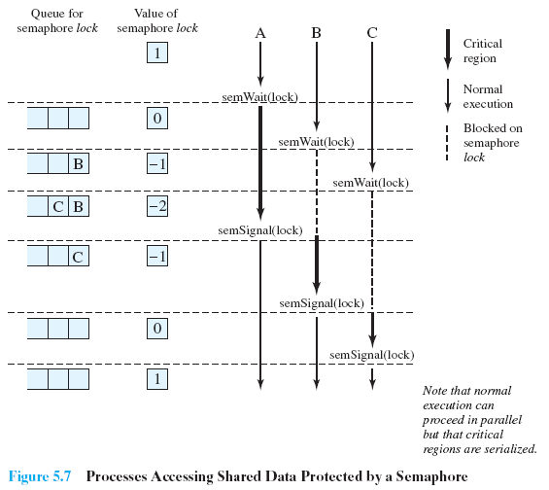
Shared Data Protected by a Semaphore
Notes:
Figure 5.7 , based on one in [BACO03], shows a possible sequence for three processes using the mutual exclusion discipline of Figure 5.6 . In this example three processes (A, B, C) access a shared resource protected by the semaphore lock . Process A executes semWait( lock ) ; because the semaphore has a value of 1 at the time of the semWait operation, A can immediately enter its critical section and the semaphore takes on the value 0. While A is in its critical section, both B and CFigure 5.7 , based on one in [BACO03], shows a possible sequence for three processes using the mutual exclusion discipline of Figure 5.6 . In this example three processes (A, B, C) access a shared resource protected by the semaphore lock .
Process A executes semWait( lock ) ; because the semaphore has a value of 1 at the time of the semWait operation, A can immediately enter its critical section and the semaphore takes on the value 0. While A is in its critical section, both B and C perform a semWait operation and are blocked pending the availability of the semaphore. When A exits its critical section and performs semSignal( lock ) , B, which was the first process in the queue, can now enter its critical section.

Slide 57
Producer/Consumer Problem
General Situation:
one or more producers are generating data and placing these in a buffer
a single consumer is taking items out of the buffer one at time
only one producer or consumer may access the buffer at any one time
The Problem:
ensure that the producer can’t add data into full buffer and consumer can’t remove data from an empty buffer
Notes:
To begin, let us assume that the buffer is infinite and consists of a linear array of elements.
We now examine one of the most common problems faced in concurrent processing: the producer/consumer problem. The general statement is this: There are one or more producers generating some type of data (records, characters) and placing these in a buffer. There is a single consumer that is taking items out of the buffer one at a time. The system is to be constrained to prevent the overlap of buffer operations. That is, only one agent (producer or consumer) may access the buffer at any one time. The problem is to make sure that the producer won’t try to add data into the buffer if it’s full and that the consumer won’t try to remove data from an empty buffer. We will look at a number of solutions to this problem to illustrate both the power and the pitfalls of semaphores.

Slide 58
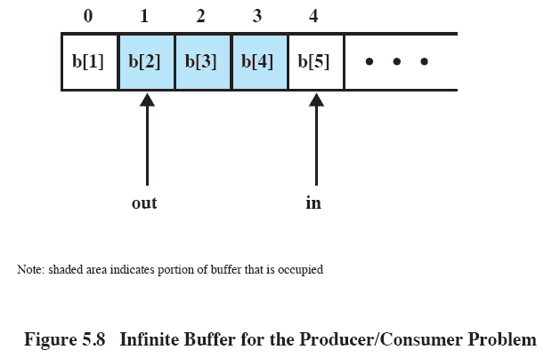
Buffer Structure
Notes:
Figure 5.8 illustrates the structure of buffer b . The producer can generate items and store them in the buffer at its own pace. Each time, an index ( in ) into the buffer is incremented. The consumer proceeds in a similar fashion but must make sure that it does not attempt to read from an empty buffer. Hence, the consumer makes sure that the producer has advanced beyond it ( in > out ) before proceeding.

Slide 59
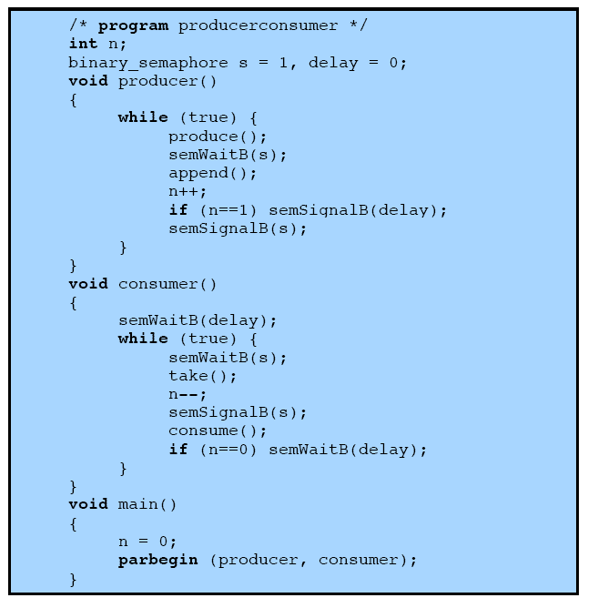
Incorrect
Solution
Notes:
Let us try to implement this system using binary semaphores. Figure 5.9 is a first attempt. Rather than deal with the indices in and out , we can simply keep track of the number of items in the buffer, using the integer variable n (= in – out ). The semaphore s is used to enforce mutual exclusion; the semaphore delay is used to force the consumer to semWait if the buffer is empty.
This solution seems rather straightforward. The producer is free to add to the buffer at any time. It performs semWaitB(s) before appending and semSignalB(s) afterward to prevent the consumer or any other producer from accessing the buffer during the append operation. Also, while in the critical section, the producer increments the value of n . If n = 1, then the buffer was empty just prior to this append, so the producer performs semSignalB(delay) to alert the consumer of this fact. The consumer begins by waiting for the first item to be produced,
using semWaitB(delay) . It then takes an item and decrements n in its critical section. If the producer is able to stay ahead of the consumer (a common situation), then the consumer will rarely block on the semaphore delay because n will usually be positive. Hence both producer and consumer run smoothly.
There is, however, a flaw in this program. When the consumer has exhausted the buffer, it needs to reset the delay semaphore so that it will be forced to wait until the producer has placed more items in the buffer. This is the purpose of the statement: if n == 0 semWaitB(delay) .

Slide 60
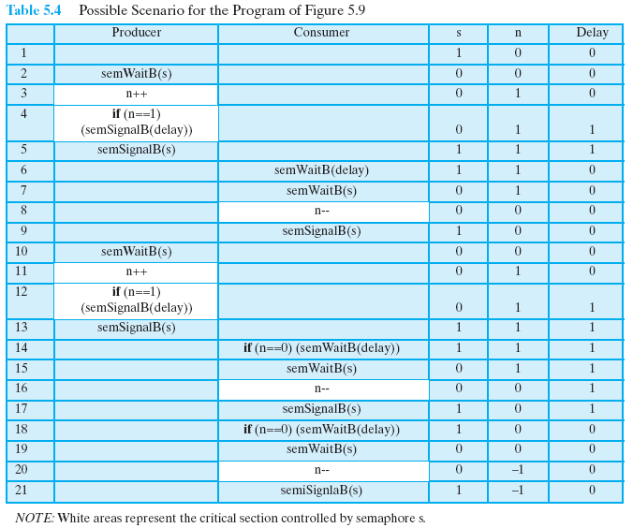
Possible Solution
Notes:
Consider the scenario outlined in Table 5.4 . In line 14, the consumer fails to execute the semWaitB operation. The consumer did indeed exhaust the buffer and set n to 0 (line 8), but the producer has incremented n before the consumer can test it in line 14. The result is a semSignalB not matched by a prior semWaitB . The value of –1 for n in line 20 means that the consumer has consumed an item from the buffer that does not exist. It would not do simply to move the conditional statement inside the critical section of the consumer because this
could lead to deadlock (e.g., after line 8 of Table 5.4 ).

Slide 61
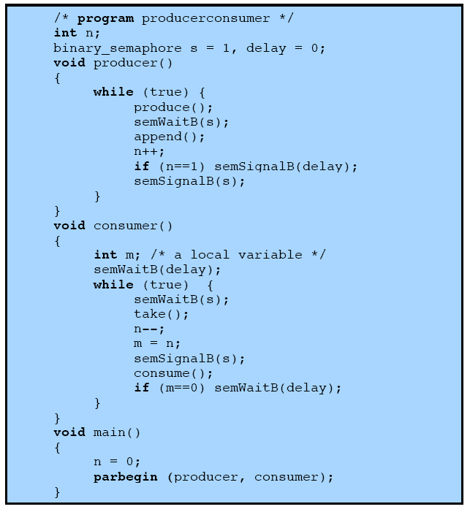
Correct
Solution
Figure 5.10 A Correct Solution to the Infinite-Buffer Producer/Consumer Problem Using Binary Semaphores
Notes:
A fix for the problem is to introduce an auxiliary variable that can be set in the consumer’s critical section for use later on. This is shown in Figure 5.10 . A careful trace of the logic should convince you that deadlock can no longer occur.

Slide 62
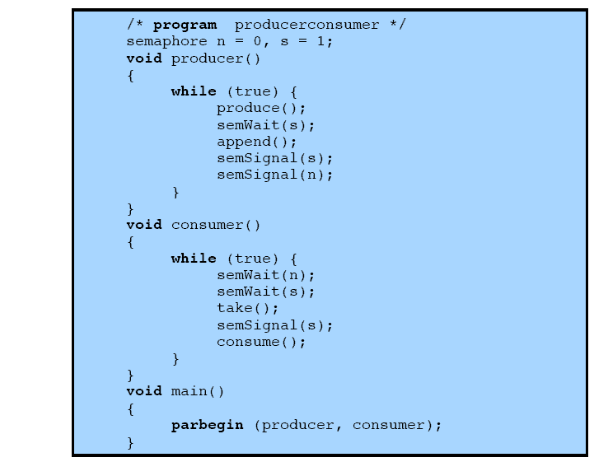
Using
Semaphores
Notes:
A somewhat cleaner solution can be obtained if general semaphores (also called counting semaphores) are used, as shown in Figure 5.11 . The variable n is now a semaphore. Its value still is equal to the number of items in the buffer. Suppose now that in transcribing this program, a mistake is made and the operations semSignal(s) and semSignal(n) are interchanged. This would require that the semSignal(n) operation be performed in the producer’s critical section without interruption by the consumer or another producer. Would this affect the program? No, because the consumer must wait on both semaphores before proceeding in any case.

Slide 63
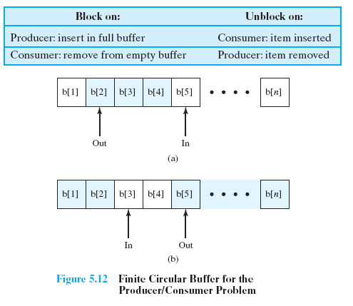
Finite Circular Buffer
Notes:
Finally, let us add a new and realistic restriction to the producer/consumer problem: namely, that the buffer is finite. The buffer is treated as a circular storage ( Figure 5.12 ), and pointer values must be expressed modulo the size of the buffer.

Slide 64
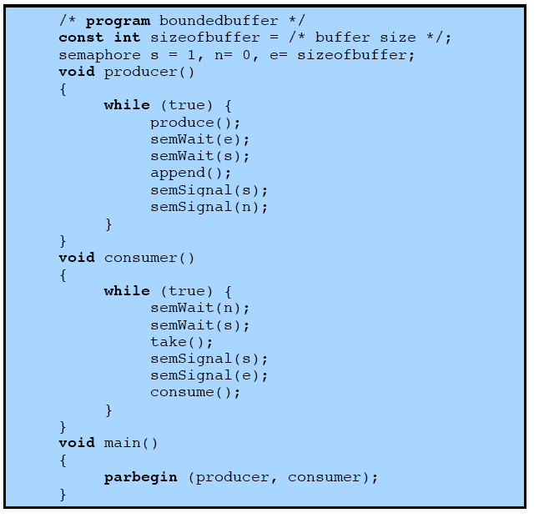
Using
Semaphore
Figure 5.13 A Solution to the Bounded-Buffer Producer/Consumer Problem Using Semaphores
Notes:
Figure 5.13 shows a solution using general semaphores. The semaphore e has been added to keep track of the number of empty spaces.

Slide 65
Implementation of Semaphores
Imperative that the semWait and semSignal operations be implemented as atomic primitives
Can be implemented in hardware or firmware
Software schemes such as Dekker’s or Peterson’s algorithms can be used
Use one of the hardware-supported schemes for mutual exclusion
Notes:
As was mentioned earlier, it is imperative that the semWait and semSignal operations be implemented as atomic primitives. One obvious way is to implement them in hardware or firmware. Failing this, a variety of schemes have been suggested. The essence of the problem is one of mutual exclusion: Only one process at a time may manipulate a semaphore with either a semWait or semSignal operation. Thus, any of the software schemes, such as Dekker’s algorithm or Peterson’s algorithm ( Appendix A ), could be used; this would entail a substantial processing overhead.
Another alternative is to use one of the hardware-supported schemes for mutual exclusion.

Slide 66
Review
Concurrent processes, threads
Access to shared data/resources
Need to enforce mutual exclusion
Hardware mechanisms have limited usefulness
Semaphores: OS mechanism for mutual exclusion & other synchronization issues
Standard semaphore/counting
Binary semaphore
Producer/consumer problem

Slide 67
Readers/Writers Problem
A data area is shared among many processes
    some processes only read the data area, (readers) and some only write to the data area (writers)
Conditions that must be satisfied:
    any number of readers may simultaneously read the file
    only one writer at a time may write to the file
    if a writer is writing to the file, no reader may read it
Notes:
The readers/writers problem is defined as follows: There is a data area shared among a number of processes. The data area could be a file, a block of main memory, or even a bank of processor registers. There are a number of processes that only read the data area (readers) and a number that only write to the data area (writers). The conditions that must be satisfied are as follows:
1. Any number of readers may simultaneously read the file.
2. Only one writer at a time may write to the file.
3. If a writer is writing to the file, no reader may read it.
Thus, readers are processes that are not required to exclude one another and writers are processes that are required to exclude all other processes, readers and writers alike.

Slide 68
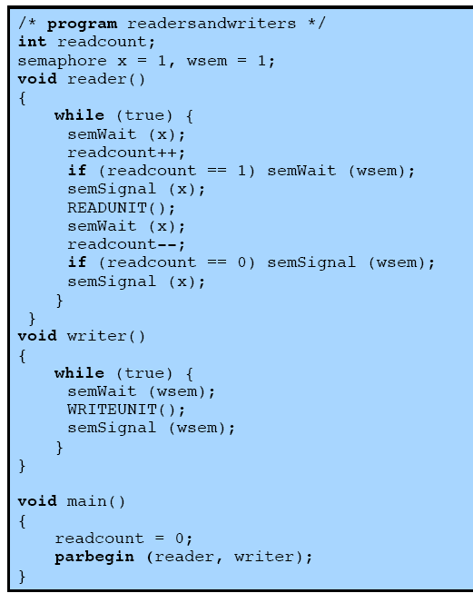
Readers Have Priority
Notes:
Figure 5.22 is a solution using semaphores, showing one instance each of a reader and a writer; the solution does not change for multiple readers and writers. The writer process is simple. The semaphore wsem is used to enforce mutual exclusion. As long as one writer is accessing the shared data area, no other writers and no readers may access it. The reader process also makes use of wsem to enforce mutual exclusion. However, to allow multiple readers, we require that, when there are no readers reading, the first reader that attempts to read should wait on wsem . When there is already at least one reader reading, subsequent readers need not wait before entering. The global variable readcount is used to keep track of the number of readers, and the semaphore x is used to assure that readcount is updated properly.

Slide 69
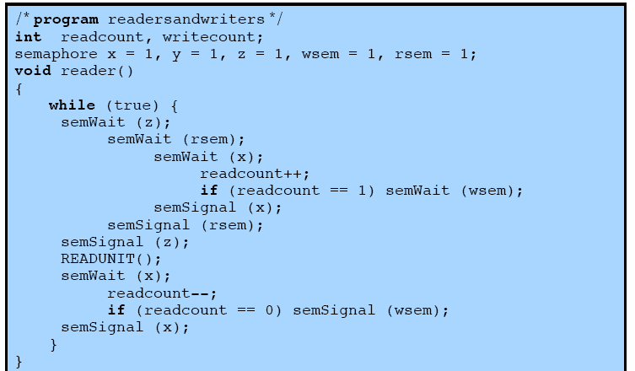
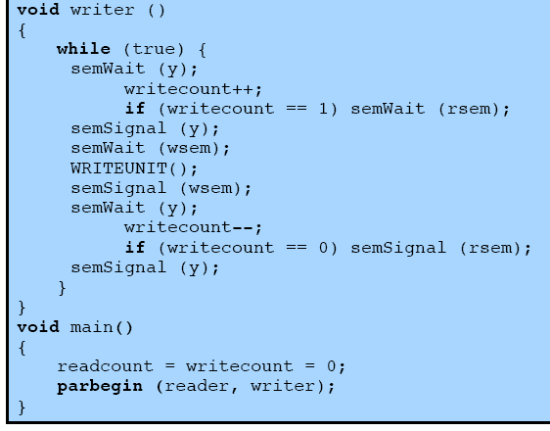
Writers Have Priority
Notes:
In the previous solution, readers have priority. Once a single reader has begun to access the data area, it is possible for readers to retain control of the data area as long as there is at least one reader in the act of reading. Therefore, writers are subject to starvation.
Figure 5.23 shows a solution that guarantees that no new readers are allowed access to the data area once at least one writer has declared a desire to write. For writers, the following semaphores and variables are added to the ones already defined:
• A semaphore rsem that inhibits all readers while there is at least one writer desiring access to the data area
• A variable writecount that controls the setting of rsem
• A semaphore y that controls the updating of writecount

Slide 70

Dining-Philosophers Problem
Philosophers spend their lives alternating thinking and eating
Don’t interact with their neighbors, occasionally try to pick up 2 chopsticks (one at a time) to eat from bowl
  Need both to eat, then release both when done
In the case of 5 philosophers
  Shared data
    Bowl of rice (data set)
    Semaphore chopstick [5] initialized to 1

Slide 71
Dining-Philosophers Problem Algorithm
The structure of Philosopher i:
    do {
    wait (chopstick[i] );
    wait (chopStick[ (i + 1) % 5] );
    // eat
    signal (chopstick[i] );
    signal (chopstick[ (i + 1) % 5] );
    // think
    } while (TRUE);
What is the problem with this algorithm?

Slide 72
Dining-Philosophers Problem Algorithm (Cont.)
Deadlock handling
  Allow at most 4 philosophers to be sitting simultaneously at the table.
  Allow a philosopher to pick up the forks only if both are available (picking must be done in a critical section.
  Use an asymmetric solution -- an odd-numbered philosopher picks up first the left chopstick and then the right chopstick. Even-numbered philosopher picks up first the right chopstick and then the left chopstick.

Slide 73
Problems with Semaphores
Incorrect use of semaphore operations:
  signal (mutex) …. wait (mutex)
  wait (mutex) … wait (mutex)
  Omitting of wait (mutex) or signal (mutex) (or both)
Deadlock and starvation are possible.

Slide 74
Monitors
Programming language construct that provides equivalent functionality to that of semaphores and is easier to control
Implemented in a number of programming languages
    including Concurrent Pascal, Pascal-Plus, Modula-2, Modula-3, and Java
    Has also been implemented as a program library
    Software module consisting of one or more procedures, an initialization sequence, and local data
Notes:
The monitor is a programming-language construct that provides equivalent functionality to that of semaphores and that is easier to control. The concept was first formally defined in [HOAR74]. The monitor construct has been implemented in a number of programming languages, including Concurrent Pascal, Pascal-Plus, Modula-2, Modula-3, and Java. It has also been implemented as a program library. This allows programmers to put a monitor lock on any object. In particular, for something like a linked list, you may want to lock all linked lists with one lock, or have one lock for each list, or have one lock for each element of each list.
A monitor is a software module consisting of one or more procedures, an initialization sequence, and local data.

Slide 75
Monitor Characteristics
Local data variables are accessible only by the monitor’s procedures and not by any external procedure
Process enters monitor by invoking one of its procedures
Only one process may be executing in the monitor at a time
Notes:
The chief characteristics of a monitor are the following:
1. The local data variables are accessible only by the monitor’s procedures and
not by any external procedure.
2. A process enters the monitor by invoking one of its procedures.
3. Only one process may be executing in the monitor at a time; any other processes
that have invoked the monitor are blocked, waiting for the monitor to become available.
The first two characteristics are reminiscent of those for objects in object-oriented software. Indeed, an object-oriented OS or programming language can readily implement a monitor as an object with special characteristics.
By enforcing the discipline of one process at a time, the monitor is able to provide a mutual exclusion facility. The data variables in the monitor can be accessed by only one process at a time. Thus, a shared data structure can be protected by placing it in a monitor. If the data in a monitor represent some resource, then the monitor provides a mutual exclusion facility for accessing the resource.
To be useful for concurrent processing, the monitor must include synchronization tools. For example, suppose a process invokes the monitor and, while in the
monitor, must be blocked until some condition is satisfied. A facility is needed by which the process is not only blocked but releases the monitor so that some other process may enter it. Later, when the condition is satisfied and the monitor is again available, the process needs to be resumed and allowed to reenter the monitor at the point of its suspension.

Slide 76
Synchronization
Achieved by the use of condition variables that are contained within the monitor and accessible only within the monitor
    Condition variables are operated on by two functions:
        cwait(c): suspend execution of the calling process on condition c
        csignal(c): resume execution of some process blocked after a cwait on the same condition
Notes:
A monitor supports synchronization by the use of condition variables that are contained within the monitor and accessible only within the monitor. Condition variables are a special data type in monitors, which are operated on by two functions:
• cwait(c) : Suspend execution of the calling process on condition c . The monitor is now available for use by another process.
• csignal(c) : Resume execution of some process blocked after a cwait on the same condition. If there are several such processes, choose one of them; if there is no such process, do nothing.
Note that monitor wait and signal operations are different from those for the semaphore. If a process in a monitor signals and no task is waiting on the condition variable, the signal is lost.

Slide 77
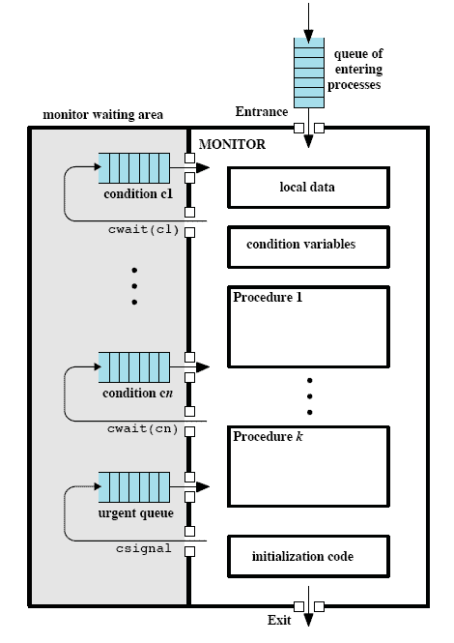
Structure of a Monitor
Notes:
Figure 5.15 illustrates the structure of a monitor. Although a process can enter the monitor by invoking any of its procedures, we can think of the monitor as having a single entry point that is guarded so that only one process may be in the monitor at a time. Other processes that attempt to enter the monitor join a queue of processes blocked waiting for monitor availability. Once a process is in the monitor, it may temporarily block itself on condition x by issuing cwait(x) ; it is then placed in a queue of processes waiting to reenter the monitor when the condition changes, and resume execution at the point in its program following the cwait(x) call. If a process that is executing in the monitor detects a change in the condition variable x , it issues csignal(x) , which alerts the corresponding condition queue that the condition has changed.

Slide 78
Monitors
A high-level abstraction that provides a convenient and effective mechanism for process synchronization
Abstract data type, internal variables only accessible by code within the procedure
Only one process may be active within the monitor at a time
But not powerful enough to model some synchronization schemes
    monitor monitor-name
    {
    // shared variable declarations
    procedure P1 (…) { …. }
    procedure Pn (…) {……}
    Initialization code (…) { … }
    }
    }

Slide 79
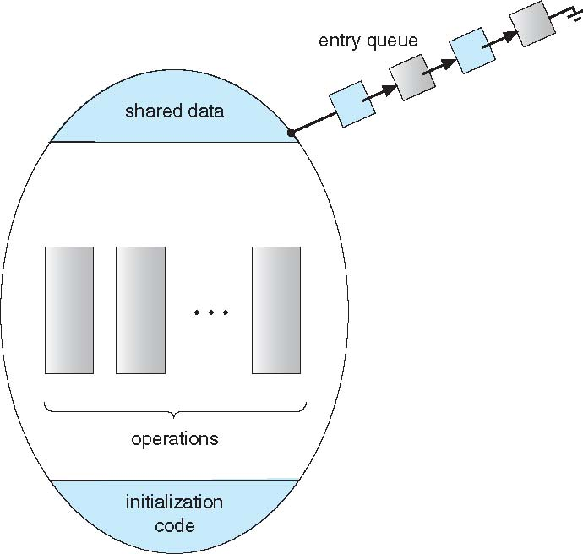
Schematic view of a Monitor

Slide 80
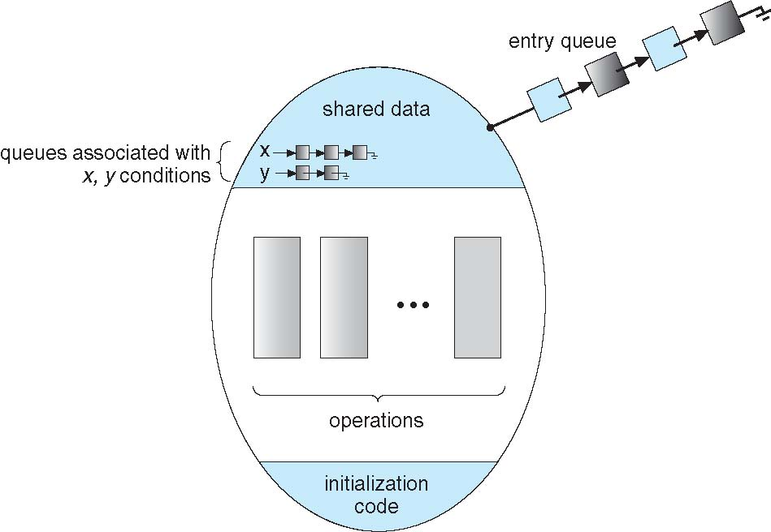
Monitor with Condition Variables

Slide 81
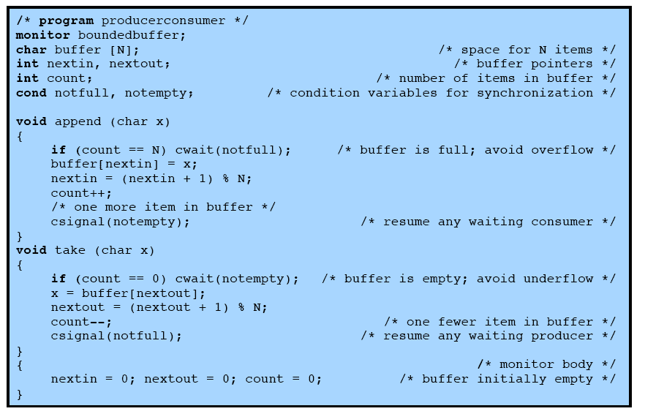
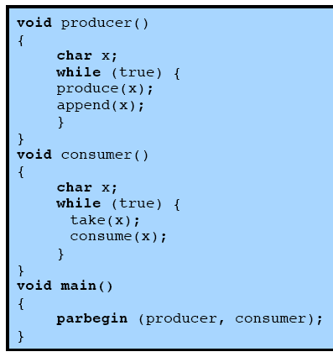
Problem Solution
Using a Monitor
Notes:
As an example of the use of a monitor, let us return to the bounded-buffer producer/consumer problem. Figure 5.16 shows a solution using a monitor. The monitor module, boundedbuffer , controls the buffer used to store and retrieve characters. The monitor includes two condition variables (declared with the construct cond ): notfull is true when there is room to add at least one character to the buffer, and notempty is true when there is at least one character in the buffer.
A producer can add characters to the buffer only by means of the procedure append inside the monitor; the producer does not have direct access to buffer . The procedure first checks the condition notfull to determine if there is space available in the buffer. If not, the process executing the monitor is blocked on that condition. Some other process (producer or consumer) may now enter the monitor. Later, when the buffer is no longer full, the blocked process may be removed from the queue, reactivated, and resume processing. After placing a character in the buffer, the process signals the notempty condition. A similar description can be made of the consumer function.
This example points out the division of responsibility with monitors compared to semaphores. In the case of monitors, the monitor construct itself enforces mutual exclusion: It is not possible for both a producer and a consumer simultaneously to access the buffer. However, the programmer must place the appropriate cwait and csignal primitives inside the monitor to prevent processes from depositing items in a full buffer or removing them from an empty one. In the case of semaphores, both mutual exclusion and synchronization are the responsibility of the programmer.
Note that in Figure 5.16 , a process exits the monitor immediately after executing the csignal function. If the csignal does not occur at the end of the procedure, then, in Hoare’s proposal, the process issuing the signal is blocked to make the monitor available and placed in a queue until the monitor is free. One possibility at this point would be to place the blocked process in the entrance queue, so that it would have to compete for access with other processes that had not yet entered the monitor. However, because a process blocked on a csignal function has already partially performed its task in the monitor, it makes sense to give this process precedence over newly entering processes by setting up a separate urgent queue ( Figure 5.15 ). One language that uses monitors, Concurrent Pascal, requires that csignal only appear as the last operation executed by a monitor procedure.
If there are no processes waiting on condition x , then the execution of csignal( x ) has no effect.

Slide 82
Monitor Solution to Dining Philosophers
monitor DiningPhilosophers
{
enum { THINKING; HUNGRY, EATING) state [5] ;
condition self [5];
void pickup (int i) {
state[i] = HUNGRY;
test(i);
if (state[i] != EATING) self[i].wait;
}
void putdown (int i) {
state[i] = THINKING;
// test left and right neighbors
test((i + 4) % 5);
test((i + 1) % 5);
}

Slide 83
Solution to Dining Philosophers (Cont.)
void test (int i) {
if ((state[(i + 4) % 5] != EATING) &&
(state[i] == HUNGRY) &&
(state[(i + 1) % 5] != EATING) ) {
state[i] = EATING ;
self[i].signal () ;
}
}
initialization_code() {
for (int i = 0; i < 5; i++)
state[i] = THINKING;
}
}

Slide 84
Message Passing
When processes interact with one another two fundamental requirements must be satisfied:
Message Passing is one approach to providing both of these functions
    works with distributed systems and shared memory multiprocessor and uniprocessor systems
synchronization
to enforce mutual exclusion
communication
to exchange information
Notes:
When processes interact with one another, two fundamental requirements must be satisfied: synchronization and communication. Processes need to be synchronized to enforce mutual exclusion; cooperating processes may need to exchange information. One approach to providing both of these functions is message passing. Message passing has the further advantage that it lends itself to implementation in distributed systems as well as in shared-memory multiprocessor and uniprocessor systems.

Slide 85
Message Passing
The actual function is normally provided in the form of a pair of primitives:
        send (destination, message)
        receive (source, message)
        A process sends information in the form of a message to another process designated by a destination
        A process receives information by executing the receive primitive, indicating the source and the message
Notes:
Message-passing systems come in many forms. In this section, we provide a general introduction that discusses features typically found in such systems. The actual function of message passing is normally provided in the form of a pair of primitives:
send (destination, message)
receive (source, message)
This is the minimum set of operations needed for processes to engage in message passing. A process sends information in the form of a message to another process designated by a destination . A process receives information by executing the receive primitive, indicating the source and the message .

Slide 86
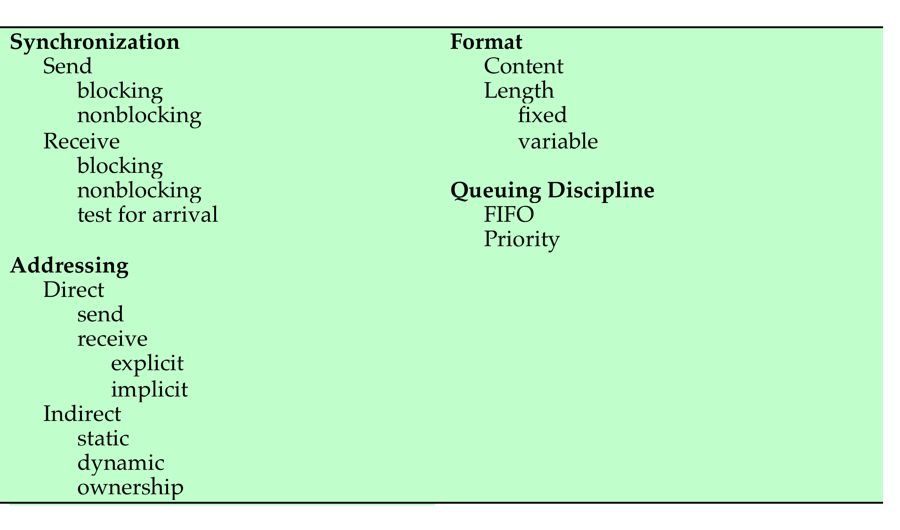
Message Passing
Notes:
A number of design issues relating to message-passing systems are listed in Table 5.5 , and examined in the remainder of this section.

Slide 87
Synchronization
Communication of a message between two processes implies synchronization between the two
the receiver cannot receive a message until it has been sent by another process
When a receive primitive is executed in a process there are two possibilities:
if a message has previously been sent the message is received and execution continues
if there is no waiting message the process is blocked until a message arrives or the process continues to execute, abandoning the attempt to receive
Notes:
The communication of a message between two processes implies some level of synchronization between the two: The receiver cannot receive a message until it has been sent by another process. In addition, we need to specify what happens to a process after it issues a send or receive primitive. Consider the send primitive first. When a send primitive is executed in a process, there are two possibilities: Either the sending process is blocked until the message is received, or it is not. Similarly, when a process issues a receive primitive, there are two possibilities:
1. If a message has previously been sent, the message is received and execution continues.
2. If there is no waiting message, then either (a) the process is blocked until a message arrives, or (b) the process continues to execute, abandoning the attempt to receive.

Slide 88
Blocking Send, Blocking Receive
Both sender and receiver are blocked until the message is delivered
Sometimes referred to as a rendezvous
Allows for tight synchronization between processes
Notes:
Thus, both the sender and receiver can be blocking or nonblocking. Three combinations are common, although any particular system will usually have only one or two combinations implemented:
• Blocking send, blocking receive: Both the sender and receiver are blocked until the message is delivered; this is sometimes referred to as a rendezvous . This combination allows for tight synchronization between processes.

Slide 89
Non-blocking Send
Nonblocking send, blocking receive
sender continues on but receiver is blocked until the requested message arrives
most useful combination
sends one or more messages to a variety of destinations as quickly as possible
example -- a service process that exists to provide a service or resource to other processes
Nonblocking send, nonblocking receive
neither party is required to wait
Notes:
Nonblocking send, blocking receive: Although the sender may continue on, the receiver is blocked until the requested message arrives. This is probably the most useful combination. It allows a process to send one or more messages to a variety of destinations as quickly as possible. A process that must receive a message before it can do useful work needs to be blocked until such a message arrives. An example is a server process that exists to provide a service or resource to other processes.
• Nonblocking send, nonblocking receive: Neither party is required to wait.
The nonblocking send is more natural for many concurrent programming tasks. For example, if it is used to request an output operation, such as printing, it allows the requesting process to issue the request in the form of a message and then carry on. One potential danger of the nonblocking send is that an error could lead to a situation in which a process repeatedly generates messages. Because there is no blocking to discipline the process, these messages could consume system resources, including processor time and buffer space, to the detriment of other processes and the OS. Also, the nonblocking send places the burden on the programmer to determine that a message has been received: Processes must employ reply messages to acknowledge receipt of a message.
For the receive primitive, the blocking version appears to be more natural for many concurrent programming tasks. Generally, a process that requests a message will need the expected information before proceeding. However, if a message is lost, which can happen in a distributed system, or if a process fails before it sends an anticipated message, a receiving process could be blocked indefinitely. This problem can be solved by the use of the nonblocking receive . However, the danger of this approach is that if a message is sent after a process has already executed a matching receive , the message will be lost. Other possible approaches are to allow a process to test whether a message is waiting before issuing a receive and
allow a process to specify more than one source in a receive primitive. The latter approach is useful if a process is waiting for messages from more than one source
and can proceed if any of these messages arrive.

Slide 90
Addressing
  Schemes for specifying processes in send and receive primitives fall into two categories:
Direct addressing
Indirect addressing
Notes:
Clearly, it is necessary to have a way of specifying in the send primitive which process is to receive the message. Similarly, most implementations allow a receiving process to indicate the source of a message to be received.
The various schemes for specifying processes in send and receive primitives fall into two categories: direct addressing and indirect addressing.

Slide 91
Direct Addressing
    Send primitive includes a specific identifier of the destination process
    Receive primitive can be handled in one of two ways:
      require that the process explicitly designate a sending process
      effective for cooperating concurrent processes
      implicit addressing
      source parameter of the receive primitive possesses a value returned when the receive operation has been performed
Notes:
With direct addressing , the send primitive includes a specific identifier of the destination process. The receive primitive can be handled in one of two ways. One possibility is to require that the process explicitly designate a sending process. Thus, the process must know ahead of time from which process a message is expected. This will often be effective for cooperating concurrent processes. In other cases, however, it is impossible to specify the anticipated source process. An example is a printer server process, which will accept a print request message from any other process. For such applications, a more effective approach is the use of implicit addressing. In this case, the source parameter of the receive primitive possesses a value returned when the receive operation has been performed.

Slide 92
Indirect Addressing
Messages are sent to a shared data structure consisting of queues that can temporarily hold messages
Queues are referred to as mailboxes
One process sends a message to the mailbox and the other process picks up the message from the mailbox
Allows for greater flexibility in the use of messages
Notes:
The other general approach is indirect addressing . In this case, messages are not sent directly from sender to receiver but rather are sent to a shared data structure consisting of queues that can temporarily hold messages. Such queues are generally referred to as mailboxes . Thus, for two processes to communicate, one process sends a message to the appropriate mailbox and the other process picks up the message from the mailbox.
A strength of the use of indirect addressing is that, by decoupling the sender and receiver, it allows for greater flexibility in the use of messages.

Slide 93
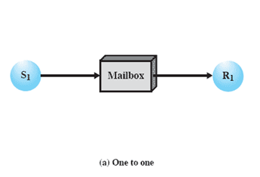
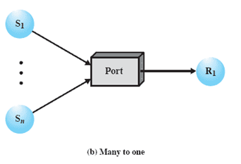
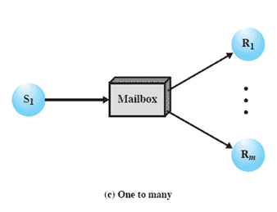
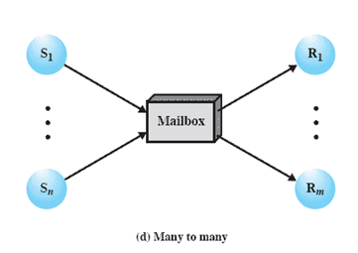
Indirect Process Communication
Notes:
The relationship between senders and receivers can be one to one, many to one, one to many, or many to many ( Figure 5.18 ). A one-to-one relationship allows a private communications link to be set up between two processes. This insulates their interaction from erroneous interference from other processes. A many-to-one relationship is useful
for client/server interaction; one process provides service to a number of other processes. In this case, the mailbox is often referred to as a port . A one-to-many relationship allows for one sender and multiple receivers; it is useful for applications where a message or some information is to be broadcast to a set of processes. A many-to-many relationship allows multiple server processes to provide concurrent service to multiple clients.
1) A one-to-one relationship
allows a private communications link to be set up between two processes.
This insulates their interaction from erroneous interference from other processes.
2) A many-to-one relationship is useful for client/server interaction;
one process provides service to a number of other processes.
In this case, the mailbox is often referred to as a port.
3) A one-to-many relationship allows for one sender and multiple receivers;
it is useful for applications where a message or some information is to be broadcast to a set of processes.
4) A many-to-many relationship
allows multiple server processes to provide concurrent service to multiple clients.
The association of processes to mailboxes can be either static or dynamic. Ports are often statically associated with a particular process; that is, the port is created and assigned to the process permanently. Similarly, a one-to-one relationship is typically defined statically and permanently. When there are many senders, the association of a sender to a mailbox may occur dynamically. Primitives such as connect and disconnect may be used for this purpose.
A related issue has to do with the ownership of a mailbox. In the case of a port, it is typically owned by and created by the receiving process. Thus, when the process is destroyed, the port is also destroyed. For the general mailbox case, the OS may offer a create-mailbox service. Such mailboxes can be viewed either as being owned by the creating process, in which case they terminate with the process, or as being owned by the OS, in which case an explicit command will be required to destroy the mailbox.

Slide 94
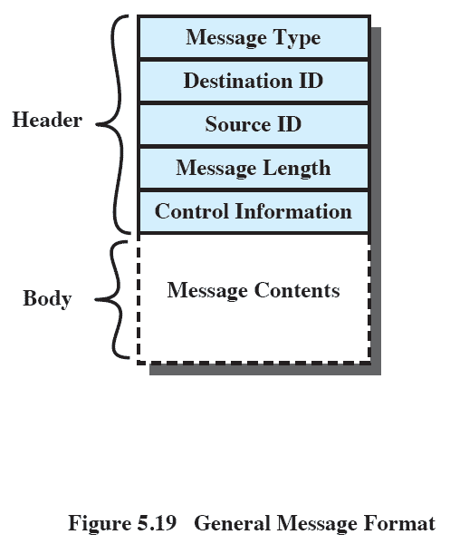
General Message Format
Notes:
The format of the message depends on the objectives of the messaging facility and whether the facility runs on a single computer or on a distributed system. For some
operating systems, designers have preferred short, fixed-length messages to minimize processing and storage overhead. If a large amount of data is to be passed, the data can be placed in a file and the message then simply references that file. A more flexible approach is to allow variable-length messages.
Figure 5.19 shows a typical message format for operating systems that support variable-length messages.
The message is divided into two parts:
a header, which contains information about the message.
The header may contain an identification of the source and intended destination of the message, a length field, and a type field to discriminate among various types of messages.
additional control information, e.g. pointer field so a linked list of messages can be created; a sequence number, to keep track of the number and order of messages passed between source and destination; and a priority field.
a body, which contains the actual contents of the message.

Slide 95
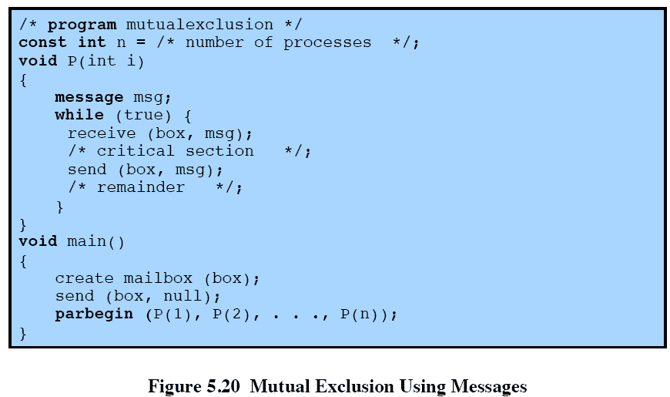
Mutual Exclusion
Notes:
Figure 5.20 shows one way in which message passing can be used to enforce mutual exclusion (compare Figures 5.1 , 5.2 , and 5.6 ). We assume the use of the blocking receive primitive and the nonblocking send primitive. A set of concurrent processes share a mailbox, box , which can be used by all processes to send and receive.
The mailbox is initialized to contain a single message with null content. A process wishing to enter its critical section first attempts to receive a message. If the mailbox is empty, then the process is blocked. Once a process has acquired the message, it performs its critical section and then places the message back into the mailbox. Thus, the message functions as a token that is passed from process to process.
The preceding solution assumes that if more than one process performs the receive operation concurrently, then:
• If there is a message, it is delivered to only one process and the others are
blocked, or
• If the message queue is empty, all processes are blocked; when a message is
available, only one blocked process is activated and given the message.
These assumptions are true of virtually all message-passing facilities.

Slide 96
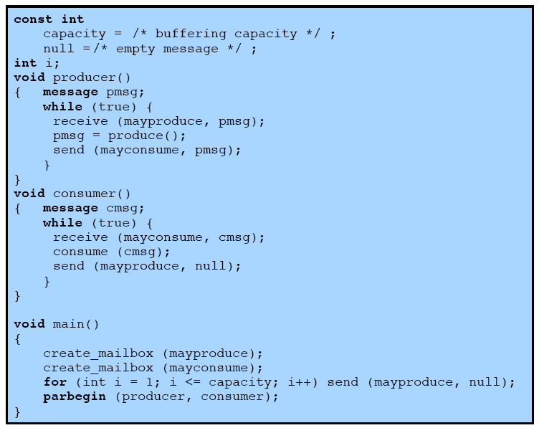
Message Passing Example
Notes:
As an example of the use of message passing, Figure 5.21 is a solution to the bounded-buffer producer/consumer problem. Using the basic mutual-exclusion power of message passing, the problem could have been solved with an algorithmic structure similar to that of Figure 5.13 . Instead, the program of Figure 5.21 takes advantage of the ability of message passing to be used to pass data in addition to signals. Two mailboxes are used. As the producer generates data, it is sent as messages to the mailbox mayconsume . As long as there is at least one message in that mailbox, the consumer can consume. Hence mayconsume serves as the buffer; the data in the buffer are organized as a queue of messages. The “size” of the buffer is
determined by the global variable capacity . Initially, the mailbox mayproduce is filled with a number of null messages equal to the capacity of the buffer. The number of messages in mayproduce shrinks with each production and grows with each consumption. This approach is quite flexible. There may be multiple producers and consumers, as long as all have access to both mailboxes. The system may even be distributed, with all producer processes and the mayproduce mailbox at one site and all the consumer processes and the mayconsume mailbox at another.

Slide 97
Summary
Messages
  Useful for the enforcement of mutual exclusion discipline
Operating System Themes
  Multiprogramming, multiprocessing, distributed processing
  Fundamental to these themes is concurrency
  issues of conflict resolution and cooperation arise
Mutual Exclusion Condition
  In which there is a set of concurrent processes, only one of which is able to access a given resource or perform a given function at any time
  One approach involves the use of special machine instructions
Semaphore
  Used for signaling among processes and can be readily used to enforce a mutual exclusion discipline

