Slide 1
DOC-CONNECT –DOCTOR APPOINMENT BOOKING SYSTEM
Team Members | Register Numbers
Mohamed Syed Ali | 99230040673
Matam Vandana | 99230040665
Mitnala Srikanth | 99230040672
Nagireddy Meghana | 99230040686
Manne Durga Bhavani | 99230040660
Modugapalam Shanmugam Reshma Reddy | 99230040039

Slide 2
PROBLEM STATEMENT
Patients often visit hospitals and wait in long queues for appointments.
Booking appointments manually causes time wastage and inconvenience.
Patients find it difficult to check doctor availability in advance.
Waiting time affects patients' daily activities.
A simple online appointment booking system is needed.

Slide 3
OBJECTIVES
To provide online doctor appointment booking.
To help patients find doctors easily.
To allow patients to check appointment status and queue details.
To help doctors manage appointments efficiently.
To provide an admin dashboard for managing doctors, patients, and bookings.
To reduce unnecessary hospital visits and waiting time.

Slide 4
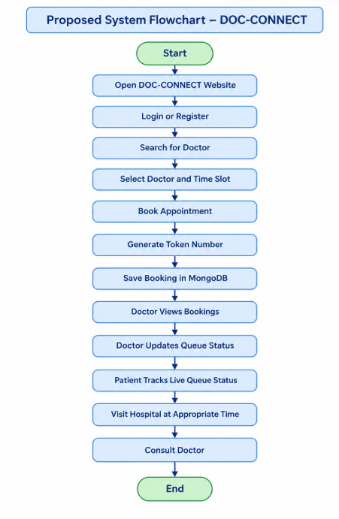
PROPOSED SYSTEM
DOC-CONNECT provides an online doctor appointment booking platform.
Patients can register, login, and search for doctors.
Patients can select appointment dates and time slots.
Appointment status and queue details can be viewed online.
Doctors can view appointments and update their status.
Admins can manage doctors, patients, and appointments.

Slide 5
PROPOSED METHODOLOGY
User Login: Patients, doctors, and admins log in through their respective portals.
Doctor Selection: Patients view available doctors and select a suitable doctor.
Appointment Booking: Patients choose an available date and time slot to book an appointment.
Appointment Management: Doctors view appointments and update their status.
Schedule Management: Doctors manage their available days and time slots.
Admin Management: Admins manage patient and doctor accounts and monitor appointments.
Database Storage: MongoDB stores user details, doctor schedules, and appointment records.
2

Slide 6
FUNCTIONALITIES
PATIENT MODULE
Registration & Login
Google Sign-In
Doctor Search
Appointment Booking
QR Demo Payment
Appointment Tracking
DOCTOR MODULE
Doctor Login
Doctor Dashboard
View Appointments
View Patient Details
Update Appointment Status
ADMIN MODULE
Admin Login
Admin Dashboard
Manage Doctors
Manage Patients
Manage Appointments
View Booking Details

Slide 7
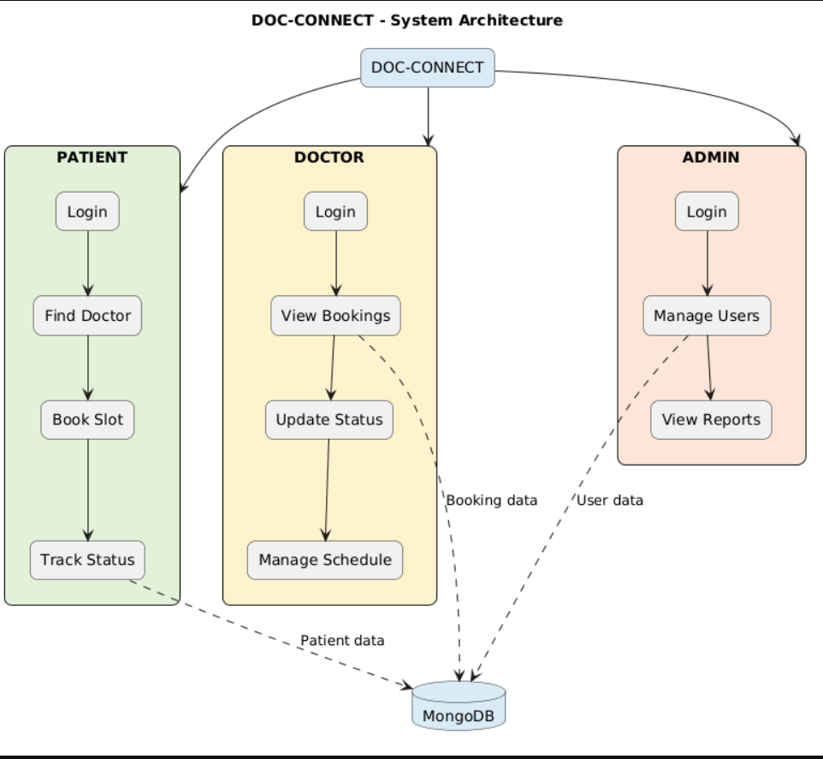
System Architecture

Slide 8
DATABASE COLLECTIONS
User Collection – Stores user login and account information.
Doctor Collection – Stores doctor details and specialization.
Appointment Collection – Stores appointment booking records.
Patient Information – Stores patient details and symptoms.
Appointment Status – Stores booking and appointment status.
Booking Details – Stores doctor, date, time, and booking information.

Slide 9
TECHNOLOGIES USED
Frontend: React.js, HTML, CSS, JavaScript
Backend: Node.js, Express.js
Database: MongoDB
Authentication: JSON Web Token (JWT)
Password Security: bcrypt
Development Tool: Visual Studio Code / Windsurf

Slide 10
ADVANTAGES
Saves Time: Reduces the need to visit hospitals just to book appointments.
Easy Booking: Patients can book doctor appointments online.
Less Waiting: Helps patients check appointment status and plan their hospital visits.
Easy Scheduling: Doctors can manage appointments and availability.
Centralized Management: Admins can manage patient and doctor details in one place.
Secure Access: Provides separate login access for patients, doctors, and administrators.

Slide 11
CONCLUSION
DOC-CONNECT is a web-based doctor appointment management system that makes appointment booking easier for patients. It helps patients find doctors and track appointments, allows doctors to manage their schedules, and enables administrators to manage users and appointments. The system aims to reduce manual work, unnecessary hospital visits, and waiting time.

Slide 12

THANK YOU !!

