Slide 1

Welcome…
News
portal
Team :sonic
Team members:
1.Bhavani prasad
2.Prathiba reddy
3.Rohith reddy
4.saiteja

Slide 2

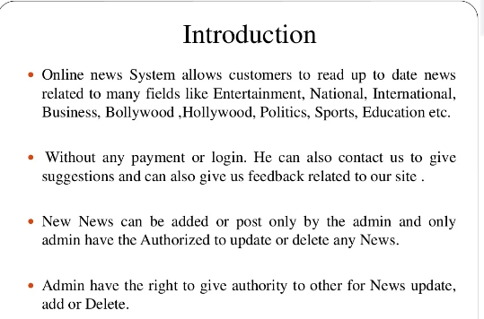

Slide 3
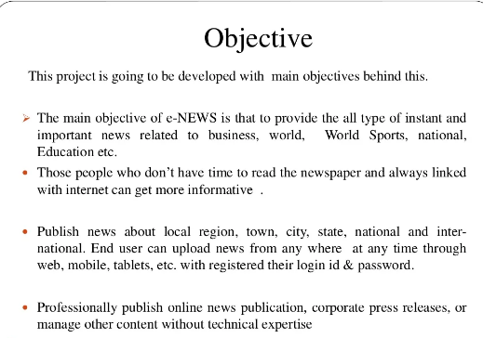

Slide 4
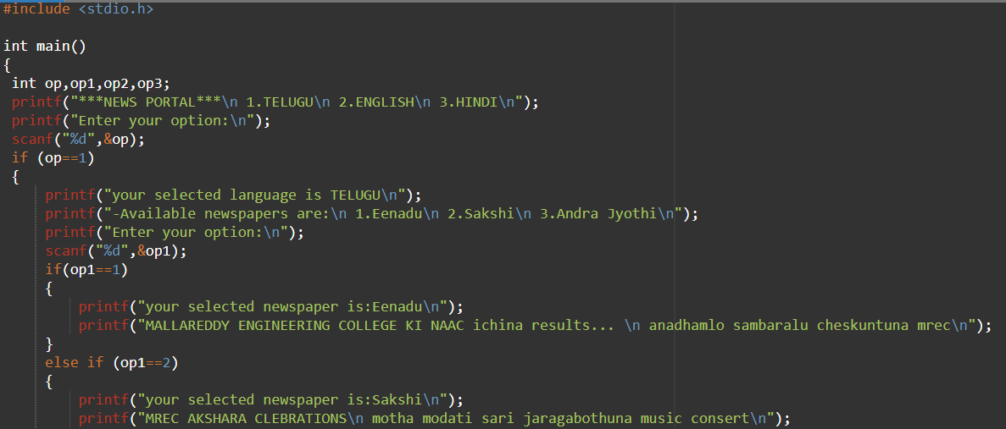

Slide 5
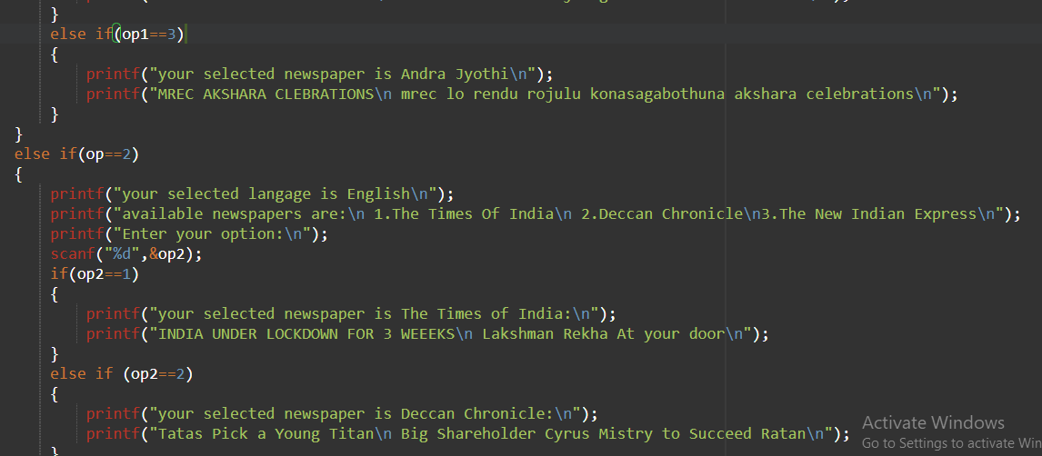

Slide 6
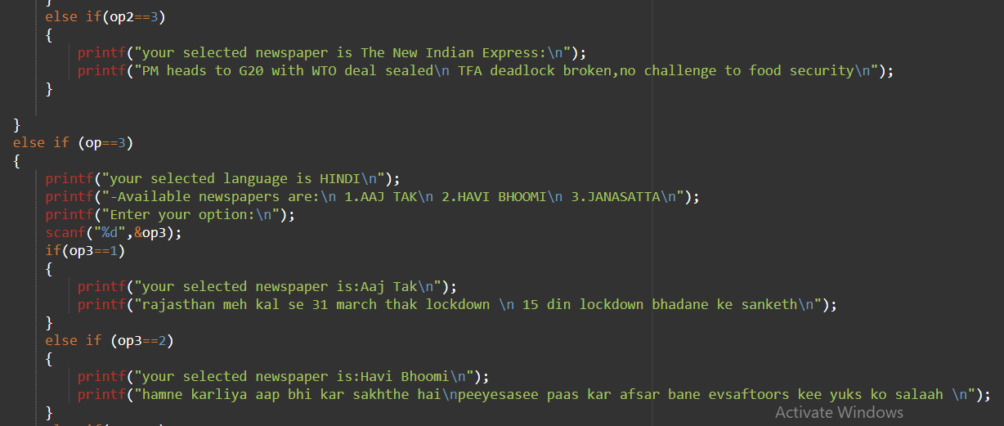

Slide 7
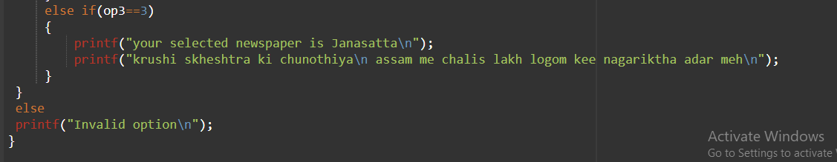

Slide 8
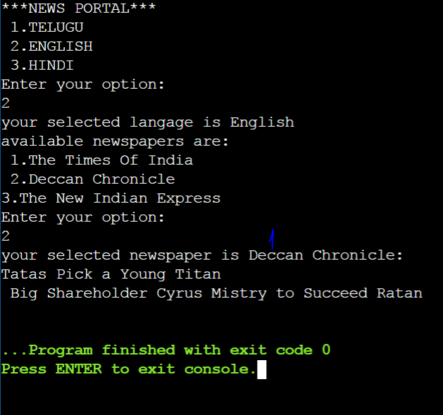

Slide 9


