Slide 1
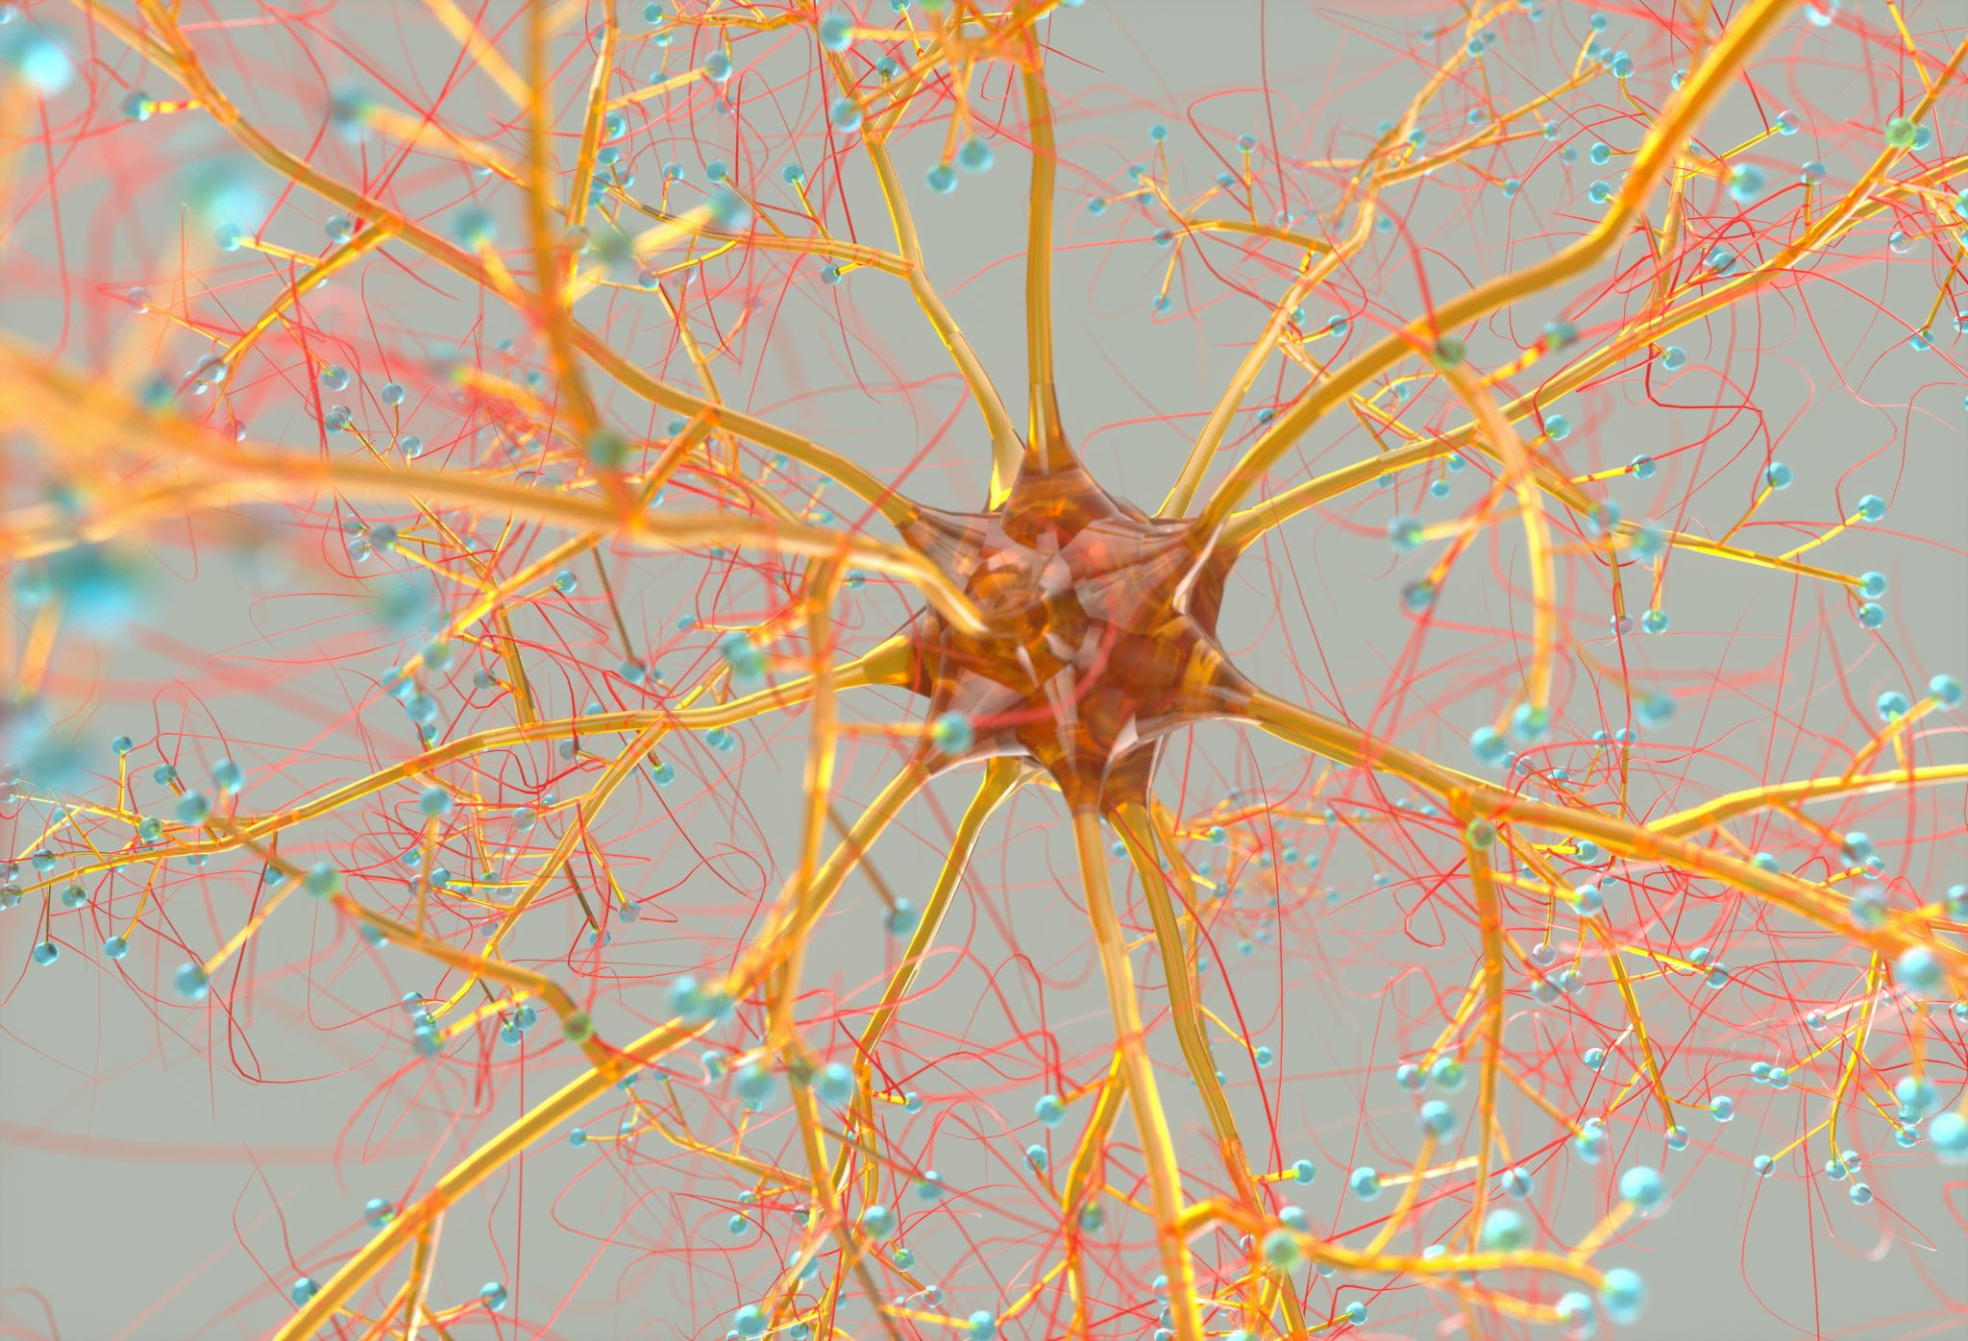
Overview of Artificial Neural Networks
Bhavani Prasad N
700757055

Slide 2


Motivation
Inspired by the biological nervous systems.
Key to solving complex problems and recognizing patterns.
Artificial Neural Networks (ANNs) mimic the brain's ability to learn and adapt.

Slide 3

Motivation
Importance in various fields such as healthcare, finance, and technology.
Growing interest and research in developing more efficient ANN models.

Slide 4
Problem Statement
Conventional computers require specific instructions to solve problems.
Lack flexibility and adaptability in handling new, unseen data.

Slide 5
Problem Statement
Challenges in dealing with complex, high-dimensional data.
Need for systems that can learn from data and improve over time.

Slide 6

Objectives
Provide an overview of Artificial Neural Networks (ANN).
Explain the basic working principles of ANN.

Slide 7

Objectives
Discuss the training processes and methodologies of ANN.
Highlight the practical applications and advantages of ANN.

Slide 8
Contributions
Historical development of Artificial Neural Networks.
Key contributions by researchers such as Warren McCulloch and Walter Pitts.

Slide 9
Contributions
• Development of training methodologies: Supervised and Unsupervised learning.
• Applications in real-time systems like speech recognition and image analysis.

Slide 10

Results
Success of ANN in various applications.
Examples: speech recognition, image analysis, and predictive analytics.

Slide 11

Results
Comparison with conventional computing techniques.
Advantages of adaptability and fault tolerance in ANN.

Slide 12
Critical Analysis
Advantages: Adaptive learning, self-organization, real-time operation.
ANN's ability to handle noisy and incomplete data.

Slide 13

Critical Analysis
Disadvantages: Unpredictability, need for extensive training data.
Comparison with traditional algorithmic approaches.

Slide 14

References
Maind, S. B., & Wankar, P. (2014). Research Paper on Basic of Artificial Neural Network. International Journal on Recent and Innovation Trends in Computing and Communication, 2(1), 96-100.

