Slide 1


Department of Computer Science and Engineering
GENDERTONE: VOICE GENDER RECOGNITION WITH SENTIMENT ANALYSIS
Mrs. Divya M,
Department of CSE
Rajalakshmi Engineering College Chennai, India
2116220701215 RAJAKUMARAN BHAVANISHRAJ

Slide 2
Problem Statement and Motivation
Voice-based Human-Computer Interaction (HCI) is increasingly popular with the rise of smart assistants and voice-controlled systems.
Identifying speaker gender and analyzing sentiment improves personalized user experiences and service quality.
This project presents a machine learning solution that performs both gender recognition and sentiment analysis from voice inputs.
Growing demand to detect human emotions and demographics from voice.
Sentiment analysis helps assess customer satisfaction in call centers and feedback systems.
Gender recognition personalizes responses in virtual assistants.

Slide 3
Existing System
Most current systems perform either gender recognition or sentiment analysis, but not both in one application.
Traditional gender recognition uses biometric data or simple pitch/frequency analysis and lacks advanced ML techniques.
Sentiment analysis is widely applied to text data but audio-based sentiment analysis often requires heavy deep learning models (LSTMs, CNNs).
Existing audio sentiment systems are usually computationally expensive and need large datasets, limiting accessibility.
There is a gap for a lightweight, real-time, open system that combines both gender and sentiment analysis with an easy Streamlit interface — which this project fulfills.

Slide 4
Objectives
Develop a machine learning-based system that performs both voice gender recognition and sentiment analysis from speech input.
Use audio feature extraction (MFCC, chroma, mel spectrogram) to capture unique vocal characteristics for classification.
Employ ML models like Random Forest, SVM, and Gradient Boosting for accurate gender and sentiment classification.
Evaluate models using accuracy, precision, recall, and F1-score to ensure high performance and reliability.
Integrate signal processing, machine learning, and web development to demonstrate real-world AI applications in voice analysis.

Slide 5
Abstract
A machine learning system that performs voice gender recognition and sentiment analysis using speech input.
Uses MFCC, chroma, and mel spectrogram features extracted via librosa for accurate predictions.
Employs Random Forest and SVM classifiers to classify gender and sentiment efficiently.
Features an easy-to-use Streamlit web interface supporting both audio upload and live voice input.
Serves as a practical tool for real-time applications and an educational demo of ML and signal processing on audio data.

Slide 6
Proposed System
An integrated ML application that performs both voice gender recognition and sentiment analysis using speech input.
Extracts key audio features like MFCC, chroma, and mel spectrograms using the librosa library for accurate classification.
Supports both audio file upload and live recording through a user-friendly Streamlit web interface.
Uses efficient ML models like Random Forest and SVM to ensure accurate, real-time predictions even on low-end devices.
Provides a unified, scalable tool useful for voice interaction systems, emotion-aware AI, and user profiling applications.

Slide 7
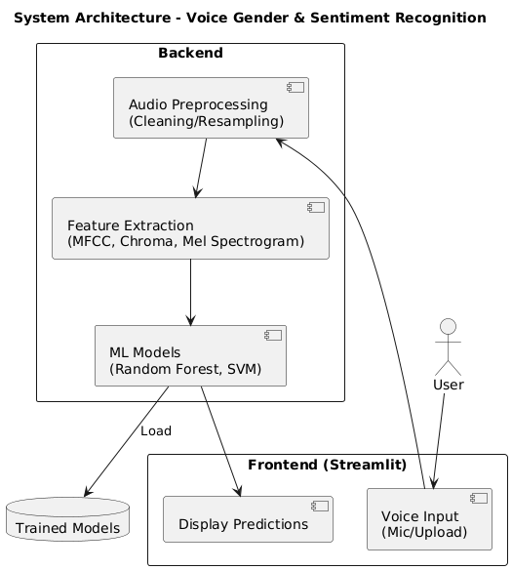
System Architecture
This architecture diagram illustrates a modular ML web application for voice-based gender and sentiment classification.
The frontend is built using Streamlit, allowing users to either upload audio or record live.
Extracted features are passed to pre-trained machine learningmodels (Random Forest, SVM) which load from stored model files.

Slide 8
List of Frameworks
Streamlit: Creates the web-based interface for audio input and result display (live recording & file upload).
sounddevice / pyaudio: Captures live microphone audio input from users.
librosa + numpy / scipy: Extracts audio features (MFCC, chroma, mel spectrogram) and handles signal processing.
scikit-learn: Provides machine learning models like Random Forest and SVM for classification.
joblib / pickle: Saves and loads pre-trained models to make real-time predictions efficient.

Slide 9
Functional Description for each modules with DFD and Activity Diagram
Streamlit Module — Provides a web-based user interface for audio file upload, live recording, and displaying prediction results.
Audio Capture Module — Records live microphone input or accepts uploaded audio files for processing.
Feature Extraction Module — Uses librosa to convert raw audio into features like MFCC, chroma, and mel spectrograms.
Machine Learning Module — Loads pre-trained models (Random Forest, SVM) to classify gender and sentiment from extracted features.
Result Display Module — Shows real-time prediction outcomes and provides users with easy-to-understand feedback.

Slide 10
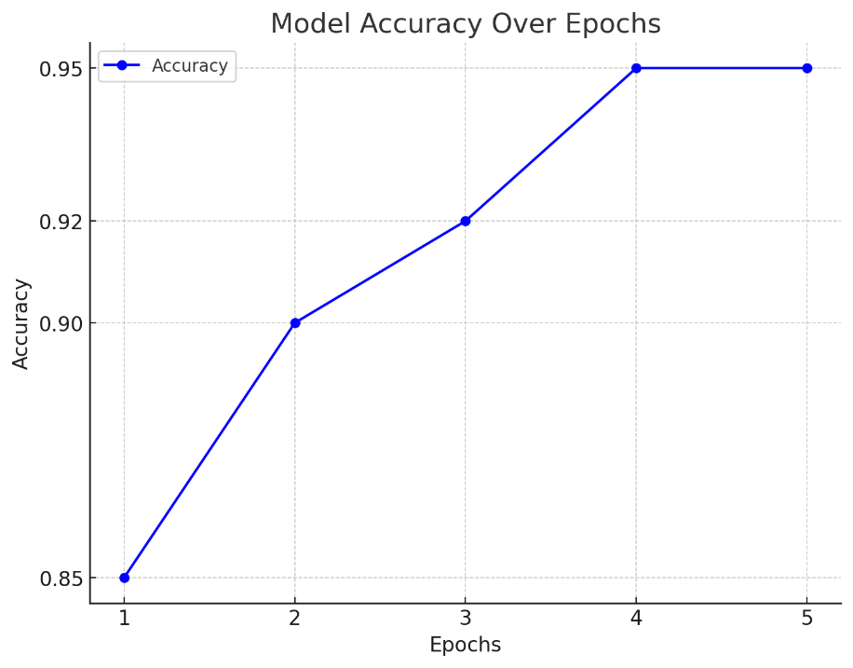
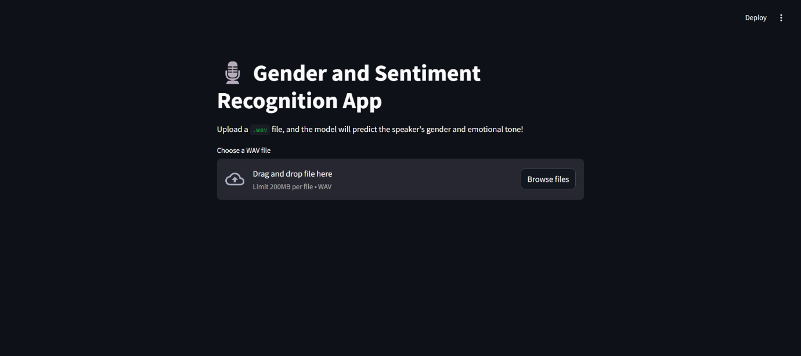
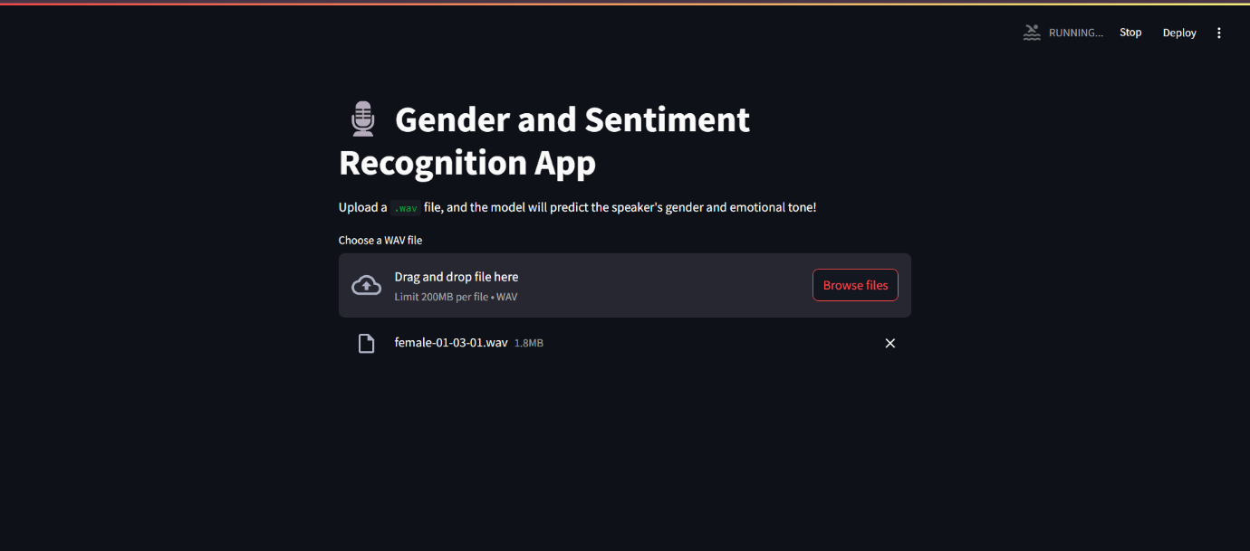
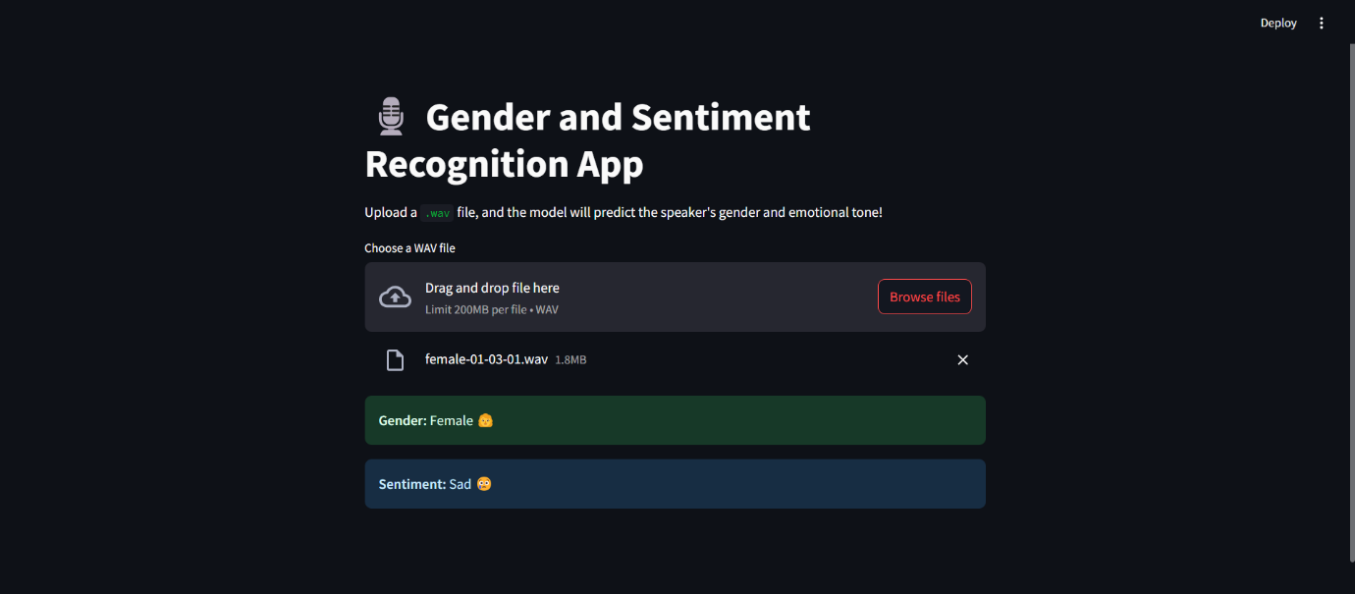
Implementation & Results of Module

Slide 11
Conclusion & Future Work
Successfully built a real-time, lightweight ML system for voice-based gender recognition and sentiment analysis.
Integrated into a user-friendly web app using Streamlit with support for both live audio and file uploads.
Achieved quick, accurate, and low-cost predictions, making it suitable even for modest hardware.
Seamless frontend-backend integration and modular design ensure easy scalability.
Proved the potential of machine learning in voice-based human-computer interaction.

Slide 12
References
S. Luitel, Y. Liu, and M. Anwar, "Audio Sentiment Analysis with Spectrogram Representations and Transformer Models," IEEE, 2024. (ResearchGate)
S. Luitel and M. Anwar, "Audio Sentiment Analysis using Spectrogram and Bag-of-Visual Words," IEEE, 2022. (ResearchGate)
M. A. Mohamed, G. E. Dahl, and G. Hinton, "Acoustic Modeling Using Deep Belief Networks," IEEE Transactions on Audio, Speech, and Language Processing, vol. 20, no. 1, pp. 14–22, 2011. (ACM Digital Library)
F. Eyben, M. Wöllmer, and B. Schuller, "OpenSMILE – The Munich Versatile and Fast Open-Source Audio Feature Extractor," in Proceedings of the ACM Multimedia, 2010. (Wikipedia)

Slide 13
Paper Publication Status
Yet to Publish

Slide 14
Thank You

