Slide 1
Twitter Sentimental Analysis using Big Data
ADVANCE DATABASE TOPICS
(COMP8157-91-R-2020S)
Project Group No - 26
Guided By: Dr. Kalyani Selvarajah

Slide 2


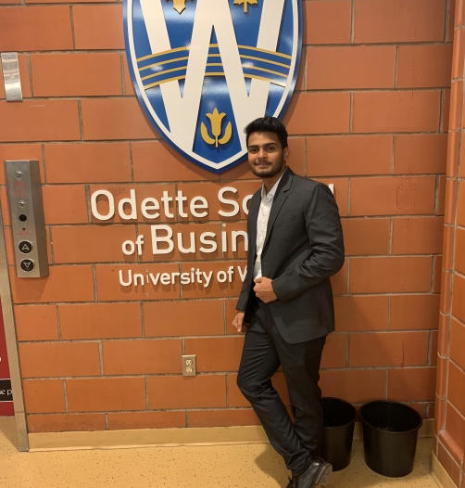
TEAM MEMBERS
Khushboo Ladha
Bhavankit Navadiya
Shubham Singh
Tester
Developer/UI
Developer
ladhak@ uwindsor.ca
mansukh@uwindsor.ca
singh1zb@uwindsor.ca

Slide 3
OUTLINE
01
Introduction
02
Goal/Objective
03
Existing Works
04
Tools and Techniques
05
Demo
06
Future Work
07
Conclusion
08
References

Slide 4
‘‘In this modern era, social media has become one of the platform where people share their emotions, views and daily updates.
Twitter social media application gets large amount of tweets in every seconds.
Companies can analyze real time twitter data to get the feedback of current users or satisfaction of product by the users.
We are providing a sentimental analysis on twitter data for particular data so that clients may aware of what trends is going on and how the user reflects on using the products. Also, using the sentimental feedback clients can work on details to make the product more effective in the market’’

Slide 5
Why this project?

Slide 6
Existing Work
Extraction of twitter data on Apache Pig
Extraction of features
Hadoop(Apache
Pig)
Different studies related to sentimental analysis on recent trends using Apache Pig
Sentimental
Analysis
Extraction of hashtags
Sentimental report on hashtags value

Slide 7









Tools and Technology Used
Online Meetings and Communication
Tools Used:
Zoom and MS Teams for Conference Meeting and TeamViewer for file sharing
Bug Resolve Tools
Tool Used:
Redmine
Code Sharing and Version Control
Tool Used:
GitHub and SVN for version control
Testing Tools
Tools Used:
Get a modern PowerPoint Presentation that is beautifully designed.
Tools Used:
Technology Used to Build the Project
Linux(Ubuntu), JDK 1.8.0 Apache Hadoop, Apache Flume, HDFS, Twitter API, Eclipse IDE, Jupyter Notebook

Slide 8
Draft step by step process:
Configured Linux(Ubuntu)
Configure Apache Hadoop and Flume
.
Implementation of Sentimental Analysis
Testing, Performance Analysis and Deployment

Slide 9

You can simply impress your audience and add a unique zing and appeal to your Presentations. Easy to change colors, photos and Text. Get a modern PowerPoint Presentation that is beautifully designed. I hope and I believe that this Template will your Time, Money and Reputation. You can simply impress your audience and add a unique zing and appeal to your Presentations. Get a modern PowerPoint Presentation that is beautifully designed. I hope and I believe that this Template will your Time, Money and Reputation.
DEMO

Slide 10
FUTURE WORK
Implementation UI
As we are getting expected output from our development, we are planning to implement some UI, so that, this meaningful information will be helpful to user in easy manner.
Attractive Visuals
We are also looking towards create some story in visual form rather than text using some reporting tool such as Tableau and embed that to our UI.
Introduction to Machine Learning
We are thinking to introduce machine leaning for our project where using will get recommendations after some visits. (Page ranking algorithm (NLP))
Maintenance
After getting feedback from users, we try our best to deliver optimum solution.
“Your most unhappy customers are your greatest source of learning.”
-Bill Gates

Slide 11
ACKNOWLEDGEMENT & CONCLUSION
Thus, based on the demo and screenshot seen from our project, we would like to end our presentation on the note that our software will be helpful to the IT companies as well as to those other relevant users would benefit from having themselves updated to the latest details concerning with feedback on economic, industrial, social, or government, rather than taking offline.
We would like to thank our Prof. Dr. Kalyani Selvarajah for supporting us throughout our project development and also our TA’s for assisting us in our Assignments and Difficulties throughout our semester.

Slide 12
REFERENCES
Y. Mejova, “Sentiment analysis: An overview,” Comprehensive exampaper, http://www.csuioedu/ymejova/publications/CompsYelena. Pdf [2010-03], 2009.
Barskar, A., & Phulre, A. (2017). Opinion mining of twitter data using Hadoop and Apache Pig. International Journal of Computer Applications.
Bhardwaj, A., Kumar, A., Narayan, Y. , & Kumar, P. (2015, December). Big data emerging technologies: A case study with analyzing twitter data using apache hive. In Recent Advances in Engineering & Computational Sciences (RAECS), 2015 2nd International Conference on (pp. 1–6)
Chauhan, V., & Shukla, A. (2017, April). Sentimental analysis of social networks using MapReduce and big data technologies. International Journal of Computer Science and Network, 6(2), 120–13.
📖

Slide 13
THANK YOU

