Slide 1


Historical Cryptocurrency Analysis
Web Scraping, Data Processing, and Machine Learning
PRESENTATION
PRESENTATION
cOURSE : MSc Computer Science & Data Science
PREPARED BY : Bhavan VASU

Slide 2
AGENDA
01
Agenda One
02
Agenda Two
03
Agenda Three
04
Agenda Four
Project Objective & Motivation
Data Collection
Data Storage & Database Integration
Data Visualization & Dashboard
05
Agenda Five
06
Agenda Six
07
Agenda Seven
08
Agenda Eight
Data Preprocessing & Feature Engineering
Machine Learning Models for BTC Weekly Price Movement
Model Evaluation & Selection
Challenges & Solutions

Slide 3
Short description :
01
Agenda One
The objective is to scrape historical cryptocurrency data, clean and preprocess it, and build a machine learning model to predict weekly Bitcoin price movement (UP/DOWN).
01
GOAL OF THE PROJECT
CoinMarketCap provides structured, reliable historical cryptocurrency data including prices, market capitalization, and volume.
02
WHY COINMARKETCAP

Slide 4
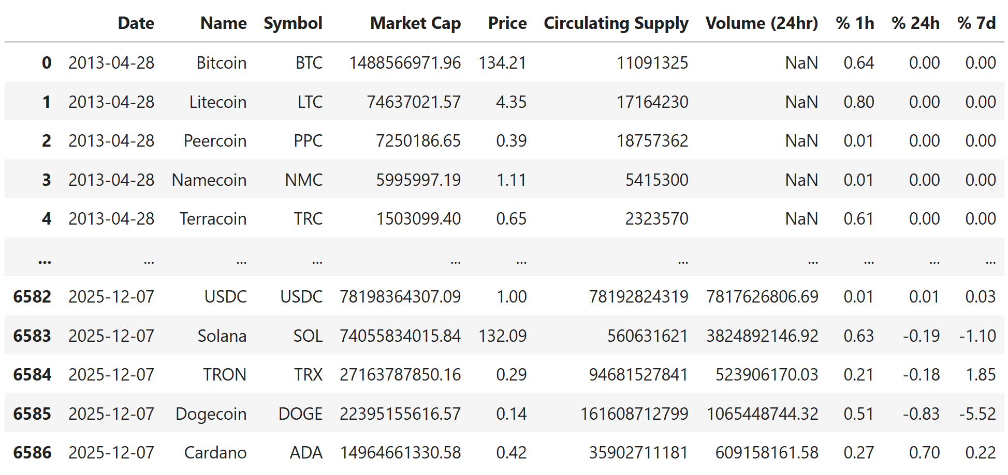
02
Agenda Two
Data Collection
Explain web scraping approach:
Scraped weekly data (Sundays) for consistency
Fields collected: Date, Name, Symbol, Market Cap, Price, Circulating Supply, Volume (24hr), % 1h, % 24h, % 7d

Slide 5
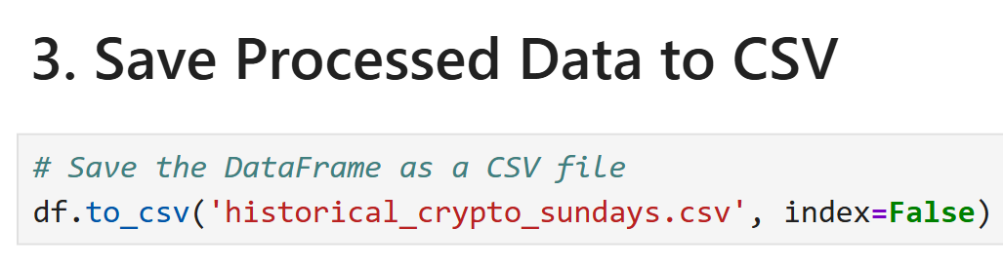
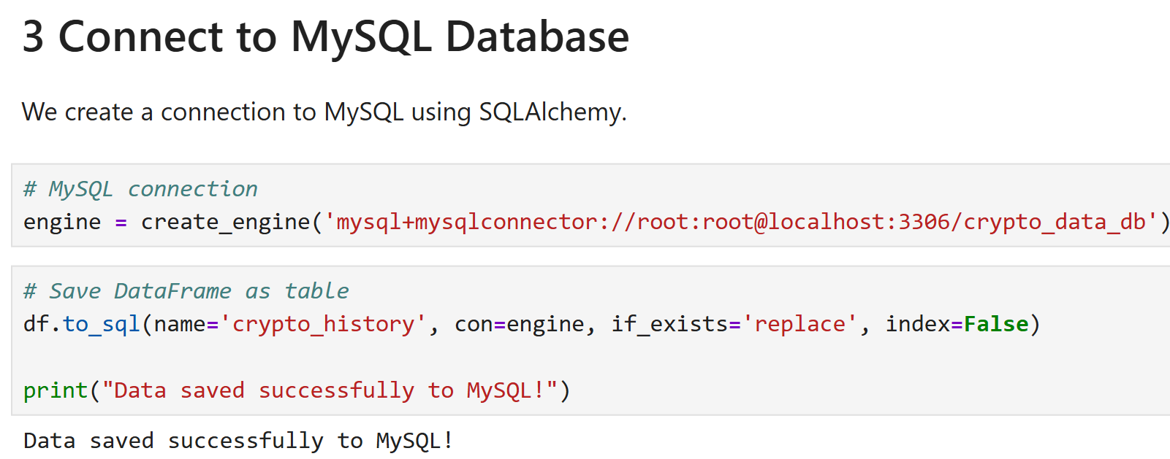
03
Agenda Three
Saving & Loading Data
Data was first saved as CSV files.
These CSV files were then imported into MySQL to allow efficient querying, table management, and seamless integration with dashboards.
This approach ensures data is accessible both as raw files and in a structured database for analysis.

Slide 6

04
Agenda Four
Data Visualization & Dashboard
This dashboard transforms scraped cryptocurrency data into visual insights across four key pages: Market Overview, Investment, Risk.
To explore the full multi-page dashboard and live metrics, click here

Slide 7
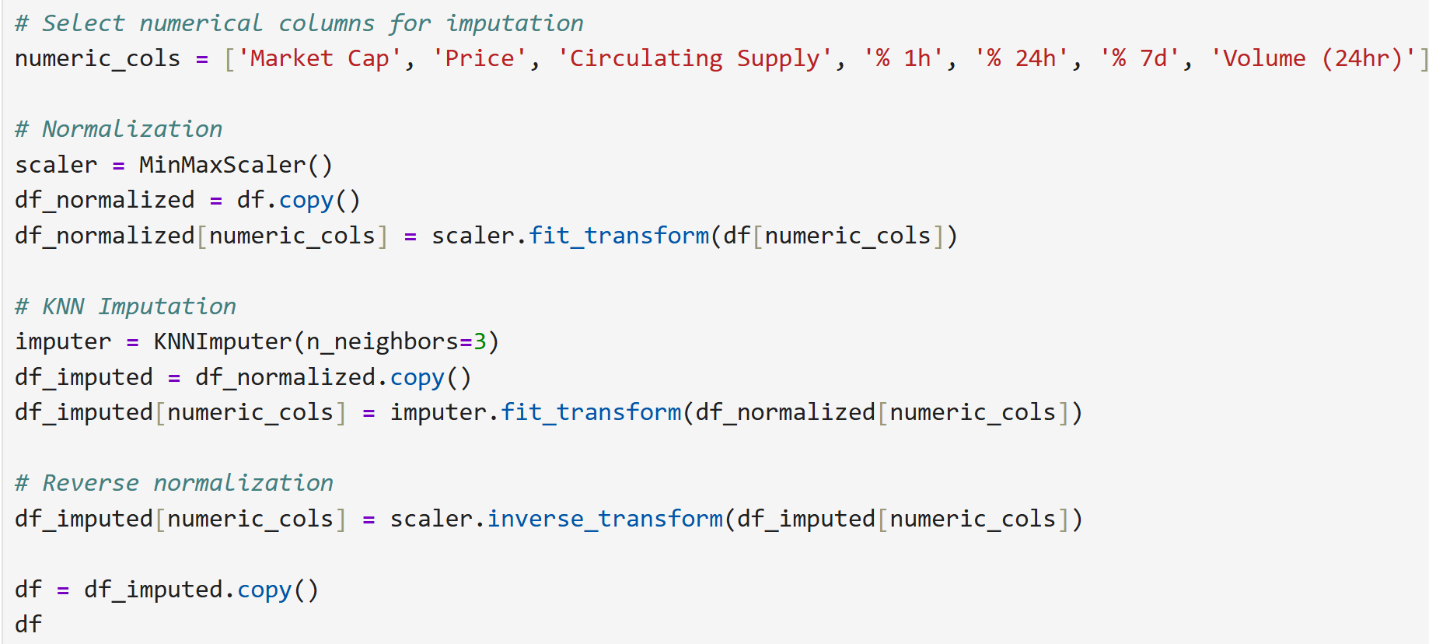
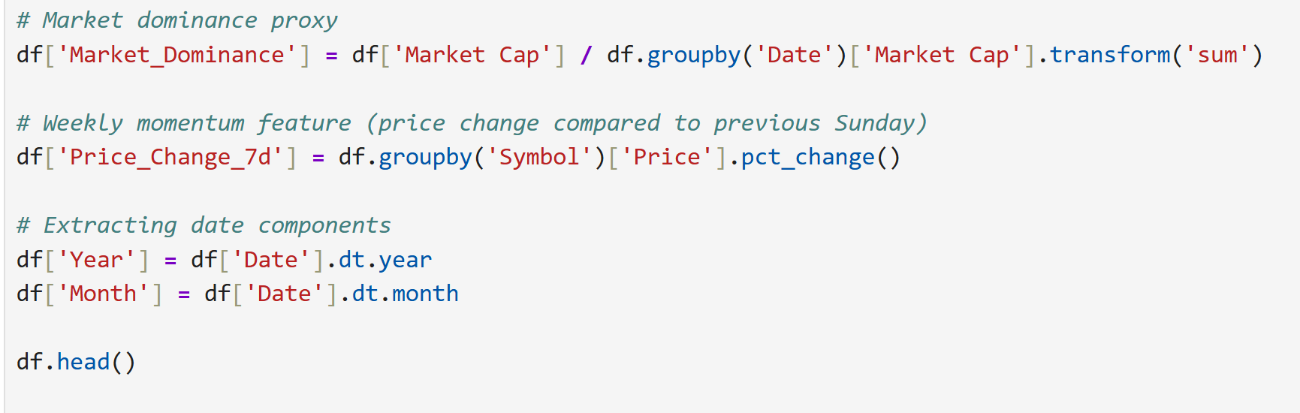
05
Agenda Five
Data Preprocessing & Feature Engineering
Removed duplicates & handled missing values using KNN imputation
Normalized numerical columns
Created new features: Market_Dominance Price_Change_7d (weekly momentum) Year & Month extracted from Date

Slide 8
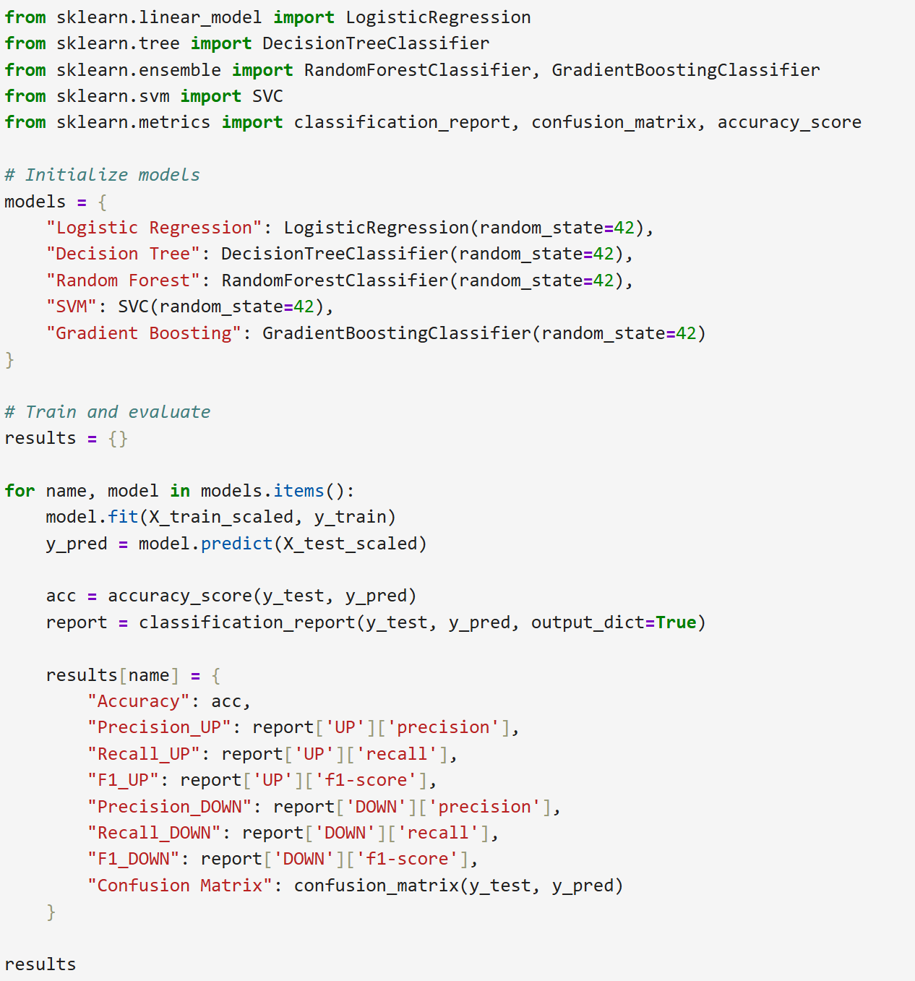
06
Agenda Six
Machine Learning Models
Explain weekly BTC price movement classification (UP/DOWN)
Models used: Random Forest, Gradient Boosting, Decision Tree, SVM, Logistic Regression
Include code snippet screenshot for model training

Slide 9
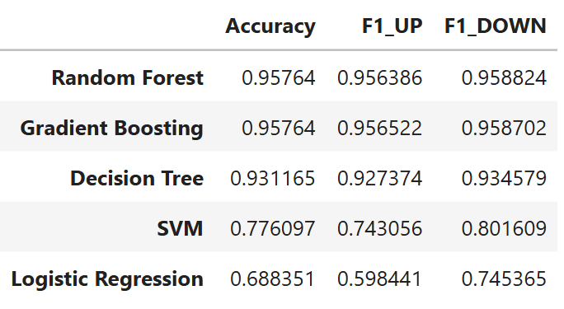
07
Agenda Seven
Model Evaluation
Gradient Boosting achieved the highest accuracy (~95.76%) and balanced F1-scores, making it the best model for BTC weekly movement prediction.

Slide 10
08
Agenda Eight
Challenges & Solutions
CHALLENGES & SOLUTIONS :
Missing values in Volume column → KNN imputation
Non-numeric formatting → string cleaning & type conversion
Weekly consistency → feature engineering for weekly momentum

Slide 11
09
Agenda Nine
Learning Outcomes
Learning Outcomes :
Practical experience in web scraping & data cleaning
Efficient data storage with MySQL.
Creating interactive dashboards & visualizations
Feature engineering for ML
Building and evaluating multiple ML models
Selecting Gradient Boost as the best performing model

Slide 12
CONCLUSION
01
02
03
04
A Bitcoin weekly price movement (UP/DOWN) classification model was developed using multiple machine learning algorithms. Gradient Boost emerged as the best-performing model with an accuracy of ~95.76%, demonstrating strong predictive capability.
05
This project successfully implemented an end-to-end data science pipeline starting from web scraping to machine learning modeling.
Historical cryptocurrency data was scraped, cleaned, transformed, and stored efficiently using Python and MySQL
Advanced feature engineering techniques were applied to enhance data quality and model performance.
The project highlights how data-driven approaches can be used to analyze and predict trends in financial markets.

Slide 13
Thank you For Watching
PRESENTATION
PRESENTATION
cOURSE : MSc Computer Science & Data Science
PREPARED BY : Bhavan VASU

