Slide 1
CAPSTONE PROJECT
ON
EMPLOYEE MANAGEMENT SYSTEM

Slide 2
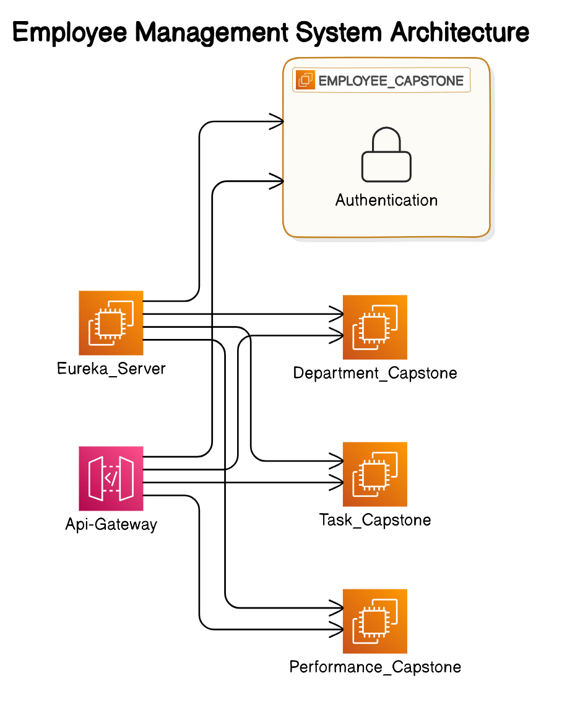

Slide 3
Introduction
Project Overview:
The Employee Management System is a distributed application designed to manage employee-related information within an organization. The system provides functionalities for managing employees, departments, tasks, and performance evaluations. It is built using microservices architecture, which allows for scalability and flexibility.
Technologies Used:
Java: The core programming language used to develop the application.
Spring Boot: A framework that simplifies the development of standalone, production-ready Spring-based applications. It provides an easy way to set up and run the application.
Spring Cloud: Used to build microservices and handle cross-cutting concerns like configuration management, service discovery, circuit breakers, and distributed tracing.
Spring Data JPA: A part of the Spring Data project, it simplifies data access by providing an abstraction over the database interaction.
MySQL/MariaDB: The relational database management system used for storing the application's data.
RESTful APIs: The architectsural style used for designing networked applications and providing communication between different microservices.

Slide 4
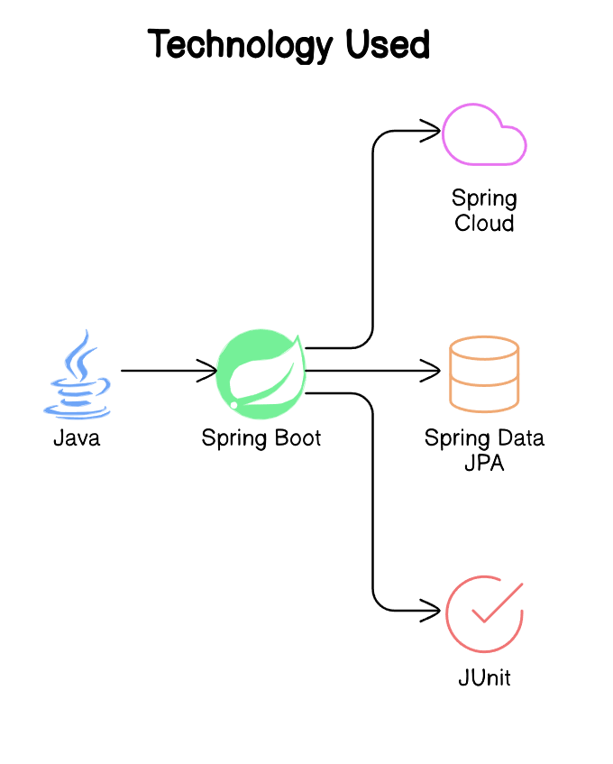

Slide 5
Problem Statement
The main objective of this project is to develop an Employee Management System that meets the following
requirements:
For Admins:
Admins need a centralized system to manage employees, departments, and roles effectively. They should be able to add, update, delete, and view employee details, organize employees into departments, assign roles, manage tasks, and evaluate performance.
For Employees:
Employees should be able to manage their profiles, view assigned tasks, update task statuses, and track their performance. They should also have access to feedback and performance evaluations from their managers.

Slide 6
Microservices Architecture
Microservices are an architectural style that structures an application as a collection of small, autonomous services modeled around a business domain. This approach helps in building scalable and flexible applications. Each microservice is responsible for a specific piece of functionality and communicates with other services via APIs.
A. Service Registry & Discovery
Eureka Server:
Eureka is a service registry that allows microservices to register themselves at runtime. This enables each service to discover the location of other services, making the communication dynamic and scalable.
Role: Eureka acts as a lookup service where each microservice registers, and other services can discover and communicate with them using the information provided by Eureka.
B. API Gateway
Spring Cloud Gateway:
The API Gateway serves as a single entry point for all client requests. It routes requests to the appropriate backend services based on the routing configuration.
Functions: Apart from routing, the gateway can handle cross-cutting concerns such as authentication, logging, rate limiting, and request validation.

Slide 7
C. Authentication Service
User Authentication & Authorization:
This service handles the authentication and authorization processes. It manages user registration and login and generates JWT (JSON Web Token) for secure communication.
Role Management: It distinguishes between different types of users (Admin and Employee) and restricts access to specific functionalities based on their roles.
D. Employee Management Microservice
Employee Directory:
This microservice is responsible for managing employee-related data. It provides APIs to create, read, update, and delete (CRUD) employee records.
Functionality: It handles storing personal information, job roles, and department assignments. It also allows for the management of employee roles within the organization.
E. Department Management Microservice
Department Catalog:
This service manages department-related information within the organization.
APIs: It provides endpoints for creating, updating, deleting, and retrieving departments. It also organizes employees within specific departments and manages department-specific data.

Slide 8
F. Task Management Microservice
Task Assignment:
This microservice handles the creation and assignment of tasks to employees.
APIs: It provides functionalities to create tasks, update task details, track progress, and mark tasks as complete. It is crucial for managing work distribution and tracking employee workload.
G. Performance Management Microservice
Employee Performance Tracking:
This service is designed to track and evaluate the performance of employees based on their task completion and other metrics.
APIs: It offers features for performance reviews, providing feedback, and generating evaluation reports. These reports can be used by Admins to make informed decisions about promotions, training, or other HR-related activities.

Slide 9
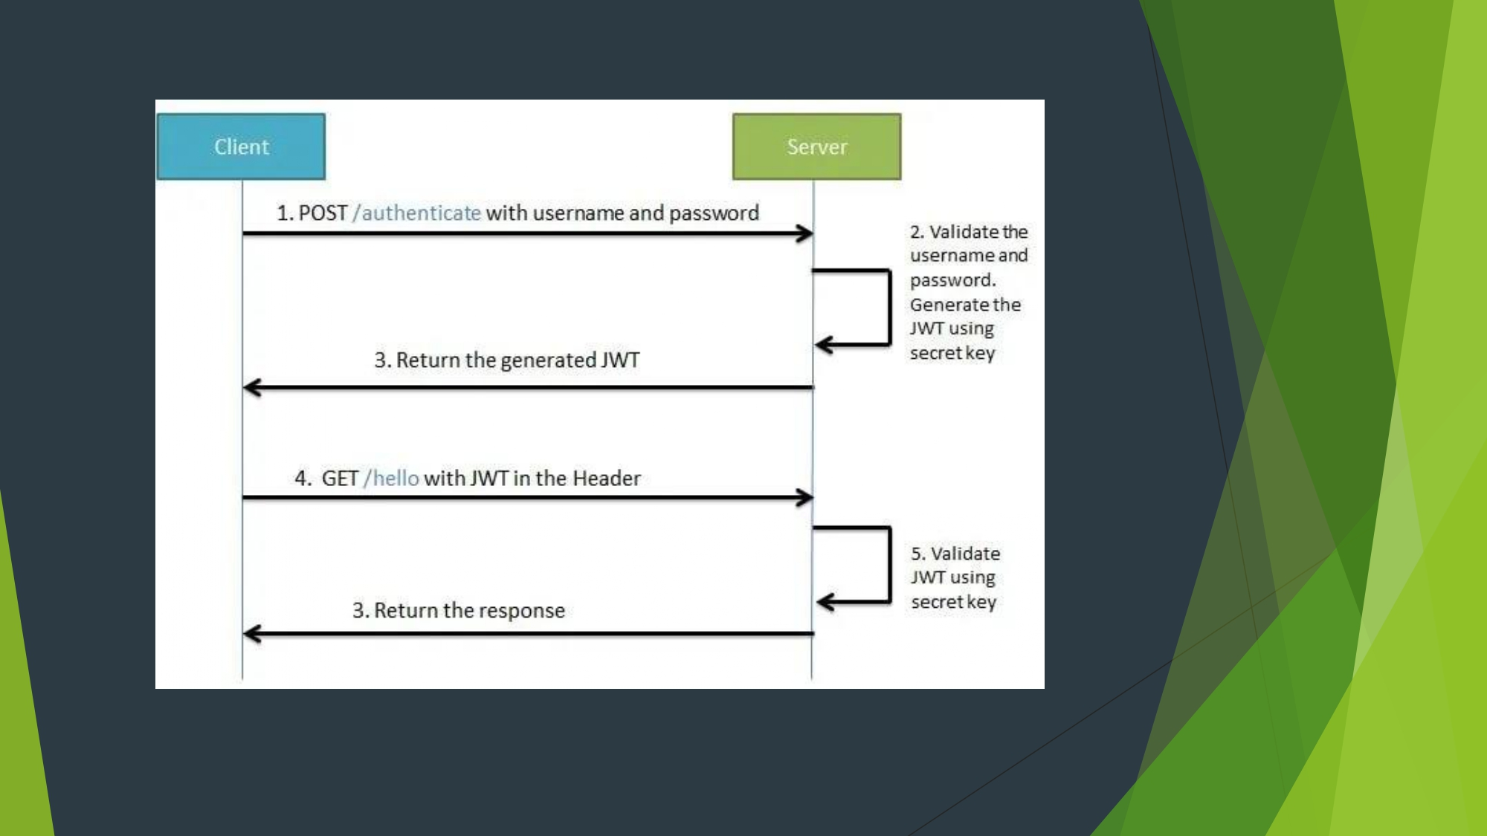
Fig: Client-Sever Connection

Slide 10
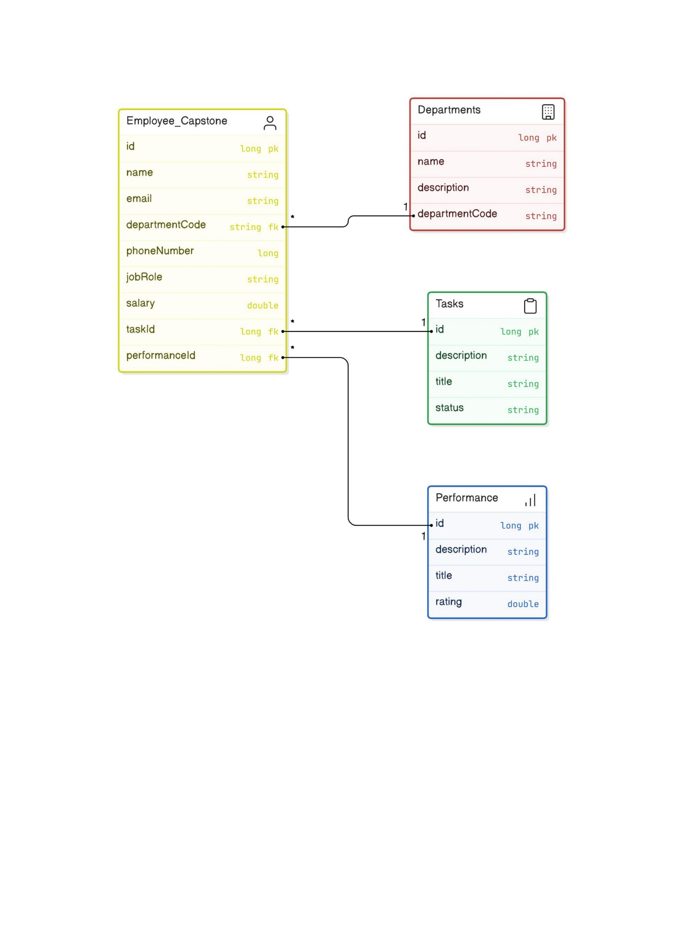
Flowchart of EMS

Slide 11
Project Flow
Admin Module
Admin Dashboard:
The dashboard acts as a centralized interface for Admins to manage various aspects of the organization.
Features: Admins can view analytics and reports on employee performance, departmental efficiency, and other key metrics.
Employee Management:
Admins can perform CRUD operations on employees, which include adding new employees, updating existing employee details, and deleting employees when necessary.
Role and Department Assignment: Admins can assign roles to employees and organize them into relevant departments.
Department Management:
Admins can manage departments by creating, viewing, editing, or deleting department records.
Employee Assignment: Manage which employees belong to which departments.

Slide 12
Task Management:
Admins can create and assign tasks to employees, monitor their progress, and update the status of tasks.
Task Monitoring: Helps track the completion rate and deadlines of tasks assigned to employees.
Performance Management:
Admins can track employee performance through various metrics, conduct performance reviews, and provide feedback.
Evaluation Reports: Generate reports based on the collected performance data, which can be used for employee development.
Employee Module
Employee Registration & Authentication:
Employees can register and log in using their credentials. The authentication service secures API access using JWT tokens.
Security:
Ensures that only authenticated users can access specific parts of the system.

Slide 13
Profile Management:
Employees can view and update their personal profiles, which include contact information, roles, and department details.
Access to Information: View their assigned roles and departments.
Task Management:
Employees can view tasks assigned to them and update the status of these tasks as they progress.
Task Tracking: Employees can track their progress and manage their workload effectively.
Performance Tracking:
Employees can view metrics related to their performance and receive feedback.
Performance Reviews: Participate in performance reviews and track their career development and goals.

Slide 14
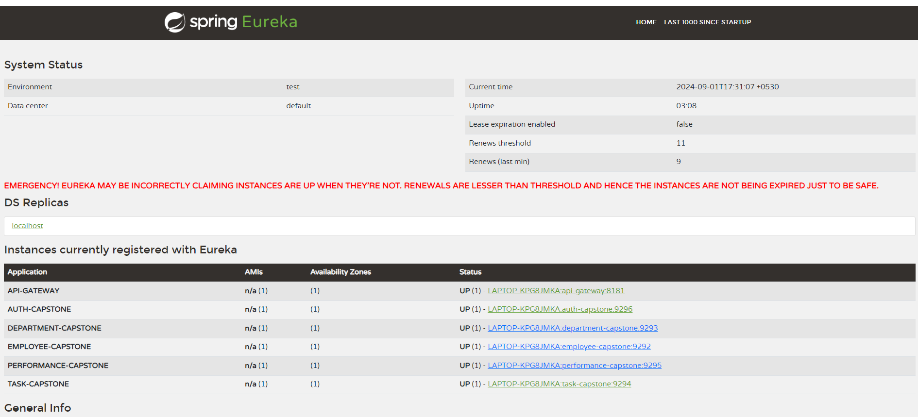
Fig: Spring Eureka

Slide 15
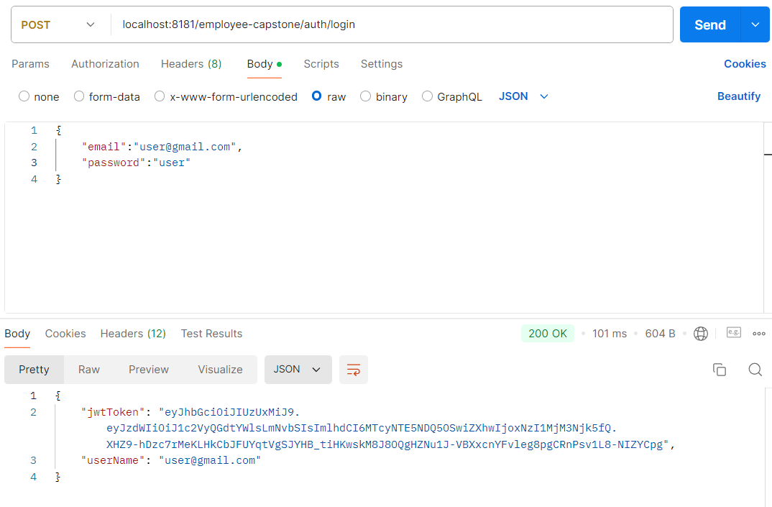
Fig. Authentication

Slide 16
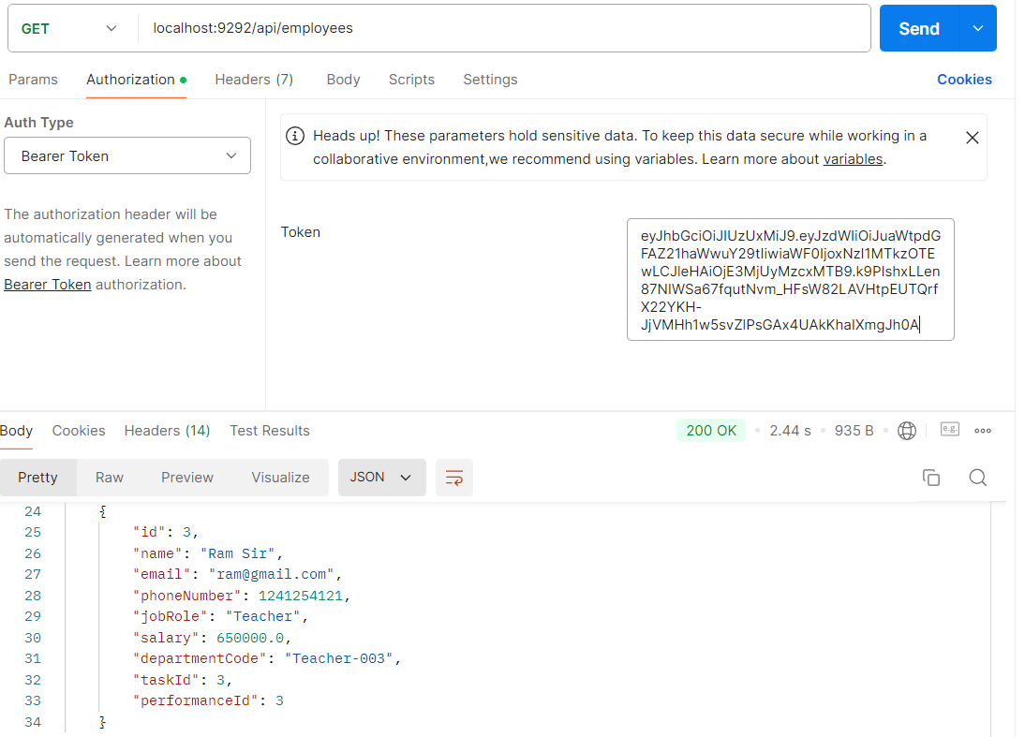
Fig. With token we are fetching employee data

Slide 17
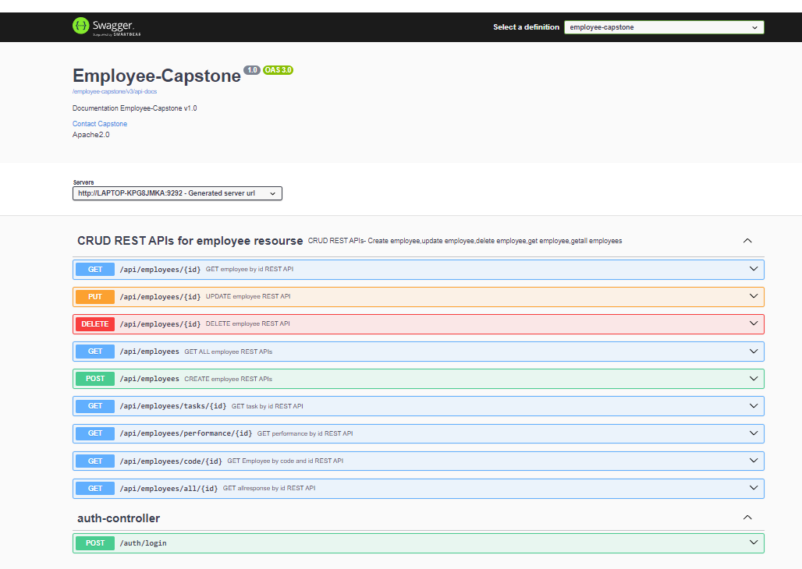
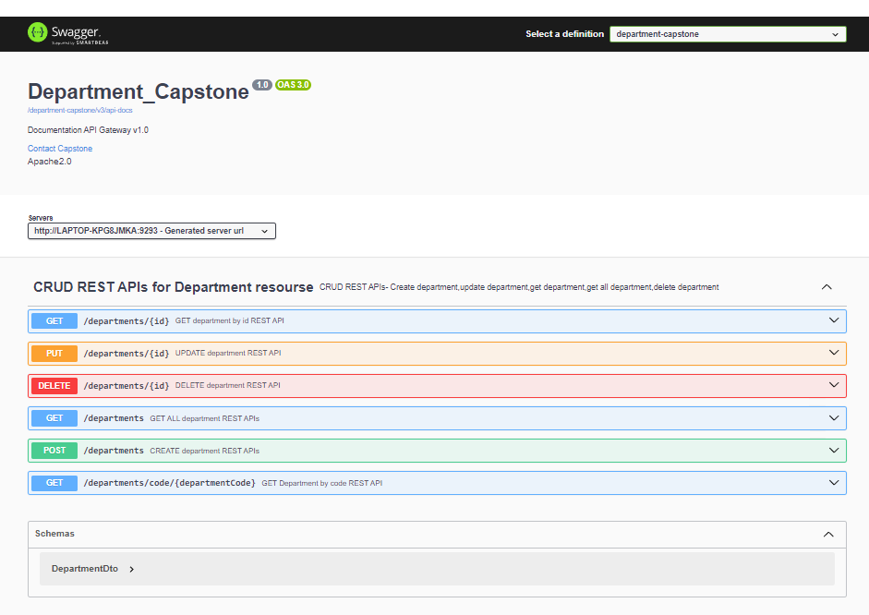
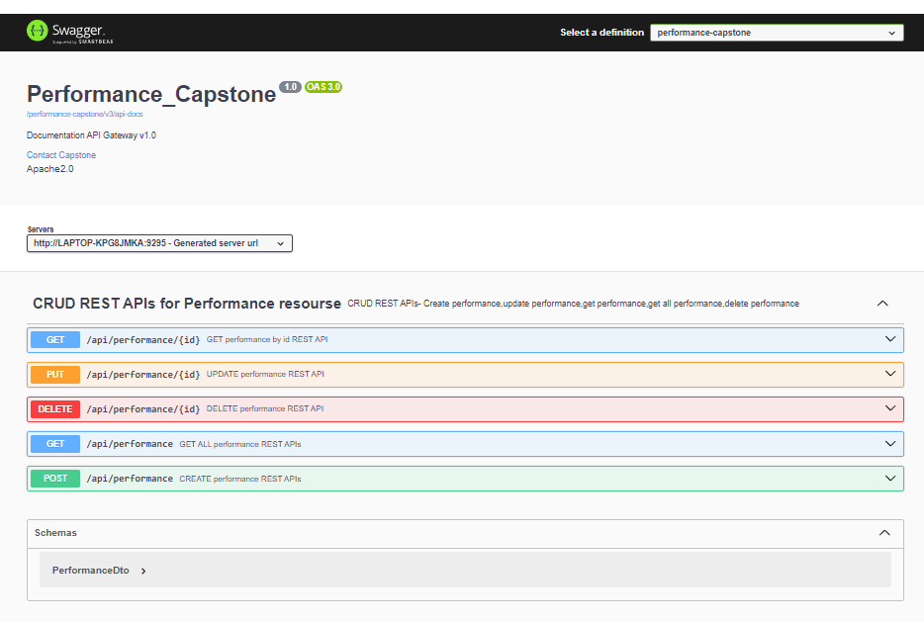
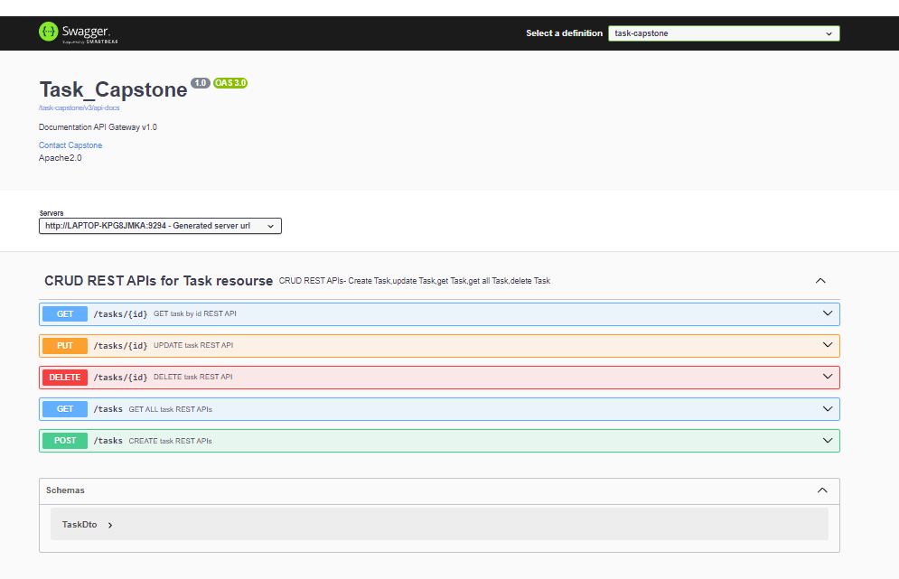
Fig:Swagger

Slide 18
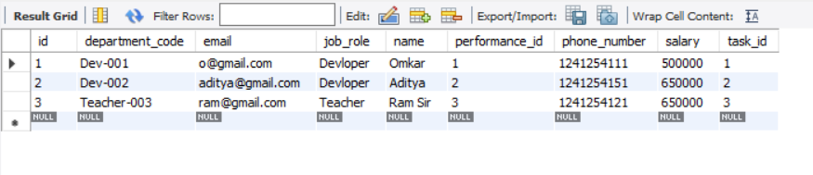
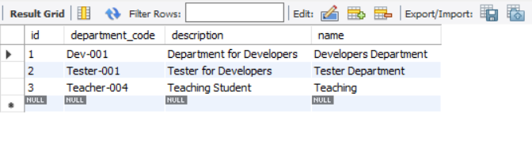
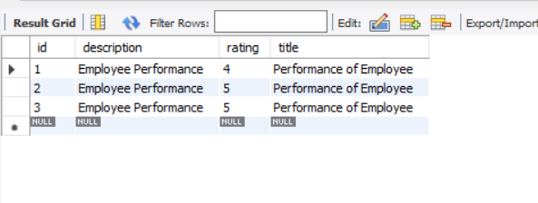
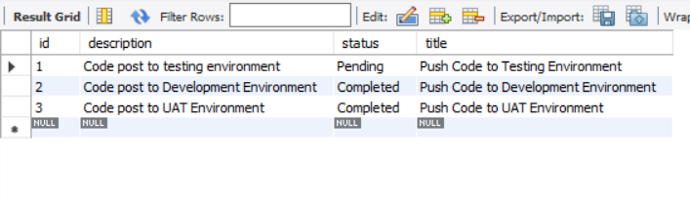
Fig: MySQL Workbench

Slide 19
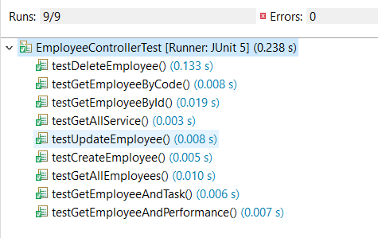
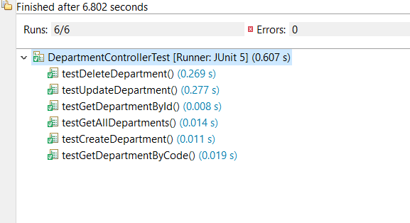
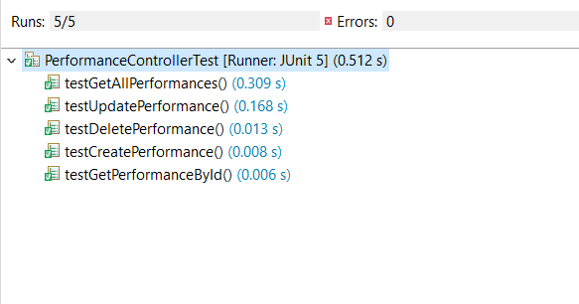
Testing and Refinement
Testing Approaches:
Unit Testing: Each microservice tested independently using JUnit and Mockito.

Slide 20
Conclusion
Summary:
The Employee Management System project effectively showcases the advantages of using a microservices architecture for scalability and modularity. By utilizing Java, Spring Boot, Spring Cloud, and MySQL/MariaDB, the system efficiently manages employees, departments, tasks, and performance evaluations. It provides secure access via JWT-based authentication, ensuring data integrity and confidentiality. This system lays a solid foundation for further enhancements, including advanced analytics, mobile integration, and machine learning, making it a robust solution for modern human resource management.
Future Enhancements:
Advanced Analytics: Integrate advanced analytics for deeper insights into employee performance and organizational efficiency.
Mobile Access: Develop mobile applications for enhanced accessibility and a better user experience.
Machine Learning: Implement predictive analytics to forecast employee performance trends.
HR System Integration: Connect with payroll, attendance, and other HR systems for comprehensive management.
Real-Time Notifications: Add real-time notifications for task updates and performance feedback.

Slide 21
THANK YOU

