Slide 1
Kitchen Vision
AI-Powered Pantry Analysis & Smart Recipe Recommendation
Team ID: SWTID-2026-4116
Team Members: Bhavatharani B, Keerthika R, Srinidhi S, Logeshwari R

Slide 2
Project Introduction
• AI-based kitchen assistant
• Analyzes pantry images
• Detects food ingredients
• Suggests recipes and cooking guidance

Slide 3
Main Features
• Pantry image upload
• Ingredient detection
• Storage categorization
• Recipe generation
• Grocery list creation

Slide 4
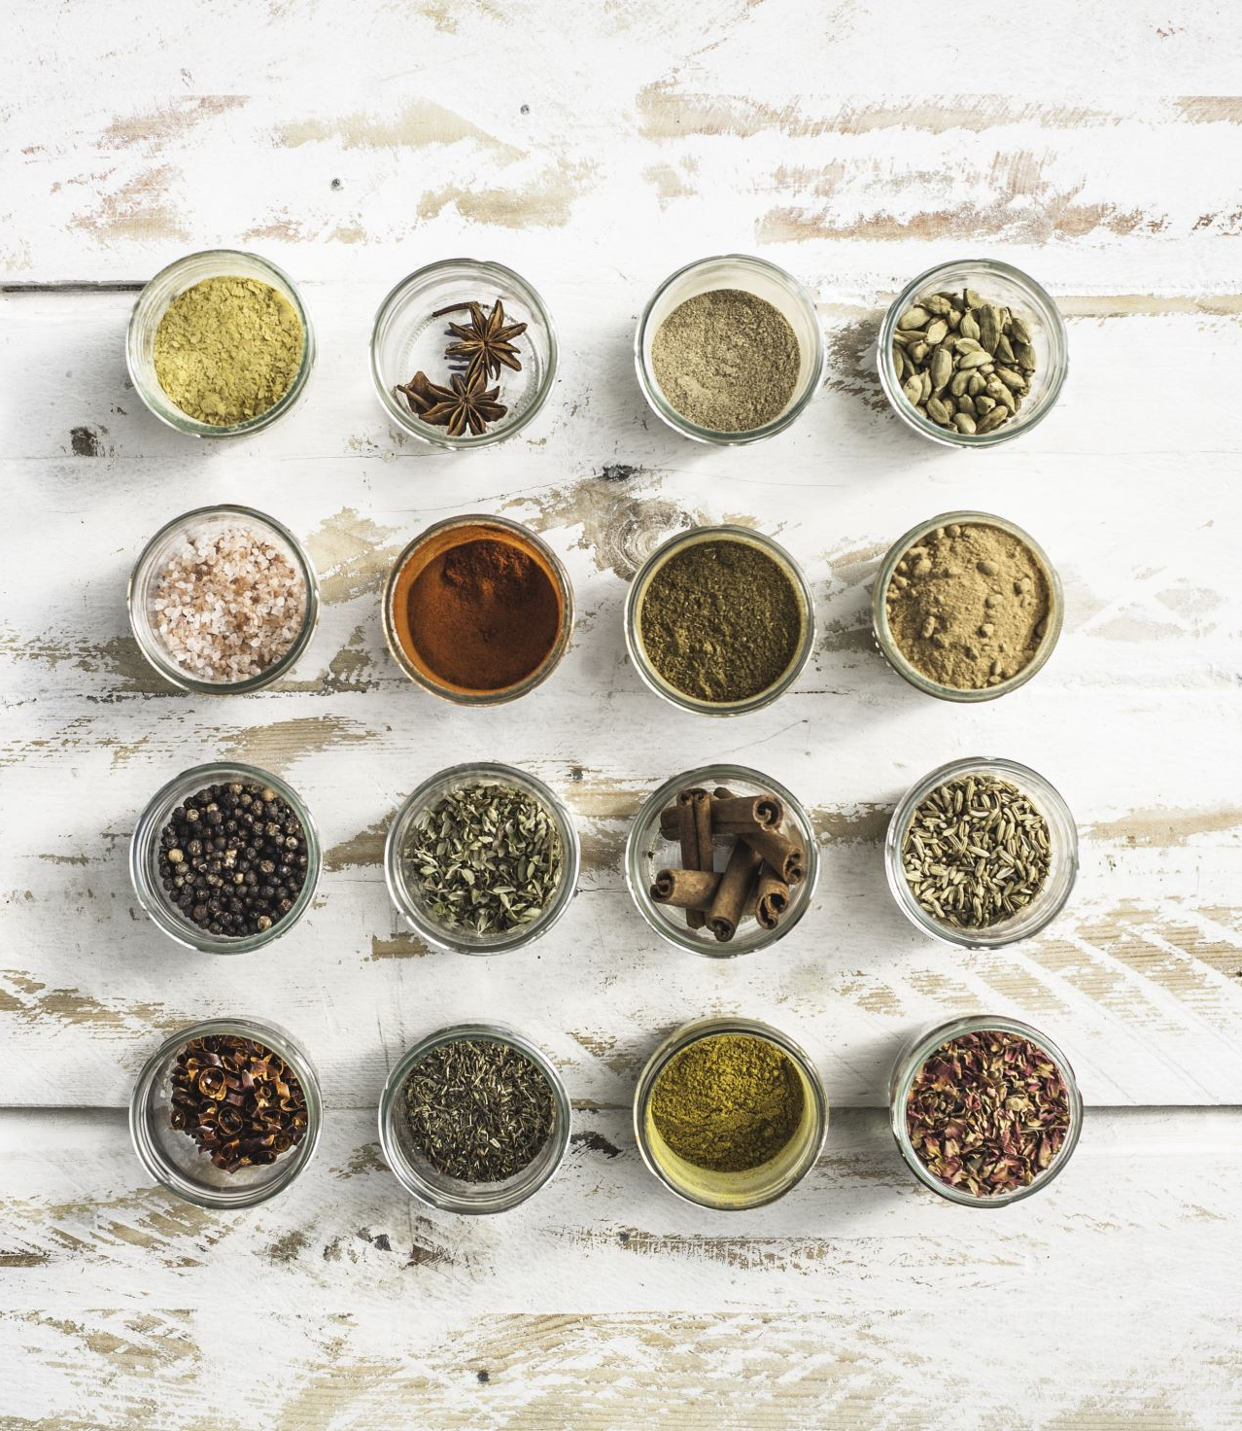
System Workflow
1. Upload pantry image
2. Image preprocessing
3. AI detects ingredients
4. Categorize storage types
5. Generate recipes & grocery list

Slide 5
Core Components
• Vision Service (item detection)
• Image Processing Module
• Recipe Generation Service
• Health Evaluation Service
• Substitution Service

Slide 6
Technologies Used
• Python
• Streamlit
• Pillow (PIL)
• Gemini / OpenAI Vision
• Docker

Slide 7
System Output
• Detected pantry items
• Storage categories
• 3-step recipes
• Health score (1–10)
• Grocery list & substitutions

Slide 8
Testing & Benefits
• Tested with different pantry images
• Accurate ingredient detection
• Easy-to-follow recipes
• Reduces food waste
• Saves cooking time

Slide 9
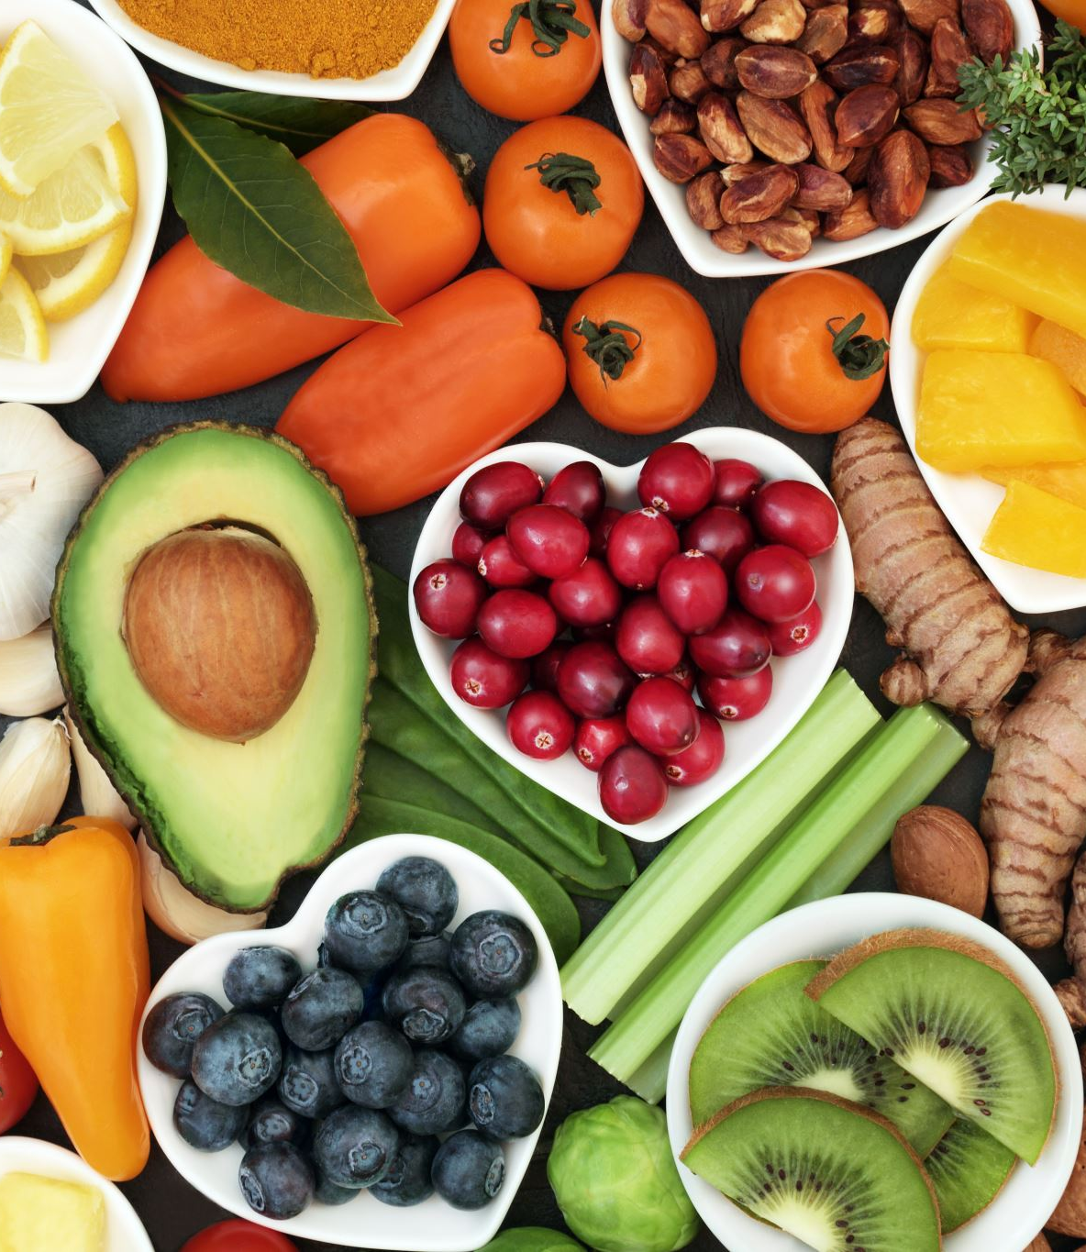
Conclusion
Kitchen Vision helps users cook smarter by
analyzing pantry items and suggesting
simple, healthy recipes using AI.

