Slide 1
Employee Data Analysis using Excel
STUDENT NAME: Bhavatharani. K
REGISTER NO: 312208374 (asunm1330312208374)
DEPARTMENT: B. com (Accounting and Finance)
COLLEGE : Chellammal Women’s College

Slide 2
PROJECT TITLE
Employee Performance Analysis using Excel

Slide 3


AGENDA
Problem Statement
Project Overview
End Users
Our Solution and Proposition
Dataset Description
Modelling Approach
Results and Discussion
Conclusion
3/21/2024 Annual Review

Slide 4

PROBLEM STATEMENT
Organizations are continually seeking ways to enhance productivity, improve employee satisfaction, and align individual performance with corporate goals. Effective performance analysis is crucial for identifying strengths, addressing weaknesses, and facilitating professional growth.
Problem Description:
Performance assessments are subjective and vary significantly across different departments or managers, causing discrepancies in performance ratings.

Slide 5

PROJECT OVERVIEW
Performance evaluations allow an employer to set clear expectations, evaluate employee performance and measure the employee’s success.
The information gathered in an overall performance evaluation can help drive decisions about pay raises, promotions, and layoffs.
Often, performance reviews include the manager’s evaluation of the employee’s overall performance and a self-evaluation conducted by the employee about their own evaluation of their success. A proper assessment is judged against specific goals using clearly defined metrics.
The performance of employees determines every company’s success. Therefore, this presentation analyzes the performance evaluation process in detail.

Slide 6
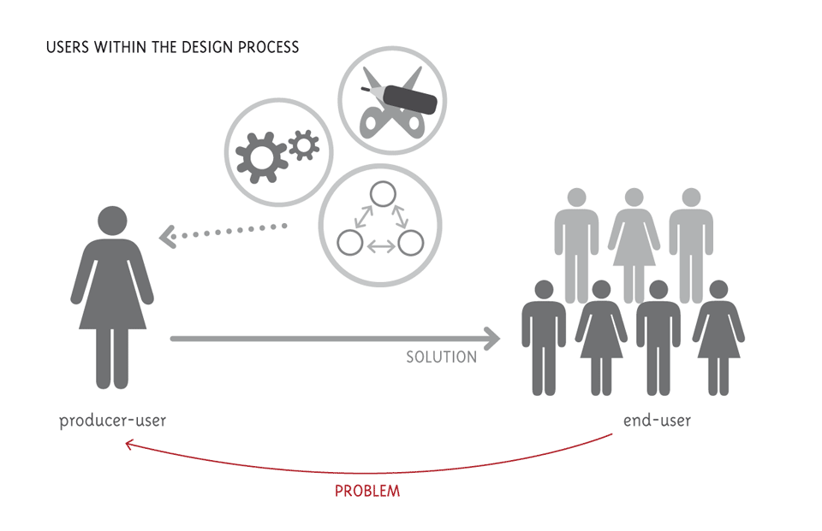

WHO ARE THE END USERS?
The Employee Performance Review Template Excel can be used by managers and human resources professionals to streamline the performance review process. The template includes a variety of customizable fields, allowing users to tailor the template to their specific needs.
Performance tracking in business is the observation and evaluation of significant e-commerce indicators and events with the goal of assessing the performance of the organization.

Slide 7

OUR SOLUTION AND ITS VALUE PROPOSITION
The enhanced performance analysis system will provide accurate, consistent, and actionable insights, leading to improved employee development, better decision-making, and a more productive and engaged workforce.
Conditional Formatting
Filter-Identify and remove duplicate entries to ensure data accuracy. Address missing data through imputation or exclusion, depending on the context.
Formula- [=IFS(Z8>=5,"VERY HIGH",Z8>=4,"HIGH",Z8>=3,"MED",TRUE,"LOW")]
Pivot- [Filters – GenderCode, Column – Performance Category, ROW – BusinessUnit, Values – Count Of EmpID]
Graph-Data Visualization

Slide 8
Dataset Description
The employee performance dataset typically includes a range of data points related to various aspects of employee performance and attributes. Here are some common components you might find in the dataset:
Employee Information:
Employee ID: A unique identifier for each employee.
Name: Employee's name
Department: The department or team where the employee works.
Position: Job title or role within the organization.
Performance Metrics:
Performance Ratings: Scores or ratings given by supervisors or through self-assessments, often categorized by performance periods.

Slide 9

THE "WOW" IN OUR SOLUTION
Data collection is a crucial step in an "Employee Performance Analysis" project, as it forms the foundation for accurate analysis and actionable insights.
Dynamic Visualizations:
Engaging Charts: Utilize advanced visualizations like trend lines, and scatter plots to make complex data more accessible and understandable.
Evaluate Results: Assess the outcomes of the implemented changes and their impact on performance.
3/21/2024 Annual Review
9

Slide 10
MODELLING
Modeling for an "Employee Performance Analysis Project" involves defining clear objectives, collecting and preparing data, employing various analytical approaches, and deriving actionable insights. Effective implementation and continuous monitoring ensure that the analysis leads to meaningful improvements in employee performance and alignment with organizational goals.
Data Collection
Quantitative Data: Performance metrics such as sales numbers, project completion rates, error rates.
Data Preparation
Cleaning :Address missing values, outliers, and inconsistencies in the data.
Integration : Combine data from different sources to create a comprehensive dataset.
Modeling Approaches
Predictive Analytics:
Classification Models: Implement classification algorithms to categorize employees into performance tiers (e.g., high, medium, low).
Visualization and Reporting
Charts and Graphs :Used visualizations such as bar charts and line graphs, represent data effectively.
10

Slide 11
RESULTS
The results of the "Employee Performance Analysis" project provide a comprehensive view of how employees are performing relative to expectations, identify areas for improvement, and offer actionable insights to enhance overall performance. This data-driven approach helps organizations make informed decisions about talent management, development initiatives, and strategic planning.
Employee Performance Analysis – Excel
11

Slide 12
Conclusion
The analysis of employee performance has provided valuable insights into various aspects of our workforce's effectiveness and productivity. Key findings from the data reveal several significant trends and areas of interest:
Performance Trends:
Top Performers: A subset of employees consistently outperforms their peers, demonstrating exceptional skills and achieving or exceeding their goals. Their success often correlates with specific factors such as advanced training, higher engagement levels, or effective leadership.
Areas for Improvement: Certain employees and teams show potential for growth but face challenges in meeting performance targets. Factors contributing to this include skill gaps, lack of resources, or unclear objectives.

