Slide 1

Bluestock Fintech Mutual Fund Analytics Platform
Capstone Project - Data Analytics
Presented By : Bhavesh Bansode
Intern, Bluestock Fintech

Slide 2
Problem Statement & Objectives
Problem :
Investors struggle to evaluate mutual fund performance.
Fund comparison requires analyzing multiple metrics.
Lack of centralized analytics and visualization.
Objectives :
Build ETL pipeline.
Create analytics database.
Perform fund performance analysis.
Build interactive dashboards.
Develop forecasting and recommendation capabilities

Slide 3
Data Sources
Sl No. | Table Name | Table Details | Rows
01 | Fund Master Data | Master list of 40 real mutual fund schemes (AMFI codes, fund house, category, expense ratio, risk grade, fund manager) | 40
02 | NAV History | Daily NAV for all 40 schemes from Jan 2022 to May 2026, anchored to real AMFI NAV values from mfapi.in | ~46000
03 | AUM by Fund House | Quarterly AUM (in Rs. crore) for 10 fund houses from 2022 to 2025, sourced from real AMFI quarterly reports | ~90
04 | Monthly SIP Inflows | Month-wise SIP inflow (Rs. crore), active SIP accounts, new registrations and SIP AUM — real AMFI Monthly Note data | 48
05 | Category Inflows | Net inflows by fund category (Large Cap, Mid Cap, Small Cap, ELSS, Liquid, etc.) for FY 2024-25 | ~144
06 | Industry Folio Count | Total mutual fund folios (in crore) broken by Equity, Debt, Hybrid — real AMFI published milestones | 21
07 | Scheme Performance | 1yr/3yr/5yr returns, Sharpe, Sortino, Alpha, Beta, Max Drawdown, Std Dev — computed from NAV history | 40
08 | Investor Transactions | Simulated SIP + Lumpsum + Redemption transactions for 5,000 investors across Indian states with demographics | ~32000
09 | Portfolio Holdings | Top equity holdings (stock, weight %, sector) for equity mutual funds as of Dec 2025 | ~320
10 | Benchmark Indices | Daily closing values for Nifty 50, Nifty 100, Nifty Midcap 150, BSE SmallCap, CRISIL Liquid & Gilt indices | ~8000

Slide 4
Architecture Diagram
DAY 1 — Project Setup + Data Ingestion (ETL)
DAY 2 — Data Cleaning + SQL Database Design
DAY 3 — Exploratory Data Analysis (EDA)
DAY 4 — Fund Performance Analytics
DAY 5 — Dashboard Development (Power BI / Tableau)
DAY 6 — Advanced Analytics + Risk Metrics
Raw Data
Data Cleaning
Exploratory Data Analysis
SQLite Database
Performance Analytics
Power BI Dashboard
Streamlit Dashboard

Slide 5
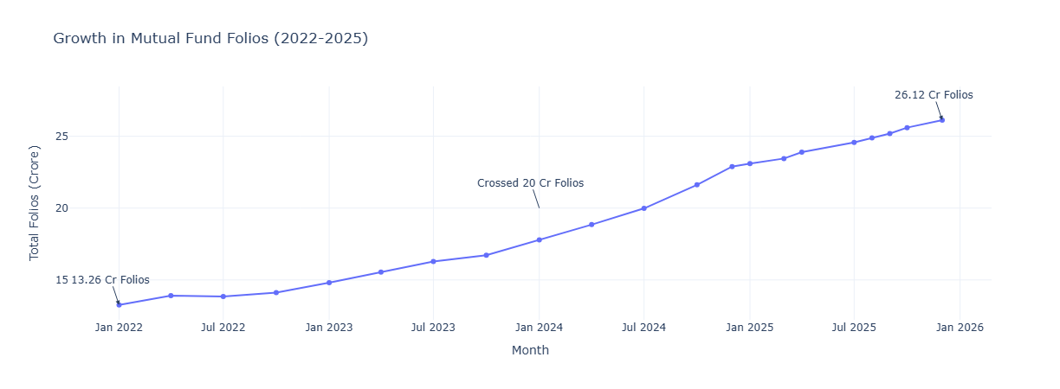
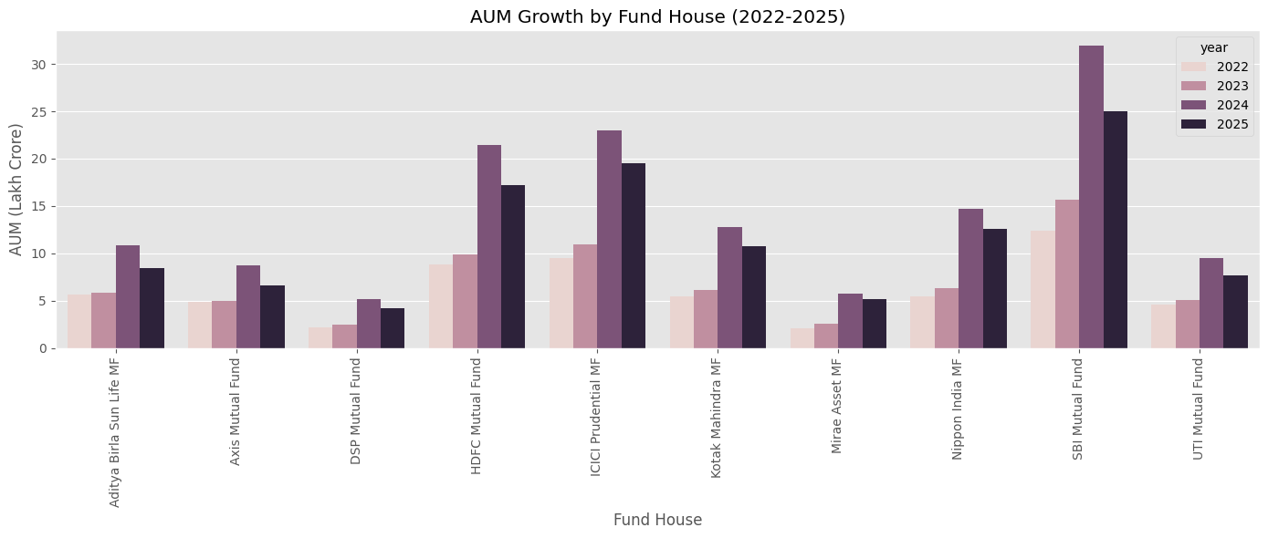
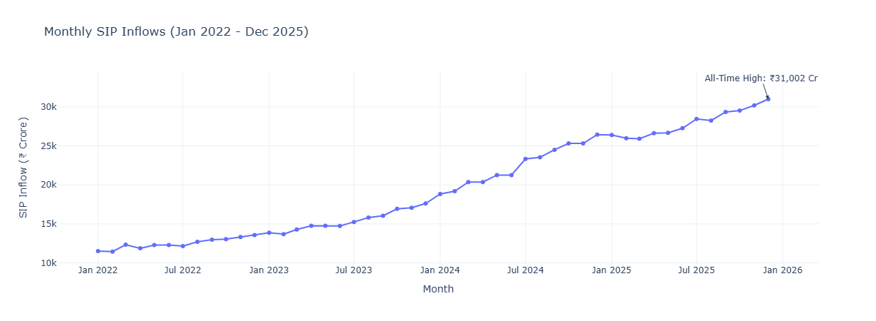
EDA Highlights
Key observations
SIP inflows increased steadily.
Industry AUM expanded significantly.
Investor participation doubled.
5

Slide 6
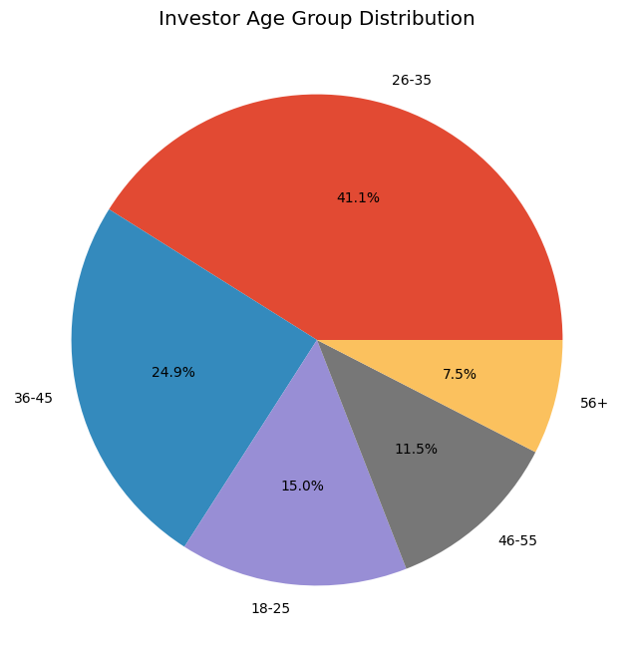
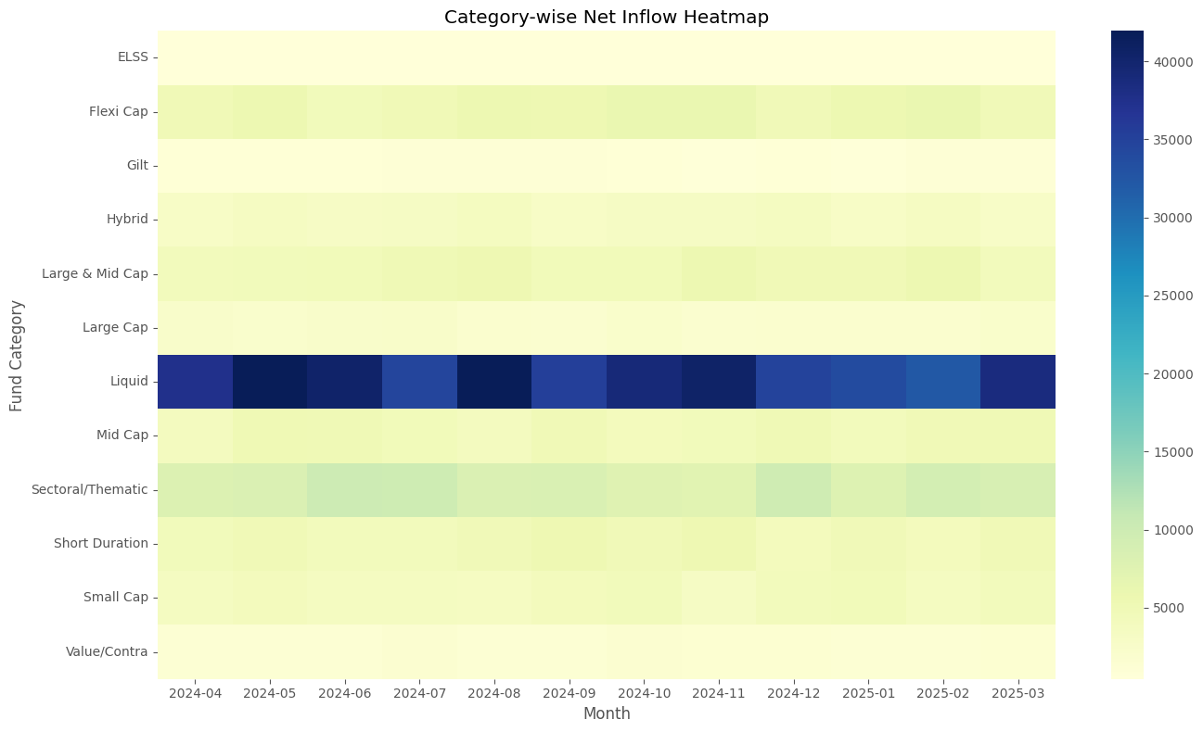
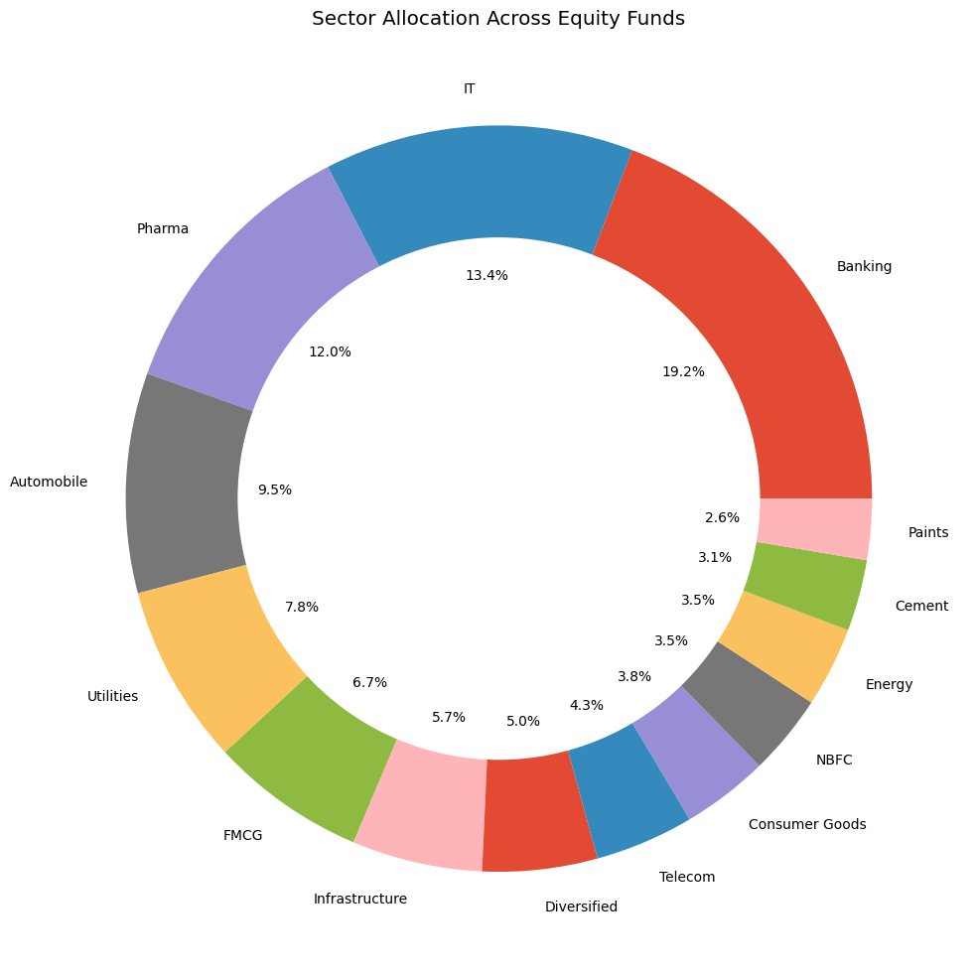
EDA Highlights Contd.
Observations:
Equity categories attracted most inflows.
Sector allocations were concentrated in key industries.
Younger investors contributed significantly.
6

Slide 7
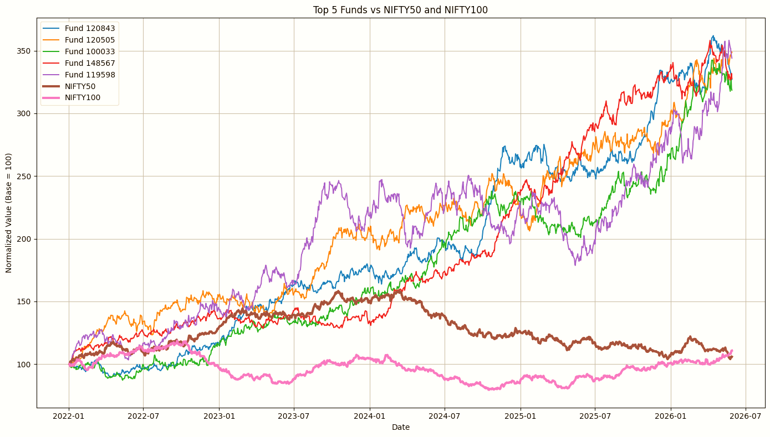
Performance Analytics
amfi_code | sharpe_ratio | sharpe_rank
148567 | 1.448291 | 1
120843 | 1.306744 | 2
148569 | 1.23493 | 3
119551 | 1.208267 | 4
120505 | 1.180101 | 5
amfi_code | alpha | beta
100016 | 0.037476 | -0.05827
100025 | 0.042818 | 0.001158
100033 | 0.271954 | 0.005104
101206 | 0.213998 | 0.021086
101207 | 0.108971 | -0.06529
amfi_code | sortino_ratio | sortino_rank
148567 | 2.385644 | 1
120843 | 2.36432 | 2
148569 | 2.146914 | 3
119551 | 2.140267 | 4
120505 | 2.029353 | 5
amfi_code | cagr_1yr | cagr_3yr | cagr_5yr
100016 | 12.13357 | 3.891151 | 2.316843
100025 | 21.15523 | 6.605772 | 3.912653
100033 | 218.5142 | 47.13284 | 26.07407
101206 | 153.4562 | 36.34346 | 20.44273
7

Slide 8
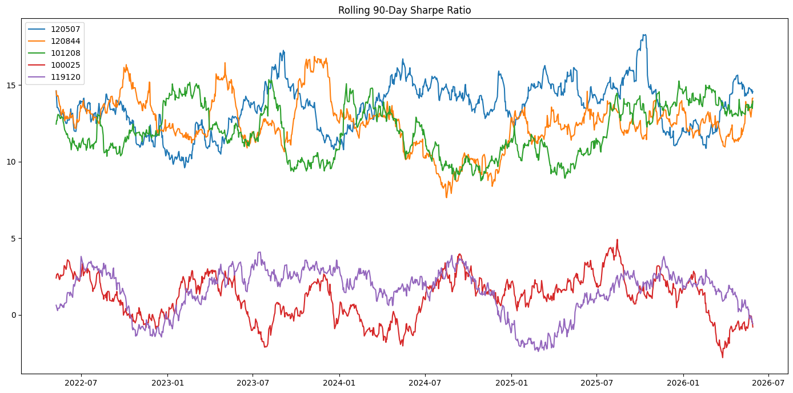
Advanced Analytics
amfi_code | VaR_95 | CVaR_95
100016 | -0.01436 | -0.01806
100025 | -0.00379 | -0.00499
100033 | -0.01903 | -0.02346
101206 | -0.01328 | -0.01744
101207 | -0.02602 | -0.03246
CAGR was used to measure long-term annualized fund growth.
Sharpe Ratio evaluated risk-adjusted returns across all schemes.
Sortino Ratio focused specifically on downside risk performance.
Alpha and Beta measured benchmark outperformance and market sensitivity.
Maximum Drawdown identified the worst historical decline for each fund.
Historical VaR and CVaR were calculated to assess downside risk exposure.
Rolling 90-Day Sharpe Ratio was used to track changing fund performance over time.
Investor Cohort Analysis identified investment patterns across different investor groups.
SIP Continuity Analysis detected investors at risk of discontinuing their SIPs.
Sector concentration was measured using the Herfindahl-Hirschman Index (HHI).
8

Slide 9
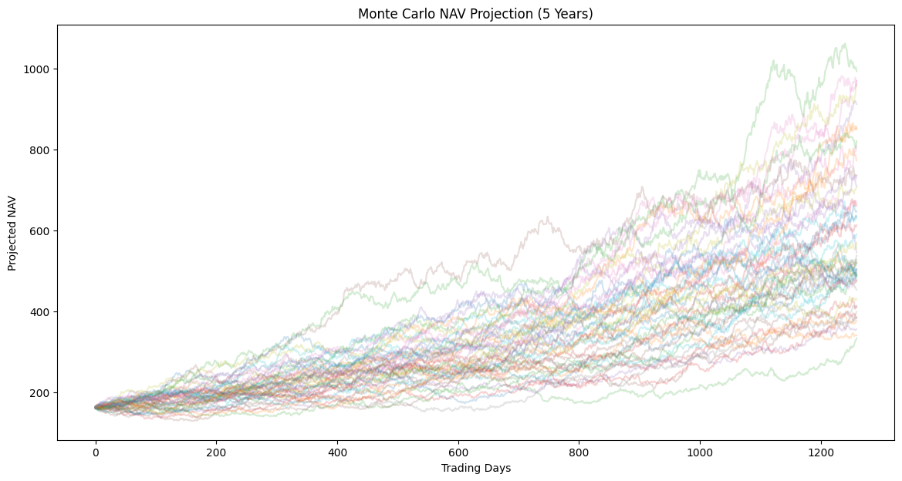
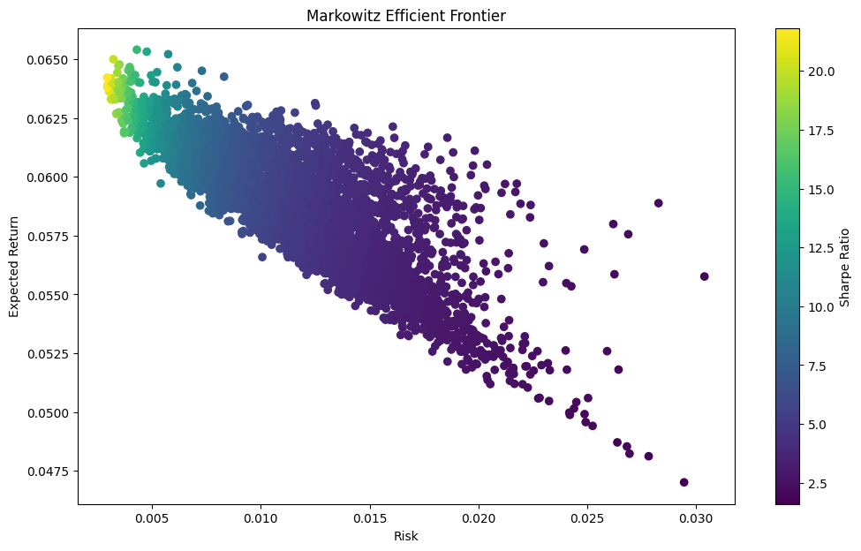
Monte Carlo & Portfolio Optimization
Monte Carlo Simulation & Portfolio Optimization
Simulated future NAV growth over 5 years using Monte Carlo methods.
Estimated expected, best-case, and worst-case investment outcomes.
Built a Markowitz Efficient Frontier to optimize portfolio risk and return.
Identified optimal portfolio allocations using Sharpe Ratio analysis.
Key Insight: Diversified portfolios achieved better risk-adjusted returns while simulations highlighted the impact of market uncertainty on future performance.

Slide 10
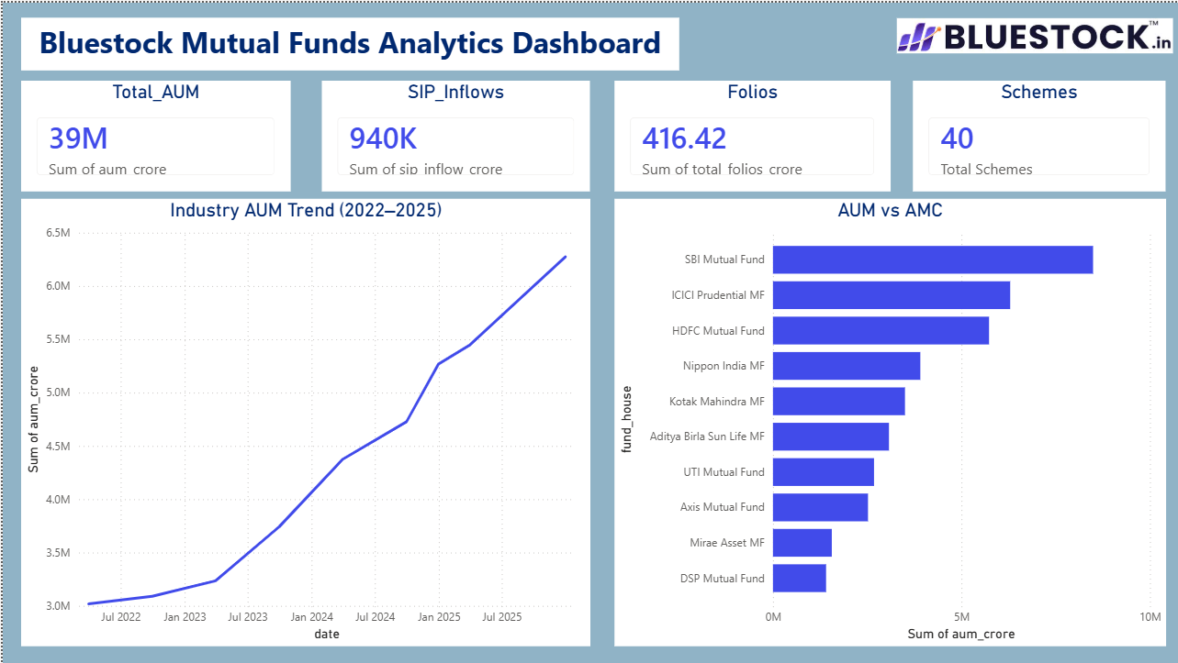
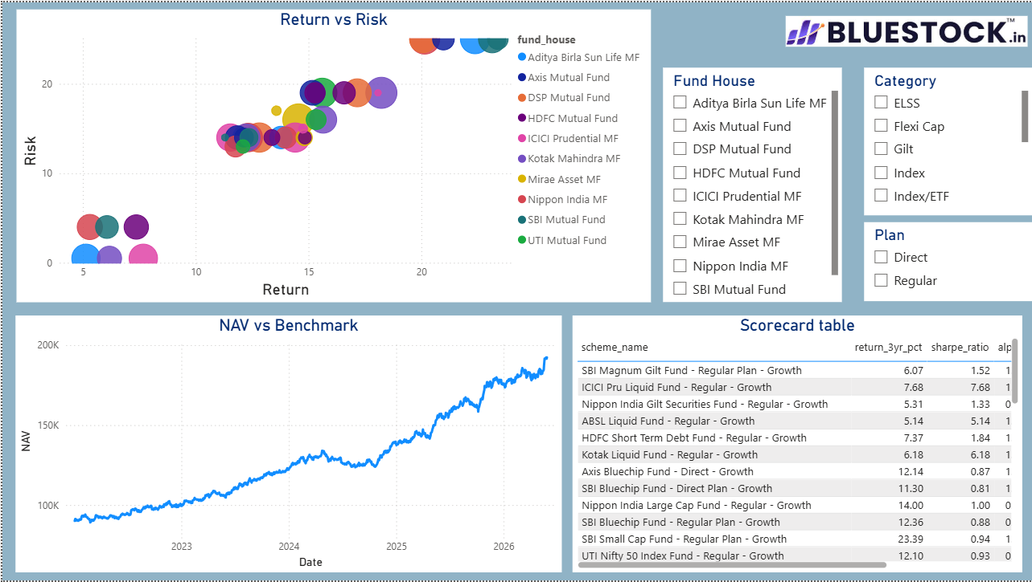
Dashboard Screenshots
Dashboard Features
Developed a 4-page interactive Power BI dashboard for mutual fund analytics.
Included Industry Overview, Fund Performance, Investor Analytics, and SIP & Market Trends.
Added filters, tooltips, and drill-through functionality for detailed exploration.
Applied company branding and visualization best practices for improved user experience.
Key Benefit
Enables stakeholders to monitor fund performance, investor behavior, and market trends through a centralized dashboard.

Slide 11
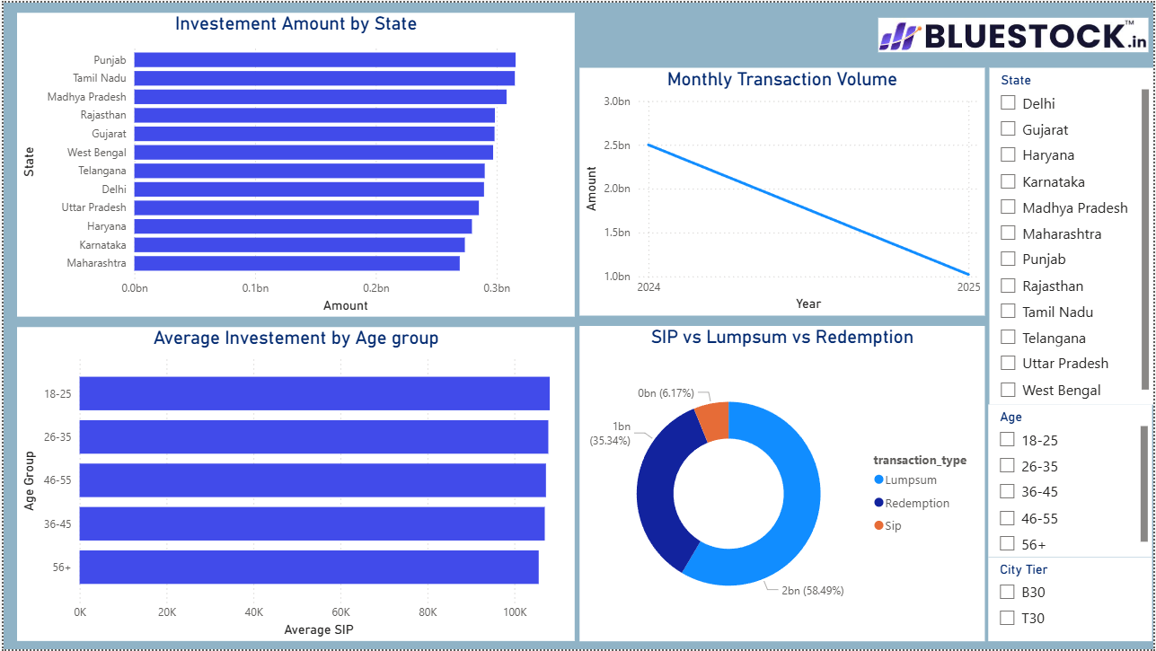
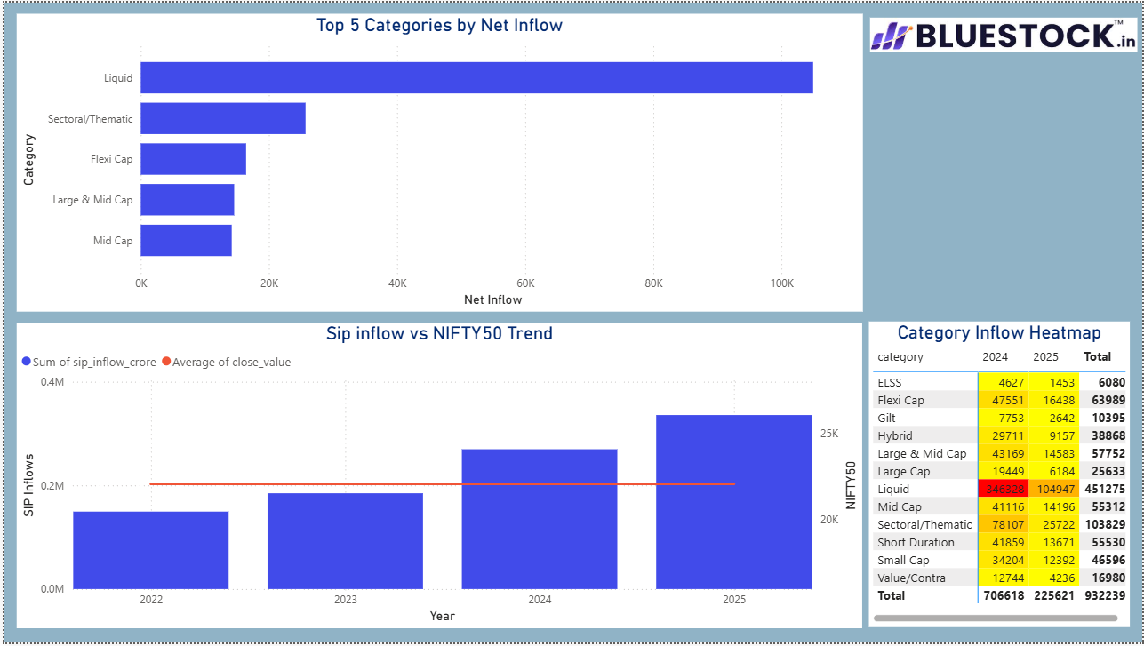
Dashboard Screenshots
Key findings:
Equity funds delivered strongest returns.
SIP participation continued to grow.
Risk-adjusted performance varied widely.
Diversification reduced drawdown risk.

Slide 12
Key Findings
Industry AUM and SIP inflows showed consistent growth, indicating increasing investor participation.
Equity-oriented funds delivered higher long-term returns but were associated with greater volatility.
Risk-adjusted performance varied significantly across funds, highlighting the importance of metrics such as Sharpe and Sortino Ratios.
Investor behaviour analysis revealed strong SIP continuity, with only a small proportion of investors identified as at-risk.
Diversified portfolios exhibited lower concentration risk and improved risk-return characteristics.
Monte Carlo simulations demonstrated the impact of market uncertainty on future NAV growth and investment outcomes.
Portfolio optimization identified efficient fund combinations that maximize returns for a given level of risk.
Conclusion
The project successfully transformed raw mutual fund data into actionable insights through ETL automation, advanced analytics, interactive dashboards, forecasting models, and portfolio optimization techniques.

Slide 13
Thank you
Bhavesh Bansode
bs23chb0a50@student.nitw.ac.in
Intern, Bluestock Fintech

