Slide 1
Architecture Design Document for Amazon Sales Data
Name – Bhavesh Kumar Thakur
Date – 13 – 08 -2024

Slide 2
Introduction:
This document outlines the architecture for analyzing Amazon sales data using Power BI. The goal is to provide actionable insights into sales performance, profitability, and trends.

Slide 3
Scope:
The project covers the following aspects:
Extracting sales data from Website.
Transforming and cleaning the data
Loading it into Power bi for Analysis.
Creating Power BI reports and dashboards

Slide 4
Architecture Overview:
3.1 Data Sources
Amazon Sales Data: Raw data containing sales transactions, including columns such as Region, Country, Item Type, Sales Channel, Order Priority, Order Date, Order ID, Ship Date, Units Sold, Unit Price, Unit Cost, Total Revenue, Total Cost, and Total Profit.
ETL Processes
Extract:
Retrieve sales data from Website.
Transform:
Clean and preprocess the data (Correct Date Format & Data Types).
Create Columns Like Month , Year, DeliveryDays, Is Valid to filter the correct Ship Date .
Load:
Load the transformed data into Power bi.

Slide 5
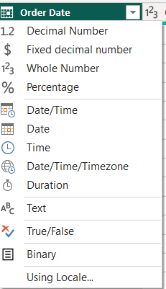
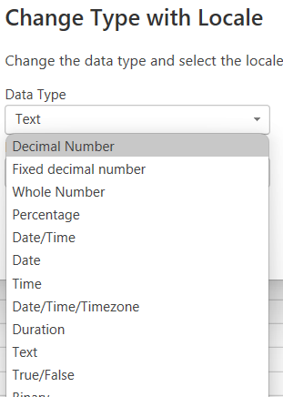
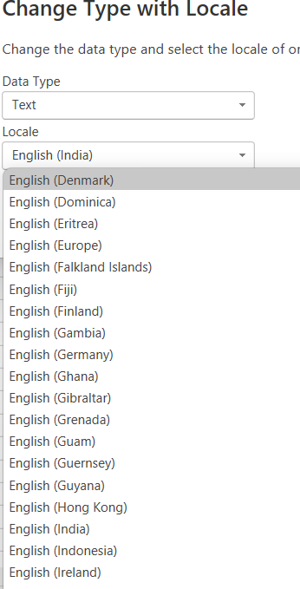
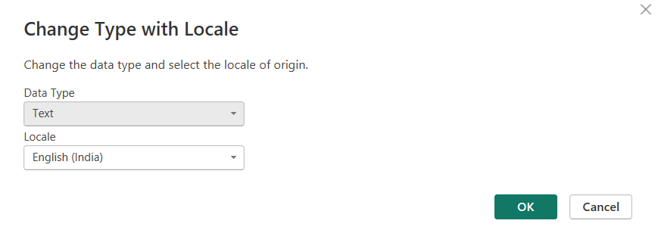
Steps to Format the Order Date:
Step 1. Click on Data type On the left Side of a column.
Step 2. Then click on Using Locale.
Step 3. In Data Type , Select Date.
Step 4. In Locale , Select the country as per your requirements.
Step 5. Click OK.

Slide 6
Power BI Components:
Power BI Service:
Publish reports and dashboards.
Configure data refresh schedules.
Set up user access.
Power BI Report Rendering Engine (Power BI Desktop):
Create visualizations (charts, Matrix) based on the data.
Use calculated columns and measures to derive insights.

Slide 7
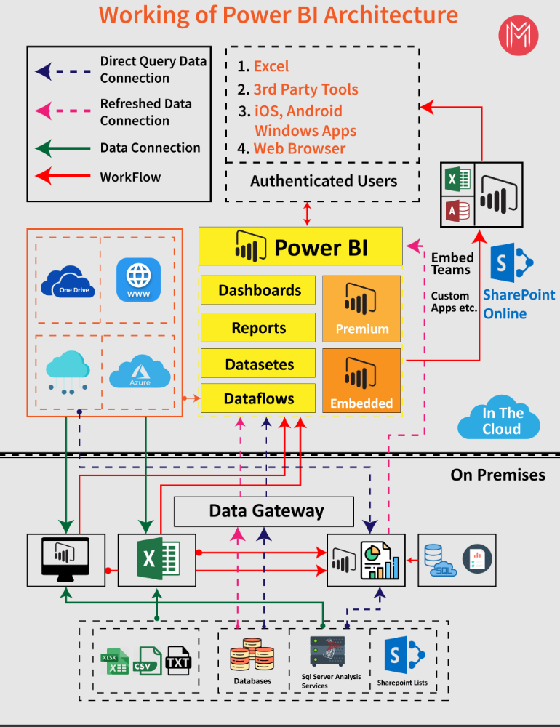
Power bi Communication Flow

