Slide 1
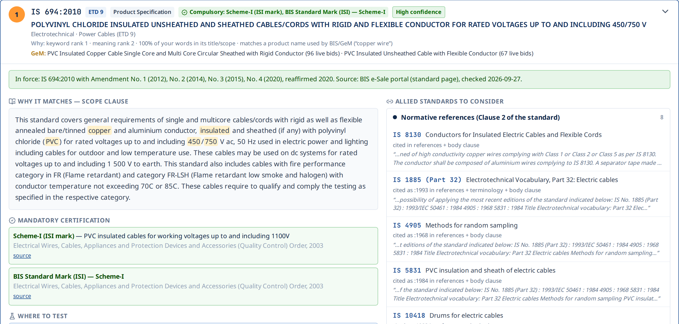
SMART INDIA HACKATHON 2026 · PS SIH26108 · MINISTRY OF CONSUMER AFFAIRS
SpecSure
The right Indian Standard for every procurement specification — with the edition in force, everything it depends on, the certification it needs and where to test it.
29,875
80,834
7 languages
Indian Standards
links read from their text
text · voice · read-aloud
Team CodeNova
Prototype — not an official Government of India system
Notes:
SpecSure answers the core question of PS SIH26108: which Indian Standards apply to what I am procuring — and it goes beyond search: edition in force, amendments, allied standards, compulsory certification, testing labs and a clause the officer can paste into the tender. The screenshot on the right is a real result for 'PVC insulated copper wire for house wiring, 450/750 V'.

Slide 2





Citing the right standard is still guesswork
What we found in 63 real public tenders and GeM bids (1,542 pages) and in the BIS catalogue
12 of 23
institutional tenders cite no Indian Standard at all
Officers know the product, not the IS number
Keyword search on titles fails for “GI pipe”, “सरिया”, “LED street light”.
A standard never travels alone
Each one pulls in test methods, terminology, sampling — easy to miss.
6,072
standards are withdrawn — yet 3 tenders still cite one
Editions, amendments, withdrawals change
Tenders quote superseded years; amendments go unnoticed.
Certification is a separate hunt
3,823
standards have a newer edition than the text usually circulated
ISI mark / CRS / hallmarking and the QCO must be looked up elsewhere.
English-only, no explanation
Buyers write in Indian languages; auditors need a reason trace.
SpecSure · SIH26108 · 2
Notes:
The problem statement is real and measurable. We ran our pipeline over 23 institutional tenders and 40 GeM bid documents. Half the institutional tenders cite no Indian Standard at all. BIS's own catalogue lists 6,072 withdrawn standards, and 3,823 standards have a newer edition than the archived text most people circulate. The five pain points on the right are exactly what the PS asks us to fix.

Slide 3




Describe it in any language — get the complete answer
One query or one uploaded tender returns seven things, each with its source and date
1
2
3
4
5
6
7
Describe
Recommend
Depends on
Edition in force
Certification
Where to test
Spec clause
text, voice, Hindi… or upload a tender / GeM bid
ranked IS with a confidence level — or an honest abstain
normative references, test methods — compliance tree
status, amendments, replacement if withdrawn
ISI mark / CRS with the Quality Control Order
BIS-recognised labs, charges, city
ready-to-paste, sourced, Word export
Works where officers already are: the same engine powers the web portal, a browser extension on GeM / CPPP pages, a REST API and an MCP server for AI assistants.
SpecSure · SIH26108 · 3
Notes:
This is the whole product in one line. Every step is backed by data — steps 4 to 6 use live BIS data we collected: the BIS catalogue, the BIS e-Sale portal and BIS LIMS for labs. The output is not a chat answer but a clause the officer can paste into the tender.

Slide 4



The knowledge base is the standards themselves
Six layers, each from an authoritative public source — not a hand-typed list
29,875
19,492
29,710
Full texts parsed
Status of every standard
Internet Archive (Public.Resource.Org, RTI) — scope, references, tests
BIS Know-Your-Standards: 21,291 active · 6,072 withdrawn · document type
Indian Standards across all BIS divisions — the largest public SIH26108 graph covers one division family.
29,607
828
Editions & amendments
Compulsory certification
80,834
BIS e-Sale portal editions · amendment lists for 1,138 key standards
BIS Scheme-I / II / X + hallmarking pages, with the QCO
typed links (references, 19,622 test methods, terminology, sampling…) — each with the clause and sentence it came from
821
482
GeM procurement layer
Testing labs
GeM categories that name their IS (3,794 live bids)
BIS LIMS: labs for 823 standards, charges & clauses
SpecSure · SIH26108 · 4
Notes:
This is our moat. Every other public SIH26108 project we surveyed has between 3 and about 2,500 standards, mostly typed by hand. We parsed the standards' own text into 80,834 relationships, then layered BIS's own catalogue for status and document type, the BIS e-Sale portal for editions and amendments, the compulsory-certification lists, GeM categories and BIS LIMS for testing labs. All fetched on 27 September 2026 and dated in every answer.

Slide 5


How it decides — evidence first, AI where it helps
Deterministic pipeline; every output line carries its source clause and the date it was checked
Input
Understand
Retrieve
Decide
Expand
Resolve
Output
text · voice · 7 languages · tender PDF (OCR) · GeM bid page
procurement glossary + loanword transliteration · item extraction from tenders
3-field BM25 (title · scope · product names) + bge-m3 multilingual embeddings, fused (RRF)
confidence from retriever agreement + coverage · abstain · withdrawn / title-only never ‘Recommended’
knowledge graph: normative refs, test methods, compliance tree (depth 1–4)
edition in force · amendments · replacement · QCO · labs & charges
result card · spec clause · Word · extension · REST / MCP API
Never invents a standard
Explains itself
Runs offline, on-prem
Every IS it shows exists in the BIS catalogue; vague or service requests get no recommendation (91 %).
Scope clause highlighted, keyword/meaning ranks, coverage, source & check date on every line.
No paid LLM needed; an LLM is optional for translation polish and never decides.
SpecSure · SIH26108 · 5
Notes:
The pipeline is deterministic and auditable: retrieval combines keyword and multilingual semantic search; the decision step computes a confidence level and abstains when the retrievers disagree; withdrawn and title-only standards can never be 'Recommended'. The graph and the BIS data then add dependencies, editions, certification and labs. No step requires a paid AI service.

Slide 6

One query, one defensible answer
“PVC insulated copper wire for house wiring, 450/750 V” → IS 694
Why it matches
the standard’s own Scope clause, highlighted — plus keyword rank, meaning rank and coverage
In force today
IS 694:2010 with Amendments 1–4, reaffirmed 2020 — from the BIS portal, dated
Compulsory certification
ISI mark under the Electrical Wires & Cables QCO, 2003
Procurement reality
the GeM categories that buy against it (96 + 67 live bids)
Allied standards
IS 8130 conductors, IS 5831 PVC, IS 10810 test methods — each with its sentence
SpecSure · SIH26108 · 6
Notes:
A real result. IS 694 ranks first because its Scope clause matches; the Why line shows the retrieval signals. The green box is the edition status from the BIS portal with every amendment and the date we checked. Certification comes from BIS's compulsory-certification pages, and the GeM line shows how many live bids use this standard.

Slide 7
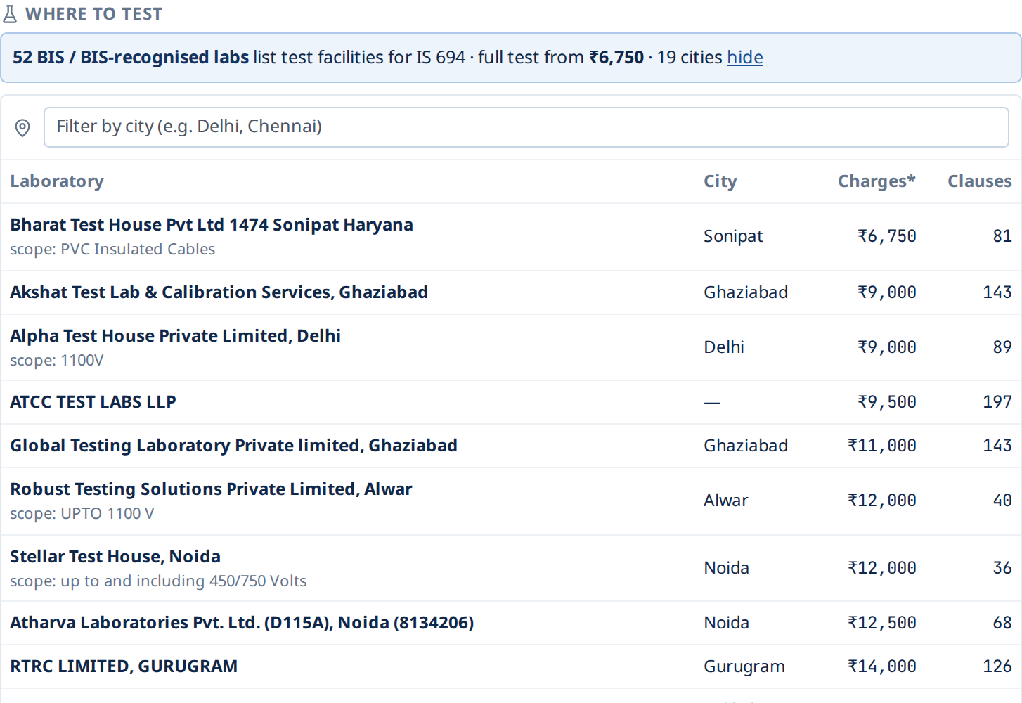
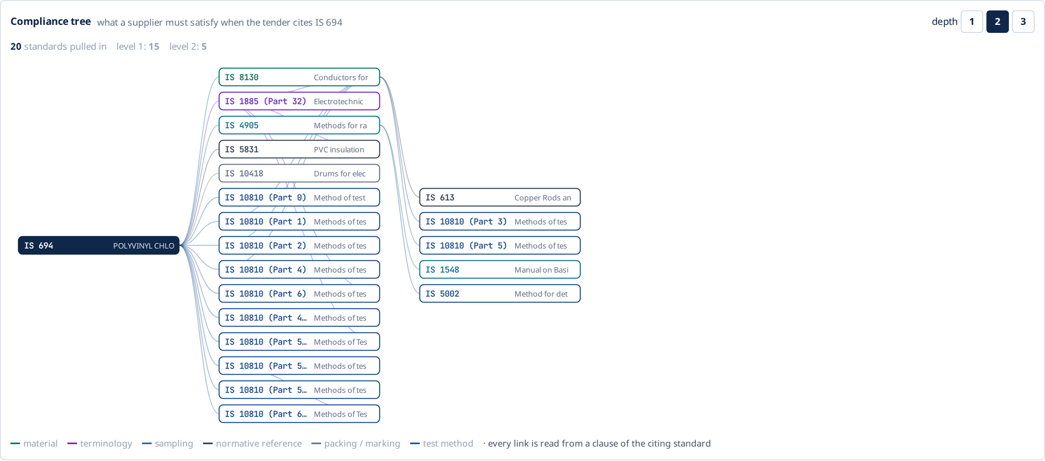
Everything the supplier must satisfy — and where to test it
Compliance tree from the standards’ own clauses · labs and charges from BIS LIMS
Compliance tree IS 694 → 15 standards at depth 1 → 20 at depth 2. IS 1786 (TMT bars) → 7 → 29 → 37. Withdrawn nodes show their replacement.
Where to test 52 BIS-recognised labs for IS 694, full test from ₹6,750, filter by city — 482 labs for 823 standards.
SpecSure · SIH26108 · 7
Notes:
The PS asks for related standards. We go further: the compliance tree is the transitive closure of references and test methods, read from each standard's text. Then the bidder's next question — where can I get this tested and at what cost — is answered from BIS LIMS. No other SIH26108 project we surveyed has real lab data.

Slide 8
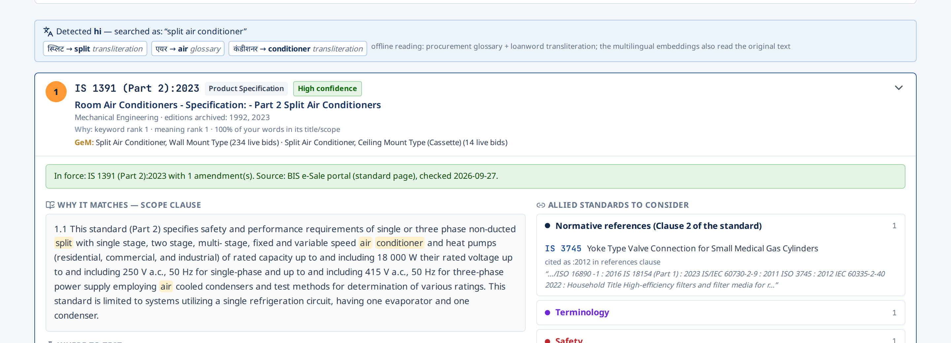

Indian languages — read offline, shown word by word
Procurement Hindi is mostly English written in Devanagari; we read it by sound, not by a paid translator
Glossary + transliteration
hi · mr · ta · te · bn · kn; sound-skeleton matching (स्प्लिट → SPLT → split)
Voice in, voice out
speak the query; ‘Speak answers’ reads the result back (browser voices, no server)
Buyer writes | SpecSure reads | Standard
स्प्लिट एयर कंडीशनर | split air conditioner | IS 1391 (Part 2)
ಸೀಲಿಂಗ್ ಫ್ಯಾನ್ (Kannada) | ceiling fan | IS 374
यूपीएस · एलपीजी | UPS · LPG (spelled acronyms) | IS 16242 · IS 3196
பிளாஸ்டிக் நாற்காலி (Tamil) | plastic chair | IS 13713
Measured honestly
held-out set: 39 % first, 71 % in top 3 (clean) · 50 % / 79 % in product mode — our weakest area, and we say so
SpecSure · SIH26108 · 8
Notes:
The PS asks for multiple Indian languages. Most tender Hindi is transliterated English, so we romanise each word, reduce it to a sound skeleton and match it to the vocabulary of standard titles. Native words go through a procurement glossary, and the multilingual embeddings also read the original text. On a held-out set written before this work, the right standard is first 39% of the time and in the top 3 71% of the time with shortcuts off; 50% and 79% in product mode. It is our weakest area and the Evidence page says so.

Slide 9
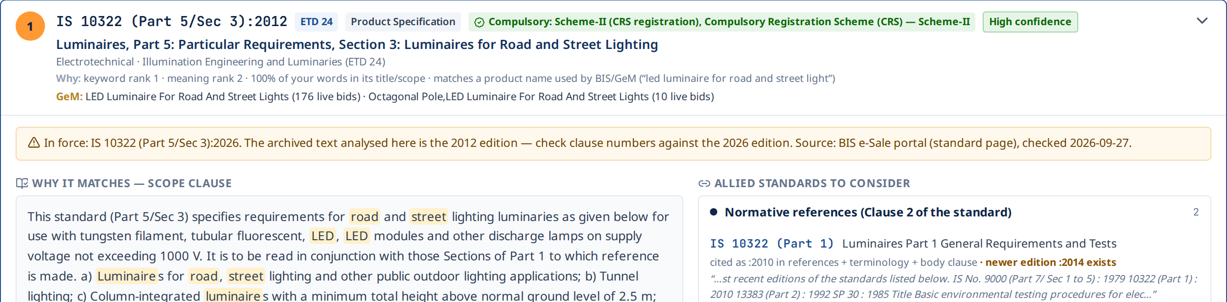
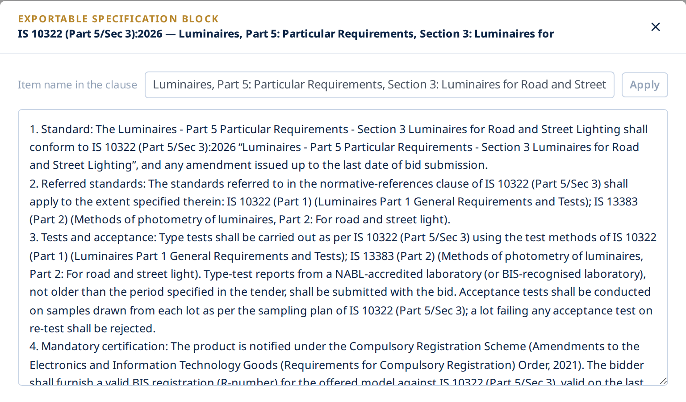

The edition in force — and a clause the officer can paste
“LED luminaire for road and street lights” → IS 10322 (Part 5/Sec 3)
Archive has 2012 — BIS lists 2026
flagged in every answer; the clause is drafted for the 2026 edition
Withdrawn? Redrafted for the replacement
IS 13849 → IS 15683 · IS 8112 → IS 269:2015 · IS 13947 → IS/IEC 60947
Certification written in
Exportable specification block: Standard · Referred standards · Tests & acceptance · Mandatory certification · Marking & packing · Terminology — with the BIS check date.
CRS registration (R-number) under the 2021 order — ISI licence (CM/L) for Scheme-I
Every sentence sourced
copy, read aloud, or collect several into one Word document
SpecSure · SIH26108 · 9
Notes:
Version tracking is where most tools stop at 'check the BIS portal'. We checked it: the archived text is the 2012 edition, but BIS lists the 2026 edition, so we flag it and draft for 2026. Withdrawn standards are redrafted for their replacement. The spec block is the PS's 'exportable specification' feature — copy, Word, or read aloud.

Slide 10
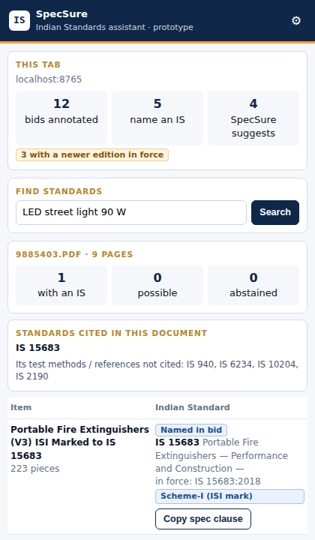
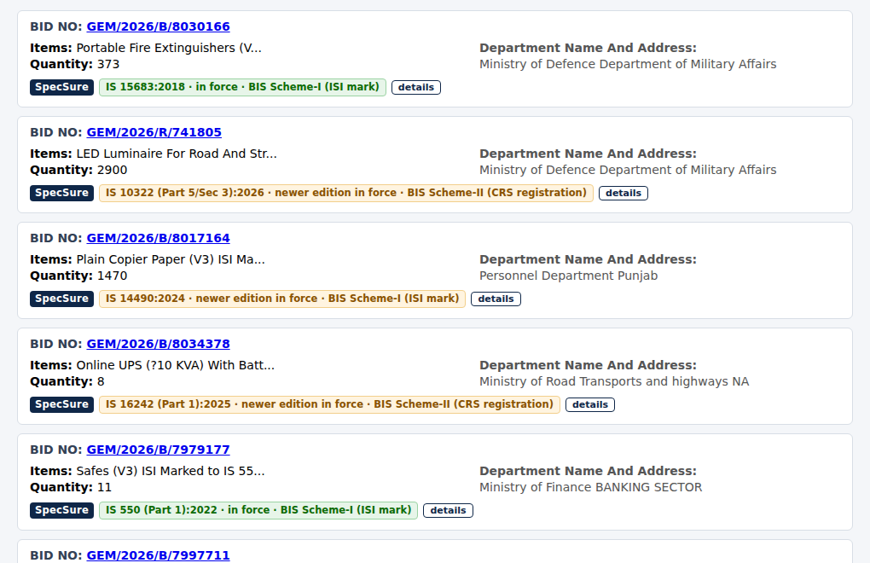
Inside GeM and CPPP — a browser extension
Officers don’t change tools: SpecSure annotates the bid pages they already use
On every bid
named standard · edition in force · amendments · ISI / CRS — or a suggestion, or “no confident match”
On a bid PDF
items bought, cited standards checked, forgotten test methods, copy-ready clause
Anywhere
select text on any page → “Find Indian Standards”; the side panel stays open while drafting
Real GeM category names, 27 Sep 2026 — road-lighting luminaires now need the 2026 edition of IS 10322 (Part 5/Sec 3).
SpecSure · SIH26108 · 10
Notes:
Integration is usually a slide of promises. Ours is a working Manifest V3 extension: on the GeM bid listing it adds a strip under every bid with the named standard's status, amendments and certification, or our suggestion. On a bid document it analyses the PDF item by item. It talks only to the SpecSure server.

Slide 11
Measured, not claimed
Clean benchmarks — every product-name shortcut switched off; scripts in the repository
89.6 %
precision when SpecSure says “Recommended” (GeM names)
91.4 %
of vague or services requests get no recommendation
8.4 %
confident but wrong — shown, not hidden
SpecSure · SIH26108 · 11
Notes:
The GeM benchmark is our strongest evidence because the labels are written by GeM, not by us: 403 category names with the standard stripped out. 80% are right first time and 91% in the top 10 with every shortcut off. Just as important for procurement: when we say Recommended we are right about 90% of the time, and 91% of vague or service requests get no recommendation. Indian languages are the weakest bar, and we show it.

Slide 12
Tested on real procurement documents
63 public tenders and GeM bid documents · 1,542 pages · 489 items found
 | Institutional tenders | GeM bid documents
Documents / pages | 23 / 1,011 | 40 / 531
Cite no Indian Standard | 12 of 23 | 13 of 40
Cite older edition / withdrawn | 3 / 3 | 0 / 0
Items: named · recommended · possible · abstained | 5 · 33 · 129 · 228 | 31 · 12 · 11 · 34
“Recommended” correct (spot-check) | 17 of 21 | 10 of 12
~85 %
of “Recommended” items were right on real documents
262 of 489
items abstained — medical, IT, services, custom parts: no guessing
Spot-check is AI-assisted and will be confirmed by the team. “Possible” items are leads (4 of 25 correct, 13 incl. partial) — the interface labels them “verify”.
SpecSure · SIH26108 · 12
Notes:
Benchmarks are clean but short; real tenders are long and messy. We ran 63 real documents end to end. The headline for judges: half the institutional tenders cite no standard at all, and when we say Recommended on real documents we were right about 85% of the time. We abstain on items no Indian Standard fits.

Slide 13
Why SpecSure stands apart
Compared with the typical approach in 28 public SIH26108 repositories we surveyed
 | Typical prototype | SpecSure
Knowledge base | 3 – 2,500 standards, mostly typed by hand | 29,875 standards, 19,492 texts parsed, all divisions
Relationships | a few curated edges | 80,834 links with clause + sentence; compliance tree
Edition / status | “verify on the BIS portal” | status for 29,710 from BIS; amendments; replacements
Certification | a handful of flags | 828 BIS rows with the QCO, written into the clause
Testing | not addressed | 482 BIS-recognised labs with charges (BIS LIMS)
Languages | English, or a paid LLM translator | offline glossary + transliteration + bge-m3, measured
Where it runs | a separate website | portal + GeM/CPPP extension + API + MCP, offline
Proof | demo queries | GeM-labelled benchmark, 63 real documents, abstention metrics
SpecSure · SIH26108 · 13
Notes:
We looked at every public repository on this problem statement. The strongest one does excellent work on one division family. What sets us apart is scale across all divisions, BIS-sourced editions and status, real certification and lab data, and proof on GeM's own labels and real documents.

Slide 14


Ready to deploy — and honest about what is next
Built for government IT: offline, on-prem, auditable
On-prem & offline
Next steps
FastAPI + Next.js, Docker; bge-m3 on CPU (~270 ms/query), automatic fallback to a small model
Amendment lists for all standards (today 1,138) — ~2 h collection from an Indian connection
Clause-level retrieval over every paragraph for sharper “why” on long standards
Full text for the 10,171 newer standards (title-only today, capped at “Possible”)
Indian languages: larger glossary; optional Bhashini / LLM translator
Pilot with a procurement cell: team-verified labels, public demo URL, GeM API
Integrates
REST API, MCP server for AI assistants, browser extension; GeM / CPPP native integration next
Refreshable
one script per source (BIS catalogue, e-Sale portal, LIMS, GeM) — re-run to update, every answer dated
Accountable
sources and dates on every line; LLM optional and never decides; human signs the tender
SpecSure · SIH26108 · 14
Notes:
Deployment is realistic for a government setting: it runs offline on a CPU server, falls back automatically if the large model is unavailable, and every data source has its own refresh script. We are open about the gaps: amendment lists cover 1,138 key standards today, newer standards are title-only, and Indian languages need more work. A pilot with a real procurement cell is the next milestone.

Slide 15
Right standard. Right edition.
Right test lab. In the buyer’s language.
SpecSure turns a product description or a whole tender into standards a procurement officer can defend — sourced, dated and explained.
Live demo
100-second film
Reproduce every number
Find Standards · Evidence · Extension
docs/media/specsure_demo.mp4
scripts/corpus_benchmark.py · real_tender_study.py
Thank you · Team CodeNova
Notes:
Close on the promise: the right standard, the right edition, the right test lab, in the buyer's language — and every line defensible. Then switch to the live demo, or play the 100-second film if the network fails.

