Slide 1



Lachoo Memorial College of Science and Technology, Jodhpur
Affiliated to
Jai Narain Vyas University
A Presentation on Marketing Strategy of Pharmaceutical Industry
Supervised By: -
Dr. Navneet Aggarwal
Professor, Department of Pharmaceutical
Chemistry
Presented By: -
Arun Baral

Slide 2
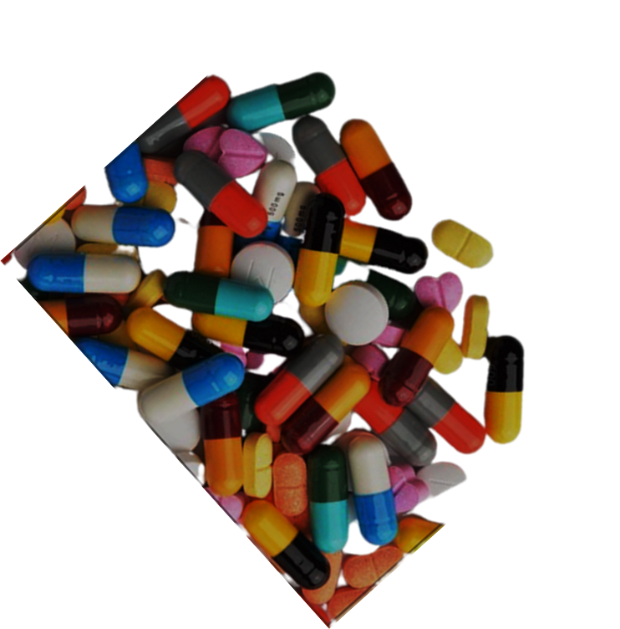

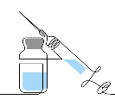
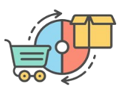


Introduction
Marketing :- Marketing is the activity, set of institutions, and processes for creating, communicating, delivering, and exchanging offerings that have value for customers, clients, partners, and society at large.
Pharmaceutical Market in India :-
2% of GDP
60% of global vaccine production
20% of the global supply
17.5 % of the World population
$50 billion &
$130 billion by 2030

Slide 3

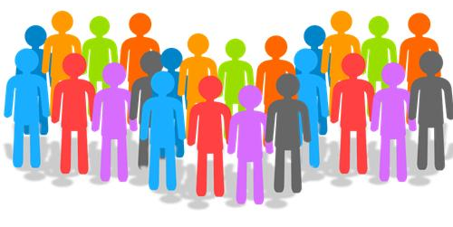

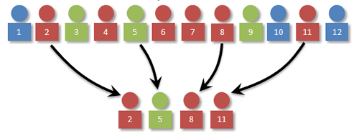
Primary Data
Secondary Data
Research Methodology
Primary data was selected from the sample by a self-administrated questionnaire.
Sample size: - 50
Sample area: - Rajasthan
Sample Unit: - Officials of many pharmaceutical companies, medical practitioners, medical representative’s in Rajasthan
Secondary data was collected through
Articles
Reports
Journals
Magazines
Newspapers
Internet
Exploratory research :- This kind of research has the primary objective of development of insights into the problem.
Sampling Technique :- The process employed to select the sample was simple random sampling.

Slide 4

1) For how many years you are practicing as a medical practicener (Doctor)?
Less than 1 year
17%
From one to five years
32%
Five to Ten years
36%
More than Ten years
12%
Cannot remember
03%

Slide 5
2) Do you agree that India’s pharmaceutical industry is one of the fastest growing segments of the Indian economy?
Agree
43%
Disagree
09%
Strongly Agree
37%
Strongly Disagree
04%
Cannot Say
07%

Slide 6
3) Do you agree that the marketing strategy of the pharmaceutical industry should be different from the marketing strategy in non-pharmaceutical segments?
Agree
50%
Disagree
10%
Strongly Agree
32%
Strongly Disagree
04%
Cannot Say
04%

Slide 7
4) Do you agree that institutional selling is quite prevalent when it comes to pharmaceutical market in India?
44%
10%
30%
06%
10%
Agree
Disagree
Strongly Agree
Strongly Disagree
Cannot Say

Slide 8
5) Do you agree that the pharmaceutical companies need to use innovative and better promotional measures for selling their products?
60%
01%
37%
00%
02%
Agree
Disagree
Strongly Agree
Strongly Disagree
Cannot Say

Slide 9
6) Do the Pharmaceutical companies offer gifts to the doctors to influence their prescriptions in favor of their company medicines?
No – 01%
Yes – 95%
Can’t Say – 04%

Slide 10
7) Out of the following which one is more correct when it comes to the promotional strategy of pharmaceutical companies in the view of the doctors?
They aim to inform about the product
22%
They aim to persuade to purchase
Other motives
03%
60%
15%
Do not know/ Cannot say

Slide 11
8) Do you agree that unethical standards exist in the promotion of pharmaceutical products in India?
52%
20%
20%
03%
05%
Agree
Disagree
Strongly Agree
Strongly Disagree
Cannot Say

Slide 12
9) Your recommendation to the industry and government regarding the promotional strategy of the pharmaceutical companies? You can choose more than one option.
Implement, improve and monitor legislation
72%
Measures to improve the transparency of drug companies’ marketing activities
86%
Stop the practice of gifts to doctors
67%
Ensure codes of conduct on drug promotion
70%
Other measures
12%
Do not know/ Cannot say
01%

Slide 13
10) Do you think that the entry of Multinationals is a Major Challenge to the domestic Players in the Pharmaceutical Market and are they ready to face the Challenges of the Foreign Players?
Yes
36%
No
54%
Do not know/ Cannot say
10%

Slide 14
11) What type of Marketing Strategy would you prefer to expand your Market size?
50%
--------------------------------------------------------------------------------
45%
40%
35%
30%
25%
20%
15%
10%
05%
32%
0%
23%
45%
B2C
B2B
Both

Slide 15
12) What type of Marketing Strategy does you as More Profitable?
50%
--------------------------------------------------------------------------------
45%
40%
35%
30%
25%
20%
15%
10%
05%
47%
0%
24%
31%
B2C
B2B
Both

Slide 16
13) What do you think is the Major challenge from the Marketing point of view for the Pharmaceutical Industry in India?
38%
22%
23%
17%
Fragmentation of the market
Market risk due to lack of price control mechanism
MNCs
Others

Slide 17
14) What innovative distribution channel do you suggest to better market your products?
47%
34%
12%
10%
02%
Better consumer supply chain
Emotional Branding
Alliance with other corporate leaders for promotion of the product
Greater media participation and power branding
Others

Slide 18
15) Are you aware that the pharmaceutical companies in India are shifting their focus from conventional method of marketing to non-conventional method of marketing?
No – 05%
Can’t Say – 09%
Yes – 86%

Slide 19
16) Do you think that market ethics/ medical Ethics are a major factor in the new distribution channel of marketing?
Yes
57%
No
28%
Do not know/ Cannot say
15%

Slide 20
17) Do You Think That These Non-Conventional Marketing Methods Are Effective Methods of Pharma Marketing in The Present Age?
55%
--------------------------------------------------------------------------------
50%
45%
40%
35%
30%
25%
20%
15%
10%
54%
05%
36%
10%
No
Yes
Do not know

Slide 21
18) Do you believe that technology utilization and innovative distribution channels will help in marketing of Pharma products in India?
Yes
75%
No
07%
Do not know/ Cannot say
18%

Slide 22
19) Major weakness of the pharmaceutical industry’s marketing strategy.
Branding
07%
77%
R&D
Publicity
09%
Do not know / Cannot say
07%

Slide 23
20) Do you follow branding of products as a marketing strategy?
100%
--------------------------------------------------------------------------------
90%
80%
70%
60%
50%
40%
30%
20%
10%
05%
00%
74%
21%
No
Yes
Do not know

Slide 24
21) Do you think that foreign direct investment (FDI) should be allowed in the pharmaceutical sector in India?
43%
36%
21%
Yes
NO
Do not know/ Cannot say

Slide 25

Social media presence
Build relationships with Doctors
Adopting new technologies for marketing and sales
Invest in innovative partnerships
Educating and supporting patients
Connecting emotionally with customers.
Marketing Strategies

Slide 26
Thank You !

