Slide 1
CAPSTONE PROJECT REVIEW
VL-JEPA vs. CLIP for CCTV Event Retrieval: Efficiency, Generalization, and Faithful Report Generation
“From Footage to Facts.”
Team Members
M. Bhavesh – 23BCE9663
N. Manmohan Reddy – 23BCE9942
A. JayaPrakash – 23BCE9945
K. Avinash – 23BCE7509

Slide 2
Index
01
Problem Statement
06
Subject Knowledge
02
Motivation
07
Comparison among existing systems
03
Objectives
08
Technical Requirements
04
Hypothesis
09
Timeline
05
Problem Survey
10
Data

Slide 3
Problem Statement
01
Industrial and surveillance CCTV systems generate large volumes of video, making it difficult to efficiently locate relevant events using conventional frame-based or manually indexed approaches. Vision-language representations such as CLIP enable semantic retrieval using natural-language queries, but their effectiveness can vary across surveillance environments, camera viewpoints, and event types. The recently proposed VL-JEPA provides an alternative vision-language representation based on joint-embedding prediction, but its suitability for CCTV event retrieval under resource-constrained conditions has not been sufficiently evaluated. Furthermore, when retrieved CCTV evidence is converted into natural-language incident reports using LLMs, the generated reports may contain unsupported or hallucinated information. Therefore, there is a need for a lightweight and reproducible framework to compare pretrained VL-JEPA and CLIP representations for CCTV event retrieval, evaluate their performance under limited domain shifts, and assess the factual faithfulness of generated surveillance reports.

Slide 4
Motivation
02
The increasing volume of CCTV footage makes manual monitoring and retrieval of relevant events inefficient and time-consuming. Existing vision-language models can support semantic video retrieval, but their computational efficiency and ability to generalize across different CCTV environments remain important open research questions. This project therefore investigates whether pretrained VL-JEPA representations can provide effective and efficient event retrieval compared with conventional CLIP representations using publicly available CCTV video datasets. Additionally, since LLM-generated surveillance reports may introduce unsupported or hallucinated information, the project evaluates the faithfulness of generated reports against the underlying video evidence. The study aims to contribute an evidence-based comparison of modern visual representations while exploring reliable and resource-efficient approaches for automated CCTV analysis.

Slide 5
Objectives
03
To develop a lightweight semantic CCTV event retrieval framework using pretrained vision-language representations.
1
To compare pretrained VL-JEPA and CLIP representations for CCTV event retrieval using standard retrieval metrics.
2
To evaluate the generalization of both representations across different cameras, viewpoints, or video sources.
3
To analyze the computational requirements of the compared representations under resource-constrained conditions.
4
To evaluate the factual faithfulness and hallucination rate of LLM-generated CCTV incident reports using retrieved visual evidence.
5

Slide 6
Hypothesis
04
H1
Main hypothesis
Pretrained VL-JEPA representations will achieve comparable or better semantic retrieval performance than CLIP representations for CCTV event retrieval.
H2
Generalization
VL-JEPA representations will maintain better retrieval performance than CLIP when tested on CCTV videos from different cameras or visual environments.
H3
Report faithfulness
Grounding LLM-generated surveillance reports in structured CCTV evidence will reduce unsupported or hallucinated claims compared with unconstrained report generation.

Slide 7
Problem Survey
05
The rapid growth of CCTV video creates a need for automated methods that can efficiently retrieve relevant events from large volumes of surveillance footage. Conventional approaches often depend on predefined event categories or task-specific models, while CLIP-based representations provide flexible natural-language retrieval but were originally developed primarily for image-text alignment rather than dedicated video understanding. Recent vision-language approaches such as VL-JEPA extend joint embedding learning to video and support text-to-video retrieval without requiring autoregressive text generation, reporting strong results compared with CLIP and other representation models on multiple video benchmarks. However, the effectiveness, computational practicality, and cross-camera generalization of such representations for CCTV-style event retrieval remain insufficiently established, particularly under limited computational resources. In addition, converting retrieved surveillance evidence into natural-language reports introduces a separate reliability problem because generated reports may contain unsupported or hallucinated details, motivating evaluation of report faithfulness against the underlying visual evidence.

Slide 8
06
Comparison among existing systems
Aspect | Conventional CCTV Systems | CLIP-based Systems | Recent Video-Language Models / VL-JEPA | Your Proposed Direction
Main approach | Predefined classes + supervised detection | Image-text embedding alignment | Joint video-text representation learning | Video-text retrieval specifically adapted to CCTV
Event categories | Fixed/predefined | More flexible through text prompts | Open-vocabulary | Open-vocabulary natural-language queries
Video understanding | Often frame/object/event based | Primarily image-oriented; video often requires frame aggregation | Designed for video representations | Dedicated surveillance-video representation
Query method | Usually fixed labels | Natural-language text | Natural-language text | Natural-language event descriptions
Training requirement | Often requires labeled surveillance data | General image-text pretraining | Large-scale video-text learning | Aim for limited task-specific training
Computational cost | Can be relatively efficient for specific tasks | Relatively practical, depending on architecture | Potentially computationally demanding | Explicitly evaluate efficiency under limited resources
Cross-camera generalization | Often weak when cameras/environments differ | Better semantic flexibility, but not guaranteed for CCTV | Promising but not sufficiently established for CCTV | Explicitly evaluate across different cameras
Retrieval capability | Usually event/class detection rather than semantic retrieval | Strong semantic text-image matching | Stronger video-text semantic retrieval | CCTV-focused text-to-video retrieval
Report generation | Usually separate or template-based | Not inherently designed for reporting | Representation models do not necessarily guarantee faithful reports | Generate reports and evaluate their faithfulness
Hallucination risk | Lower if template-based | Not applicable unless combined with a generative model | Still possible when paired with generation | Explicitly measure unsupported details
Main limitation | Rigid and task-specific | Not optimized specifically for temporal video understanding | Resource requirements and CCTV generalization remain unclear | Combine retrieval, efficiency, generalization, and evidence-grounded reporting

Slide 9
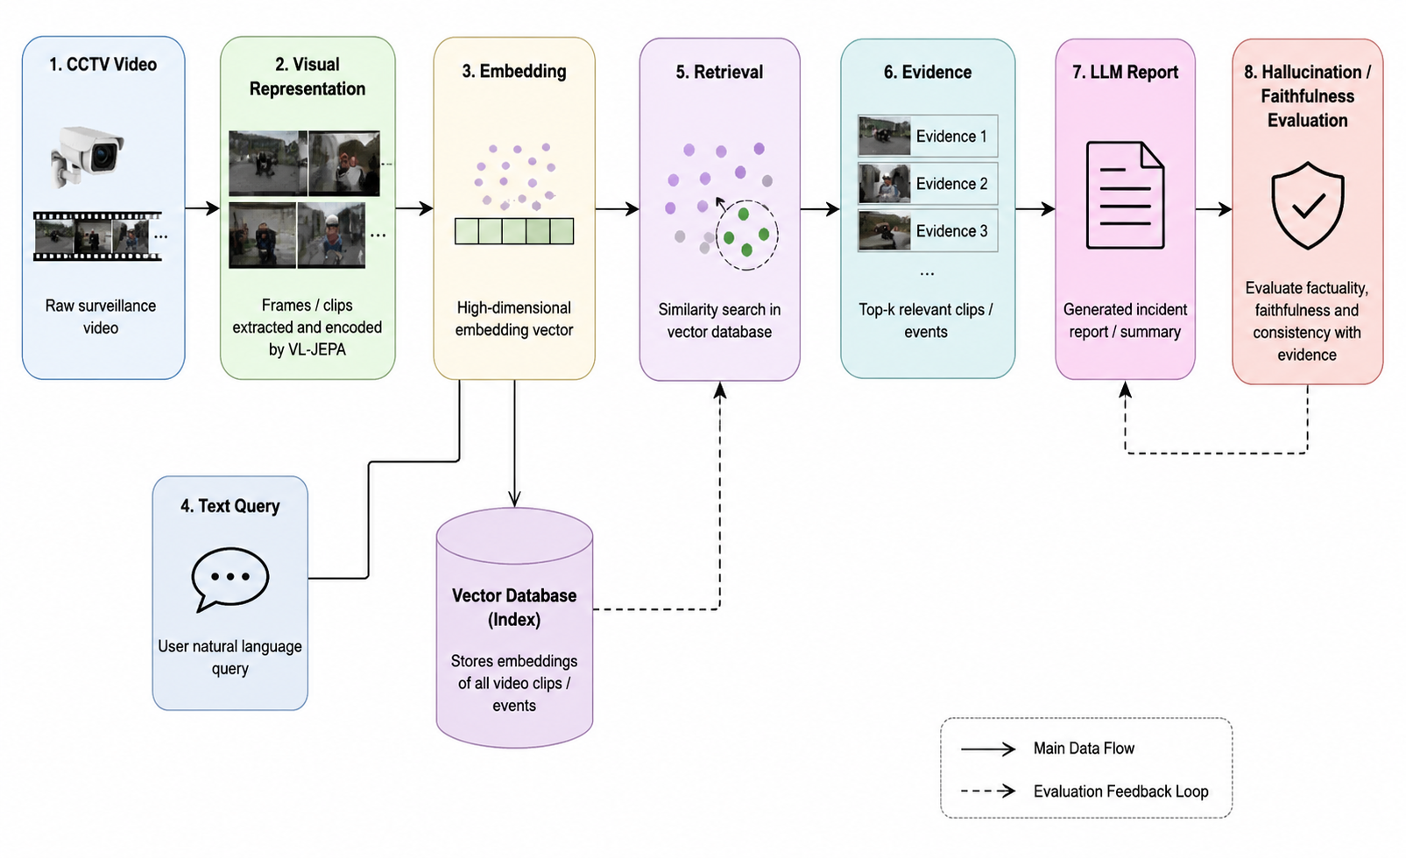
Subject Knowledge
07
Computer Vision & Video Processing – Basics of video frames, feature extraction, and CCTV event understanding.
CLIP & Vision-Language Models – Understanding image/video-text embeddings and semantic retrieval.
VL-JEPA & Representation Learning – Basic understanding of pretrained VL-JEPA and how it represents video and language in an embedding space.
Semantic Video Retrieval – Embeddings, cosine similarity, FAISS, and metrics such as Recall@K.
LLMs & Hallucination – Generating incident reports from retrieved evidence and identifying unsupported claims.
Experimental Evaluation – Comparing CLIP and VL-JEPA using retrieval accuracy, generalization, and computational cost.

Slide 10
Technical Requirements
08
Component | Requirement
CPU | Intel Core i5 / AMD Ryzen 5 or better
GPU | NVIDIA GPU with 8 GB+ VRAM recommended; free cloud GPU (T4/P100) can be used for model inference
RAM | 16 GB recommended, 8 GB minimum
Storage | 50–100 GB free space, depending on selected datasets and cached embeddings
OS | Windows 10/11, Ubuntu Linux, or macOS
Programming | Python 3.10+
Deep Learning | PyTorch, CUDA (when NVIDIA GPU is available)
Vision Models | Pretrained CLIP and VL-JEPA
Video Processing | OpenCV, FFmpeg
Retrieval | FAISS, NumPy, SciPy
LLM / Reporting | Hugging Face Transformers + lightweight pretrained LLM
Evaluation | Recall@K, MRR, retrieval latency, memory usage, hallucination/faithfulness metrics
Development | Jupyter/Google Colab, VS Code, Git/GitHub
Demo | Streamlit
Data | Public CCTV/video datasets + text-based event queries

Slide 11
Timeline
09
Period | Main Goal | What the 4 members should finish
Before / Review 1 | Research & planning | Literature review, problem statement, objectives, hypotheses, datasets, methodology
23–30 Aug | Setup & feasibility | Dataset preprocessing, CLIP baseline, VL-JEPA feasibility test
1–7 Sep | Baseline implementation | CLIP embeddings + retrieval + FAISS
8–14 Sep | VL-JEPA implementation | Pretrained VL-JEPA inference + embedding extraction
15–21 Sep | Initial experiments | CLIP vs VL-JEPA retrieval results
22–28 Sep | Prepare Review 2 | Results, graphs, methodology, preliminary demo
29 Sep–3 Oct | Review 2 | Working prototype + preliminary results
4–15 Oct | Main experiments | Full retrieval + cross-camera/dataset generalization
16–25 Oct | Faithfulness study | LLM reports + hallucination/faithfulness evaluation
26 Oct–5 Nov | Analysis | Final metrics, comparisons, ablations, graphs
6–12 Nov | System/demo | Integrate retrieval + report generation + simple UI
13–16 Nov | Final preparation | Testing, documentation, presentation, poster
17–21 Nov | Final Review | Final system + research findings
By 20 Nov | Submission | Final report, poster, supporting material

Slide 12
Data
10
https://www.crcv.ucf.edu/research/data-sets/
https://viratdata.org/?utm_source=chatgpt.com
https://github.com/ahmadmughees/SH17dataset?utm_source=chatgpt.com
https://mevadata.org/index.html?utm_source=chatgpt.com
https://github.com/lilygeorgescu/ubnormal?utm_source=chatgpt.com

