Slide 1


Gender Recognition by Voice
Objective
The aim of this project is to identify a voice as male or female, based upon the acoustic properties of voice and speech.
Dataset
voice.csv
Which is a voice-gender dataset obtained from kaggle.com
The dataset consists of 3,168 recorded voice samples, collected from male and female speakers.
The voice samples are pre-processed by acoustic analysis in R using the seewave and tuneR packages, with an analyzed frequency range of 0hz-280hz (human vocal range).
Data Analysis of acoustic dataset
Men and women typically have different sizes of vocal fold; reflecting the male-female differences in larynx size.
Adult male voices are usually lower-pitched and have larger folds.
The male vocal folds are between 17 mm and 25 mm in length.
The female vocal folds are between 12.5 mm and 17.5 mm in length.

Slide 2
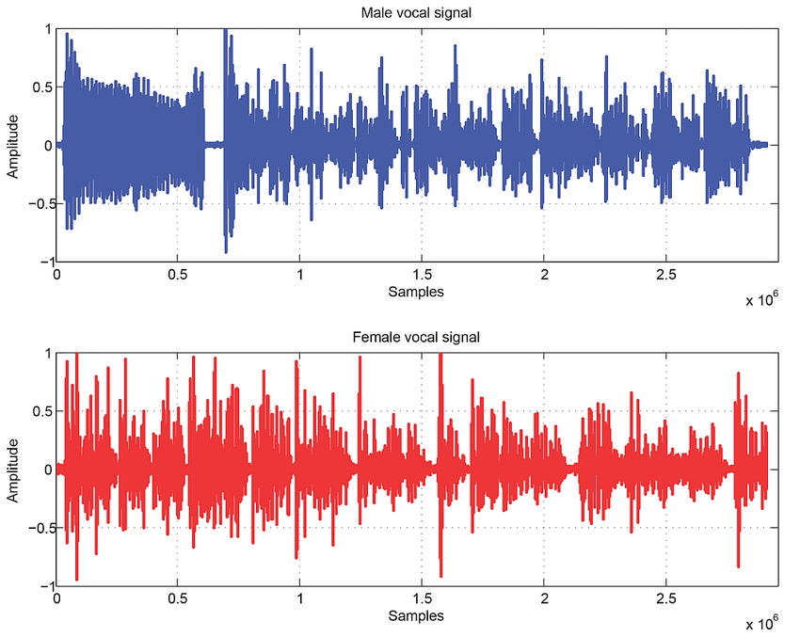
Data Analysis of acoustic dataset
What features differ between male and female voice?
Fundamental frequency - Voiced speech of a typical adult male will have a fundamental frequency from 85 to 180 Hz, and that of a typical adult female from 165 to 255 Hz.
sp.ent - Spectral entropy of audio for females lesser in comparision to males.
sfm - Spectral flatness of audio for females lesser in comparision to males
sd - standard deviation of frequency,
meanfun - average of fundamental frequency measured across acoustic signal
IQR - Interquartile range in KHz, comparitively lesser for female voices
Q25 - first quantile (in kHz)
Is it possible to find a difference in resonance between male and female voice?
The human vocal tract resonates in different frequency. Usually it shows four or more resonances. The Formant is the term applied to describe the resonant frequencies of the voice tract.
Male and female voices differ in the fundamental frequency, which of male voice lies in the range of 85 to 180 Hz while that of the female in the range of 150 to 300 Hz. In terms of the Formants,. about five formants are required for male voice while four formats for female voice.
The formant frequencies of female are higher than that of the male. The difference is very high in the third and fourth formants and least for the first formant. This is mainly due to the length of the voice tract. Voice tract of the female is shorter than that of the male. The formant frequencies are inversely proportional to the length of the voice tract.

Slide 3
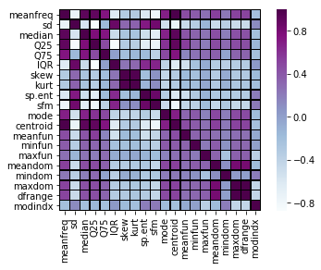
Covariance Matrix
The Dataset has the following features:
meanfreq | sd | median | Q25 | Q75
IQR | kurt | skew | sp.ent | sfm
mode | centroid | modindex | meanfun | minfun
maxfun | meanrandom | minrandom | maxrandom | dfrange
The feature label is the output feature – male or female
Data Splitting Techniques
Data splitting methods:
Holdout
Stratified Holdout
k-fold cross_validation(stratified)
Bootstrapping
Best results were achieved using Bootstrapping
(train-test ratio as 80:20)
Total number of samples = 3168
Training set = 2534
Test set = 634

Slide 4
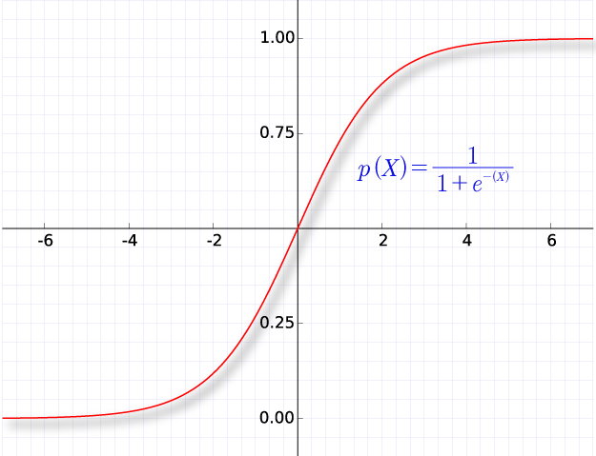
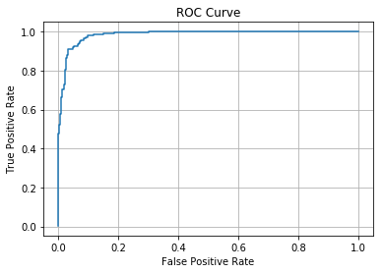
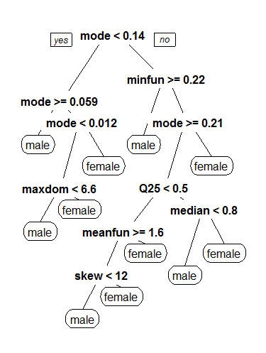
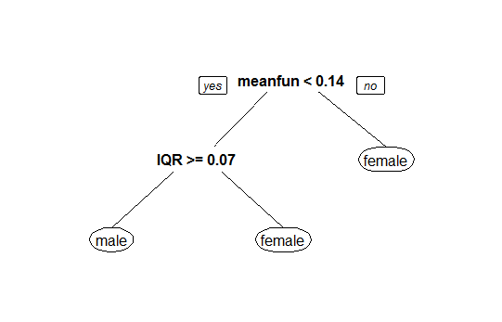

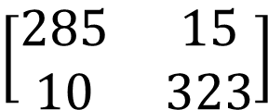
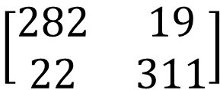
Learning Models
Logistic Regression Model
Using features: meanfreq, sd, median, meanfun
Train accuracy: 0.9242304656669298
Test accuracy: 0.9353312302839116
Misclassification Rate: 0.06466876971608833
ROC AUC: 0.984426286751868
$$\left[\begin{matrix}282 & 19 \\ 22 & 311\end{matrix}\right]$$
Confusion Matrix
Decision Tree Model
Using features: meanfreq, sd, meanfun, IQR, Q25, sp.ent, sfm
Train accuracy: 0.9534333070244673
Test accuracy: 0.9605678233438486
Area under ROC curve: 0.9601
Misclassification Rate: 0.03943217665615142
ROC AUC: 0.9890305587980006
$$\left[\begin{matrix}285 & 15 \\ 10 & 323\end{matrix}\right]$$
Confusion Matrix

Slide 5
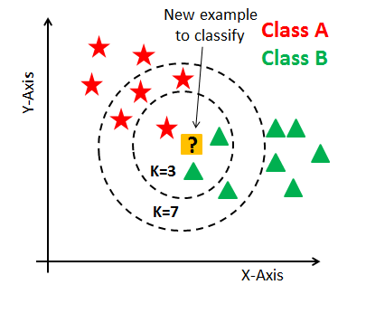
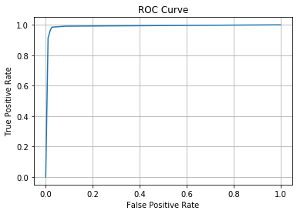
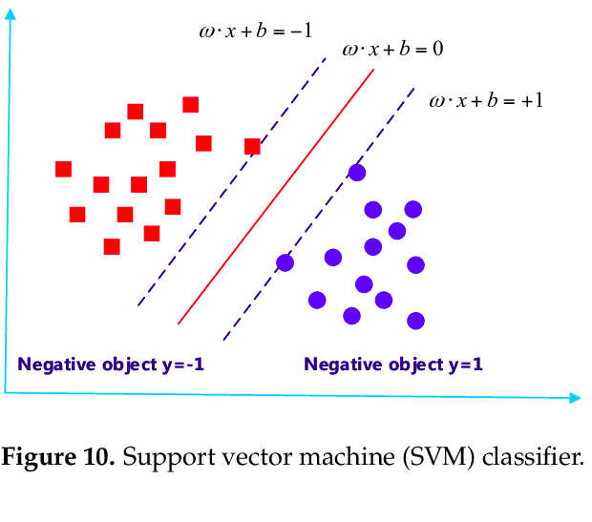
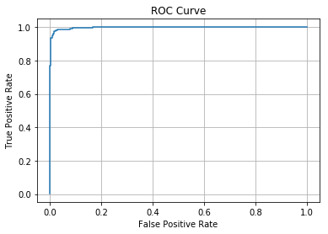
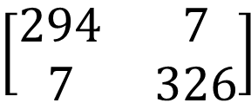
KNN(K-Nearest Neighbours) Model
Using features: meanfreq, sd, meanfun, IQR, Q25, sp.ent, sfm
Train accuracy: 0.9806629834254144
Test accuracy: 0.9794952681388013
Misclassification Rate: 0.02050473186119874
ROC AUC: 0.9890056169125938
SVM(Support Vector Machine) Model
Using features: meanfreq, sd, meanfun, IQR, Q25, sp.ent, sfm
Train accuracy: 0.9707971586424625
Test accuracy: 0.9779179810725552
Misclassification Rate: 0.022082018927444796
ROC AUC: 0.9970967645386251
$$\left[\begin{matrix}294 & 7 \\ 7 & 326\end{matrix}\right]$$
Confusion Matrix

Slide 6
Model Comparison and Optimal Model
Graph of Misclassification rates and ROC AUCs of
different models
Model with highest ROC AUC & lowest MCR
Best Model
SVM Model (Linear Kernel)
Data splitting using Bootstrapping method
Best train and test accuracy compared to all other models
Train accuracy: 0.9707971586424625
Test accuracy: 0.9779179810725552
Misclassification Rate: 0.022082018927444796
ROC AUC: 0.9970967645386251
Model features: meanfreq, sd, meanfun, IQR, Q25, sp.ent, sfm

Slide 7
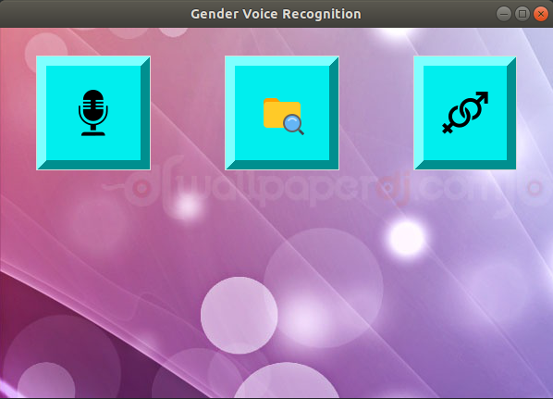
Results & Conclusions
Mainly meanfreq, sd, meanfun, IQR, Q25, sp.ent and sfm were prominent features in differentiating male voices from female voices.
With our best-fitted model, i.e., SVM (Linear Kernel) - Bootstrapping, the Train and Test accuracies are 0.9707971586424 and 0.977917981072 respectively.
This ability to be able to distinguish the gender can provide many applications, a more user-friendly environment which will be extremely helpful in human-computer interactions. For e.g.: In Recommendation systems
We have created an application, based on this ML Algorithm, that predicts the gender of real time voice input given.

