Slide 1

Implementation of SRTF
BY Rameez Raja.
Bhavesh Singh.
Sudhanshu Rasotra.

Slide 2
Shortest Remaining Time First
This algorithm is the preemptive version of SJF Scheduling. In SRTF , the execution of the process can be stopped after certain amount of time. At the arrival of every process, the short term scheduler schedules the process with the least remaining burst time among the list of available processes and the running process.

Slide 3
Advantages of SRTF
1. SRTF algorithm makes the processing of the jobs faster than
SJF algorithm, given its overhead charges are not counted.
2.It guarantees the minimum average waiting time.

Slide 4
Disadvantages of SRTF
The context switch is done a lot more times in SRTF than in SJF.
Consumes CPU ’s valuable time for processing.
This adds up to it’s processing time and diminishes it’s advantage of fast processing.

Slide 5
How SRTF is different from Round RObin
1.SRTF executes the processes based upon their burst time while Round Robin executes the processes based upon the time quantum i,e. each process is executed for a fixed amount of time
2.In Round Robin shortest one have to wait for a longer time and in SRTF longer process behaves as a suspend process as short taste keep on executing.

Slide 6
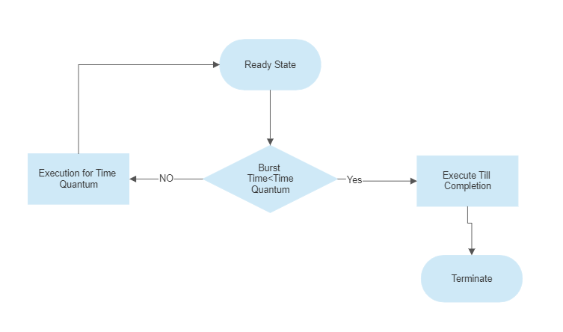

Slide 7

Github LINK
https://github.com/Bhavesh9682/group4OSproject

Slide 8
Thank you

