Slide 1

Bank Loan Analytics
Presented by Group 2
BHAVESH Biraris
Tanvi SAWANT
ADITYA BADAM
ROHAN MD
AMRUTA KW
GAGAN M
SAILAJA

Slide 2

Introduction
This project is an in-depth analysis of bank loan data, aimed at uncovering key insights into loan issuance trends, customer credit behavior, and financial performance metrics. The analysis combines SQL, Tableau, Excel and Power BI for data extraction and transformation into data visualization, providing a comprehensive overview of loan trends over time, the financial health of different customer segments, and risk assessment across various loan grades. This project serves as a crucial tool for understanding the dynamics of loan portfolios and guiding strategic decision-making in the financial sector.

Slide 3
table's OF CONTENT
All KPI Analysis & Recommendation .
Dashboard Screenshots .
Challenges .
What We Learn ?

Slide 4
Data Cleaning
Merging and cleaning data :- “Firstly Merge data sheet of then convert it merged file into power query then cleaning the data
Data types:- Date column in sheet was changed to “dd-mm-yyyy” format.
Null values:- Column had many null values, so this column was completely deleted from the database.
New Add Column :- Extract the required and meaningful column in power query.
These data cleaning steps were crucial to ensure relevance of data and give accurate results for further analysis.

Slide 5
Our Findings
Total Loan Amount
110,364,554
Net Transaction Amount
318,117
Delinquent Loan Rate
9.970
Total Collection
140,118,327

Slide 6
Bank Loan Dashboard KPI’s
Total Loan Amount Funded
Total Loans
Total Collection
Total Interest
Branch-Wise Performance
State-Wise Loan
Religion-Wise Loan
Product Group-Wise Loan
Disbursement Trend
Grade-Wise Loan
Default Loan Count
Delinquent Client Count
Delinquent Loan Rate
Default Loan Rate
Loan Status-Wise Loan
Age Group-Wise Loan
Loan Maturity
No Verified Loans
1

Slide 7
Bank Debit & Credit Dashboard KPI’s
Total Credit Amount
Total Debit Amount
Credit to Debit Ratio
Net Transaction Amount
Account Activity Ratio
Transactions per Day/Week/Month
Total Transaction Amount by Branch
2

Slide 8
Bank Loan KPI’s
1

Slide 9
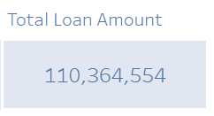
KPI 1 :- Total Loan Amount funded
The total loan amount surpassing 110 million indicates a strong financing capability, reflecting substantial investor trust and borrower demand.
Understanding how this loan amount translates into revenue, repayment rates, and default risks can provide deeper insights into financial sustainability and operational efficiency.
A high loan amount may attract new investors and stakeholders looking for stable returns.
Indicates the number of borrowers supported, showcasing social or economic impact.

Slide 10
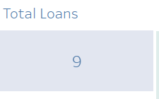
KPI 2 :- total loans
This visual represents the Total Number of Loans, which stands at 9.
With a smaller number of loans, each loan carries more weight in overall risk management. A default or delay in repayment could have a substantial impact on the portfolio’s performance.
A small number of loans means each one needs thorough vetting to mitigate financial risk.

Slide 11
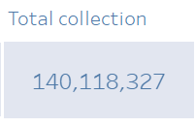
KPI 3 :- total collection
The total collections exceed 140 million, indicating efficient loan repayment and cash flow management.
Comparing this with the Total Loan Amount Funded (110,364,554), the collection is higher than the disbursed amount, suggesting a additional revenue from interest, penalties, or fees, Effective loan recovery strategies and strong borrower repayment discipline.
High collections suggest strong financial health, ensuring liquidity for future lending and operational expenses. A well-performing collection process reduces defaults and enhances profitability.
A positive collection trend provides confidence for future expansion, allowing for increased loan disbursement while maintaining financial stability.

Slide 12
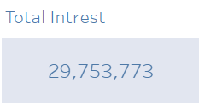
KPI 4 :- total interest
Interest earnings of nearly 30 million indicate a significant revenue stream, showing the profitability of the lending operations.
When compared to the Total Loan Amount Funded (110,364,554), this suggests an effective interest rate strategy and a healthy return on lending activities.
Sustainable interest earnings allow reinvestment in business expansion and risk mitigation.
If interest earnings grow over time, it signals business expansion and increased loan disbursements.

Slide 13
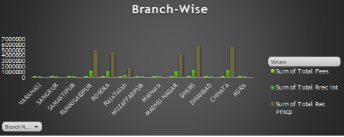
KPI 5 :- branch-wise performance
Identifies which branches are excelling in collections and which need improvement.
Helps management allocate resources, introduce incentives, or improve recovery strategies in weaker branches.
Underperforming branches may require targeted strategies such as enhanced customer engagement, better loan structuring, or improved credit risk assessment.

Slide 14
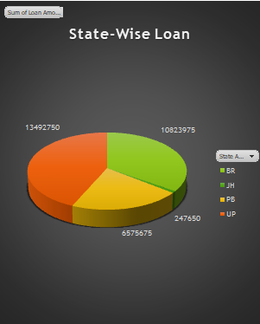
KPI 6 :- state-wise loan
Higher disbursement states like UP and Bihar need effective risk management to ensure repayment efficiency.
Lower loan distribution in Punjab might indicate an opportunity for market expansion.
Further investigation can determine whether the variations in loan amounts are due to regional policies, borrower demand, or economic factors.
Jharkhand (JH) shows a mid-range loan distribution compared to other states.

Slide 15
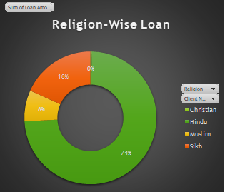
KPI 7 :- religion-wise loan
The Hindu community receives the highest percentage of loans (74%), possibly reflecting their higher representation among borrowers.
At 18%, the Muslim community holds a significant share, indicating considerable financial engagement.
The Sikh community has a smaller loan share (8%), which might suggest lesser loan demand or access issues.
The absence of loans to Christians (0%) raises questions about either a lack of applications or eligibility constraints.

Slide 16
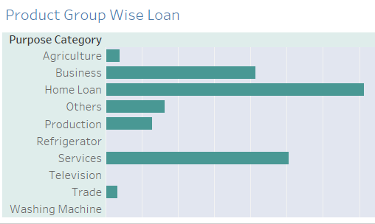
KPI 8 :- product group-wise loan
The largest share of loans is directed toward home financing, reflecting a focus on real estate investments and housing development.
Loans for services and business categories are also substantial, suggesting entrepreneurial activity and operational funding needs.
The small allocation for agriculture implies either lower demand from farmers or limited lending in this sector.
There is an opportunity to expand financial products for lesser-funded categories, such as trade and agriculture, to ensure broader financial inclusion.

Slide 17
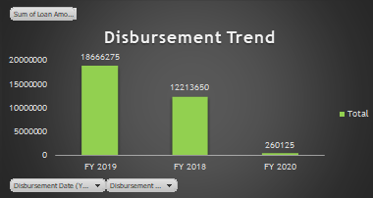
KPI 9 :- disbursement trend
There was a substantial increase in loan disbursement from FY 2018 to FY 2019, suggesting higher demand for loans or aggressive lending strategies.
The steep drop in disbursements in FY 2020 could be due to economic downturns, policy changes, or external market factors like the COVID-19 pandemic.
Investigating the reasons behind FY 2019’s growth could help replicate similar success strategies.

Slide 18
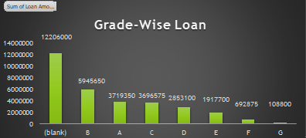
KPI 10 :- grade-wise loan
A large portion of loans (12.2M) falls under an undefined category. Data inconsistency or grading inefficiencies should be investigated.
This suggests that moderate-risk borrowers (Grade B) are preferred over high-risk or lower-rated applicants.
The decreasing loan amounts from Grade C to Grade G indicate higher-risk borrowers receive fewer loans due to strict lending policies.
Since Grades A, B, and C have substantial loan disbursements, targeted lending strategies could help expand these categories further.
The high number of unclassified loans suggests a need for better data categorization to ensure transparency in loan grading.

Slide 19

KPI 11 :- default loan count
This visual represents the total default loan value, indicating the amount that has not been repaid by borrowers. It is a crucial metric for assessing credit risk and financial health.
A high default loan value suggests increased risk and potential financial losses for the organization.
There may be no loan defaults in the recorded period.
If no defaults exist, it could indicate an efficient loan approval process and strong borrower repayment behavior.

Slide 20
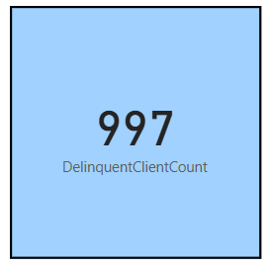
KPI 12 :-delinquent client count
With 997 clients in delinquency, there is a notable level of overdue payments, indicating potential financial stress among borrowers.
A high delinquency count can lead to cash flow disruptions and may require stronger collection strategies to recover overdue amounts.
Delinquency suggests potential loan defaults, which can impact the institution’s financial stability and risk exposure.
Delinquent clients affect overall loan book quality, potentially increasing provisioning costs for bad debts, Monitoring trends in delinquency can help assess the long-term profitability and sustainability of lending operations.

Slide 21
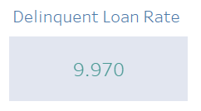
KPI 13 :- delinquent loan rate
This KPI card highlights the Delinquent Loan Rate as 9.97%, representing the percentage of loans that are past due but not yet defaulted.
Nearly 10% of loans are in delinquency, signaling potential repayment challenges.
If not managed properly, delinquent loans may transition into defaults, increasing financial risk.
Immediate action is required to strengthen collection efforts and support borrowers facing repayment issues.

Slide 22
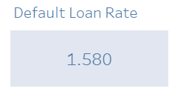
KPI 14 :- default loan rate
This KPI card displays the Default Loan Rate as 1.58%, indicating the proportion of loans that have defaulted.
A 1.58% default rate suggests that the majority of borrowers are repaying their loans successfully.
While the rate is relatively low, continued monitoring is crucial to prevent future defaults.
A lower default rate ensures financial stability and better profitability for the lending institution.

Slide 23
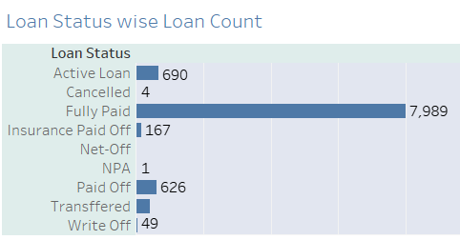
KPI 15 :- loan status-wise loan
7,989 loans have been fully repaid, indicating strong repayment behavior among borrowers.
690 loans are currently active, suggesting an ongoing revenue stream for the lender.
Only 1 loan is classified as NPA, indicating a low default rate.
49 loans have been written off, meaning they are considered uncollectible.
626 loans have been paid off, and 167 were settled through insurance.
trong repayment trends indicate a financially responsible customer base, Monitor active loans closely to ensure timely repayments, Minimize write-offs and NPAs by improving loan recovery strategies.

Slide 24
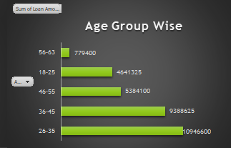
KPI 16 :- age group-wise loan
The 26-35 age group received the highest loan disbursement (10,946,600), suggesting they are the most active borrowers. This could indicate a strong demand for personal, home, or business loans in this financially active stage of life.
The 36-45 age group follows with 9,388,625 in loans, indicating a stable financial position where individuals may be seeking home or expansion loans.
Loan amounts start to decrease for age groups 46-55 (5,384,100) and 56-63 (779,400), likely due to retirement considerations and lower credit-seeking behavior.
The 18-25 age group has received 4,641,325, showing a growing trend in younger borrowers seeking financial support, possibly for education or business startups.

Slide 25
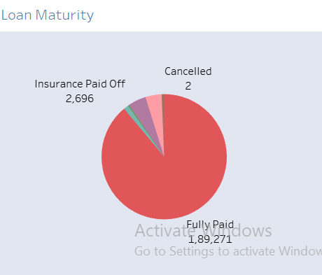
KPI 17 :- loan maturity
The majority of loans (1,89,271) have been successfully fully paid, indicating strong repayment behavior. This suggests a healthy financial ecosystem where borrowers are able to meet their obligations.
A smaller proportion (2,696) of loans were paid off through insurance, implying that these loans may have been covered due to unforeseen circumstances like borrower defaults, accidents, or death.
Only 2 loans have been canceled, showing that loan applications are rarely withdrawn after approval.
High loan maturity rates reflect good borrower creditworthiness and effective risk management. The presence of insurance-paid loans should be monitored to assess default risks covered by policies.

Slide 26
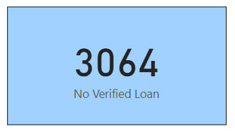
KPI 18 :- no verified loan
With 3,064 loans classified as "No Verified Loan," there may be potential issues in the verification process, compliance, or documentation gaps.
Unverified loans pose a financial risk as they may lead to higher default rates, fraud, or regulatory non-compliance if not properly assessed.
Unverified loans may slow down disbursement or create uncertainty in loan repayments, impacting cash flow and revenue realization.
Addressing verification challenges can enhance lender credibility and investor confidence.

Slide 27
Bank Debit & Credit KPI’s
2

Slide 28

KPI 1 :- total credit amount
This figure sums up all credit-related financial activities.
A quick snapshot of incoming transactions, helping assess financial health.
High credit volume suggests strong revenue or incoming funds.
Can help determine if the organization has sufficient credited funds to cover expenses.

Slide 29

KPI 2 :- total debit amount
This figure aggregates all outgoing financial activities, helps in assessing cash outflows and financial stability, essential to determine the net financial position.
High debit volume may indicate significant expenditures or investments.
Understanding trends in debit transactions can inform budget adjustments.

Slide 30

KPI 3 :- credit to debit ratio
A ratio of 1.0025 suggests that the total credited amount is slightly higher than the debited amount.
A ratio close to 1 implies balanced inflows and outflows, minimizing liquidity concerns, This metric helps in assessing financial sustainability and operational efficiency.
A nearly 1:1 ratio suggests steady cash movement without significant surplus or deficit.
Ensures that credits are sufficient to cover debits, reducing the risk of financial shortfalls.

Slide 31

KPI 4 :- net transaction amount
This value represents the difference between total credit and total debit, indicating whether there is a surplus or deficit.
A positive net amount (318.12K) suggests more credit than debit, indicating financial gain or surplus.
A positive net transaction amount could indicate growth, profitability, or excess funds available for reinvestment.
Monitoring net transactions helps assess liquidity and optimize financial planning.

Slide 32
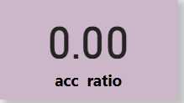
KPI 5 :- account activity ratio
This ratio typically measures the frequency of account transactions relative to total account activity.
A low or zero ratio may indicate inactive accounts, potential issues in transaction processing, or a lack of financial engagement.
A higher ratio generally reflects active account usage and healthy financial movement.
Further investigation is recommended to determine the reason for inactivity and identify potential corrective actions.

Slide 33
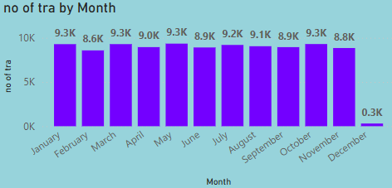
KPI 6 :- transaction per day/week/month
Most months maintain a steady transaction range between 8.6K and 9.3K transactions.
A significant decline is observed, with December’s transactions dropping to 0.3K, indicating a potential seasonal trend, system issue, or business slowdown.
The highest recorded transaction counts hover around 9.3K (January, April), while the lowest before December is 8.6K (February)

Slide 34
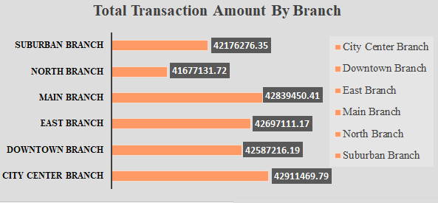
KPI 7 :- total transaction amount by branch
City Center Branch leads with $42,911,469.79, indicating its dominance in transaction volume.
Main, East, and Downtown Branches follow closely, each recording transactions over $42 million.
North Branch has the lowest recorded transactions at $41,677,131.72, yet the variation among branches is minimal.
The transaction amounts are relatively close across all branches, suggesting stable financial activity across locations.

Slide 35
Dashboard Screenshots
2

Slide 36
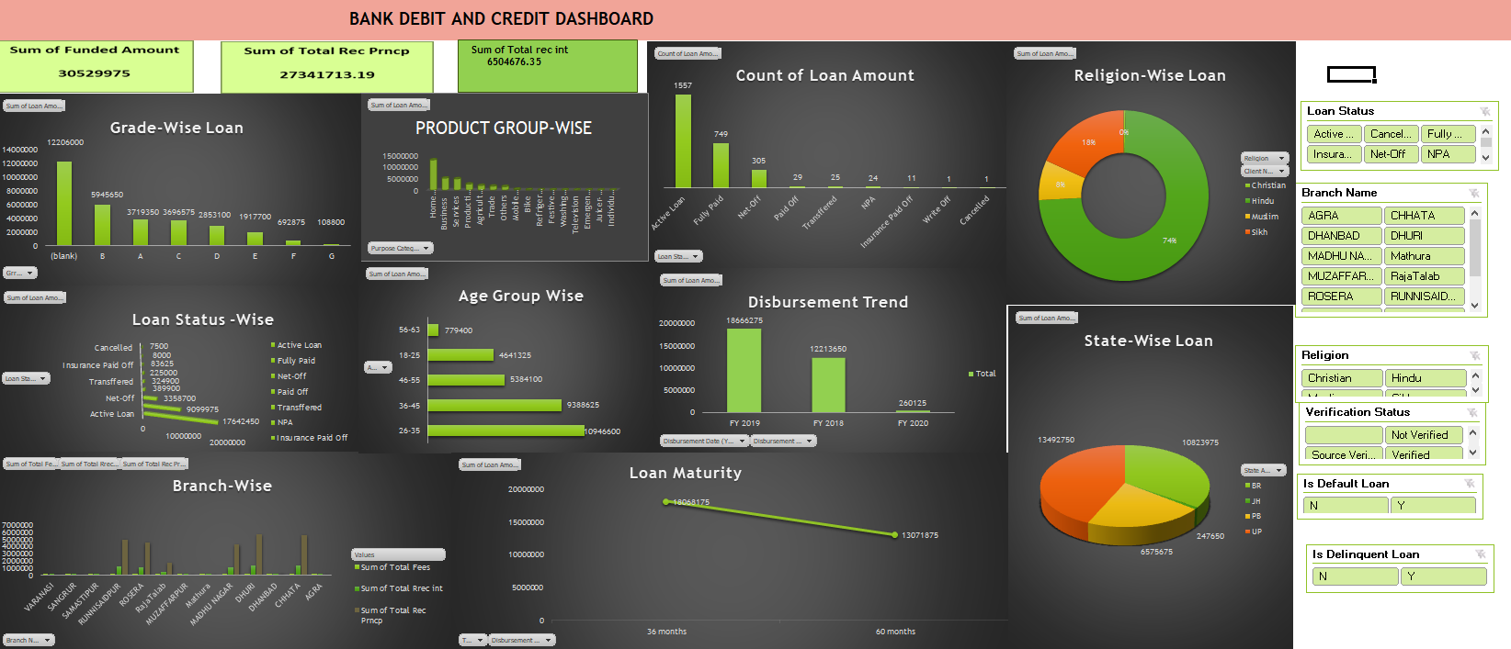
Excel Dashboard

Slide 37
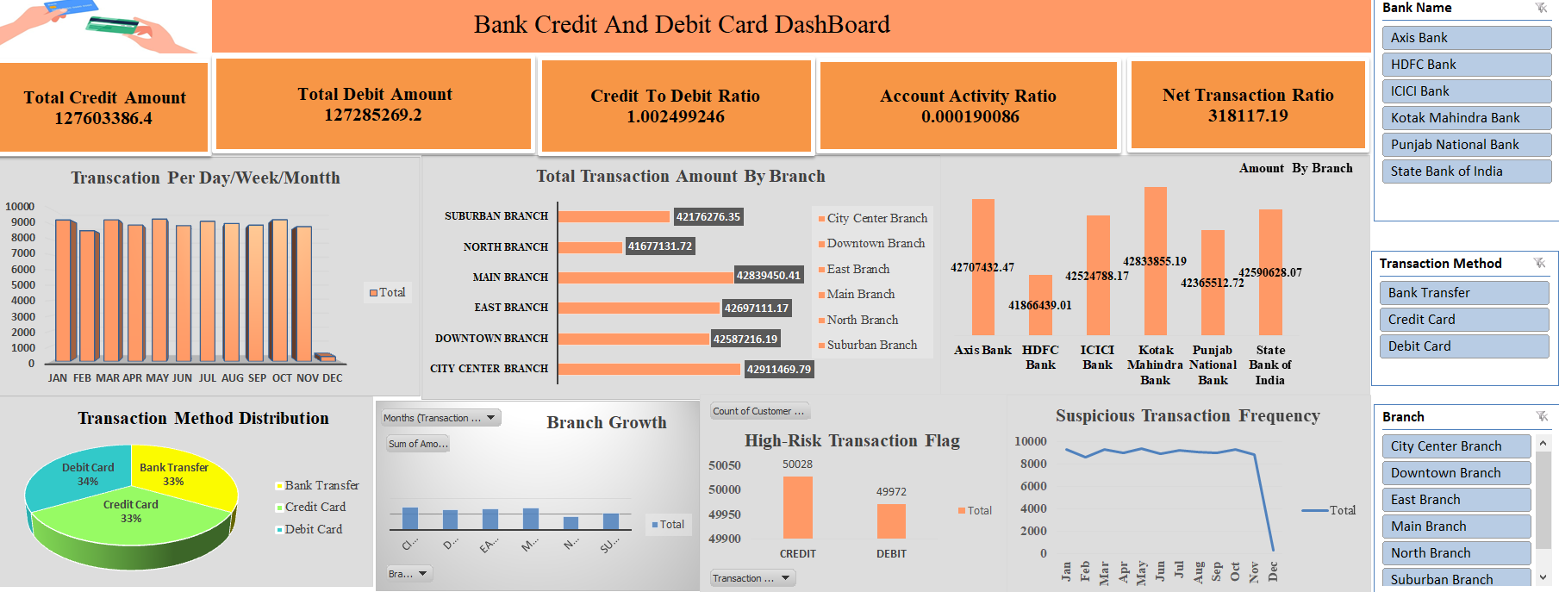
Excel Dashboard

Slide 38
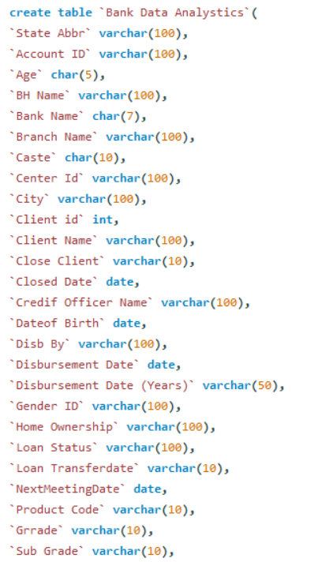
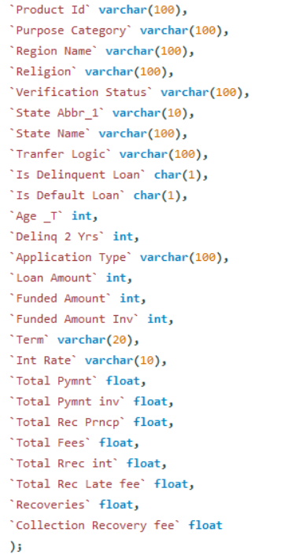
My SQL Query’s
Query’s For
Bank Data

Slide 39
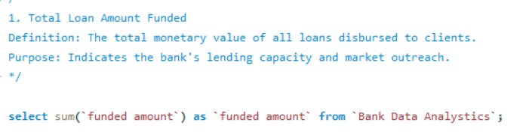
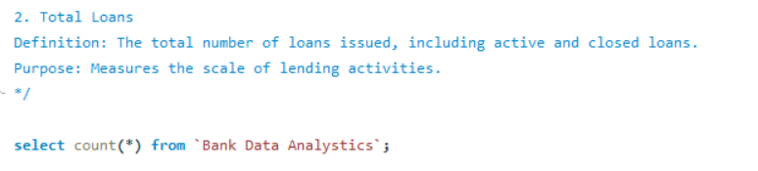
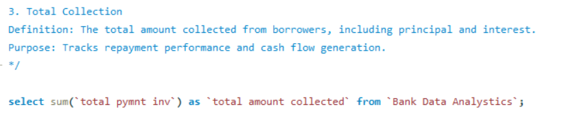
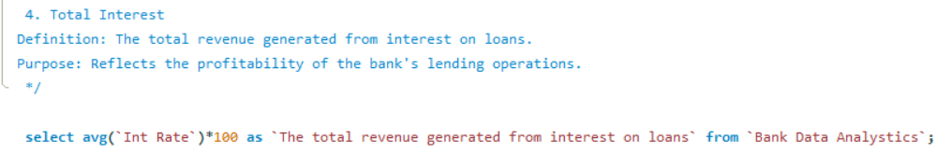
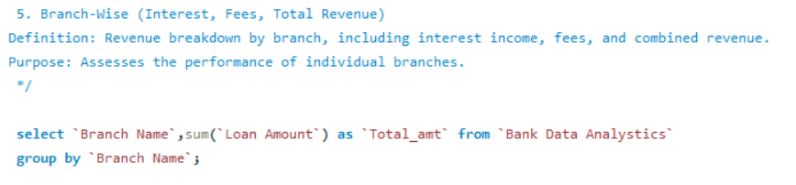
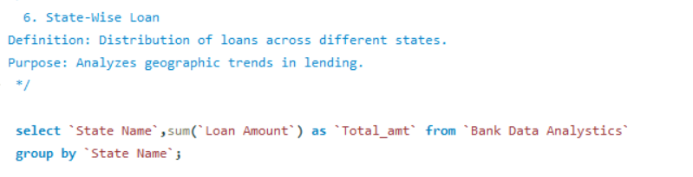
My SQL Query’s
KPI’s For Bank Dataset

Slide 40
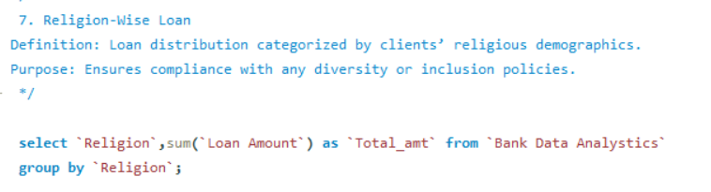
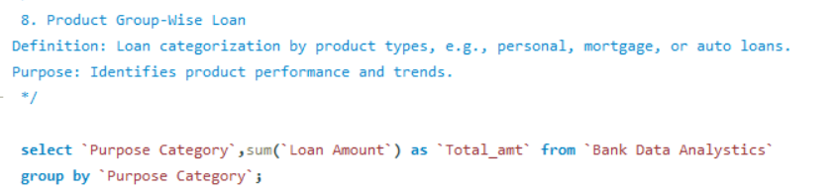
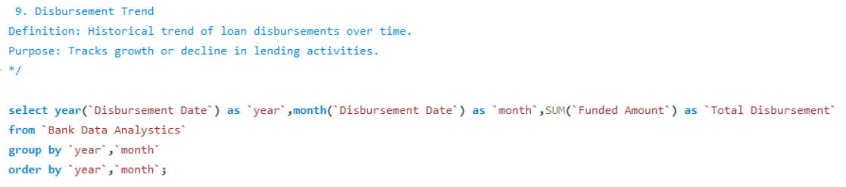
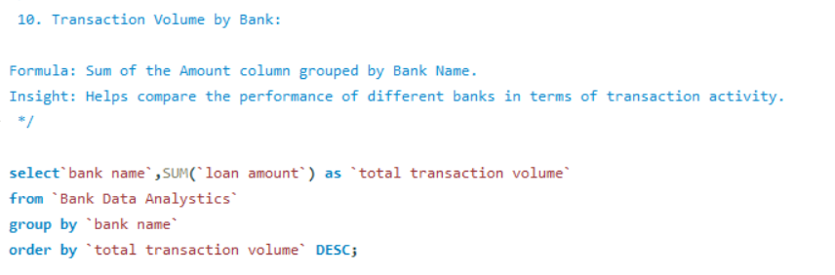
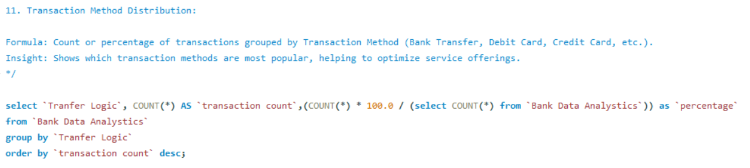
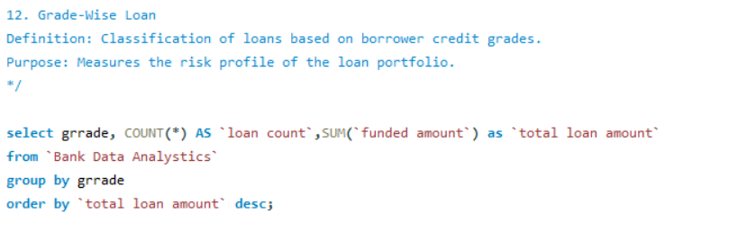
My SQL Query’s
KPI’s For Bank Dataset

Slide 41
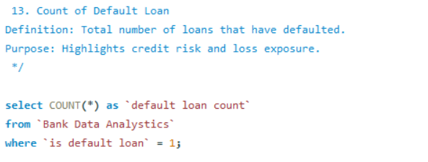
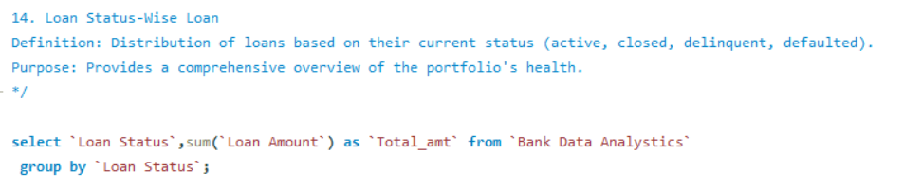
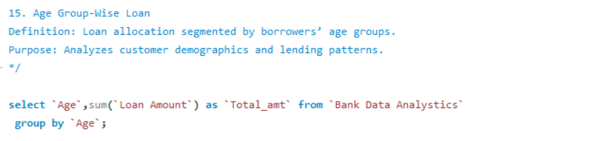
My SQL Query’s
KPI’s For Bank Dataset

Slide 42
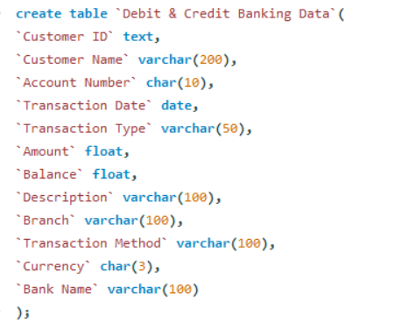
My SQL Query’s
Query’s For
Debit and Credit

Slide 43
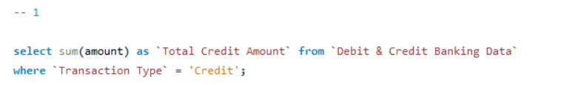
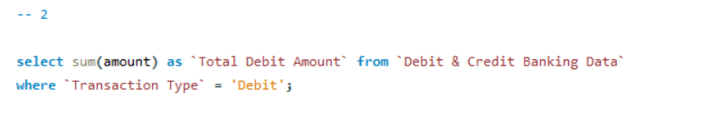
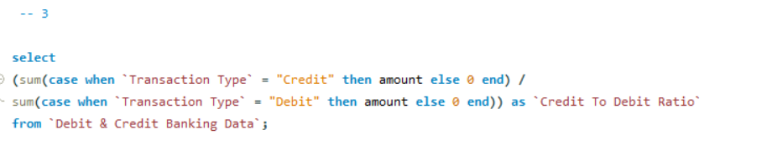
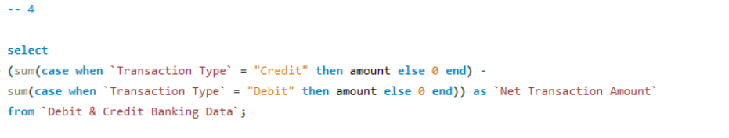
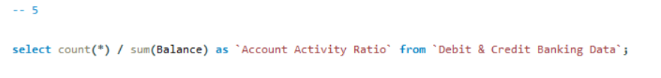
My SQL Query’s
KPI’s For Debit and Credit

Slide 44
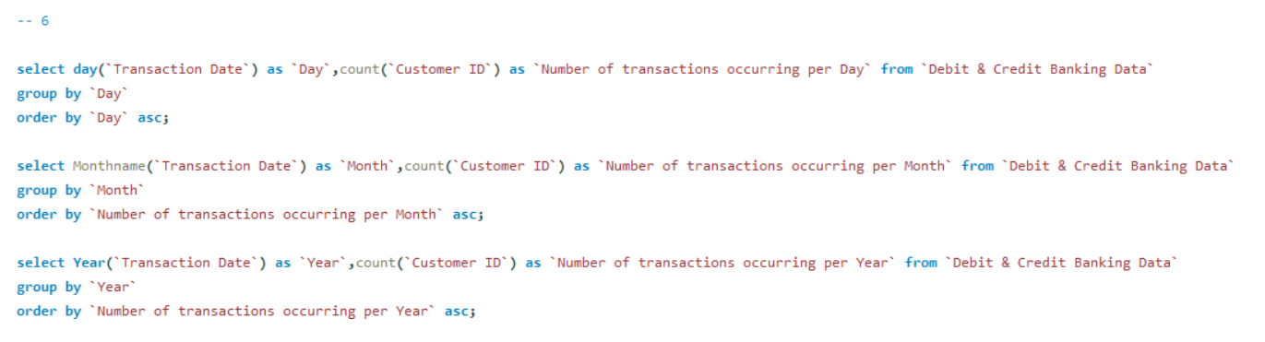
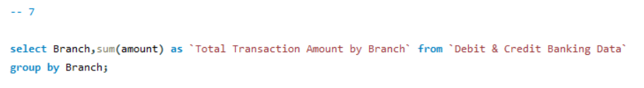
My SQL Query’s
KPI’s For Debit and Credit

Slide 45
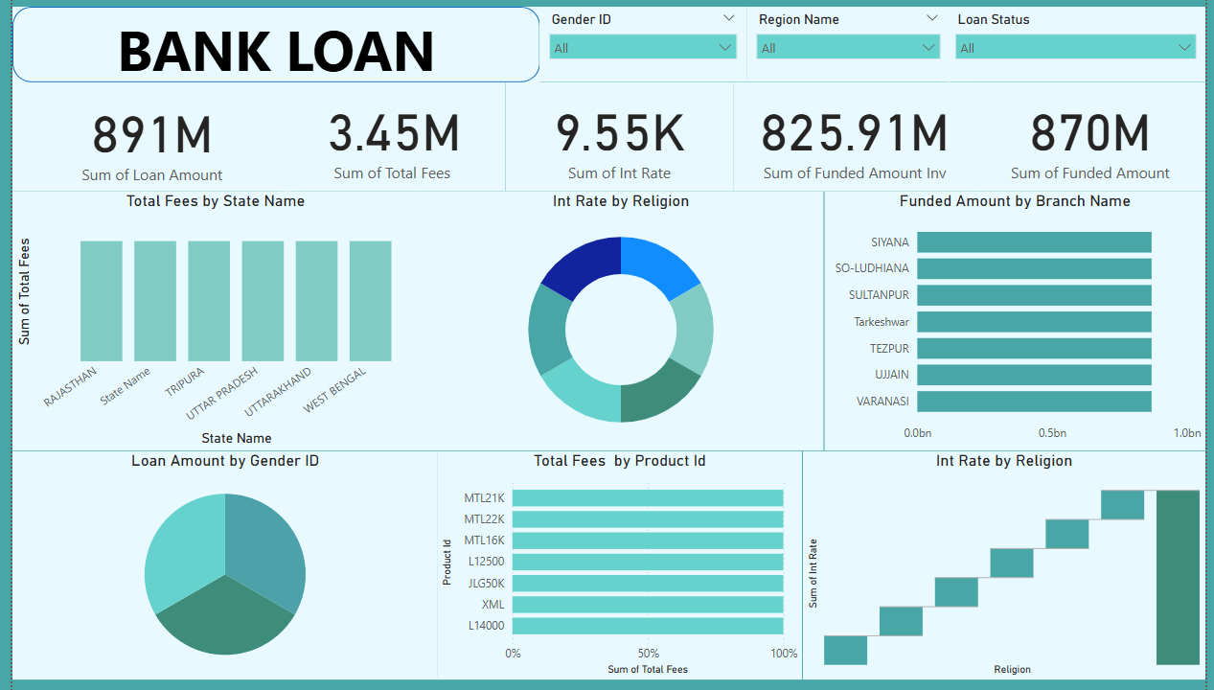
Power BI Dashboard

Slide 46
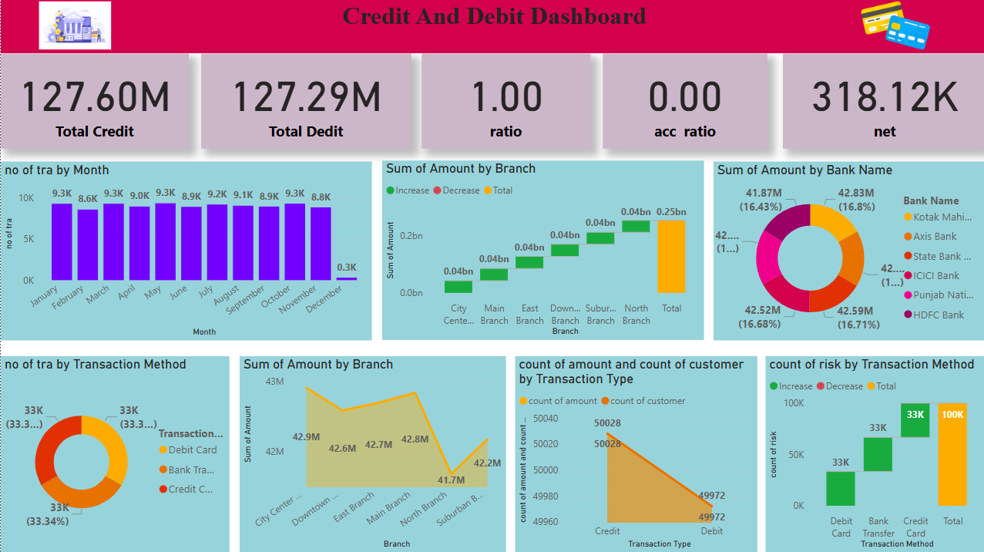
Power BI Dashboard

Slide 47
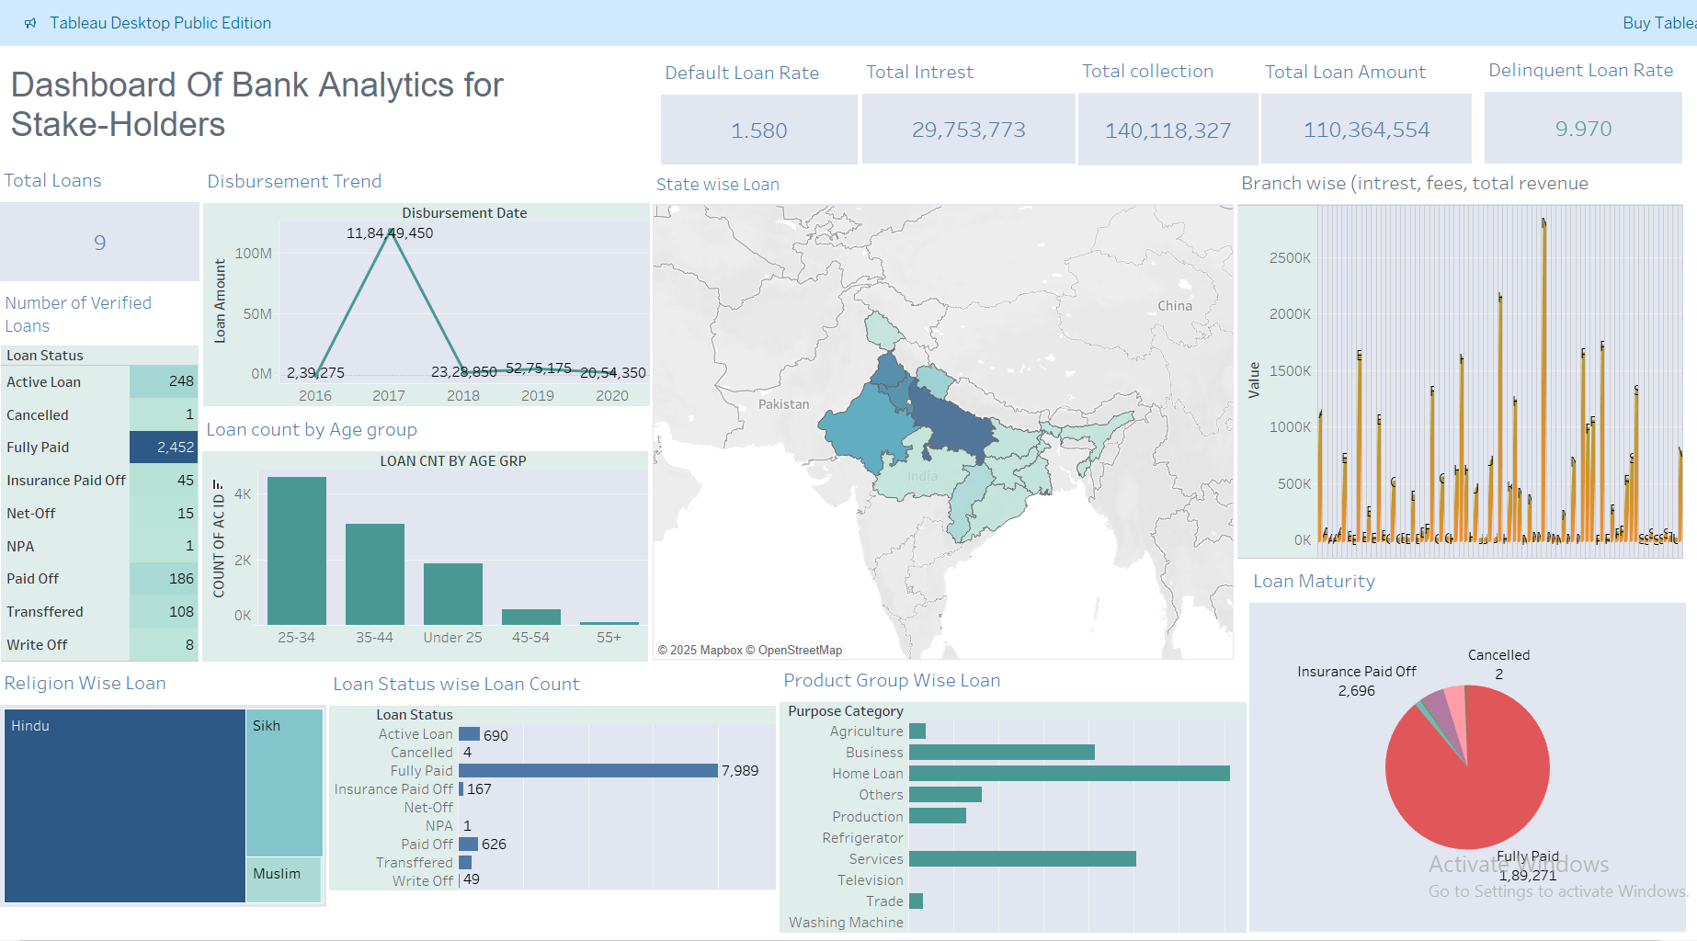
Tableau Dashboard

Slide 48

Tableau Dashboard

Slide 49
Challenges During Project
3
True challenge was to assemble our classroom knowledge and to put it into this real-world scenario.
Different opinions and priorities to be gathered as a team for each tasks.
Compiling and selecting the best outcomes for presentation.

Slide 50
What We Learn ?
Importance of key performance indicators in data analytics.
Parameters to be assessed after loan distribution by banks e.g. home ownership, revolving balance, grades, verification status, etc.
How all these parameters are extracted from data to make Pivot tables, charts and beautify interactive and mesmerizing dashboards in Excel, PowerBI and Tableau using slicers, filters, icons and images. Writing queries for the same in SQL.
4

Slide 51


