Slide 1
Hardware

Slide 2
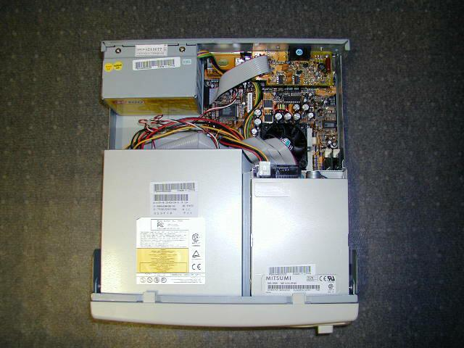

Slide 3
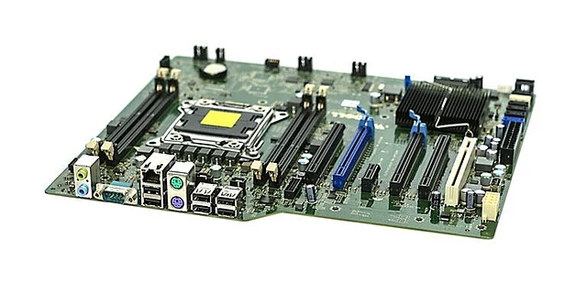
Typical Desktop Motherboard

Slide 4
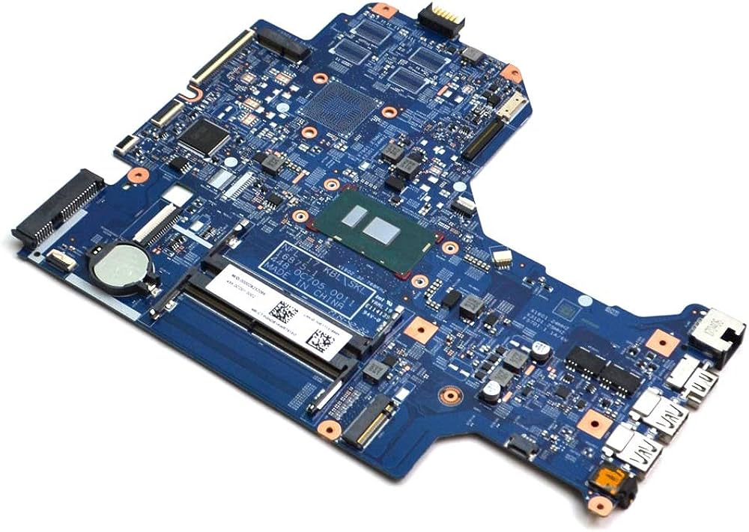
Typical Laptop Motherboard

Slide 5
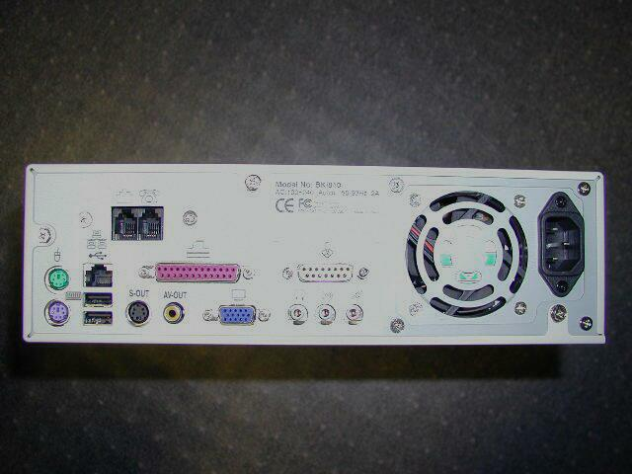
Back side of a desktop computer (ports, power supply, etc)

Slide 6
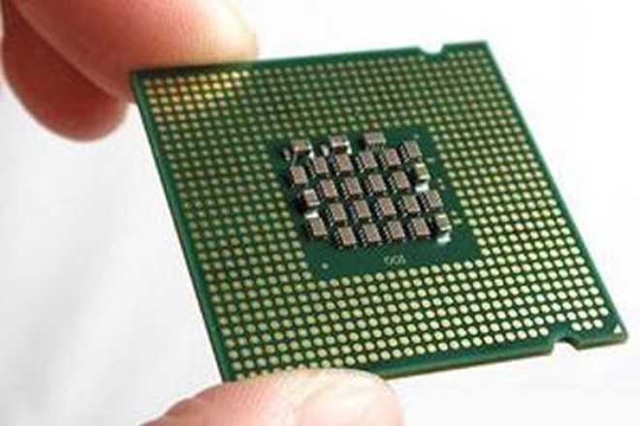
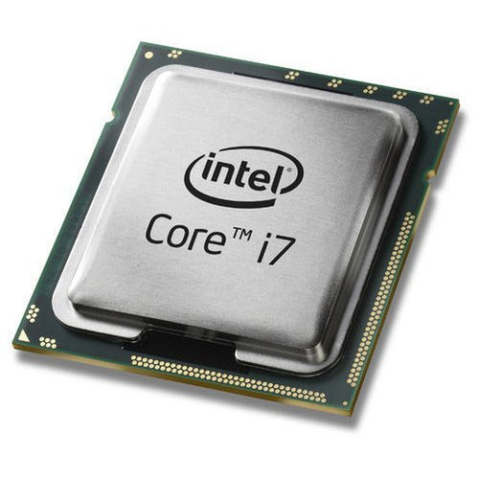
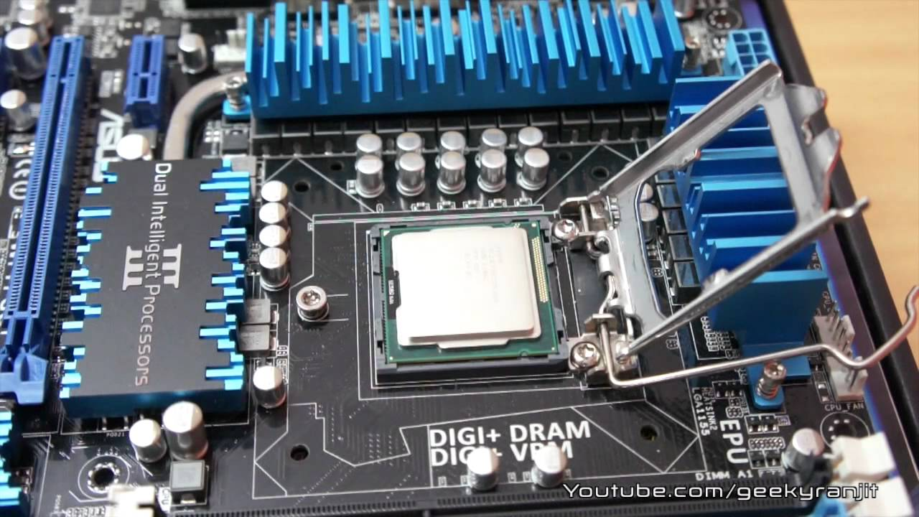
Processor
Top view
Processor is the “brain” of the computer.
  interprets instructions to the computer (control unit)
    Understands a language of instructions
    Called machine language
    Machine language is basically set of input electric signals to various pins on the processor
    We see the machine language as seq of 1s and 0s
  performs the arithmetic and logical processing (ALU)
    Done using manipulations of electronic signals
    Semiconductor physics, Combinatorial circuits, Switching theory
Bottom view
Slot on motherboard

Slide 7
Storage Devices

Slide 8
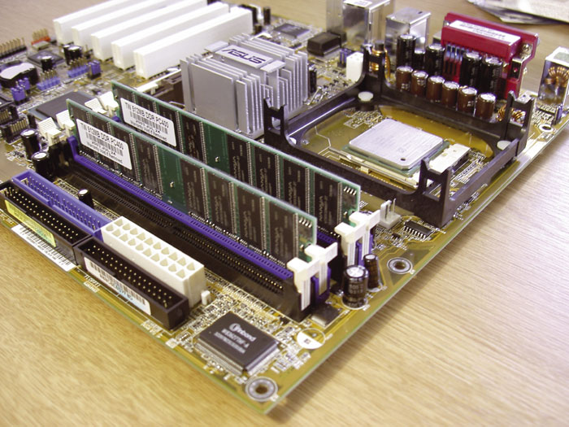
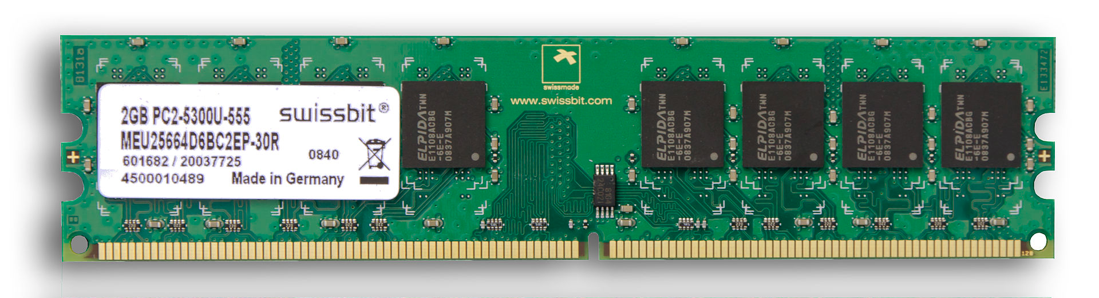
Memory
Random Access Memory (RAM, or just “memory”)
  Same time of access to any location – randomly accessible
  Semiconductor device
RAM chip
RAM fitting on motherboard

Slide 9
Memory i.e. RAM
Processor
Is connected to Processor via “Buses”
Bus
  Is a set of “wires”
  With a protocol – way to access the set of wires, meaning of each set of signals
Programs are stored in memory and then executed by the processor
Is “volatile”
  Contents lost on power OFF
RAM, ROM, PROM, EPROM, DRAM
BUS
RAM

Slide 10
Memory i.e. RAM
addresses
RAM
20
4G
4G-4
4G-8
...
...
...
1004
1000
4
0
Typical Size: 8 GB, 16 GB, etc.
Memory has “addresses”, locations where to store data
Addresses are numbered 0,1, 2, .... etc
But typically RAM is addressible on 4/8 byte boundaries
CPU reads and writes data to/from memory using addresses
In this diagram, the address 1000 contains a 4 byte number 20

Slide 11
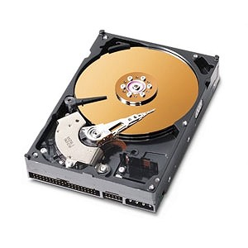
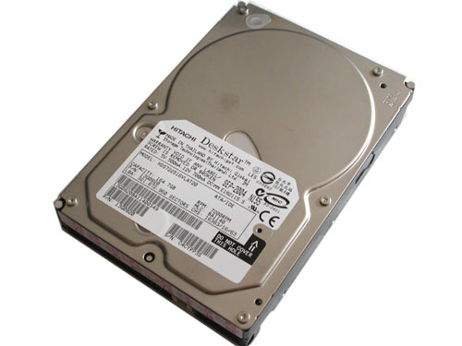
The Hard Drive

Slide 12
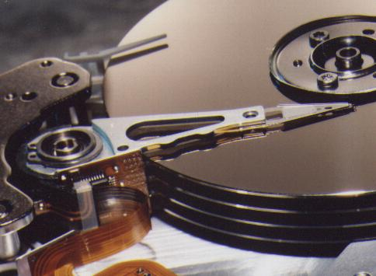
The Hard Drive
Spindle
Magnetic disks
Head

Slide 13
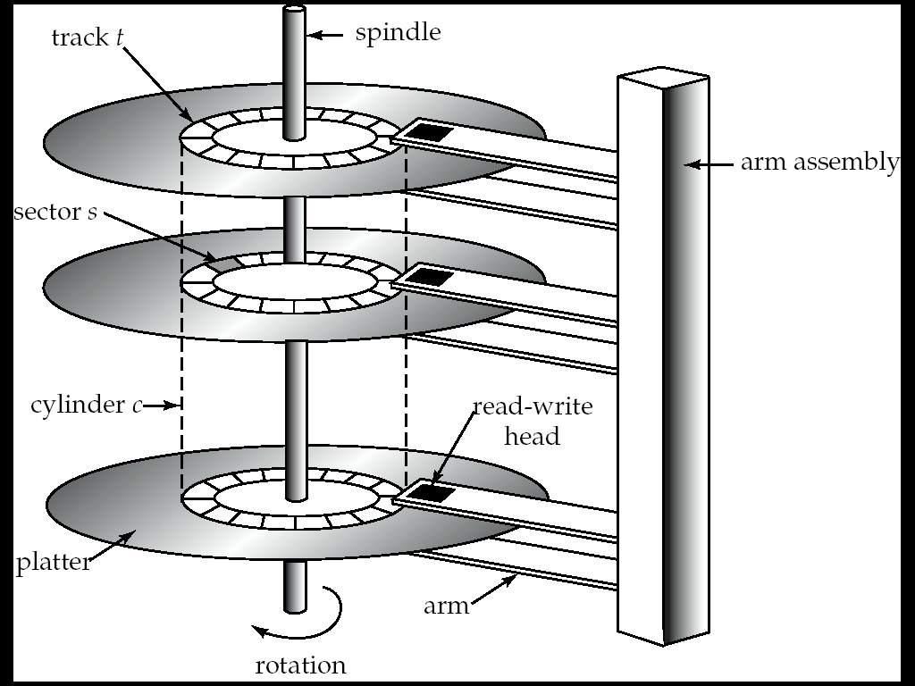
The hard Drive

Slide 14
The Hard Drive
Is a Magnetic device
Each disk divided into tiny magnetic spots, each representing 1 or 0
  What's the physics ?
  Two orientations of a magnet
Is “persistent”
  Data stays on powering-off
Is slow
IDE, SATA, SCSI, PATA, SAS, …

Slide 15
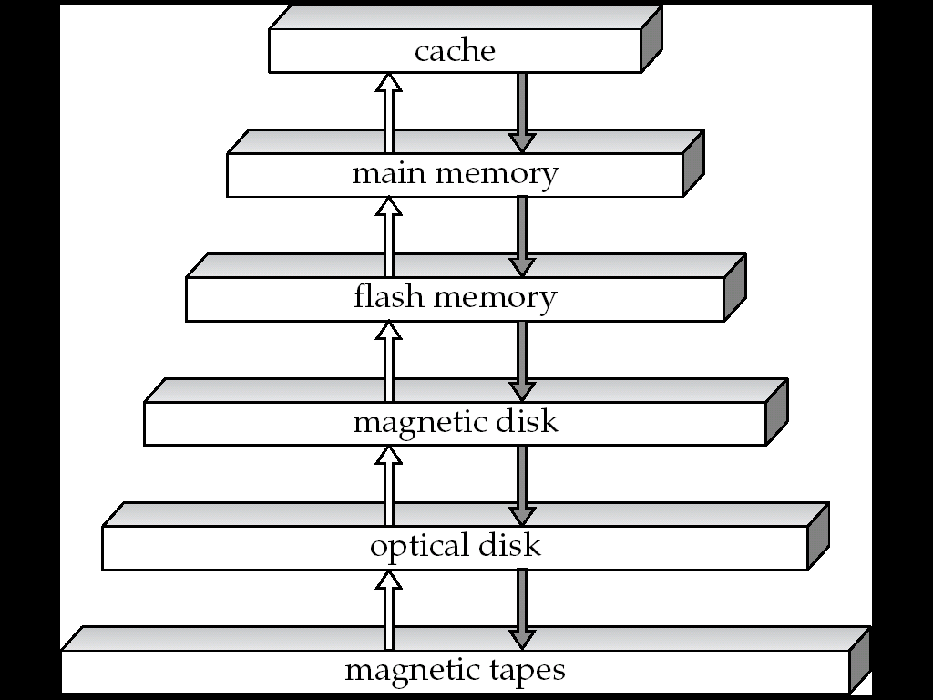
The storage hierarchy: In terms of access speed
Semiconductor Memory On CPU
Semiconductor Memory On Motherboard (RAM or Memory)
On Motherboard
Hard drive
CD
Tape

Slide 16
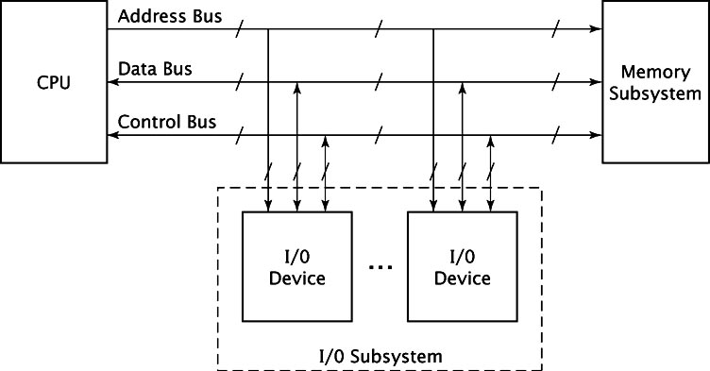
On the motherboard (simplified diagram)

Slide 17
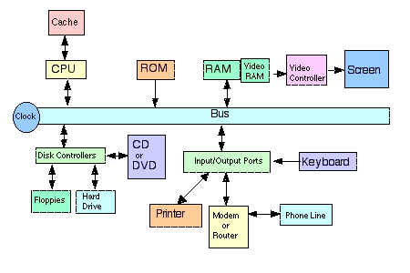
Connections on motherboard (simplified schematic diagram)

Slide 18
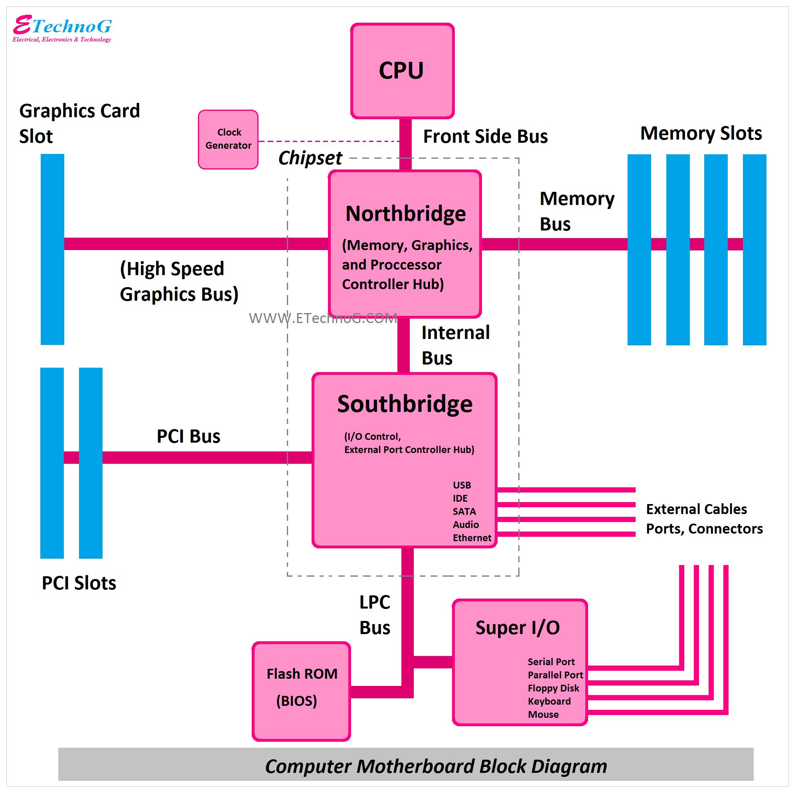
A slightley more realistic connection diagram
(No need to understand this right now!)

Slide 19
To write C programs, you really DO NOT have to understand how the hardware works in totality !
The C language itself provides use a “High Level” picture, and we work with it.
What is the “high level” picture?

