Slide 1
Basics of CO and
Hardware

Slide 2
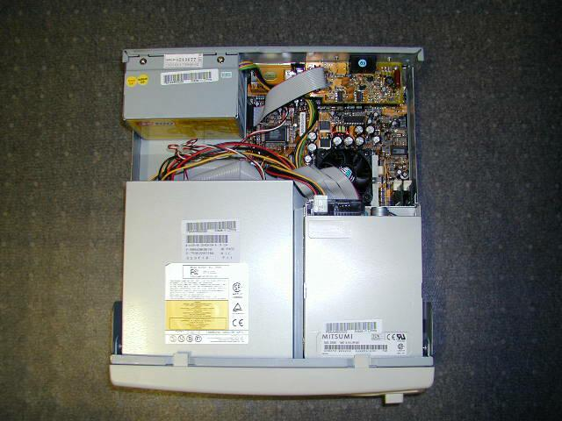

Slide 3
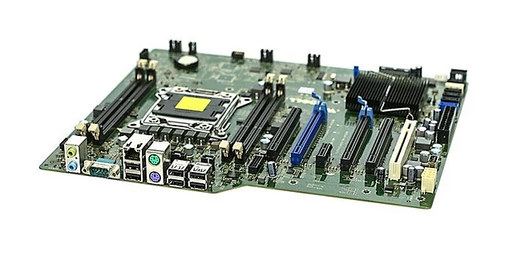
Typical Desktop Motherboard

Slide 4
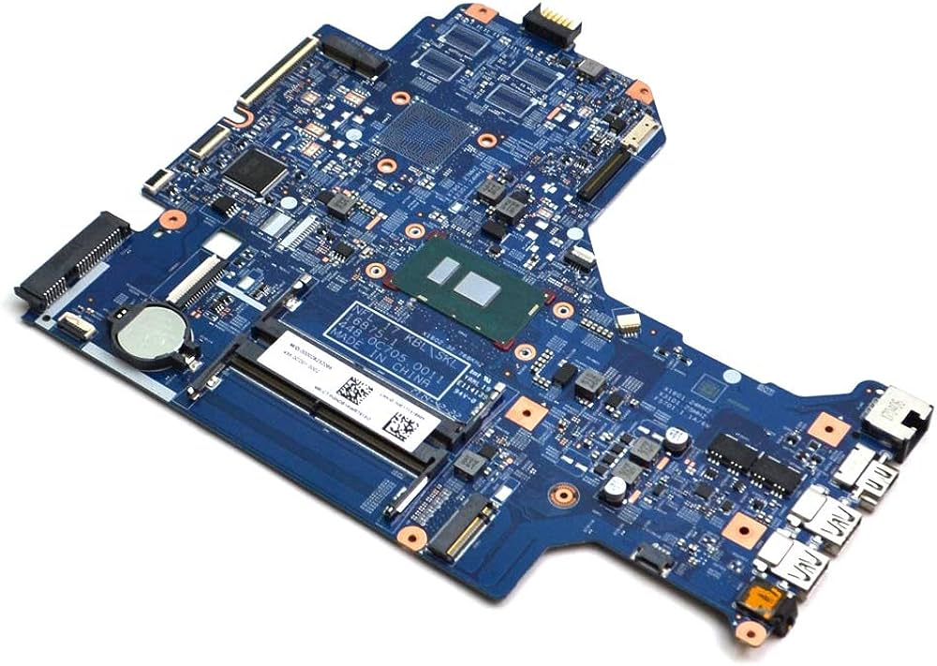
Typical Laptop Motherboard

Slide 5
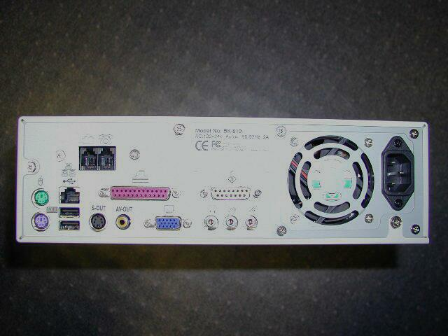
Back side of a desktop computer (ports, power supply, etc)

Slide 6
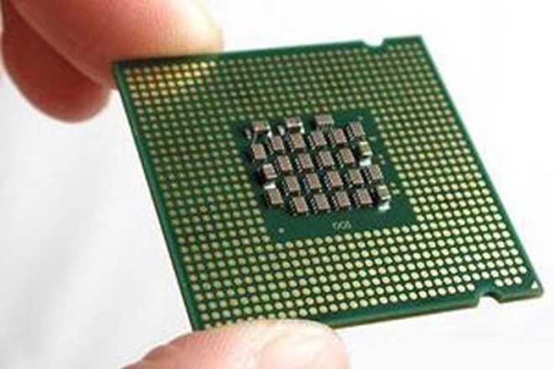
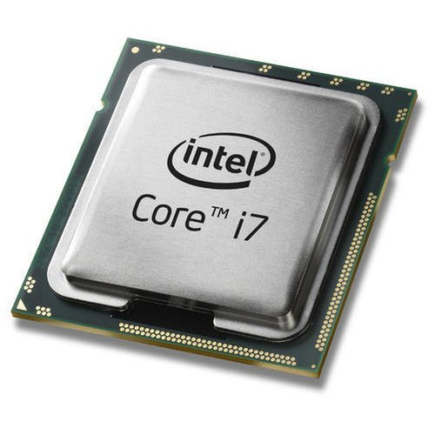
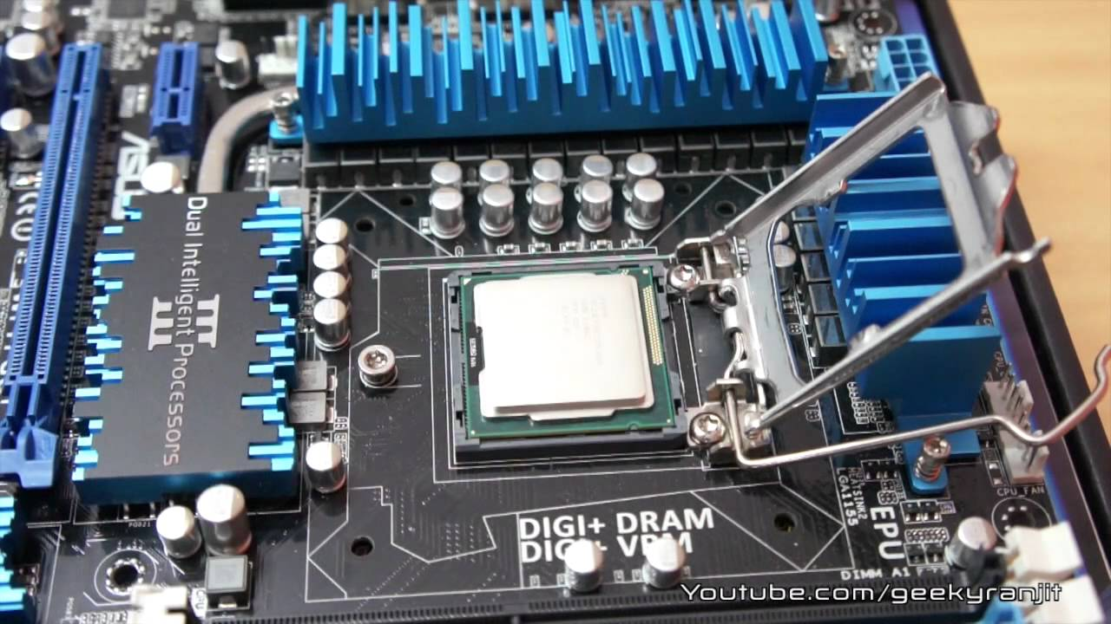
Processor
Top view
Processor is the “brain” of the computer.
  interprets instructions to the computer (control unit)
    Understands a language of instructions
    Called machine language
    Machine language is basically set of input electric signals to various pins on the processor
    We see the machine language as seq of 1s and 0s
  performs the arithmetic and logical processing (ALU)
    Done using manipulations of electronic signals
    Semiconductor physics, Combinatorial circuits, Switching theory
Bottom view
Slot on motherboard

Slide 7
Storage Devices

Slide 8
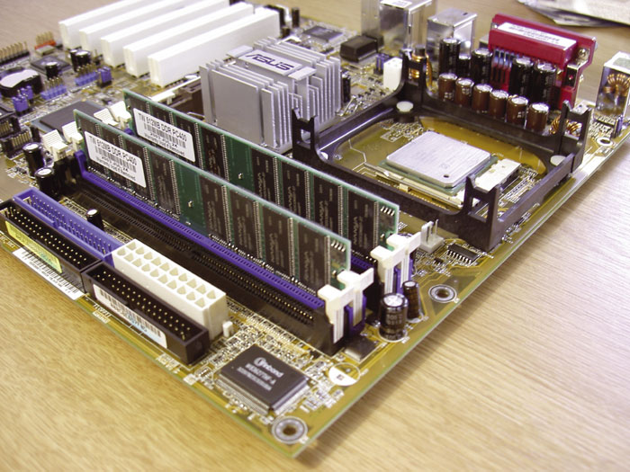
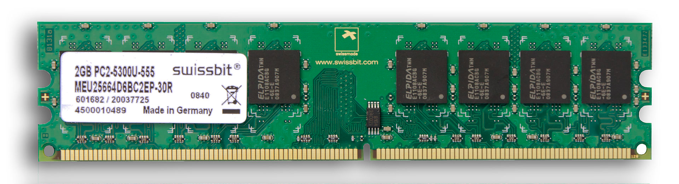
Memory
Random Access Memory (RAM, or just “memory”)
  Same time of access to any location – randomly accessible
  Semiconductor device
RAM chip
RAM fitting on motherboard

Slide 9
Memory i.e. RAM
Processor
Is connected to Processor via “Buses”
Bus
  Is a set of “wires”
  With a protocol – way to access the set of wires, meaning of each set of signals
Programs need to be stored in memory so that they can be executed by the processor
Is “volatile”
  Contents lost on power OFF
RAM, ROM, PROM, EPROM, DRAM
BUS
RAM

Slide 10
Memory i.e. RAM
addresses
RAM
20
4G
4G-4
4G-8
...
...
...
1004
1000
4
0
Typical Size: 8 GB, 16 GB, etc.
Memory has “addresses”, locations where to store data
Addresses are numbered 0,1, 2, .... etc
But typically RAM is addressible on 4/8 byte boundaries
CPU reads and writes data to/from memory using addresses
In this diagram, the address 1000 contains a 4 byte number 20

Slide 11
Hardware and software:
How a program gets executed

Slide 12
Very imp
What does a CPU do?
1. Fetch instruction
  from RAM address given in PC
  Over the CPU-RAM bus
2. Decode instruction
  Decide what is to be done, add/sub/load/store/jmp/call etc
3. Execute instruction
  Use the ALU to do the job (add/sub/call/jmp etc)
  May change the PC (PC = PC +4 or PC = new value)
4. Goto 1

Slide 13
How program gets executed
256 MB
A
B
C
Bus
Processor
Auto increment
Add r1, r2
Program counter
Mov $400, r2
Mov $200, r1
0
Memory

Slide 14
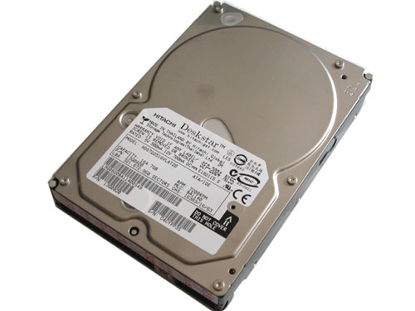
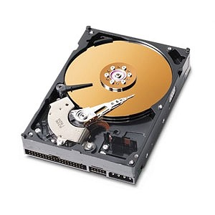
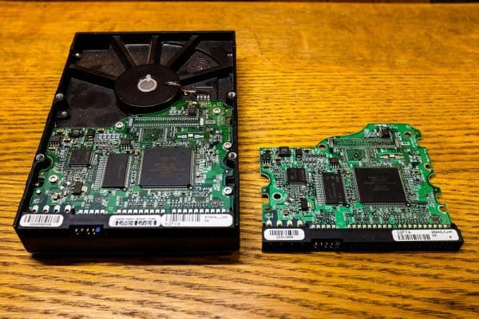
The Hard Drive
Inside the disk
Disk controller

Slide 15
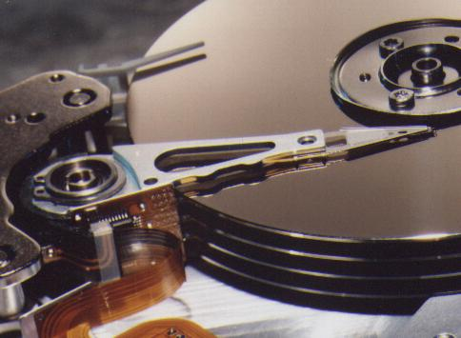
The Hard Drive: inside
Spindle
Magnetic disks
Head

Slide 16
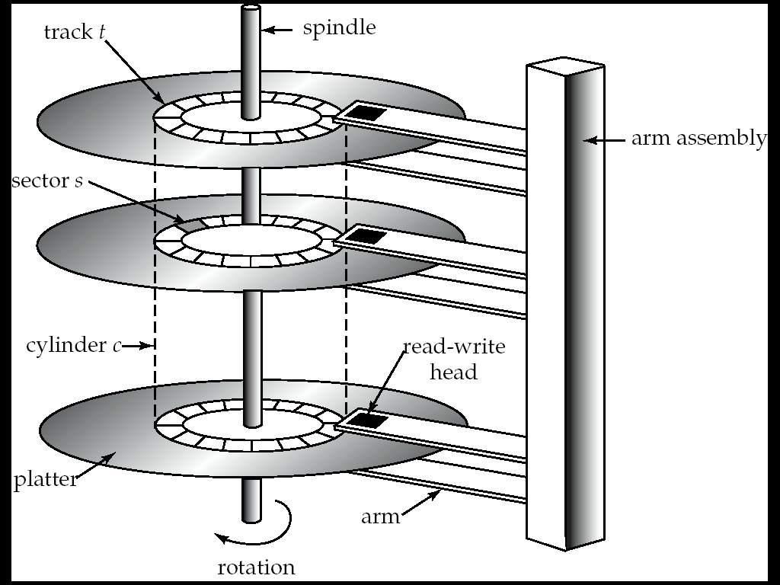
The hard Drive: inside

Slide 17
The Hard Drive
Is a Magnetic device
Each disk divided into tiny magnetic spots, each representing 1 or 0
  What's the physics ?
Is “persistent”: Data stays on powering-off
Is slow
IDE, SATA, SCSI, PATA, SAS, …
“Block” accessible
  You can read/write a 512 byte sector only. Can’t read/write a particular byte
Disk Controller:
  Electronic circuit on the disk, moves the mechanical parts, can be told to read/write a particular “sector” on the disk.

Slide 18
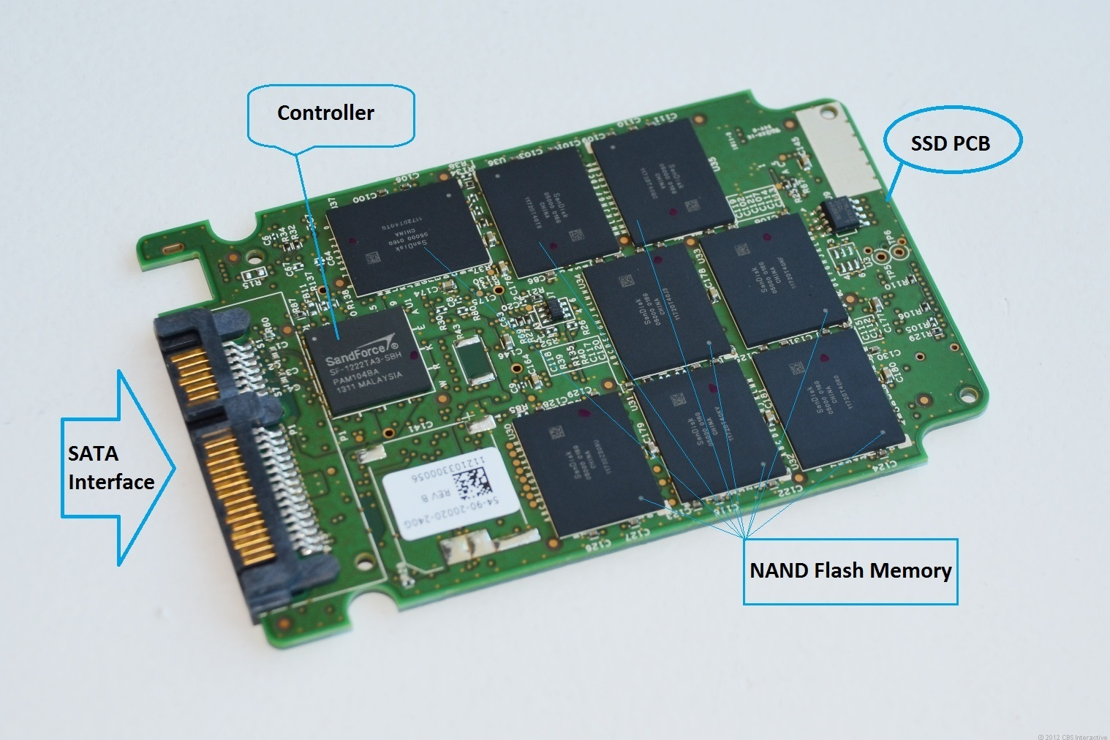
Solid State Drives (SSD)

Slide 19
Device Controllers
Every hardware device comes with a “device controller”
  It is an electronic circuit
  The manufacturer of the device makes it
Controllers convert mechanical world data into electronic world data
  e.g. physical movement of mouse is converted by mouse controller into electrical signals (some bits!)
  The disk controller converts electronic siganls (bits!) into rotations and movement of the disk head
  The disk controller converts the key presses (one or more keys) into a Key-code (bits or signals!)
The first software layer that is built over the controller is called “Device Driver”
  It is typically part of the kernel
  Typically device manufacturers themselves write the device drivers (mostly in C) and make them available (on their website). Often they are just called “drivers”
  You can also write your own device drivers, if you know how the controller works
  E.g. (remember this) the file ide.c is a disk driver in the code of xv6

Slide 20
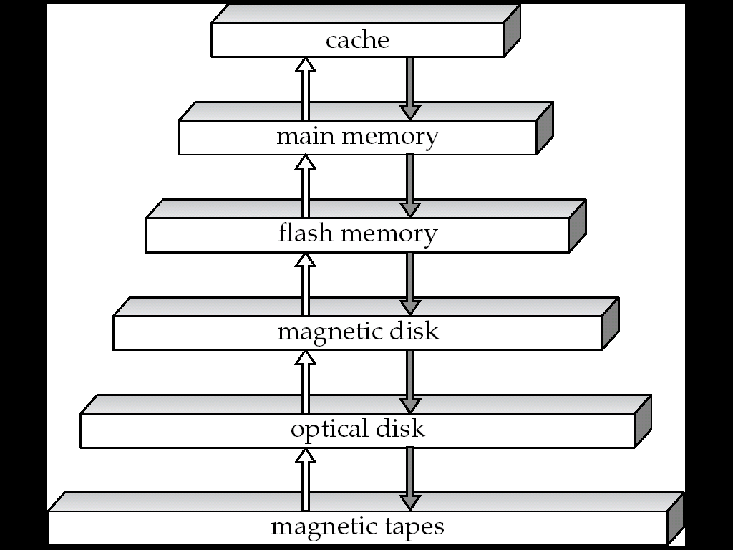
The storage hierarchy: In terms of access speed
Semiconductor Memory On CPU
Semiconductor Memory On Motherboard (RAM or Memory)
On Motherboard
Hard drive
CD
Tape
It is given to use,
not chosen by us. Many major problems in CS are a result of this.

Slide 21
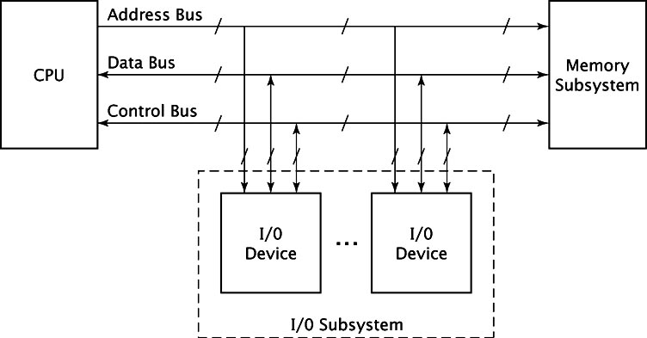
On the motherboard (simplified diagram)

Slide 22
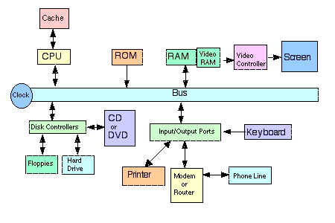
Connections on motherboard (simplified schematic diagram)

Slide 23
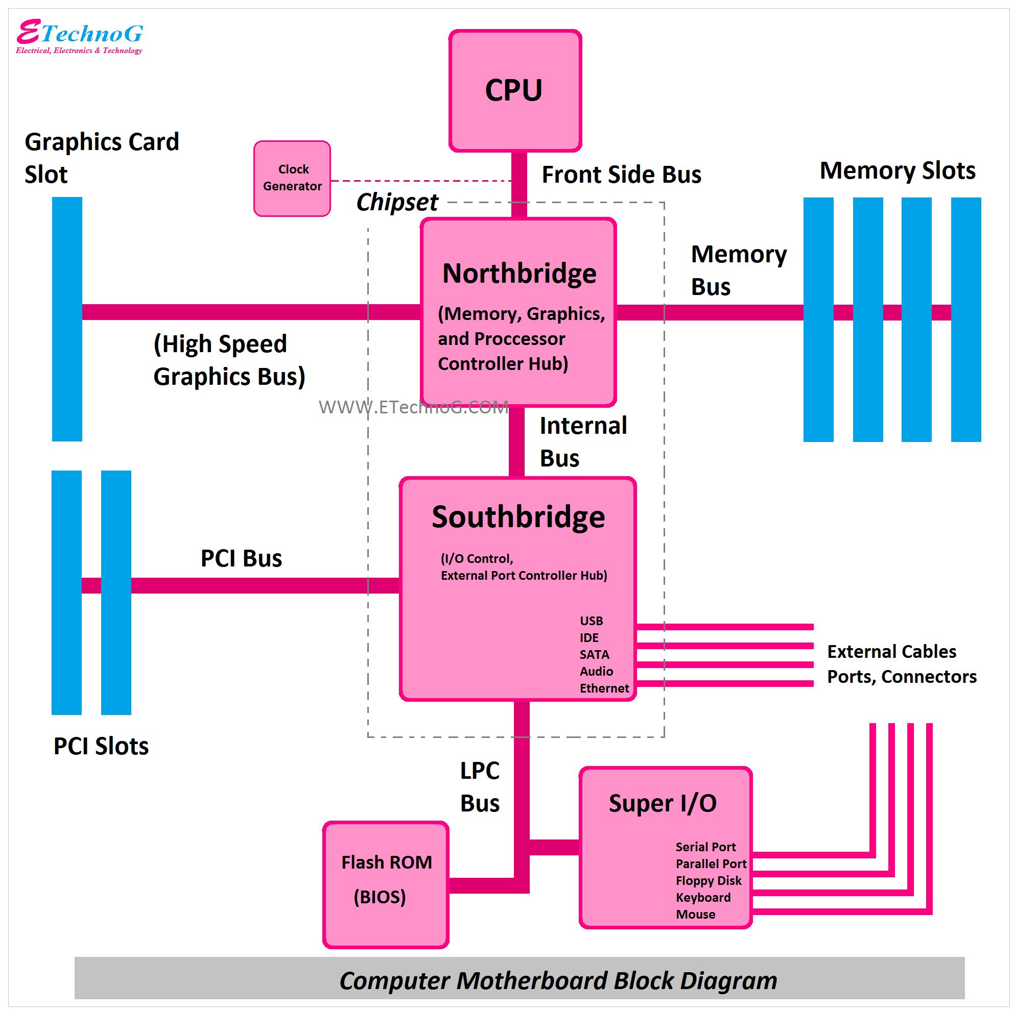
A slightley more realistic connection diagram
(No need to understand this right now!)

Slide 24
To write C programs, you really DO NOT have to understand how the hardware works in totality !
The C language itself provides use a “High Level” picture, and we work with it.
What is the “high level” picture?
You wrote and executed application programs assuming: You program will get (entire) CPU, it will get RAM as needed, and it can access files (on disk) using path names like /home/student/a.c.
This gap between application world (Your C programs with a main()) and hardware world (CPU, RAM, device controllers) is filled by the OS.

