Slide 1
Introduction to Applications, Files,
Linux commands
and
Basics of System Calls
Abhijit A. M.
abhijit.comp@coep.ac.in

Slide 2

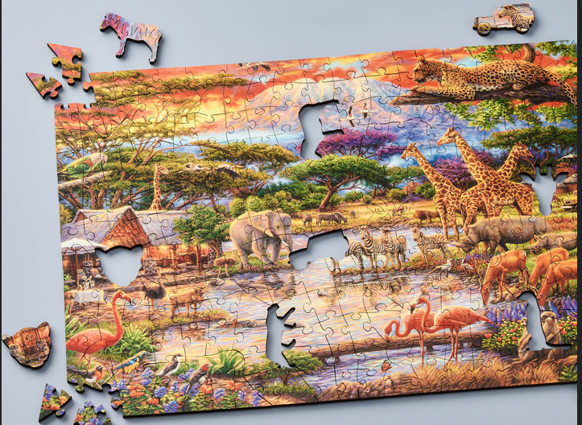
Learning involves solving a JIGSAW puzzle.
Can you fit in concepts? Can you find empty slots? Can you find patterns?
OS is a very complex JIGSAW puzzle.

Slide 3
In the OS Jigsaw puzzle, always ask:
Who does what, when, why, how, for whom ....

Slide 4
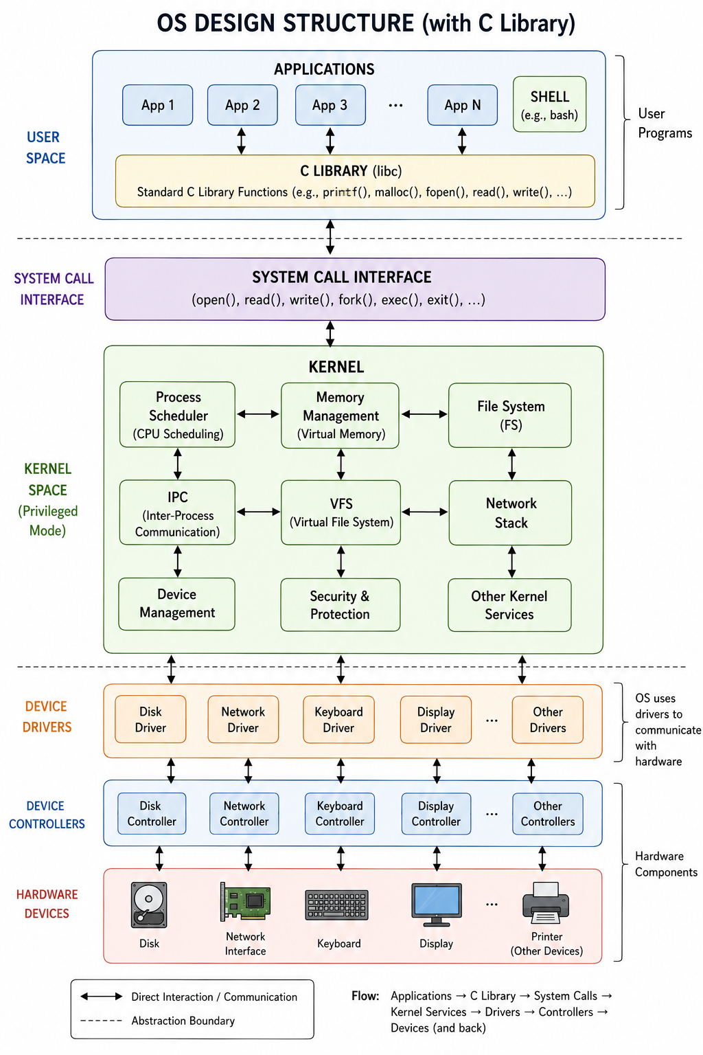
In reality, its more nuanced, layered, with more details

Slide 5
In reality, its more nuanced, layered, with more details

Slide 6
Basic concepts about Unix/Linux commands
Beginning to understand ...
Files, processes

Slide 7
To understand command line, lets undersatnd few Key Concepts
What is a file?
  File is a “dumb” sequence of bytes lying on the hard disk (or SSD or CD or PD, etc)
  It has a name, owner, size, etc.
  Does not do anything on its own ! Just stays there !
  Files are located in directories. Hiearacrhical structure.
  Pathnames:
    /home/student/a.c /x/y/z.tmp /a/b

Slide 8
Few Key Concepts
What is an application?
  Application is a program that runs in an “environment” created by the operating system, under the control of the operating system
    Hence also called “User Applications”
  Lets use these words differently: Program, Application, Code.
    Code: Any piece of complete/incomplete programming language
    Program: Any piece of “complete” code (OS, device drivers, applications, ...) that does something on its own
    Application: as above
Code
Programs
apps

Slide 9
What is a process?
An application that is in execution is a process
Program:
  File sitting on disk !
  e.g. your “a.out” file or
  When you run
    Cc myprog.c -o myprog
    Then the “myprog” file
Process
  When you run it (and as long as it runs)!
    $./myprog
To see list of processes: run “ps” “ps -a” “ps -eaf”

Slide 10
Lets begin with few basic Linux/Unix commands
pwd
ls
cd

Slide 11
Few more commands
Come commands
  ls -l /tmp/
  ls -l -a /home / /var/www/html
  cat /etc/passwd
  head -5 /etc/passwd
  echo “hi”
Concepts:
  Options : -a -5 -l
  Arguments: /var/www/html /home “hi”
  See “man <cmd>” e.g. “man ls”

Slide 12
Few misconceptions from GUI world
Files don't open themselves
  Always some application/program open()s a file.
Files don't display themselves
  A file is displayed by the program which opens it. Each program has it's own way of handling files
  It’s possible NOT TO HAVE an application to display/show a file

Slide 13
Few misconceptions from GUI world
Programs don't run themselves
  You click on a program, or run a command --> equivalent to request to Operating System to run it. The OS runs your program
Users (humans) request OS to run programs, using Graphical or Command line interface
  and programs open files

Slide 14
Summary
Users interact with applications
Only applications can open files
When you click on a file
  the GUI application asks the kernel to run a particular application
  the GUI passes the name of the file to kernel
    and the kernel to the particular application
  the particular application open() the file

Slide 15
File/directory: Path names
Tree like directory structure
Root directory called /
Programs that deal with files, need to identify files using path names
  A absolute/complete path name for a file.
    /home/student/a.c
    Begins with a “/”
  Relative path names, . and .. notation
    concept: every running program has a current working directory
    . current directory
    .. parent directory
    E.g. ./Desktop/xyz/../p.c
    It begins with a “.” or “..” or (without “.” or “/” in beginning - then “./” is assumed)

Slide 16
A command (written on shell prompt)
Command is a request to the kernel to execute an application.
Name of command, is name of an executable file
  For example: 'ls' is actually “/usr/bin/ls”
Command takes arguments
  E.g. ls /tmp/
Command takes options
  E.g. ls -a

Slide 17
A command
Command can take both arguments and options
  E.g. ls -a /tmp/
Options and arguments are basically argv[] of the main() of that program . The “Shell” passes them to kernel, and kernel passes them to the application’s main()
  int main(int argc, char *argv[]) {
    int i;
    for(i = 0; i < argc; i++)
      Printf(“%s\n”, argv[i]);
  }
  $ ./a.out hi hello 123 /a/b/c.c ./m/a.c

Slide 18
Basic Navigation Commands
pwd
ls
  ls -l
  ls -l /tmp/
  ls -l /home/student/Desktop
  ls -l ./Desktop
  ls -a
  \ls -F
cd
  cd /tmp/
  cd
  cd /home/student/Desktop
notation: ~
  cd ~
  cd ~/Desktop
  ls ~/Desktop
Map these commands to navigation using a graphical file browser
To be a good command line user
  Always think about “pwd” and relative path names
  Use pwd, cd, ls extensively

Slide 19
Unix job control
Start a background process:
  gedit a.c &
  gedit
  hit ctrl-z
  bg
Where did it go?
  jobs
  ps
Terminate the job: kill it
  kill %jobid
  kill pid
Bring it back into the foreground
  fg %1

Slide 20
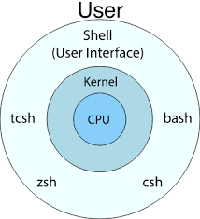
The Shell
Shell = Cover
Covers some of the Operating System's “System Calls” (mainly fork+exec) for the Applications
Talks with Users and Applications and does some talk with OS
Not a very accurate diagram !
http://code.snipcademy.com/tutorials/linux-command-line/environment/shells

Slide 21
The Shell
Shell waits for user's input
Requests the OS to run a program which the user has asked to run
Again waits for user's input
GUI is a Shell !
So is the command-line “bash” shell!

