Slide 1
System Calls, fork(), exec()
Shell
Abhijit A. M.
abhijit.comp@coep.ac.in
(C) Abhijit A.M.
Available under Creative Commons Attribution-ShareAlike License V3.0+
Credits: Slides of “OS Book” ed10.

Slide 2

Components of a computer system
Abstract view

Slide 3


Slide 4
System Calls
Services provided by operating system to applications
  Essentially available to applications by calling the particular software interrupt application
    All system calls essentially involve the “INT 0x80” on x86 processors + Linux
    Different arguments specified in EAX register inform the kernel about different system calls
The C library has wrapper functions for each of the system calls
  E.g. open(), read(), write(), fork(), mmap(), etc.

Slide 5
Types of System Calls
File System Related
  Open(), read(), write(), close(), etc.
Processes Related
  Fork(), exec(), ...
Memory management related
  Mmap(), shm_open(), ...
Device Management
Information maintainance – time,date
Communication between processes (IPC)
Read man syscalls
https://linuxhint.com/list_of_linux_syscalls/

Slide 6
Two important system calls
Related to processes
fork() and exec()

Slide 7
Process
A program in execution
Exists in RAM
Scheduled by OS
  In a timesharing system, intermittantly scheduled by allocating a time quantum, e.g. 20 microseconds
The “ps” command on Linux

Slide 8
Process
Kernel creates processes (we will see today – how !)
The kernel maintains one PCB (Process Control Block) per process
  All PCBs are stored as an array, or a linked list or multiple linked lists
Each process is given a unique PID (Process ID) by the kernel
  stored in the PCB

Slide 9
Creating a process involves allocating RAM
Memory is required to store the following components of a process
  Code
  Global variables (data)
  Stack (stores local variables of functions)
  Heap (stores malloced memory)
  Shared libraries (e.g. code of printf, etc)
  Few other things, may be

Slide 10

MS-DOS: a single tasking operating system
Only one program in RAM at a time, and only one program can run at a time
“Command Interpreter” is a Shell type program.

Slide 11

A multi tasking system
With multiple programs loaded in memory
Along with kernel
(A very simplified conceptual diagram. Things are more complex in reality)

Slide 12
fork()
A running process creates it’s own duplicate!
After call to fork() is over
  Two processes are running
  Identical
  The calling function returns in two places!
  Caller is called parent, and the new process is called child
  PID is returned to parent and 0 to child

Slide 13
exec()
Variants: execvp(), execl(), etc.
Takes the path name of an executable as an argument
Overwrites the existing process using the code provided in the executable
The original process is OVER ! Vanished!
The new program starts running overwritting the existing process!

Slide 14
Let's Understand fork() and exec()
#include <unistd.h>
int main() {
fork();
printf("hi\n");
return 0;
}
#include <unistd.h>
int main() {
printf("hi\n");
execl("/bin/ls", "ls", NULL);
printf("bye\n");
return 0;
}

Slide 15
A simple shell
#include <stdio.h>
#include <unistd.h>
int main() {
char string[128];
int pid;
while(1) {
printf("prompt>");
scanf("%s", string);
pid = fork();
if(pid == 0) {
execl(string, string, NULL);
} else {
wait(0);
}
}
}

Slide 16
Shell using fork and exec
Demo
The only way a process can be created on Unix/Linux is using fork() + exec()
All processes that you see were started by some other process using fork() + exec() , except the initial “init” process
When you click on “firefox” icon, the user-interface program does a fork() + exec() to start firefox; same with a command line shell program
The “bash” shell you have been using is nothing but an advanced version of the shell code shown during the demo
See the process tree starting from “init”
Your next assignment

Slide 17
Shell variables
Bash understand variables
  User defined
  Pre-defined variables
    E.g. PATH, HOME, PS1, PWD, USER, ...
PATH variable
  Sequence of directories used to search for an executable file
    ls is /usr/bin/ls is found using PATH
  Try changing PATH

Slide 18
The Boot sequence
CPU is always doing fetch-decode-execute-repeat
What does it run ? After power-ON till you see a terminal?
  Boot sequence
We know: shell <- terminal <- systemd <- init
How did we reach init?
  Ans: BIOS -> Boot Loader -> Kernel -> init

Slide 19
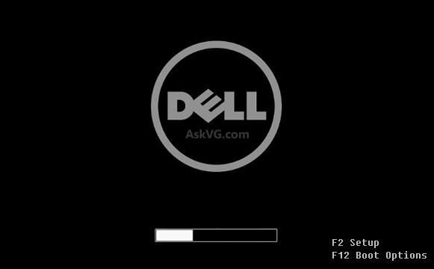
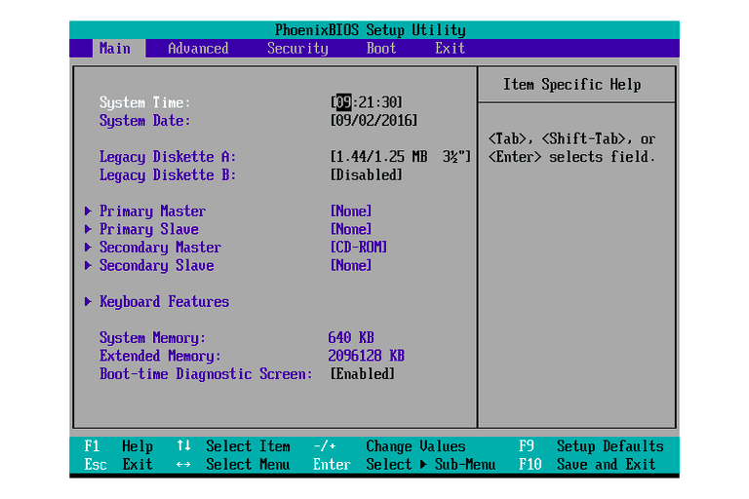
The boot Sequence:
BIOS -> Boot Loader -> Kernel -> init
BIOS/UEFI
  The firmware (stored in ROM). Runs “Automatically”.
  Shows you Manufacturer logo, and options like “Press F2 for Setup”, etc.
  CPU is hardwired to start running instructions stored a a fixed address, when powered ON
    The Motherboard manufacturers, ensure that the BIOS/UEFI is at his address
  BIOS contains ISRs also !
    Thats how your press F2/F10 etc keys work !
  UEFI (Unified Extended Firware Interace) is a firmware that much more advanced than BIOS

Slide 20
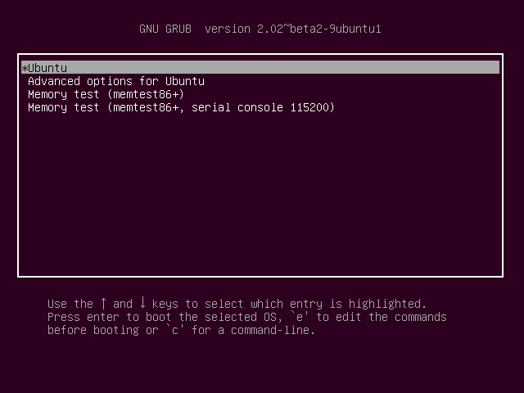
The boot Sequence:
BIOS -> Boot Loader -> Kernel -> init
Boot loader
  BIOS reads the code from sector 0 of the “Boot device”, this is called “Boot Loader”, and loads it in RAM
  Program Counter changed to Boot Loader code
  GRUB is an example

Slide 21
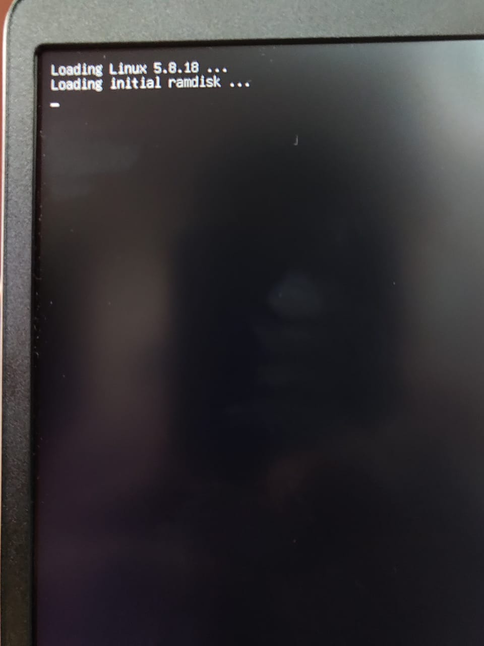
The boot Sequence:
BIOS -> Boot Loader -> Kernel -> init
kernel
  The Boot Loader shows the choice of running an OS, user selects a choice
  The Boot loader loads the code of kernel from disk into RAM
  PC changed to kernel code
  “Loading Linux ...” flashes for a very small time !

Slide 22
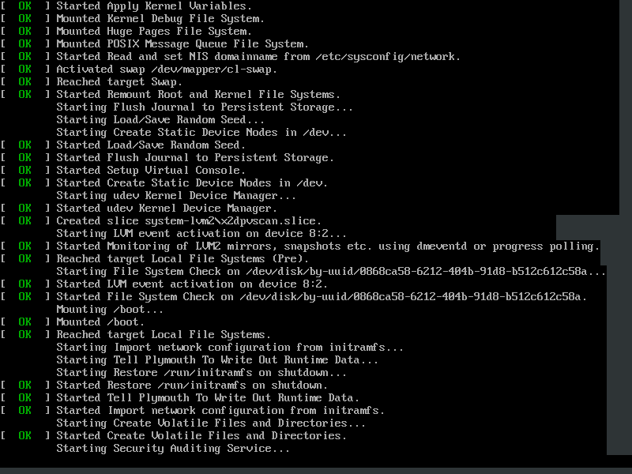
The boot Sequence:
BIOS -> Boot Loader -> Kernel -> init
Kernel initialization
  Kernel initializes hardware, it’s own data structures, etc etc
  Init created by kernel “by Hand”
  Kernel schedules init (the only process)

Slide 23
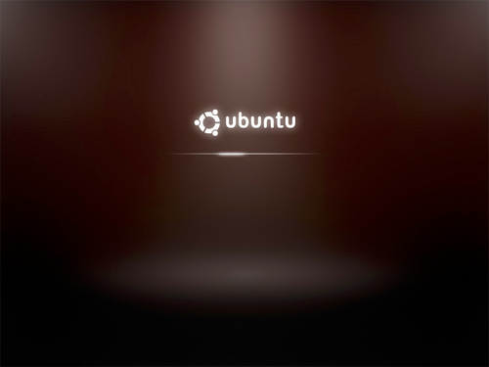
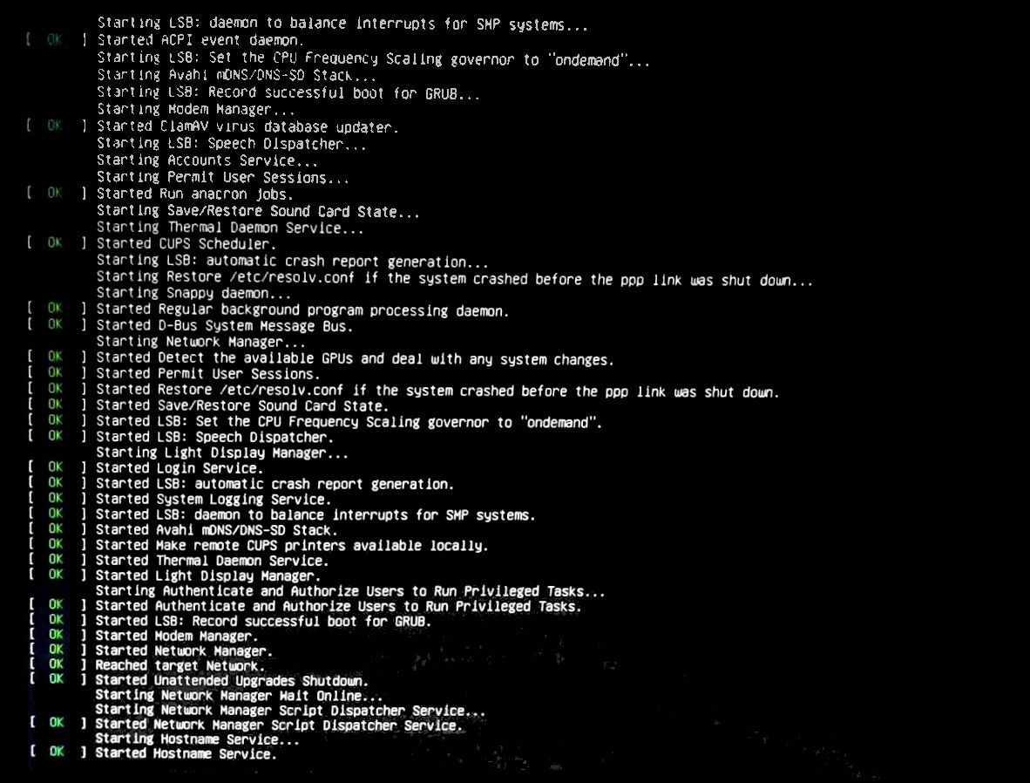
The boot Sequence:
BIOS -> Boot Loader -> Kernel -> init
From init to processes
  Init fork-execs some programs (user mode)
  Now these programs will be scheduled by OS
  Init -> systemd -> login -> GUI -> shell
  One of the typical parent-child relationships

