Slide 1
Compilation, Linking, Loading
(Small story of an application code becoming executable file,
before it becomes a process using exec())
Abhijit A M

Slide 2
Review of last few lectures
Process
  Created with fork, exec
  PCB in the kernel code
  State changes: new, runnable, running, exited, waiting, ...
  Context switch
Traps, 2 modes of execution, 2 types of instructions, ...
Syscalls ...

Slide 3
Today’s class
A process is created by exec(), but before that
  There is an executable file on disk
Executable file contains code, some data, and extra information
It’s created by compiler and linker
Exec() needs to understand the executable !

Slide 4
What are compiler, assembler, linker and loader, and C library
System Programs/Utilities
Most essential to make a kernel really usable

Slide 5
Compiler
application program, which converts one (programming) language to another
  Most typically compilers convert a high level language like C, C++, etc. to Machine code language
E.g. GCC /usr/bin/gcc
  Usage: e.g.
  $ gcc main.c -o main
  Here main.c is the C code, and "main" is the object/machine code file generated
Input is a file and output is also a file.
Other examples: g++ (for C++), javac (for java)
main.c
gcc
main
Source code file
Machine code file

Slide 6
Assembler
application program, converts assembly code into machine code
What is assembly language?
  Human readable machine code language.
E.g. x86 assembly code
  mov 50, r1
  add 10, r1
  mov r1, 500
Usage. eg..
  $ as something.s -o something
main.s
as
main
assembly code file
Machine code file

Slide 7
Compilation Process
preprocessor
compiler + assembler
linking
m/c Code
try.o
Exectable
m/c Code
try
C Code
try.c
Handles all # directives in the input C code
Checks syntax errors, grammatical errors, missing declarations,e tc. And converts the input code to machine code
Combines machine code of input file(S) and library files
gcc

Slide 8
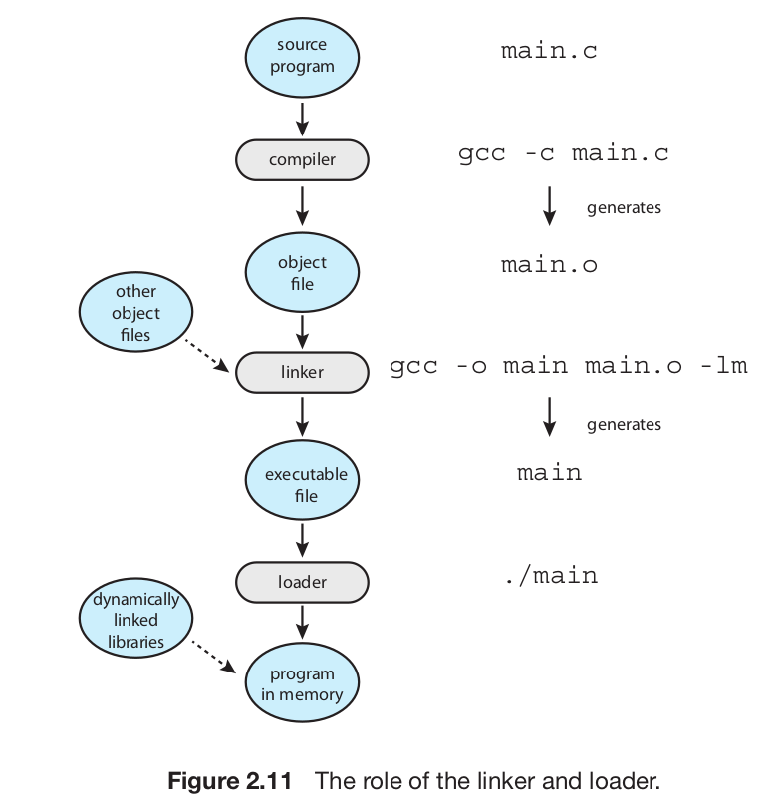
From the textbook

Slide 9
Example
try.c
#include <stdio.h>
#define MAX 30
int f(int, int);
int main() {
int i, j, k;
scanf("%d%d", &i, &j);
k = f(i, j) + MAX;
printf("%d\n", k);
return 0;
}
f.c
int g(int);
#define ADD(a, b) (a + b)
int f(int m, int n) {
return ADD(m,n) + g(10);
}
g.c
int g(int x) {
return x + 10;
}
Try these commands, observe the output/errors/warnings, and try to understand what is happening
$ gcc try.c
$ gcc -c try.c
$ gcc -c f.c
$ gcc -c g.c
$ gcc try.o f.o g.o -o try
$ gcc -E try.c
$ gcc -E f.c

Slide 10
Standard C Library
A collection of some of the most frequently needed functions for C programs
  scanf, printf, getchar, system-call wrappers (open, read, fork, exec, etc.), ...
An machine/object code file containing the machine code of all these functions
  Normally on your computer, it’s not a source code file, and neither just a header file.
Where is the C library on your computer?
  /usr/lib/x86_64-linux-gnu/libc-2.31.so , /usr/include/stdio.h

Slide 11
More about the steps
Pre-processor
  #define ABC XYZ
    cut ABC and paste XYZ
  # include <stdio.h>
    copy-paste the file stdio.h
    There is no CODE in stdio.h, only typedefs, #includes, #define, #ifdef, etc.
Linking
  Normally links with the standard C-library by default
  To link with other libraries, use the -l option of gcc
    cc main.c -lm -lncurses -o main # links with libm.so and libncurses.so

Slide 12
Using gcc itself to understand the process
Run only the preprocessor
  cc -E test.c
  Shows the output on the screen
Run only till compilation (no linking)
  cc -c test.c
  Generates the “test.o” file , runs compilation + assembler
  gcc -S main.c
  One step before machine code generation, stops at assembly code
Combine multiple .o files (only linking part)
  cc test.o main.o try.o -o something

Slide 13
Linking steps
Linker is an application program
  On linux, it's the "ld" program
  E.g. you can run commands like
    $ ld a.o b.o -o c.o
  Normally you have to specify some options to ld to get a proper executable file.
When you run gcc
  $ cc main.o f.o g.o -o try
    the CC will internally invoke "ld" . ld does the job of linking
  $ ld -dynamic-linker /lib64/ld-linux-x86-64.so.2 /usr/lib/x86_64-linux-gnu/crt1.o /usr/lib/x86_64-linux-gnu/crti.o main.o f.o -lc /usr/lib/x86_64-linux-gnu/crtn.o -o try
See the output of this
  $strace -v -s 200 -f cc test.c 2> /tmp/dump ; vi /tmp/dump

Slide 14
Linking steps
The resultatnt file "try" here, will contain the codes of all the functions and linkages also.
What is linking?
  "connecting" the call of a function with the (address of) code of the function.
What happens with the code of printf()?
  The linker or CC will automatically pick up code from the libc.so.6 file for the functions.

Slide 15
Linking (extra slide, self study)
Courtsy: AI !
crt1.o – C Runtime Startup
  Contains the _start symbol, which is the true entry point of a C program (not main()).
  Sets up the environment before main() is called.
  Typically does:
    Initializes stack
  Passes arguments to main()
  Calls __libc_start_main() (provided by libc), which then calls main()
  Handles program termination
  Think of this as the bridge between the OS and your C program.
crti.o – C Runtime Initialization
  Contains start-up code for constructors:
  Defines functions or sections (.init, .fini) used to register initialization and finalization routines (used for things like static constructors in C++)
  Included at the start of the constructor section.
  It works in tandem with crtn.o.
crtn.o – C Runtime Termination
  Contains the end of constructor/destructor sections.
  Typically finalizes:
  .init (initialization routines)
  .fini (termination routines)
  Placed at the end of the object file list to close off those sections.

Slide 16
Linking (extra slide, self study)
Visual Order in Linking
  When gcc links a C program, the order looks roughly like:
$ld \
/usr/lib/.../crt1.o # contains _start
/usr/lib/.../crti.o # start of .init/.fini
main.o f.o ... # your program
-lc # libc (includes __libc_start_main)
/usr/lib/.../crtn.o # end of .init/.fini
This ensures:
  _start runs first
  It calls __libc_start_main(main, ...)
  Your main() is called in a fully initialized environment
  Static constructors/destructors are supported

Slide 17
Linking (extra slide, self study)
RUN
  objdump -t /usr/lib/x86_64-linux-gnu/crt1.o
  objdump -d /usr/lib/x86_64-linux-gnu/crt1.o
  readelf -S /usr/lib/x86_64-linux-gnu/crti.o

Slide 18
Linking (extra slide, self study)
What is /lib64/ld-linux-x86-64.so.2?
It is the ELF dynamic linker/loader for 64-bit Linux systems.
  Full name: The ELF interpreter for dynamically linked 64-bit executables.
  When you run a dynamically linked program (most programs on Linux), this binary is automatically loaded first by the kernel — before your _start function runs
Role of the Dynamic Linker
  Loads all shared libraries (like libc.so.6, libm.so.6, etc.)
  Resolves symbol references at runtime (e.g., where is printf() actually implemented?)
  Applies relocations
  Sets up Thread-Local Storage (TLS), ld.so internal state, etc.
  Then transfers control to _start in your program
$ readelf -l myprogram | grep 'INTERP'

Slide 19
Executable file format
An executable file needs to execute in an environment created by OS and on a particular processor
  Contains machine code + other information for OS
  Need for a structured-way of storing machine code in it
Different OS demand different formats
  Windows: PE, Linux: ELF, Old Unixes: a.out, etc.
ELF : The format on Linux.
Try this
  $ file /bin/ls
  $ file /usr/lib/x86_64-linux-gnu/libc-2.31.so

Slide 20
Exec() and ELF
When you run a program
  $ ./try
  Essentially there willl be a fork() and exec("./try", ...")
  So the kernel has to read the file "./try" and understand it.
  So each kernel will demand it's own object code file format.
  Hence ELF, EXE, etc. Formats
ELF is used not only for executable (complete machine code) programs, but also for partially compiled files e.g. main.o and library files like libc.so.6
What is a.out?
  "a.out" was the name of a format used on earleir Unixes.
  It so happened that the early compiler writers, also created executable with default name 'a.out'

Slide 21
Utilities to play with object code files
objdump
  $ objdump -D -x /bin/ls
  Shows all disassembled machine instructions and “headers”
hexdump
  $ hexdump /bin/ls
  Just shows the file in hexadecimal
readelf
  Alternative to objdump
ar
  To create a “statically linked” library file
  $ ar -crs libmine.a one.o two.o
Gcc to create shared library
  $ gcc hello.o -shared -o libhello.so
To see how gcc invokes as, ld, etc; do this
  $ gcc -v hello.c -o hello
  /* https://stackoverflow.com/questions/1170809/how-to-get-gcc-linker-command */

Slide 22
Linker, Loader, Link-Loader
Linker or linkage-editor or link-editor
  The “ld” program. Does linking.
Loader
  The exec(). It loads an executable in the memory.
Link-Loader
  Often the linker is called link-loader in literature. Because there were days when the linker and loader’s jobs were quite over-lapping.

Slide 23
Static, dynamic / linking, loading
Both linking and loading can be
  Static or dynamic
  More about this when we learn memory management
An important fundamental:
  memory management features of processor, memory management architecture of kernel, executable/object-code file format, output of linker and job of loader, are all interdependent and in-separable.
  They all should fit into each other to make a system work
  That’s why the phrase “system programs”

Slide 24
Cross-compiler
Compiler on system-A, but generate object-code file for system-B (target system)
  E.g. compile on Ubuntu, but create an EXE for windows
Normally used when there is no compiler available on target system. More common, than compiling and running on the same system!
  see gcc -m option
See https://wiki.osdev.org/GCC_Cross-Compiler
We compile applications for xv6 kernel (32 bit x86), on 64-bit x86_64 Ubuntu Linux.

