Slide 1
Memory Management Basics
Virtualizing the memory

Slide 2
Diversion: A point of confusion on “root” user
“root” user has privileges in accessing files
When “root” user runs an application, it runs in process-mode, not in kernel-mode!
  That process can do “more” but , it’s not kernel mode code!
Kernel is not run by “root” user!
  Kernel is not run by any user

Slide 3
Summary
Understanding how different “MMU” in CPU leads to
  different memory management schemes by kernel
  Different ways of generating code by compiler/linker

Slide 4
What does the hardware give us ?

Slide 5
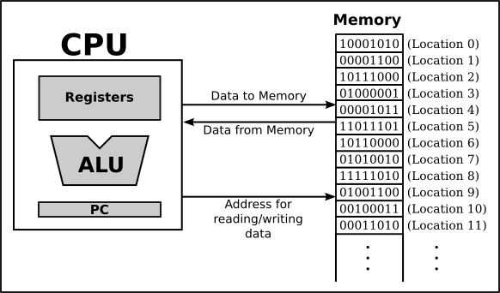
Addresses issued by CPU
During the entire ‘on’ time of the CPU
  Addresses are “issued” by the CPU on address bus
  One address to fetch instruction from location specified by PC
  Zero or more addresses depending on instruction
    e.g. mov $0x300, r1 # move contents of address 0x300 to r1 --> one extra address issued on address bus

Slide 6
Memory is required for which things in a program?

Slide 7
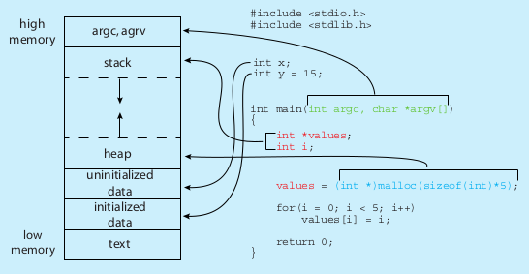
Memory layout of a C program
This “layout” shows
(a) which parts of a C program occupy memory, when the program is running
(b) A typical conceptual layout assumed by many compilers for calculating addresses in the generated machine code. This does not mean that other layouts are not possible
$ size /bin/ls
text data bss dec hex filename
128069 4688 4824 137581 2196d /bin/ls

Slide 8
Terminology
Text
  The machine code of the program(functions)
Data
  Initiazlied global variables
  Do not get confused with the generic word “data” in English
BSS (old term, Block Started by Symbol, ignore this longform)
  Uninitialized global variables
Heap
  Region from where malloc() gets memory
Stack
  Region from where the local variables and formal paramters are allocated space

Slide 9
What do we want from memory management system?

Slide 10
Desired from a multi-tasking system
Multiple processes in RAM at the same time (multi-programming)
Processes should not be able to see/touch each other’s code, data (globals), stack, heap, etc.
  Protection
Further advanced requirements
  Process could reside anywhere in RAM
  Process need not be continuous in RAM
  Parts of process could be moved anywhere in RAM

Slide 11
Different ‘times’
Different actions related to memory management for a program are taken at different times. So let’s know the different ‘times’
Compile time
  When compiler is compiling your C code
Load time
  When you execute “./myprogram” and it’s getting loaded in RAM by loader i.e. exec()
Run time
  When the process is alive, and getting scheduled by the kernel

Slide 12
The sequence
Do not forget this
  Compiler: Generates machine code for program
  Loader: program is put in RAM by the Loader (part of kernel) , that is exec() , when it’s requested to run that program
  Processors: runs program. The CPU’s PIPELINE will issue addresses on address bus as mentioned in the executable file
So question arises
  How does compiler put in addresses (for code, data, bss, local-variables, etc) in the executable file at ‘compile time’?
  Answer: Assumptions of compiler depend on processor+kernel features (more ahead)

Slide 13
Simplest case
RAM
Suppose the address issued by CPU reaches the RAM controller directly
CPU
address

Slide 14
Simplest case
How does this impact the compiler and kernel ?
When a process is running the addresses issued by it, will reach the RAM directly
So exact addresses of globals, addresses in “jmp” and “call” must be part the machine instructions generated by compiler
  How will the compiler know the addresses, at “compile time” ?
RAM
CPU
address
Example
address: instruction
1000: mov $0x300, r1
1004: add r1, -3
1008: jnz 1000
Sequence of addressed sent by CPU: 1000, 0x300, 1004, 1008, 1000, 0x300, ...

Slide 15
Simplest case
Solution: compiler assumes some fixed addresses for globals, code, etc.
kernel loads the program exactly at the same addresses specified in the executable file. Non-relocatable code.
Now program can execute properly.
RAM
CPU
address
Example
1000: mov $0x300, r1
1004: add r1, -3
1008: jnz 1000

Slide 16
Simplest case
Problem with this solution
  Programs once loaded in RAM must stay there, can’t be moved
  What about 2 programs?
    Compilers being “programs”, will make same assumptions and are likely to generate same/overlapping addresses for two different programs
    Hence only one program can be in memory at a time !
    No need to check for any memory boundary violations – all memory belongs to one process
Example: DOS
RAM
CPU
address
Example
1000: mov $0x300, r1
1004: add r1, -3
1008: jnz 1000

Slide 17

Base/Relocation + Limit scheme
base/relocation address
Base and Limit are two registers inside CPU’s Memory Management Unit
‘base’ is added to the address generated by CPU
The result is compared with base+limit and if less passed to memory, else hardware interrupt is raised
Process
In
RAM

Slide 18
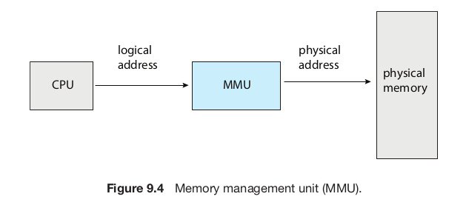
Memory Management Unit (MMU)
Is part of the CPU chip, acts on every memory address issue by execution unit of the CPU
In the scheme just discussed, the base, limit calculation parts are part of MMU

Slide 19
Base/Relocation + Limit scheme
Compiler’s work
  Assume that the process is one continous chunk in memory, with a size limit
  Assume that the process starts at address zero (!) and calculate addresses for globals, code, etc. And accordingly generate machine code
base
Compiler’s
view
Process
In
RAM
Base =0
Limit
Code
--
data
--
Bss
--
heap
--
stack
Limit
RAM

Slide 20
Base/Relocation + Limit scheme
base/relocation address
Loader’s job
  While loading the process in memory – must load as one continous segment
    Find an empty slot for this!
  Remember the ‘base’ and ‘limit’ values in the struct proc (memory management info in PCB)
    Setup the limit to be the size of the process as set by compiler in the executable file.
  Call the scheduler()
Scheduler()
  Will replace the base-limit registers with values obtained from PCB before scheduling the process
Process
In
RAM

Slide 21
Base/Relocation + Limit scheme
base/relocation address
Combined effect
  “Relocatable code” – the process can go anywhere in RAM at the time of loading
  Some memory violations can be detected – a memory access beyond base+limit will raise interrupt, thus running kernel in turn, which may take action against the process
Process
In
RAM

Slide 22
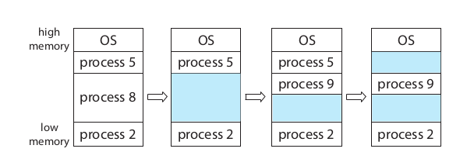
Example scenario of memory in base+limit scheme
Process 8 called exit()
Process 9 forked
Process 5 terminated

Slide 23
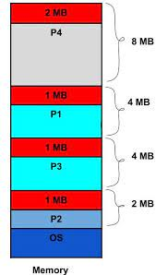
Continuous memory management and external fragmentation problem
Free chunks: 2 MB, 1MB, 1MB, 1MB
Total 5 MB is available!
Can we create a process of size 3MB?
No! - 3 MB not continous!

Slide 24
External Fragmentation
kernel needs to find a continuous free chunk of memory that fits the size of the “segment”
  If not available, your exec() can fail due to lack of memory
Suppose 50k is needed
  Possible that mong 3 free chunks total 100K may be available, but no single chunk of 50k!
  External fragmentation
Solution to external fragmentation: compaction – move the chunks around and make a continous big chunk available. Time consuming, tricky.

Slide 25
It should be possible to have relocatable code even with “simplest case”
By doing extra work during “loading”.
How?
(Ans: loader replaces all addresses in the code! That is quite a lot of work, and challenging too)

Slide 26
Different types of Address binding
Which binding is actually used, is mandated by processor features + OS
Compile time address binding (no MMU!)
  Address of code/variables is fixed by compiler
  Very rigid scheme
  Location of process in RAM can not be changed ! Non-relocatable code.
Load time address binding
  Address of code/variables is fixed by loader
  Location of process in RAM is decided at load time, but can’t be changed later
  Flexible scheme, relocatable code
Run time address binding
  Address of code/variables is fixed at the time of executing the code
  Very flexible scheme , highly relocatable code
  Location of process in RAM is decided at load time, but CAN be changed later also

