Slide 1
Next scheme:
Multiple base +limit pairs
Process as seen by compiler
0
data
0
text
0
0
heap
bss
Limit:text
Base: text
Limit:data
Base: data
Limit: heap
Base: heap
P1: text
Limit: stack
Base: stack
Segment selector
P1: data
P1: heap
>
+
Process in memory on LHS
Logical address
Physical address
P1: stack
trap

Slide 2
Specifying “selector”
Explicitely
  Mov ES: 300, $30
  Here selector is Extra Segment Register (contents of ES indicate which base register to use) and Logical address (or offset) is 300
Implicitely, like in x86
  Mov 300, $30
  Here Data Segment register is “implicit” selector

Slide 3
Next scheme: Segmentation
Multiple base +limit pairs
Multiple sets of base + limit registers
Whenever an address is issued by execution unit of CPU, it will also include reference to some base register
  And hence limit register paired to that base register will be used for error checking
Compiler: can assume a separate chunk of memory for code, data, stack, heap, etc. And accordingly calculate addresses . Each “segment” starting at address 0.
OS (Loader): will load the different ‘sections’ in different memory regions and accordingly set different ‘base’ registers

Slide 4
Next scheme:
Multiple base +limit pairs, with further indirection
Base + limit pairs can also be stored in some memory location (not in registers). Then it’s called Segment Table.
  Question: how will the cpu know where it’s in memory?
  One CPU register to point to the location of table in memory . Segment Table Base Register (STBR)
    X86 has two tables. Local Descriptor Table and Global Descriptor Table. Both are segment tables.
    Accordingly it has LDTR and GDTR.
Segment registers still in use, they give an index in this table
This is x86 segmentation
  Flexibility to have lot more “base+limits” in the array/table in memory

Slide 5
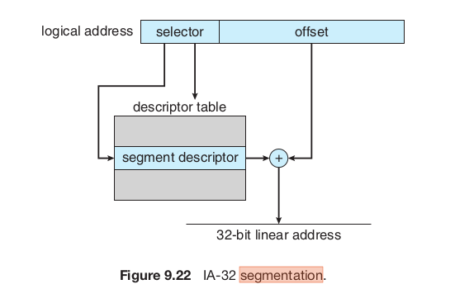
Next scheme:
Multiple base +limit pairs, with further indirection
Note:
”Selector” here is normally a segment register, like CS, DS (it’s not connected physically with offset)
Segment Descriptor entry is : base + Limit + other fields
The machine code only has offset in it
The “Descriptor table” is a segmentation table
GDTR/
LDTR

Slide 6
Segmentation and External fragmentation
Does segmentation also suffer from external fragmentation?
  Yes!

Slide 7
How many segment tables?
One per process
One for the kernel!
  Remember: kernel code also undergoes translation in MMU!

Slide 8
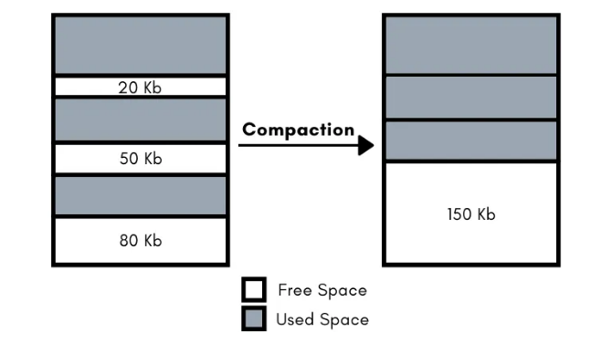
Solution to external fragmentation
Compaction !
OS moves the process chunks in memory to make available continous memory region
  Then it must update the memory management information in PCB (e.g. base of the process) of each process
Time consuming
Possible only if the relocation+limit scheme of MMU is available
P1
P1
P2
P2
P3
P3

Slide 9
Another solution to external fragmentation: Fixed size partitions
Fixed partition scheme
Memory is divided by OS into chunks of equal size: e.g., say, 50k
  If total 1M memory, then 20 such chunks
Allocate one or more chunks to a process, such that the total size is >= the size of the process (the process is still continuous in RAM)
  E.g.if request is 50k, allocate 1 chunk
  If request is 40k, still allocate 1 chunk
  If request is 60k, then allocate 2 chunks
Leads to internal fragmentation
  space wasted in the case of 40k or 60k requests above
50K
Kernel
50K
Kernel
50K
Free
50K
P1 (50 KB)
50K
P2 (80 KB)
50K
Unused (20 KB)
50K
Free
50K
P3 (120 KB)
50K
50K
Unused (30 KB)
50K
Free
50K
Free

Slide 10
Solving external fragmentation problem
Process should not be continous in memory!
  The trouble is finding a big continous chunk!
Divide the continuous process image in smaller chunks (let’s say 4k each) and locate the chunks anywhere in the physical memory
  Need a way to map the logical memory addresses into actual physical memory addresses

Slide 11


Slide 12

Compilers generates code using addresses like 0, 4, ... 12, 14 etc.
Note:
address 4 = page 1 + offset 0
0100 = 01 00
2 big page number, 2 bit offset
Adress 13 = page 3 + offset 1
1101 = 11 01
In translation, the page number changes, not the offset.

Slide 13
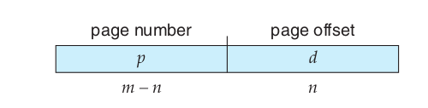

Paging scheme
Logical address of m bits, split into two parts of m-n and n bits each.
PTBR

Slide 14
Paging
Process is assumed to be composed of equally sized “pages” (e.g. 4k page)
Actual memory is considered to be divided into page “frames”. (same as page size)
CPU generated (compiler given) logical address is split into a page number and offset
A Page Table Base Register (PTBR) inside CPU will give location of an in memory table called page table (this was setup by Kernel)
Page number used as offset in a table called page table, which gives the physical page frame number
Frame number + offset are combined to get physical memory address

Slide 15
Paging
Compiler: assume the process to be one continous chunk of memory (!) . Generate addresses accordingly . Compiler still treats text,data,bss,.. to be separate chunks, but in multiples of page-sizes.
OS: at exec() time – allocate different frames to process, allocate a page table(!), setup the page table to map page numbers with frame numbers, setup the page table base register, start the process
Now hardware will take care of all translations of logical addresses to physical addresses

Slide 16
