Slide 1


Slide 2

Compilers generates code using addresses like 0, 4, ... 12, 14 etc.
Note:
address 4 (for ‘e’) = page 1 + offset 0
0100 = 01 00
2 bit page number, 2 bit offset
PT says, Page-1 is in Frame-6 (=110), so
110 00 = 24 is address of ‘e’ in physical memory
Adress 13 (for ‘n’) = page 3 + offset 1
1101 = 11 01
-> 10 01
In translation, the page number changes, not the offset.

Slide 3
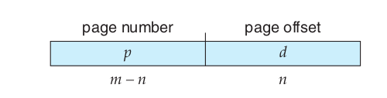

Paging scheme
Logical address of m bits, split into two parts of m-n and n bits each.
PTBR

Slide 4
Paging
Process is assumed to be composed of equally sized “pages” (e.g. 4k page)
Actual memory is considered to be divided into page “frames”. (same as page size)
CPU generated (compiler given) logical address is split into a page number and offset
A Page Table Base Register (PTBR) inside CPU will give location of an in memory table called page table (this was setup by Kernel)
Page number used as offset in a table called page table, which gives the physical page frame number
Frame number + offset are combined to get physical memory address

Slide 5
Paging
Compiler: assume the process to be one continous chunk of memory (!) . Generate addresses accordingly . Compiler still treats text,data,bss,.. to be separate chunks, but in multiples of page-sizes.
kernel: at exec() time – allocate different frames to process, allocate a page table(!), setup the page table to map page numbers with frame numbers, store the PTBR in PCB
  Scheduler: load the PTRBR from the value obtained from PCB and schedule the process
Now hardware will take care of all translations of logical addresses to physical addresses

Slide 6
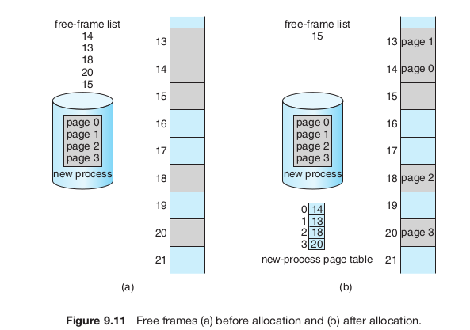

Slide 7
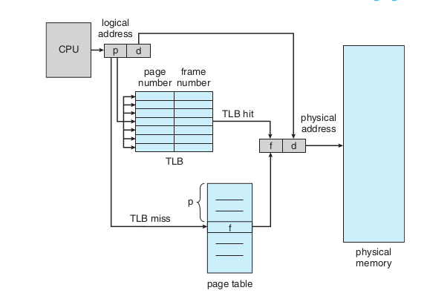
Speeding up paging
Problem: Every memory access becomes two memory access: one for Page table and one for actual memory location. CPU pipeline slows down.
Translation Lookaside Buffer (TLB)
Part of CPU hardware
A cache of Page table entries
Searched in parallel for a page number

Slide 8
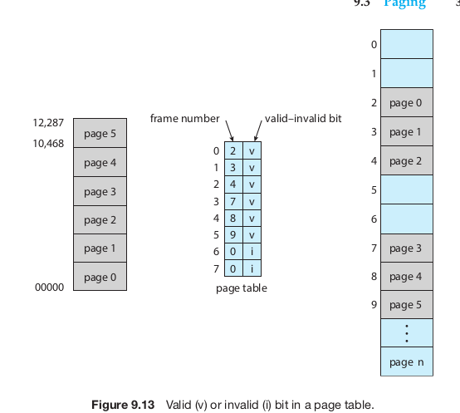
Memory protection with paging
`i` bit leads to trap

Slide 9
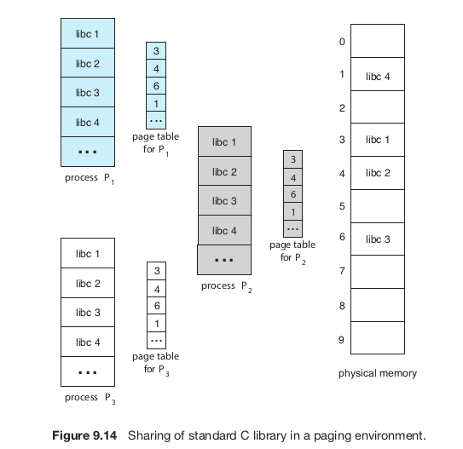
Shared pages (e.g. library) with paging

Slide 10
Paging: problem of large PT
64 bit address
Suppose 20 bit offset
  That means 2^20 = 1 MB pages
  44 bit page number: 2^44 that is trillion sized page table!
  Can’t have that big continuous page table!

Slide 11
Paging: problem of large PT
32 bit address
Suppose 12 bit offset
  That means 2^12 = 4 KB pages
  20 bit page number: 2^20 that is a million entries
  Can’t always have that big continuous page table as well, for each process!

Slide 12
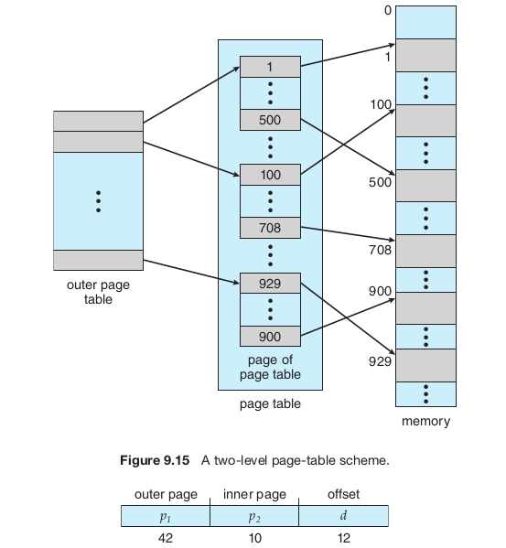
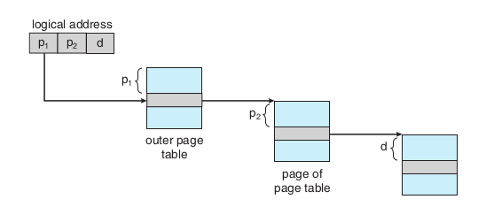
Hierarchical paging

Slide 13
X86 memory management

Slide 14
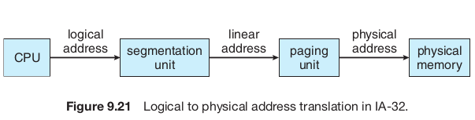

Slide 15
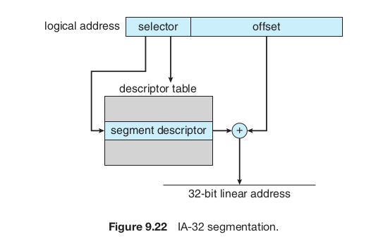
Segmentation in x86
The selector is automatically chosen using Code Segment (CS) register, or Data Segment (DS) register or SS register, depending on which type of memory address is being fetched
  e.g. during fetch, CS is segment selector and IP is offset
  e.g. during “push” instruction, the ESP is offset and SS is segment selector
  e.g. accessing a memory address mentioned in an instruction, that address is offset and DS is segment selector
Descriptor table (that is a segmentation table) is in memory
The location of Descriptor table (Global DT- GDT or Local DT – LDT) is given by a GDT-register i.e. GDTR or LDT-register i.e. LDTR
GDTR/
LDTR

Slide 16
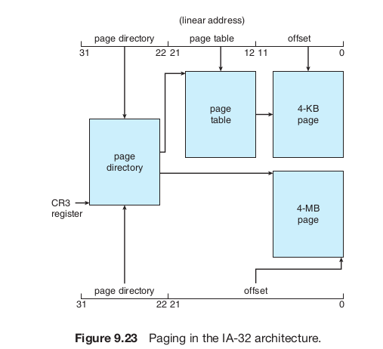
Paging in x86
Both 1-level and 2-level paging is possible
  Depending on a flag setup in CR3 register, either 4 MB or 4 KB pages can be enabled
Page directory, page table are both in memory
Beauty: PD or PT are always 4KB

Slide 17

X86 Segmentation + Paging
GDTR
Selector value is implicit based on address being accessed.
Instruction: CS
Stack Variable: SS
Data: DS
etc.

Slide 18
X86 Segmentation + Paging
Paging is optional, segmentation compulsory
  Setting flags in Control Registers (CR) enables this
Page Table, Page Directory, page - are all size=4k, if 2-level paging is used
  Makes life simpler for the kernel

