Slide 1
Introduction to Algorithms
Definition of algorithm
An algorithm is a finite, step-by-step, unambiguous set of instructions designed to perform a specific task or solve a particular problem. It takes an input, processes it through logical steps, and produces a output.
Characteristics of an Algorithm
To be considered a valid algorithm, a procedure must satisfy five core criteria:
Input: Zero or more well-defined quantities supplied externally.
Output: At least one clearly defined result produced.
Definiteness: Every step must be unambiguous and clear.
Finiteness: Must terminate after a finite number of steps for all input cases.
Effectiveness: Every instruction must be very basic so that it can be carried out, in principle, by a person using only pencil and paper. It is not enough that each operation be definite as in criterion c; it also must be feasible.

Slide 2
Example of Algorithm
Problem Statement:
Write a function that returns the largest from two numbers.
Algorithm:
Algorithm LargestOfTwoNumbers(A, B)
Step 1: Start
Step 2: Read two numbers A and B
Step 3:
If A > B
Print "Largest Number =", A
Else If B > A
Print "Largest Number =", B
Else Print "Both numbers are equal"
End If
Step 4: Stop
Input:
A = 25 B = 18
Output:
Largest Number = 25

Slide 3
Performance Analysis
There are two ways: Time Complexity and Space Complexity.
Space complexity:
Total amount of computer memory required by an algorithm to complete its execution is called as space complexity of that algorithm.
The Space required by an algorithm is the sum of following components
A fixed part that is independent of the input and output. This includes memory space for codes, variables, constants and so on.
A variable part that depends on the input, output and recursion stack. ( We call these parameters as instance characteristics)
Space requirement S(P) of an algorithm P,
S(P) = c + Sp
where c is a constant depends on the fixed part, Sp is the instance characteristics

Slide 4
Space Complexity
Example 1: Find the Sum of Two Numbers
Algorithm Algorithm Sum(A, B) Step 1: Read A and B Step 2: Sum = A + B Step 3: Print Sum Step 4: Stop | Memory Required Variable Size A 4 Bytes B 4 Bytes Sum 4 Bytes Total Variable Memory = 12 Bytes Assume Program Code and Constants = 100 Bytes Therefore, c = 100 Bytes Sp = 12 Bytes S(P)=100+12=112 Bytes
Space Complexity Since the number of variables does not change with the input size, Space Complexity =O(1)

Slide 5
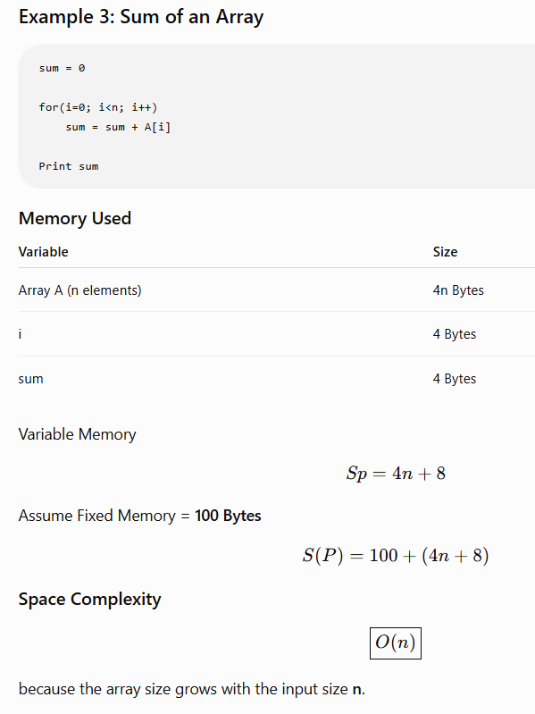

Slide 6
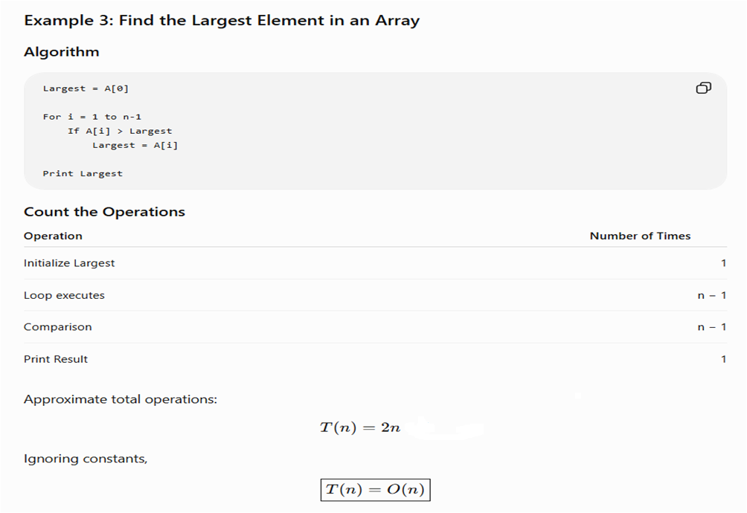

Slide 7
Time complexity
Time complexity Usually, the execution time or run-time of the program is refereed as its time complexity denoted by tp(instance characteristics). This is the sum of the time taken to execute all instructions in the program.

Slide 8
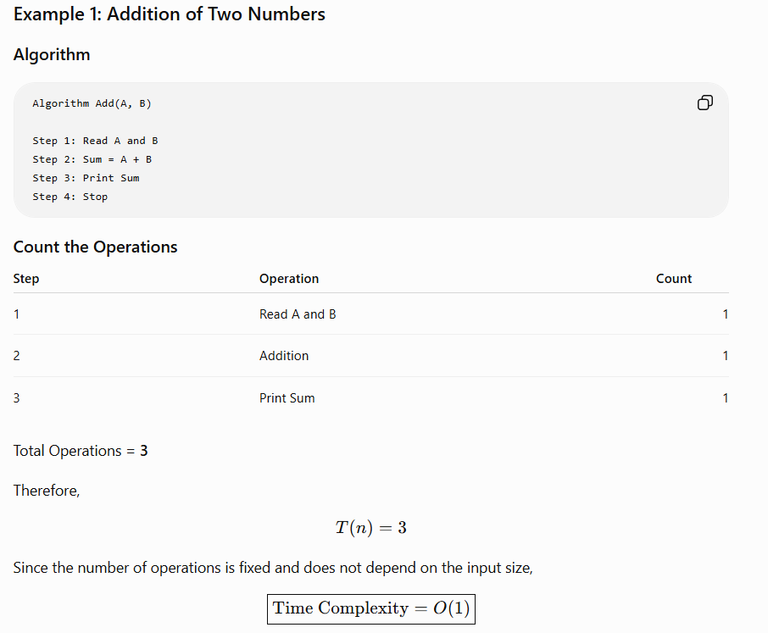

Slide 9
Asymptotic Analysis
Asymptotic notations are mathematical tools to represent the time complexity of algorithms for asymptotic analysis.
There are mainly three asymptotic notations:
Big-O Notation (O-notation)
Omega Notation (Ω-notation)
Theta Notation (Θ-notation)
By using asymptotic notations, such as Big O, Big Omega, and Big Theta, we can categorize algorithms based on their worst-case, best-case, or average-case time or space complexities, providing valuable insights into their efficiency.

Slide 10
1. Big-O Notation (O-notation):
Big-O notation represents the upper bound of the running time of an algorithm. Therefore, it gives the worst-case complexity of an algorithm.
It is the most widely used notation for Asymptotic analysis. It specifies the upper bound of a function. The maximum time required by an algorithm or the worst-case time complexity. It returns the highest possible output value(big-O) for a given input. Big-O(Worst Case) It is defined as the condition that allows an algorithm to complete statement execution in the longest amount of time possible.

Slide 11
1. Big-O Notation (O-notation):
If f(n) describes the running time of an algorithm,
f(n) is O(g(n)) if there exist a positive constant C
and n0 such that, 0 ≤ f(n) ≤ cg(n) for all n ≥ n0
It returns the highest possible output value
(big-O) for a given input.
The execution time serves as an upper bound on the algorithm's time complexity.

Slide 12
2. Omega Notation (Ω-Notation):
Omega notation represents the lower bound of the running time of an algorithm. Thus, it provides the best case complexity of an algorithm.
The execution time serves as a lower bound on the algorithm's time complexity.
It is defined as the condition that allows an algorithm to complete statement execution in the shortest amount of time.

Slide 13
2. Omega Notation (Ω-Notation):
Mathematical Representation of Omega notation :
Ω(g(n)) = { f(n): there exist positive constants c and n0 such that 0 ≤ cg(n) ≤ f(n) for all n ≥ n0 }
Let g and f be the function from the set of natural numbers to itself.
The function f is said to be Ω(g), if there is a constant c > 0 and a natural number n0 such that c*g(n) ≤ f(n) for all n ≥ n0

Slide 14
3. Theta Notation (Θ-Notation):
Theta notation represents the upper and the lower bound of the running time of an algorithm, it is used for analyzing the average-case complexity of an algorithm.
Theta (Average Case) You add the running times for each possible input combination and take the average in the average case.
Let g and f be the function from the set of natural numbers to itself.
The function f is said to be Θ(g), if there are constants c1, c2 > 0 and a natural number n0 such that c1* g(n) ≤ f(n) ≤ c2 * g(n) for all n ≥ n0

Slide 15
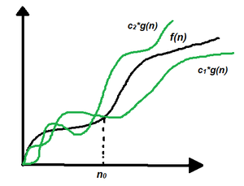
Θ-Notation(Average Case)
Mathematical Representation of Theta notation:
Θ (g(n)) = { f(n): there exist positive constants c1, c2 and n0 such that
0 ≤ c1 * g(n) ≤ f(n) ≤ c2 * g(n) for all n ≥ n0 }
Note: Θ(g) is a set
The above expression can be described as if f(n) is theta of g(n), then the value f(n)
is always between c1 * g(n) and c2 * g(n) for large values of n (n ≥ n0).
The definition of theta also requires that f(n) must be non-negative for values of n greater than n0.
The execution time serves as both a lower and upper bound on the algorithm's time complexity.

Slide 16
// Function to perform linear search
bool search(int arr[], int n, int target) {
for (int i = 0; i < n; i++) { // Loop executes up to 'n' times
if (arr[i] == target) { // 1 comparison step
return true; // Target found!
}
}
return false; // Target not found
}
int main() {
int arr[] = {10, 25, 30, 45, 50};
int n = sizeof(arr) / sizeof(arr[0]);
int target = 45;
if (search(arr, n, target)) {
printf("Element %d found in the array.\n", target);
} else {
printf("Element %d not found in the array.\n", target);
}
return 0;
}

Slide 17
Calculating Big O — Worst Case
Scenario: The target is absent from the array (or at the last index n - 1).
Code Trace:
Initializing i = 0: Executed 1 time.
Condition check i < n: Executed n + 1 times.
Increment i++: Executed n times.
Comparison if (arr[i] == target): Executed n times.
Total Basic Operations:
T(n) = 1 + (n + 1) + n + n = 3n + 2
Mathematical Bound:
3n + 2 <= 4n for all n >= 2 => c = 4, n_0 = 2
Complexity: O(n) (Linear Time)

Slide 18
Calculating Big Omega Ω — Best Case
Scenario: The target is at the very first position (arr[0]).
Code Trace:
Initializing i = 0: Executed 1 time.
Condition check i < n (for i=0): Executed 1 time.
Comparison arr[0] == target: Executed 1 time (evaluates to true).
Returns true immediately.
Total Basic Operations:
T(n) = 1 + 1 + 1 = 3 (Constant)
Mathematical Bound:
3 >= 1 . 1 for all n >= 1 => c = 1, n_0 = 1
Complexity: Ω (1) (Constant Time)

Slide 19
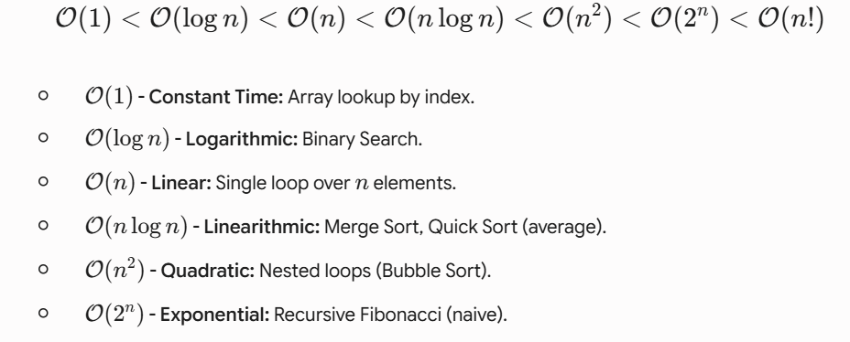
From Best to Worst

