Slide 1
XV6 bootloader
Abhijit A. M.
abhijit.comp@coep.ac.in
Credits:
xv6 book by Cox, Kaashoek, Morris
Notes by Prof. Sorav Bansal

Slide 2
A word of caution
We begin reading xv6 code
But it’s not possible to read this code in a “linear fashion”
  The dependency between knowing OS concepts and reading/writing a kernel that is written using all concepts

Slide 3
What we have seen ....
Compilation process, calling conventions
Basics of Memory Management by OS
Basics of x86 architecture
  Registers, segments, memory management unit, addressing, some basic machine instructions,
ELF files
  Objdump, program headers
  Symbol tables

Slide 4
Lets not forget (!)
Every line of (machine) code that runs (bootloader, kernel, init, processes, etc....)
  Will need MMU Setup!
  Will need Interrupt handlers setup (or interrupts disabled!)
  Will need “esp” setup (or not use the stack at all!)
  ... (anything else) ?

Slide 5
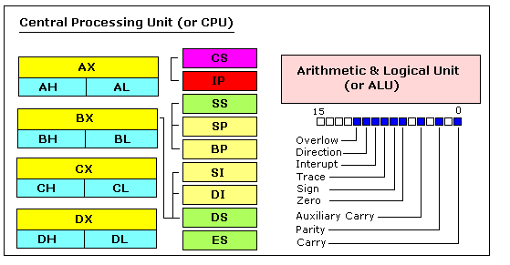
8086: 16 bit CPU
(precursor to x86 family)
https://jerry153fish.github.io/2016/01/01/8086-Registers.html

Slide 6
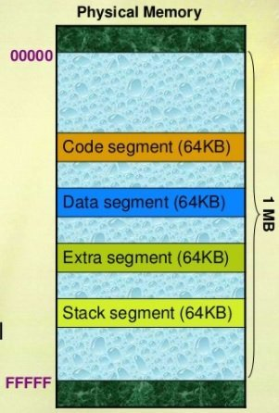
8086 address extension
8086 has 20-bit physical addresses ==> 1 MB AS
the extra four bits usually come from a 16-bit "segment register":
  CS - code segment, for fetches via IP
  SS - stack segment, for load/store via SP and BP
  DS - data segment, for load/store via other registers
  ES - another data segment, destination for string operations
%cs:%ip full address: %cs * 16 + %ip is actual address that goes on bus. virtual to physical translation is
  pa = va + seg*16
e.g. set CS = 4096 to execute starting at 65536

Slide 7
32 bit 80386
boots in 16-bit mode, then on running particular instructions switches to 32-bit mode (protected mode)
  For backward compatibility, INTEL continued this. The CPU starts in 16 bit mode, called real mode
  If particular instructions are not executed (may be in boot loader) all processors will continue in real mode
registers are 32 bits wide, called EAX rather than AX
  EAX EBX ECX EDX
  ESP EBP ESI EDI
operands and addresses 32-bit in 32-bit mode,
  e.g. ADD does 32-bit arithmetic
Segment registers are 16 bit: CS, SS, DS, etc. But now MMU uses Segment tables (called GDT/LDT) and Seg registeres are indices into the tables

Slide 8
Summary of registers in 80386
For a typical register, the corresponding segment is used. Pairs of Indexes & pointers (Segment & Registers)
  CS:EIP
    Code Segment: Index Pointer
    E.g. mov $32, %eax ==> The code of move instruction uses CS: EIP
  SS:ESP
    Stack Segment: ESP
    E.g. push $32 ==> The $32 will be pushed on stack. Using SS: ESP address
  SS:EBP
    Stack Segment: EBP ==> mov (%ebp), %eax ==> for accessing (%ebp) SS: EBP address will be used
  DS:ESI , ES: EDI .
    ESI: Extended Source Index, EDI: Extended Destination Index
The EFLAGS register for flags

Slide 9
Examples of X86 instructions
AT&T syntax | "C"-ish equivalent | Operands
movl %eax, %edx | edx = eax; | register mode
movl $0x123, %edx | edx = 0x123; | immediate
movl 0x123, %edx | edx = *(int32_t*)0x123; | direct
movl (%ebx), %edx | edx = *(int32_t*)ebx; | indirect
movl 4(%ebx), %edx | edx = *(int32_t*)(ebx+4) | displaced

Slide 10
bootloader
BIOS Runs (automatically)
Loads boot sector into RAM at 0x7c00
Starts executing that code
  Make sure that your bootloader is loaded at 0x7c00
  Makefile has
    bootblock: bootblock.S bootmain.c
      $(CC) $(CFLAGS) -fno-pic -nostdinc -I. -c bootasm.S .....
      ...
      $(LD) $(LDFLAGS) -N -e start -Ttext 0x7C00 -o bootblock.o bootasm.o bootmain.o
    Resuls in:
      00007c00 <start>: in bootblock.asm

Slide 11
Instructions suffix/prefix
mov %eax, %ebx # 32 bit data
movw %ax, %bx # move 16 bit data
mov %ax, %bx # ax is 16 bit, so equivalent to movw
mov $123, 0x123 # Ambigious
movw $123, 0x123 # correct, move 16 bit data

Slide 12
x86 Processor starts in real mode
Processor starts in real mode – works like 16 bit 8088
eight 16-bit general-purpose registers,
Segment registers %cs, %ds, %es, and %ss --> additional bits necessary to generate 20-bit memory addresses from 16-bit registers.
  addr = seg << 4 + addr

Slide 13
Virtual ddress = offset
Address
Effective memory translation in the beginning
At _start in bootasm.S:
%cs=0 %ip=7c00.
So effective address = 0*16+ip = ip

Slide 14
Bootloader code: bootasm.S
First instruction is ‘cli’
  disable interrupts
So that until your code loads all hardware interrupt handlers, no interrupt will occur

Slide 15
Bootloader code: bootasm.S
Zeroing registers
# Zero data segment registers DS, ES, and SS.
xorw %ax,%ax # Set %ax to zero
movw %ax,%ds # -> Data Segment
movw %ax,%es # -> Extra Segment
movw %ax,%ss # -> Stack Segment
zero ax and ds, es, ss
BIOS did not put in anything perhaps

Slide 16
Bootloader code: bootasm.S
A not so necessary detail
Enable 21 bit address
Seg:off with 16 bit segments can actually address more than 20 bits of memory. After 0x100000 (=2^20), 8086 wrapped addresses to 0.
80286 introduced 21st bit of address. But older software required 20 bits only. BIOS disabled 21st bit. Some OS needed 21st Bit. So enable it.
Write to Port 0x64 and 0x60 -> keyboard controller
  to enable 21st bit out of address translation
  Why? Before the A20, i.e. 21st bit was introduced, it belonged to keyboard controller
  For more details see https://en.wikipedia.org/wiki/A20_line https://en.wikipedia.org/wiki/A20_line
seta20.1:
inb $0x64,%al # Wait for not busy
testb $0x2,%al
jnz seta20.1
movb $0xd1,%al # 0xd1 -> port 0x64
outb %al,$0x64
seta20.2:
inb $0x64,%al # Wait for not busy
testb $0x2,%al
jnz seta20.2
movb $0xdf,%al # 0xdf -> port 0x60
outb %al,$0x60

Slide 17
After this
Some instructions are run
to enter protected mode
And further code runs in protected mode

Slide 18
Real mode Vs protected mode
Real mode 16 bit registers
Protected mode
  Enables segmentation + Paging both
    No longer seg*16+offset calculations
    Segment registers is index into segment descriptor table. But segment:offset pairs continue
      mov %esp, $32 # SS will be used with esp
    More in next few slides
    Other segment registers need to be explicitely mentioned in instructions
      Mov FS:$200, 30
  32 bit registers
    can address upto 2³² memory
    Can do arithmetic in 32 bits

Slide 19

X86 address : protected mode address translation
Both Segmentation and Paging are used in x86
X86 allows optionally one-level or two-level paging
Segmentation is a must to setup, paging is optional (needs to be enabled)
Hence different OS can use segmentation+paging in different ways

Slide 20

X86 segmentation

Slide 21

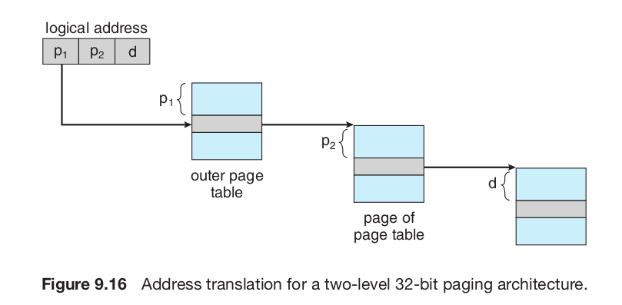
Paging concept, hierarchical paging
Paging scheme
PTBR

Slide 22

X86 paging

Slide 23

Page Directory Entry (PDE)
Page Table Entry (PTE) in RAM as understood by x86 MMU

Slide 24


X86 register: CR3
X86 register: CR4

Slide 25

X86: Segmentation + Paging
GDTR
Selector value is implicit based on address being accessed.
Instruction: CS
Stack Variable: SS
Data: DS
etc.

Slide 26
Segmentation + Paging setup of xv6
xv6 configures the segmentation hardware by setting Base = 0, Limit = 4 GB
  translate logical to linear addresses without change, so that they are always equal.
  Segmentation is pratically off
Once paging is enabled, the only interesting address mapping in the system will be linear to physical.
  In xv6 paging is NOT enabled while loading kernel
  After kernel is loaded 4 MB pages are used for a while
  Later the kernel switches to 4 kB pages!

Slide 27

X86: GDT Entry
asm.h
#define SEG_ASM(type,base,lim) \
.word (((lim) >> 12) & 0xffff), ((base) & 0xffff); \
.byte (((base) >> 16) & 0xff), (0x90 | (type)), \
(0xC0 | (((lim) >> 28) & 0xf)), (((base) >> 24) & 0xff)

Slide 28


X86: Segment selector
X86: EFLAGS register
Note in 16 bit mode, segment selector is 16 bit, here it’s 13 bit + 3 bits

Slide 29
Bootloader code: bootasm.S lgdt
lgdt gdtdesc
...
# Bootstrap GDT
.p2align 2 # force 4 byte alignment
gdt:
SEG_NULLASM # null seg
SEG_ASM(STA_X|STA_R, 0x0, 0xffffffff) # code seg
SEG_ASM(STA_W, 0x0, 0xffffffff)
# data seg
gdtdesc:
.word (gdtdesc - gdt - 1)
# sizeof(gdt) - 1
.long gdt
load the processor’s (GDT) register with the value gdtdesc which points to the table gdt.
table gdt : The table has a null entry, one entry for executable code, and one entry to data.
all segments have a base address of zero and the maximum possible limit
The code segment descriptor has a flag set that indicates that the code should run in 32-bit mode
With this setup, when the boot loader enters protected mode, logical addresses map one-to-one to physical addresses.
At gdtdesc we have this data
  2, <4 byte addr of gdt>
  Total 6 bytes
  GDTR is : <address 4 byte>, <table limit 2 byte>
  So lgdt gdtdesc loads these two values in GDTR

Slide 30
bootasm.S after “lgdt gdtdesc”
till jump to “entry”
Still
Logical Address = Physical address!
But with GDT in picture and
Protected Mode operation
During this time,
Loading kernel from ELF into physical memory
Addresses in “kernel” file translate to same physical address!
Logical Address = offset
Physical
Address
Base | Limit | Permissions
0 | 4GB | Write
0 | 4GB | Read, Execute
0 | 0 | 0
GDT

Slide 31
Bootloader code: bootasm.S
Prepare to enable protected mode
Prepare to enable protected mode by setting the 1 bit (CR0_PE) in register %cr0
movl %cr0, %eax
orl $CR0_PE, %eax
movl %eax, %cr0

Slide 32

X86 register: CR0
PG: Paging enabled or not WP: Write protecion on/off
PE: Protection Enabled --> protected mode.

Slide 33
Bootloader code: bootasm.S
Complete transition to 32 bit mode
ljmp $(SEG_KCODE<<3), $start32
Complete the transition to 32-bit protected mode by using a long jmp
to reload %cs (=1) and %eip (=start32).
Note that ‘start32’ is the address of next instruction after ljmp.
Note: The segment descriptors are set up with no translation (that is 0-4GB setting), so that the mapping is still the identity mapping.

Slide 34
Bootloader code: bootasm.S
Jumping to “C” code
movw $(SEG_KDATA<<3), %ax # Our data segment selector
movw %ax, %ds # -> DS: Data Segment
movw %ax, %es # -> ES: Extra Segment
movw %ax, %ss # -> SS: Stack Segment
movw $0, %ax # Zero segments not ready for use
movw %ax, %fs # -> FS
movw %ax, %gs # -> GS
# Set up the stack pointer and call into C.
movl $start, %esp
call bootmain
Setup Data, extra, stack segment with SEG_KDATA (=2), FS & GS (=0)
Copy “$start” i.e. 7c00 to stack-ptr
  It will grow from 7c00 to 0000
Call bootmain() a C function
  In bootmain.c

Slide 35
Setup now
Logical Address = offset
Physical
Address
CS, SS, etc.
Selector
Base | Limit | Permissions
0 | 4GB | Write
0 | 4GB | Read, Execute
0 | 0 | 0
3
2
1
0
DS
SS
CS
GDT

