Slide 1
Processes in xv6 code

Slide 2
Process Table
struct {
struct spinlock lock;
struct proc proc[NPROC];
} ptable;
One single global array of processes
Protected by
ptable.lock

Slide 3
Paging schema
Kernel needs to allocate pages to processes and kernel itself
Kernel itself needs to be in some fixed location in RAM
One PT/PD needed per process and one for the kernel itself
Kernel needs to run on behalf of a process also (i.e. system calls; process context in kernel mode)
In a kernel that exploits full x86 functionality, each process could use logical addressses from 0 to 4GB and the kernel itself could also use 0 to 4 GB
  Each PT will map each logical address to different physical address
But xv6 chose to do something simpler to save some effort in context switch

Slide 4

Layout of process’s VA space xv6 schema! different from Linux

Slide 5
Some summary points
LA are divided
  Kernel uses LA from KERNLINK i.e. 2097 MB onwards
  Process uses LA from 0 upto KERNBASE
In the page table of each process, the mappings of kernel code/data are copied !
  No need to change Page table on syscall
Page tables in xv6
  One per process, with mappings for process (0 upto process size) and kernel (2097 MB onwards)
  One separate PT for kernel (to run interrupt handlers) – with mappings 2097 MB onwards

Slide 6
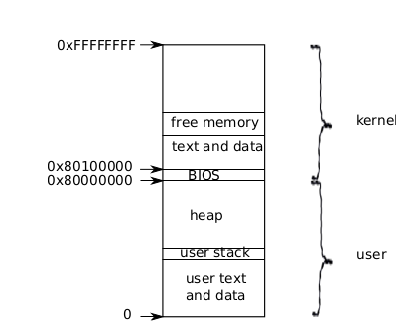
Logical addresses used in creating Page table for a process
Address 0: code
Then globals
Then stack (one page); then one page left unused (not shown in diagram)
Then heap
Each processe’s address space maps kernel’s text, data also --> so that system calls run with these mappings
Kernel system call code can directly access user memory now

Slide 7
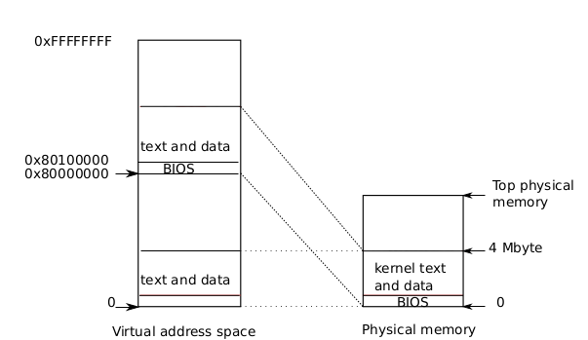
Kernel mappings in user address space actual location of kernel
Kernel is loaded at 0x100000 physical address, i.e. 1 MB
PA 0 to 0x100000 is BIOS and devices
Process’s page table will map
  VA 0x80000000 to PA 0x00000 and
  VA 0x8010000 to 0x100000

Slide 8
Kernel mappings in user address space actual location of kernel
Kernel is not loaded at the PA 0x80000000 because some systems may not have that much memory

Slide 9
Imp Concepts
A process has two stacks
  user stack: used when user code is running
  kernel stack: used when kernel is running on behalf of a process
Note: there is a third stack also!
  The kernel stack used by the scheduler itself
  Not a per process stack

Slide 10
Struct proc
// Per-process state
struct proc {
uint sz; // Size of process memory (bytes)
pde_t* pgdir; // Page table
char *kstack; // Bottom of kernel stack for this process
enum procstate state; // Process state. allocated, ready to run, running, wait-
ing for I/O, or exiting.
int pid; // Process ID
struct proc *parent; // Parent process
struct trapframe *tf; // Trap frame for current syscall
struct context *context; // swtch() here to run process. Process’s context
void *chan; // If non-zero, sleeping on chan. More when we discuss sleep, wakeup
int killed; // If non-zero, have been killed
struct file *ofile[NOFILE]; // Open files, used by open(), read(),...
struct inode *cwd; // Current directory, changed with “chdir()”
char name[16]; // Process name (for debugging)
};

Slide 11
struct proc diagram: Very imp!
Trapframe
edi, esi, ebp,ebx,
edx, ecx, eax,
gs, fs, es=4,
ds=4, trapno=?,
err, eip, cs = 3,
EFLAGS = FL_IF
ESP = 4096, ss=4
EIP = 0
Code &data
of
“cat”
trapret()
proc
process
stack
sz = a24f
pgdir
kstack
int state=RUNNABLE
int pid = 22
proc *parent
tf
context
void *chan
int killed=0
file *ofile
inode *cwd
name =”cat”
Page table
eip=forkret()
ebp
ebx
esi
edi
Page table
Towards
Kernel
pages
Page table
In use only when you are in kernel on a “trap” = interrupt/syscall. “tf” always used. trapret,forkret used during fork()
pgdir
Inode
for “/”
sz = ELF-code->memsz (includes data, check “ld -N”
+ 2*4096 (for stack)

Slide 12

Memory Layout of a user process
After exec()
Note the argc, argv on stack
The “guard page” is just a mapping in page table. No frame allocated. It’s marked as invalid. So if stack grows (due to many function calls), then OS will detect it with an exception

