Slide 1
Inter Process Communication

Slide 2
Revision of process related concepts
PCB, struct proc
Process lifecycle – different states
Queues/Lists of processes
What is “Blocking”
Event driven kernel

Slide 3
Before IPC, let’s learn more about file related system calls
Redirection
  ls > /tmp/file
  cat < /etc/passwd
how does this work?
File descriptors are inherited across fork

Slide 4
IPC: Inter Process Communication
Processes within a system may be independent or cooperating
Cooperating process can affect or be affected by other processes, including sharing data
Reasons for cooperating processes:
  Information sharing, e.g. copy paste
  Computation speedup, e.g. matrix multiplication
  Modularity, e.g. chrome – separate process for display, separate for fetching data
  Convenience ,
Cooperating processes need interprocess communication (IPC)
Broadly Two models of IPC
  Shared memory (examples: shared memory, pipes, ... )
  Message passing (examples: send/recv on socket, send-recv messages, ...)

Slide 5
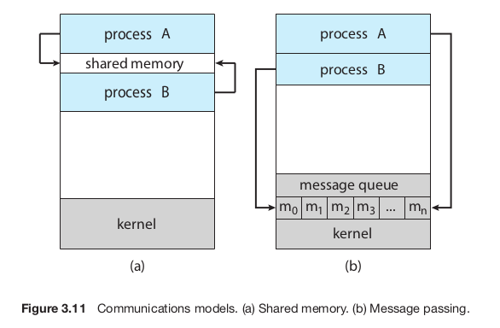
Shared Memory Vs Message Passing
Each requires OS to provide system calls for
  Creating the IPC mechanism
  To read/write using the IPC mechanism
  Delete the IPC mechanism
Note: processes communicating with each other with the help of OS!

Slide 6
Typical code of shared memory type of solutions
Process P1
  x = getshm(ID)
  *x = 100;
Process P2
  x = getshm(ID)
  y = *x

Slide 7
Typical code of message passing type solutions
Process P1
  send(P2, x)
  or
  broadcast(x)
Process P2
  y = receive(P1)
  or
  y = receive(anyone)

Slide 8
Example of co-operating processes: Producer Consumer Problem
Paradigm for cooperating processes, producer process produces information that is consumed by a consumer process
  unbounded-buffer places no practical limit on the size of the buffer
  bounded-buffer assumes that there is a fixed buffer size

Slide 9
Example of co-operating processes: Producer Consumer Problem
Shared data
#define BUFFER_SIZE 10
typedef struct {
. . .
} item;
item buffer[BUFFER_SIZE];
int in = 0;
int out = 0;
Can only use BUFFER_SIZE-1 elements

Slide 10
Example of co-operating processes: Producer Consumer Problem
Code of Producer
while (true) {
/* Produce an item */
while (((in = (in + 1) % BUFFER SIZE count) == out)
; /* do nothing -- no free buffers */
buffer[in] = item;
in = (in + 1) % BUFFER SIZE;
}

Slide 11
Example of co-operating processes: Producer Consumer Problem
Code of Consumer
while (true) {
while (in == out)
; // do nothing -- nothing to consume
// remove an item from the buffer
item = buffer[out];
out = (out + 1) % BUFFER SIZE;
return item;
}

Slide 12
Pipes

Slide 13
Pipes for IPC
Two types
  Unnamed Pipes or ordinary pipes
  Named Pipe

Slide 14
Ordinary pipes
Ordinary Pipes allow communication in standard producer-consumer style
Producer writes to one end (the write-end of the pipe)
Consumer reads from the other end (the read-end of the pipe)
Ordinary pipes are therefore unidirectional
Requires a parent-child (or sibling, etc) kind of relationship between communicating processes

Slide 15
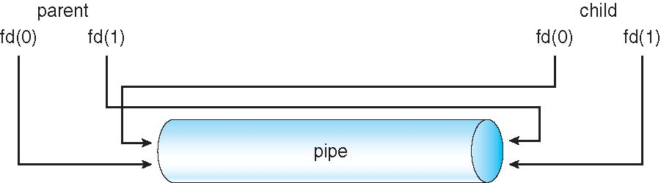

Slide 16
Example of a code using pipe() system call on Linux

Slide 17
Named pipes
Also called FIFO
Processes can create a “file” that acts as pipe. Multiple processes can share the file to read/write as a FIFO
Named Pipes are more powerful than ordinary pipes
Communication is bidirectional
No parent-child relationship is necessary between the communicating processes
Several processes can use the named pipe for communication
Provided on both UNIX and Windows systems
Is not deleted automatically by OS

Slide 18
Named pipes
C library function
  int mkfifo(const char *pathname, mode_t mode);
  Does syscall mknod()
Example

