Slide 1
File Systems
Abhijit A. M.
abhijit.comp@coep.ac.in

Slide 2
What we are going to learn
User’s / Programmer’s view of File system
  The operating system interface (system calls, commands/utilities) for accessing files in a file-sysetm
Implementation of file system
  Design aspects of OS to implement the file system
    On disk data structure
    In memory kernel data structures

Slide 3
End user view of file systems
Using file system as an end-user
Mounting, formatting, device files, soft/hard links

Slide 4
User view and programmer view
User view
  Graphical : Tree structure of files/folders, click to open&see, etc.
  Command driven: cat, cp, mv, rm, ln, ...
Programmer view:
  open(), read(), write(), lseek(), close()
  dup(), dup2(), stat(),
  chmod(), chown()
  link(), unlink()
  mount()

Slide 5
What is a file?
For the kernel: A (dumb!) sequence of bytes (typically on a permanent storage:seconary, tertiary) , with
  A name
  Permissions
  Owner
  Timestamps,
  Etc.
Types: Text files, binary files (one classification in application domain)
  Text: All bytes are human readable (e.g. ASCII)
  Binary: Non-text
Types: ODT, MP4, TXT, DOCX, etc. (another classification)
  Most typically describing the organization of the data inside the file
  Each type serving the needs of a particular application (not kernel)

Slide 6
File types and kernel
For example, MP4 file
  vlc will do a open(...) on the file, and call read(...), interpret the contents of the file as movie and show movie
  Kernel will simply provide open(...) read(...), write(...) to access file data
  Meaning of the file contents is known to VLC and not to kernel!

Slide 7

An application world classification of files

Slide 8
What is a file?
The sequence of bytes can be interpreted (by an application) to be
  Just a sequence of bytes
    E.g. a text file
  Sequence of records/structures
    E.g. a file of student records , by database application, etc
  A complexly organized, collection of records and bytes
    E.g. a “ODT” or “DOCX” file
What’s the role of OS in above mentioned file type, and organization?
  Mostly NO role on Unixes, Linuxes!
  They are handled by applications !
  Types handled by OS: normal file, directory, block device file, character device file, FIFO file (named pipe), etc.
  Also types handled by OS: executable file, non-executable file

Slide 9
File attributes
Run
  $ ls -l
on Linux
To see file listing with different attributes
Different OSes and file-systems provide different sets of file attributes
  Some attributes are common to most, while some are different
  E.g. name, size, owner can be found on most systems
  “Executable” permission may not be found on all systems

Slide 10
File protection attributes
File owner/creator should be able to control:
  what can be done
  by whom
Types of access
  Read
  Write
  Execute
  Append
  Delete
  List
Linux: See commands: “chown”, “chgrp” and “chmod”
Linux file permissions
  For owner, group and others
  Read, write and execute
  Total 9 permissions

Slide 11

A Sample UNIX Directory Listing

Slide 12

Windows
XP
Access List

Slide 13
Access methods
OS system calls may provide two types of access to files
  Sequential Access
    read next
    write next
    reset
  Linux provides sequential access using open(), read(), write(), ...
  Direct Access
    read n
    write n
    position to n
    read next
    write next
    rewrite n
  n = relative block number
  pread(), pwrite() on Linux
    ssize_t pread(int fd, void *buf, size_t count, off_t offset);
    ssize_t pwrite(int fd, const void *buf, size_t count, off_t offset);

Slide 14
Hard and Soft links

Slide 15
Creating “links”
Hard link
$ touch m
$ ls -l m
-rw-rw-r-- 1 abhijit abhijit 0 Jan 5 16:18 m
$ ln m ../mm
$ ls -l m ../mm
-rw-rw-r-- 2 abhijit abhijit 0 Jan 5 16:18 m
-rw-rw-r-- 2 abhijit abhijit 0 Jan 5 16:18 ../mm
$ ln ../mm ./mmm; ls -l m ../mm ./mmm
$ chmod 444 ../mm # changes perms on all files

Slide 16
Creating “links”
$ ls -l m mm mmm
-rw-rw-r-- 3 abhijit abhijit 0 Jan 5 16:18 m
-rw-rw-r-- 3 abhijit abhijit 0 Jan 5 16:18 mm
-rw-rw-r-- 3 abhijit abhijit 0 Jan 5 16:18 mmm
$ echo Hi > m
$ ls -l m mm mmm
-rw-rw-r-- 3 abhijit abhijit 3 Jan 5 16:18 m
-rw-rw-r-- 3 abhijit abhijit 3 Jan 5 16:18 mm
-rw-rw-r-- 3 abhijit abhijit 3 Jan 5 16:18 mmm
$ cat m
Hi
$ cat mm
Hi

Slide 17
Creating “links”
Soft Link
$ ln -s m y
$ ls -l m y
-rw-rw-r-- 3 abhijit abhijit 3 Jan 5 16:18 m
lrwxrwxrwx 1 abhijit abhijit 1 Jan 5 16:18 y -> m

Slide 18
The hard link problem
Name1
Data of file
Name2
We are not considering other problems here , just focussing on hard link problem

Slide 19
File system implementation
Other subproblems: Hard link problem
Need to separate name from data !
  /x/y and /a/b should be same file. How?
  Both names should refer to same data !
  Data is separated separately from name, and the name gives a “reference” to data
What about attributes ?
  They go with data! (not with name!)
  But changing permissions on one link shoudl change permissions for all links, “rm” on one link should not delete the file (unless its last link)
    Metadata separated from data into “inode”
So solution was: indirection !

Slide 20
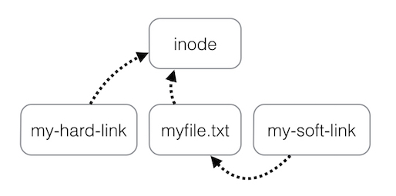
Files names and inodes
Hard Links Vs Soft Links
Data

Slide 21
Open File Semantics

Slide 22
File sharing semantics
Consistency semantics specify how multiple users are to access a shared file simultaneously
Unix file system (UFS) implements:
  Writes to an open file visible immediately to other users of the same open file
  One mode of sharing file pointer to allow multiple users to read and write concurrently
AFS has session semantics
  Writes only visible to sessions starting after the file is closed

Slide 23
What does the hardware give us ?
Disk, drivers, controllers

Slide 24
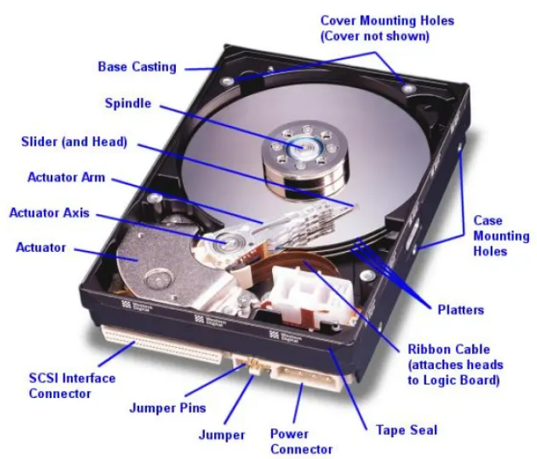
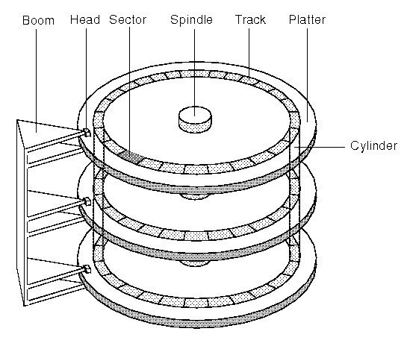
Disk

Slide 25
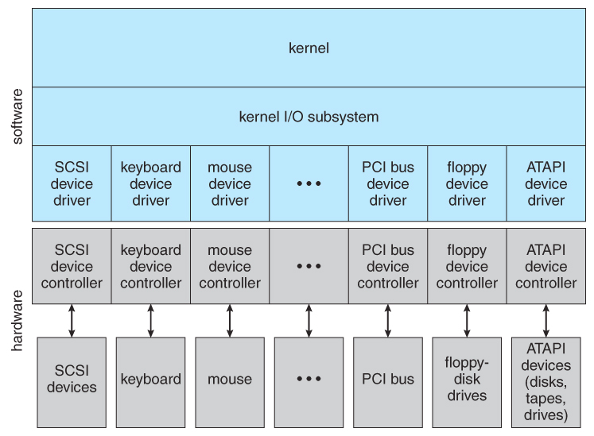
Device Driver

Slide 26
Logical view of a disk/partition
Sequence of blocks (512 bytes each)
Given by Disk driver / SSD Driver / CD Driver / etc
512 sized sector/block
Note: Hardware and hence Device drivers give block size of 512 bytes. sometimes File System code in kernel, adds one more layer on top of device driver, and creates abstraction of block size = n * 512

Slide 27
Disk controller and driver
Disk Controller
  Electronic hardware circuit
  Can handle instructions like : read block no. N, write to block no. N
  IN OUT instructions to deal with this
Disk driver / CD Driver / PD driver etc
  A wrapper on the controller , in C
  Gives functions like
    readblk(int n, buf *f) ; // read n’th block into buf f
    writeblk(int n, buf *f) // write from buf f, into n’th block

Slide 28
Disk controller and driver
In xv6 driver code
  In bootmain()
    readsect()
    Polling driven disk driver
  In ide.c
    iderw(), idestart(), ideintr(),
    Interrupt driven disk driver

Slide 29
Device Drivers
Hardware manufacturers provide “hardware controllers” for their devices
Hardware controllers can operate the hardware, as instructed
Hardware controllers are instructed by writing to particular I/O ports using CPU’s machine instructions
  This bridges the hardware-software gap
OS programmers, typically, write one “device driver” code that interacts with one hardware controller
  This is pure C code
  Which calls I/O instructions for hardware controller
  This code is independent of most of the OS code
  Often this code is like an add-on Module , eg. Linux kernel

Slide 30
Disk device driver
OS views the disk as a logical sequence of blocks
  OS’s assumed block size may be > sector size
OS Talks to disk controller
Helps the OS Convert it’s view of “logical block” of the disk, into physical sector numbers
Acts as a translator between rest of OS and hardware controller
xv6: ide.c

Slide 31
Partitions

Slide 32
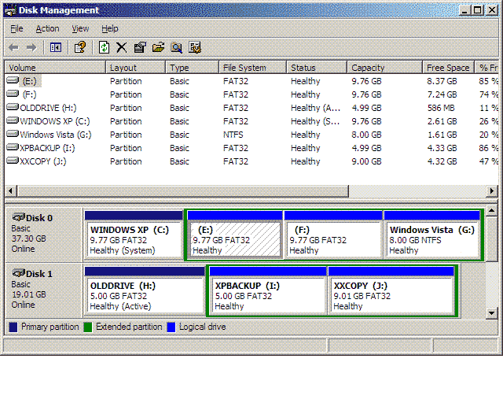
Partitions

Slide 33
Partition
Logical division of a disk
Each partition appears as it was a separate “disk”, i.e. a logical sequence of blocks (0 to N)
On Linux commands like ‘fdisk’ help create partitions on disk
  Device files /dev/sda are disks and /dev/sda1 /dev/sda2 are its partitions

Slide 34
Logical view of file system
Windows Namespace
c:\temp\songs\xyz.mp3
Root is C:\ or D:\ etc
Separator is also “\”
C:\
temp\
windows\
songs\
report.doc
system32\
drivers\
x.dll
xyz.mp3
abc.mp3
write.exe
notepad.exe

Slide 35
Logical view of file system
Windows Namespace
C:\ D:\ Are partitions of the disk drive
Typical convention: C: contains programs, D: contains data
One “tree” per partition
  Together they make a “forest”
C:\
D:\
temp\
windows\
xyz\
sandip\
drivers\
songs\
x.doc
y\
college\
songs\
report.doc
system32\
x.dll
prog.c
xyz.mp3
abc.mp3
file.jpg
game.exe
xyz.mp3
abc.mp3
write.exe
notepad.exe
Root is C:\ or D:\ etc
Separator is also “\”
C:\ D:\ Are partitions of the disk drive
One “tree” per partition
  Together they make a forest
Typical convention: C: contains programs, D: contains data

Slide 36
Logical view of file system
Linux Namespace: On a partition
/usr/songs/xyz.mp3
On every partition:
  Root is “/”
  Separator is also “/”
/
usr/
home/
abhijit/
songs/
note.txt
guest/
myfile
xyz.mp3
abc.mp3
midspark.odp
a.out

Slide 37
Formatting
Physical hard disk divided into partitions
  Partitions also known as minidisks, slices
A raw disk partition is accessible using device driver – but no block contains any data !
  Like an un-initialized array, or sectors/blocks
Formatting
  Creating an initialized data structure on the partition, so that it can start storing the acyclic graph tree structure on it
  Different formats depending on different implementations of the directory tree structure: ext4, NTFS, vfat, VxFS, ReiserFS, WafleFS, etc.
Formatting happens on “a physical partition” or “a logical volume made available by volume manager”

Slide 38
Mounting on Linux/Unix

Slide 39
Mount
Linux namespace is a single “tree” and not a “forest” like Windows
Combining of multiple trees is done through “mount”
/
Linux Hard disk
usr/
home/
songs/
abhijit/
guest/
note.txt
mydir/
A disk partition
xyz.mp3
abc.mp3
midspark.odp
a.out
/
x/
y/
my.x
b.cpp
file.txt
chess.flv

Slide 40
Mount
Linux Hard disk
Mounting another partition on /home/guest/mydir/ directory
/
usr/
home/
Mounted disk partition
songs/
abhijit/
guest/
note.txt
mydir/
xyz.mp3
abc.mp3
midspark.odp
a.out
x/
y/
my.x
b.cpp
file.txt
chess.flv
/home/guest/mydir/x/b.cpp → way to access the file on the other disk partition

Slide 41
Mounting across network!
Using Network File System (NFS)
sudo apt install nfs-common
$ sudo mount 172.16.1.75:/mnt/data /myfolder
http//free-electrons.com

Slide 42
Some Device files

Slide 43
Special devices (1)
Device files with a special behavior or contents
/dev/null
The data sink! Discards all data written to this file.
Useful to get rid of unwanted output, typically log information:
mplayer black_adder_4th.avi &> /dev/null
/dev/zero
Reads from this file always return \0 characters
Useful to create a file filled with zeros:
dd if=/dev/zero of=disk.img bs=1k count=2048
See man null or man zero for details
http//free-electrons.com

Slide 44
Special devices (2)
/dev/random
Returns random bytes when read. Mainly used by cryptographic programs. Uses interrupts from some device drivers as sources of true randomness (“entropy”).
Reads can be blocked until enough entropy is gathered.
/dev/urandom
For programs for which pseudo random numbers are fine.
Always generates random bytes, even if not enough entropy is available (in which case it is possible, though still difficult, to predict future byte sequences from past ones).
See man random for details.
http//free-electrons.com

Slide 45
Special devices (3)
/dev/full
Mimics a full device.
Useful to check that your application properly handles
this kind of situation.
See man full for details.
http//free-electrons.com

Slide 46
Implementing file systems

Slide 47
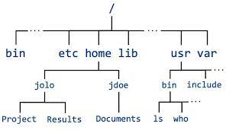
Implementing a file system on disk
Problem:
  Store a n-ary tree (or acyclic graph, or even a graph) in an array which is a sequence of blocks

Slide 48
Different sub-problems
What should be the logical view ?
  Graph, acyclic graph, tree, just 2 level or 1 level directory structure, no directories and onl files. ...
    Decreasing level of complexity
How to store a “file” ?
  Data of the file, properties of the file, name of the file, LINKS (hard and soft)
  How to deal with growth and shrinkage of file size
How to store a “directory”
  As a file ? Separate data structure ?
How to allocate blocks to a file ?
  Which blocks are free, which are not, which strategy is best , what improves the performance ?
Answers will decide: Max file size permitted, performance in file acess, max file name len, max no. Of files in a folder, properties of files, security permission, etc.

Slide 49
File system implementation
Other subproblems
What to do at boot time, how to locate kernel ?
How to manage list of free sectors/blocks?
How to store the summary information about the complete file system : #files, #free-blocks, ...
How to mount a file system , how to unmount?

Slide 50
File system implementation
Other subproblems
About storing a file, how to store
  Data
  Attributes
  Name
  Link count

Slide 51
Second part of problem
Implementing a FS in kernel
Kernel data structure for representing on disk FS layout
Additional kernel data structures to speed up operations
  “Caching” by the kernel
Defining semantics of open, read , write ....
  What if there are multiple writes to the same file at the “same” time ?
  What if file opened by one process is deleted by another?
  ...

Slide 52
Possible solutions to directory/files organization
“Logical View”

Slide 53
Directory Implementation
Problem
  Directory contains files and/or subdirectories
  Operations required – create files/directories, access files/directories, search for a file (during lookup), etc.
  Directory needs to give location of each file on disk

Slide 54
Directory Implementation
Linear list of file names with pointer to the data blocks
  Simple to program
  Time-consuming to execute
    Linear search time
    Could keep ordered alphabetically via linked list or use B+ tree
  Ext2 improves upon this approach.
Hash Table – linear list with hash data structure
  Decreases directory search time
  Collisions – situations where two file names hash to the same location
  Only good if entries are fixed size, or use chained-overflow method

Slide 55
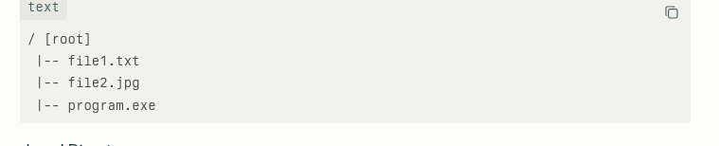
No Directory
Early DOS
FAT12 file system
Try “mkfs -t fat”

Slide 56

Different types of “layouts”
Single level directory
Naming problem
Grouping problem
Example: RT-11, from 1970s https://en.wikipedia.org/wiki/RT-11

Slide 57

Different types of “layouts”
Two level directory
Path name ; Can have the same file name for different user
Efficient searching; No grouping capability
Example: Unix V6

Slide 58

Tree Structured directories
e.g.
FAT32
(no hard links)

Slide 59

Acyclic Graph Directories
Need
Hard/Soft link
Support
E.g. most
Modern FS
ext2, ext3, ext4,
NTFS, ..

Slide 60

General Graph directory
e.g
graphFS

Slide 61
File system on disk
What we know
  Disk I/O in terms of sectors (512 bytes)
  File system: implementation of acyclic graph using the linear sequence of sectors
    Store a acyclic graph into array of “blocks”/“sectors”
  Device driver available: gives sector/block wise access to the disk

Slide 62
At boot time
Root partition
  Contains the file system hosting OS
  “mounted” at boot time – contains “/”
    Normally can’t be unmounted!
Check all other partitions
  Specified in /etc/fstab on Linux
  Check if the data structure on them is consistent
    Consistent != perfect/accurate/complete

Slide 63
Block allocation problem

Slide 64
Disk space allocation for files
File contain data and need disk blocks/sectors for storing it
File system layer does the allocation of blocks on disk to files
Files need to
  Be created, expanded, deleted, shrunk, etc.
  How to accommodate these requirements?

Slide 65

Contiguous Allocation of Disk Space

Slide 66
Contiguous allocation
Each file occupies set of contiguous blocks
Best performance in most cases
Simple – only starting location (block #) and length (number of blocks) are required
Problems include finding space for file, knowing file size, external fragmentation, need for compaction off-line (downtime) or on-line

Slide 67

Linked allocation of blocks to a file

Slide 68
Linked allocation of blocks to a file
Linked allocation
  Each file a linked list of blocks
  File ends at nil pointer
  No external fragmentation
  Each block contains pointer to next block (i.e. data + pointer to next block)
  No compaction, external fragmentation
  Free space management system called when new block needed
  Improve efficiency by clustering blocks into groups but increases internal fragmentation
  Reliability can be a problem
  Locating a block can take many I/Os and disk seeks

Slide 69

FAT: File Allocation Table
FAT (File Allocation Table), a variation
  Beginning of volume has table, indexed by block number
  Much like a linked list, but faster on disk and cacheable
  New block allocation simple

Slide 70

FAT: File Allocation Table
Variants: FAT8, FAT12, FAT16, FAT32, VFAT, ...

Slide 71

Indexed allocation

Slide 72
Indexed allocation
Need index table
Random access
Dynamic access without external fragmentation, but have overhead of index block
Mapping from logical to physical in a file of maximum size of 256K bytes and block size of 512 bytes. We need only 1 block for index table

Slide 73
Multi level indexing
outer-index
index table
file

Slide 74

Unix UFS: combined scheme for block allocation

Slide 75
Free Space Management
File system maintains free-space list to track available blocks/clusters
  Bit vector or bit map (n blocks)
  Or Linked list

Slide 76
Free Space Management: bit vector
Each block is represented by 1 bit.
If the block is free, the bit is 1; if the block is allocated, the bit is 0.
  For example, consider a disk where blocks 2, 3, 4, 5, 8, 9, 10, 11, 12, 13, 17 18, 25, 26, and 27 are free and the rest of the blocks are allocated. The free-space bitmap would be
  001111001111110001100000011100000 ...
A 1- TB disk with 4- KB blocks would require 32 MB (2⁴⁰ / 2¹² = 2²⁸ bits = 2²⁵ bytes = 2⁵ MB) to store its bitmap

Slide 77

Free Space Management: Linked list (not in memory, on disk!)

Slide 78
Further improvements on link list method of free-blocks
Grouping
Counting
Space Maps (ZFS)
Read as homework

Slide 79

A typical file control block (inode)
Name is stored separately
Where?
IN data block of directory

Slide 80
Kernel data structures and code structure

Slide 81

In memory data structures: for open,read,write, ...
Open returns a file handle for subsequent use
Data from read eventually copied to specified user process memory address

Slide 82
In memory data structures
Mount table
  storing file system mounts, mount points, file system types
See next slide for “file” related data structures
Buffers
  hold data blocks from secondary storage

Slide 83
Buffer Cache
User memory
Kernel buffer cache
Disk
User does
read(fd, ubuf, 10);
sys_read() in kernel ?
if the data does not exist in kernel buffer cache then
read from disk into kernel buffer cache
copy from kernel buffer cache into “ubuf” of user land
sys_write() in kernel
write in kernel buffer cache
Return ; // delayed write
That is why if power goes off, or you remove your storage device without umount/safely-remove/eject then data (and metadata) is likely lost !

Slide 84
Ext2 FS layout

Slide 85
Once again:
Implementing a file system on disk
Problem:
  Store a n-ary tree (or acyclic graph, or even a graph) in an array which is a sequence of blocks

Slide 86
Parts of the solution, known to us, so far
Allocate a block (i.e. sector or FS logical block) for data of file, even when actual data is less (e.g. 5 bytes)
Separate Name, Metadata, and Data
  To support hard/soft links
Data of directory = filename + index-block
Indexed allocation of blocks
Data

Slide 87
Inode
Identity Node
Unique identifier for a file on disk
Metadata (data about data) for a file
All properties of a file, PLUS
data block information, MINUS
name of file

Slide 88
struct ext2_inode {
__le16 i_mode; /* File mode */
__le16 i_uid; /* Low 16 bits of Owner Uid */
__le32 i_size; /* Size in bytes */
__le32 i_atime; /* Access time */
__le32 i_ctime; /* Creation time */
__le32 i_mtime; /* Modification time */
__le32 i_dtime; /* Deletion Time */
__le16 i_gid; /* Low 16 bits of Group Id */
__le16 i_links_count; /* Links count */
__le32 i_blocks; /* Blocks count */
__le32 i_flags; /* File flags */

Slide 89
struct ext2_inode {
...
union {
struct {
__le32 l_i_reserved1;
} linux1;
struct {
__le32 h_i_translator;
} hurd1;
struct {
__le32 m_i_reserved1;
} masix1;
} osd1; /* OS dependent 1 */
__le32 i_block[EXT2_N_BLOCKS];/* Pointers to blocks */
__le32 i_generation; /* File version (for NFS) */
__le32 i_file_acl; /* File ACL */
__le32 i_dir_acl; /* Directory ACL */
__le32 i_faddr; /* Fragment address */

Slide 90
struct ext2_inode {
...
union {
struct {
__u8 l_i_frag; /* Fragment number */ __u8 l_i_fsize; /* Fragment size */
__u16 i_pad1; __le16 l_i_uid_high; /* these 2 fields */
__le16 l_i_gid_high; /* were reserved2[0] */
__u32 l_i_reserved2;
} linux2;
struct {
__u8 h_i_frag; /* Fragment number */ __u8 h_i_fsize; /* Fragment size */
__le16 h_i_mode_high; __le16 h_i_uid_high;
__le16 h_i_gid_high;
__le32 h_i_author;
} hurd2;
struct {
__u8 m_i_frag; /* Fragment number */ __u8 m_i_fsize; /* Fragment size */
__u16 m_pad1; __u32 m_i_reserved2[2];
} masix2;
} osd2; /* OS dependent 2 */

Slide 91

Inode in ext2
i_block[]
Note: no pointers
On disk. Block
Numbers are
stored

Slide 92

Ext2 FS Layout: Entries in directory’s data blocks to support add/delete efficiently

Slide 93

Ext2 FS Layout
Size of block
4k,1k, etc
Determined at time of mkfs (formatting)

Slide 94
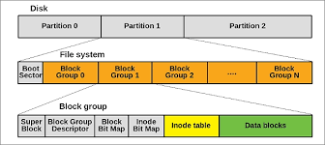
Note: the diagram was for a partition

Slide 95
Calculations done by “mkfs” like this
Block size = 4KB (specified to mkfs)
Number of total blocks = size of partition / 4KB
  How to get size of partition ?
4KB = 4 * 1024 * 8 = 32768 bits
Data Block Bitmap, Inode Bitmap are always one block
So
  size of a group is 32,768 Blocks
  #groups = #blocks-in-partition / 32,768

Slide 96
struct ext2_super_block {
__le32 s_inodes_count; /* Inodes count */
__le32 s_blocks_count; /* Blocks count */
__le32 s_r_blocks_count; /* Reserved blocks count */
__le32 s_free_blocks_count; /* Free blocks count */
__le32 s_free_inodes_count; /* Free inodes count */
__le32 s_first_data_block; /* First Data Block */
__le32 s_log_block_size; /* Block size */
__le32 s_log_frag_size; /* Fragment size */
__le32 s_blocks_per_group; /* # Blocks per group */
__le32 s_frags_per_group; /* # Fragments per group */
__le32 s_inodes_per_group; /* # Inodes per group */
__le32 s_mtime; /* Mount time */
__le32 s_wtime; /* Write time */
__le16 s_mnt_count; /* Mount count */
__le16 s_max_mnt_count; /* Maximal mount count */
__le16 s_magic; /* Magic signature */
__le16 s_state; /* File system state */
__le16 s_errors; /* Behaviour when detecting errors */

Slide 97
struct ext2_super_block {
...
__le16 s_minor_rev_level; /* minor revision level */
__le32 s_lastcheck; /* time of last check */
__le32 s_checkinterval; /* max. time between checks */
__le32 s_creator_os; /* OS */
__le32 s_rev_level; /* Revision level */
__le16 s_def_resuid; /* Default uid for reserved blocks */
__le16 s_def_resgid; /* Default gid for reserved blocks */
__le32 s_first_ino; /* First non-reserved inode */
__le16 s_inode_size; /* size of inode structure */
__le16 s_block_group_nr; /* block group # of this superblock */
__le32 s_feature_compat; /* compatible feature set */
__le32 s_feature_incompat; /* incompatible feature set */
__le32 s_feature_ro_compat; /* readonly-compatible feature set */
__u8 s_uuid[16]; /* 128-bit uuid for volume */
char s_volume_name[16]; /* volume name */
char s_last_mounted[64]; /* directory where last mounted */
__le32 s_algorithm_usage_bitmap; /* For compression */

Slide 98
struct ext2_super_block {
...
__u8 s_prealloc_blocks; /* Nr of blocks to try to preallocate*/
__u8 s_prealloc_dir_blocks; /* Nr to preallocate for dirs */
__u16 s_padding1;
/*
* Journaling support valid if EXT3_FEATURE_COMPAT_HAS_JOURNAL set.
*/
__u8 s_journal_uuid[16]; /* uuid of journal superblock */
__u32 s_journal_inum; /* inode number of journal file */
__u32 s_journal_dev; /* device number of journal file */
__u32 s_last_orphan; /* start of list of inodes to delete */
__u32 s_hash_seed[4]; /* HTREE hash seed */
__u8 s_def_hash_version; /* Default hash version to use */
__u8 s_reserved_char_pad;
__u16 s_reserved_word_pad;
__le32 s_default_mount_opts;
__le32 s_first_meta_bg; /* First metablock block group */
__u32 s_reserved[190]; /* Padding to the end of the block */

Slide 99
struct ext2_group_desc
{
__le32 bg_block_bitmap; /* Blocks bitmap block */
__le32 bg_inode_bitmap; /* Inodes bitmap block */
__le32 bg_inode_table; /* Inodes table block */
__le16 bg_free_blocks_count; /* Free blocks count */
__le16 bg_free_inodes_count; /* Free inodes count */
__le16 bg_used_dirs_count; /* Directories count */
__le16 bg_pad;
__le32 bg_reserved[3];
};

Slide 100
Traversal / path-name resolution
//resolving /a/b
s = read_superblock(); // struct
g = read_bg_descriptors(); // array
inode getinode(int n) {
calculate the block number for n'th inode
(using info from superblock, bg
descriptors, block-size etc)
read that block
extract inode from block
return inode
}
ino = 2
i = getinode(ino) ; //root
while (path not complete) {
if (i is directory and path not complete)
x = get-pathname-component(path);
// give "a" from "/a/b", then "b" , etc
read-data blocks of i'th inode
search for x in the data-blocks
if found
ino = inode for found entry
else
return not-found
}

Slide 101
Let’s see a program to read superblock of an ext2 file system.

Slide 102

File system implementation: layering

Slide 103
Idea of Layering
Main() { // application
write(fd, "hello", 5);
}
C library
int write(int fd, char *str, int len) {
...
mov 5, eax; // 5 is syscall number
int 80;
}
--- application-kernel-boundary----
Kernel // logical file system
int sys_write(int fd, char *str, int len) {
file *fp = currproc->ofile[fd];
x = file_write(fp, str, len);
}
int file_write(file *fp, char *str, int len) { //file-organization module
// map current position in file to disk block, etc // basic file system
// prepare disc block to be writeen, say *buf
disk_device_driver_write(blockno, buf);
}
disk_device_driver_write(int blockno, char *buf) { // device-control
cyllinder, track, sector = convert(blockno)
//assembly code
//ask controller to write "buf" to cyllinder,track,sector
}
---hardware-software-boundary----
Controller (hw)
writes.

Slide 104
Basic File system:
basic_read(int blockno, char *buf, ...) {
os_buffer *bp;
sectorno = calculation on blockno;
disk_driver_read(sectono, bp );
move-process-to-wait-queue;
copy-data-to-user-buffer(bp, buf);
}
IO Control, Device driver:
disk_driver_read(sectorno) {
issue instructions to disk controller
(often assembly code)
to read sectorno
into specific location;
}
XV6 does it slightely differently, but following the layering principle!
Application programs
int main() {
char buf[128]; int count;
fd = open(...):
read(fd, buf, count);
}
-----
OS
Logical file system:
sys_read(int fd, char *buf, int count) {
file *fp = currproc->fdarray[fd];
file_read(fp, ...);
}
File organization module:
file_read(file *fp, char *buf, int count) {
offset = fp->current-offset;
translate offset into blockno;
basic_read(blockno, buf, count);
}

Slide 105
File system implementation
We have system calls at the API level, but how do we implement their functions?
  On-disk and in-memory structures. Let’s see some of the important ones.
  Boot control block contains info needed by system to boot OS from that volume
    Not always needed. Needed if volume contains OS, usually first block of volume
  Volume control block (superblock, master file table) contains volume details
    Total # of blocks, # of free blocks, block size, free block pointers or array
  Per-file File Control Block (FCB) contains many details about the file
    Inode(FCB) number, permissions, size, dates
  Directory structure organizes the files
    Names and inode numbers, master file table

Slide 106
File system: Layering
Device drivers manage I/O devices at the I/O control layer
  Given commands like “read drive1, cylinder 72, track 2, sector 10, into memory location 1060” outputs low-level hardware specific commands to hardware controller
Basic file system given command like “retrieve block 123” translates to device driver
  Also manages memory buffers and caches (allocation, freeing, replacement)
  Buffers hold data in transit
  Caches hold frequently used data
File organization module understands files, logical address, and physical blocks
  Translates logical block # to physical block #
  Manages free space, disk allocation
Logical file system manages metadata information
  Translates file name into file number, file handle, location by maintaining file control blocks (inodes in Unix)
  Directory management
  Protection

Slide 107
Layering advantages
Layering useful for reducing complexity and redundancy, but adds overhead and can decrease performance
  Logical layers can be implemented by any coding method according to OS designer
Many file systems, sometimes many within an operating system
  Each with its own format (CD-ROM is ISO 9660; Unix has UFS, FFS; Windows has FAT, FAT32, NTFS as well as floppy, CD, DVD Blu-ray, Linux has more than 40 types, with extended file system ext2 and ext3 leading; plus distributed file systems, etc)
  New ones still arriving – ZFS, GoogleFS, Oracle ASM, FUSE
  The Virtual File System (to be discussed later) helps us combine multiple physically different file systems into one logical layer at the top

