Slide 1
Page replacement

Slide 2
LRU: Counter implementation
Counter implementation
  Every page entry has a counter; every time page is referenced through this entry, copy the clock into the counter
  When a page needs to be changed, look at the counters to find smallest value
    Search through table needed

Slide 3
LRU: Stack implementation
Keep a stack of page numbers in a double link form:
Page referenced: move it to the top
  requires 6 pointers to be changed and
  each update more expensive
  But no need of a search for replacement

Slide 4
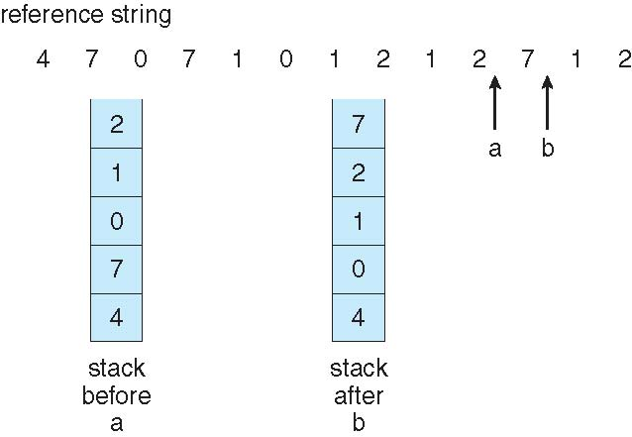
Use of a Stack to
Record The
Most Recent Page References

Slide 5
Stack algorithms
An algorithm for which it can be shown that the set of pages in memory for n frames is always a subset of the set of pages that would be in memory with n + 1 frames
Do not suffer from Balady’s anamoly
For example: Optimal, LRU

Slide 6
LRU: Approximation algorithms
LRU needs special hardware and still slow
Reference bit
  With each page associate a bit, initially = 0
  When page is referenced bit set to 1
  Replace any with reference bit = 0 (if one exists)
  We do not know the order, however

Slide 7
LRU: Approximation algorithms
Second-chance algorithm
  FIFO + hardware-provided reference bit. If bit is 0 select, if bit is 1, then set it to 0 and move to next one.
An implementation of second-chance: Clock replacement
  If page to be replaced has
  Reference bit = 0 -> replace it
  reference bit = 1 then:
    set reference bit 0, leave page in memory
    replace next page, subject to same rules

Slide 8
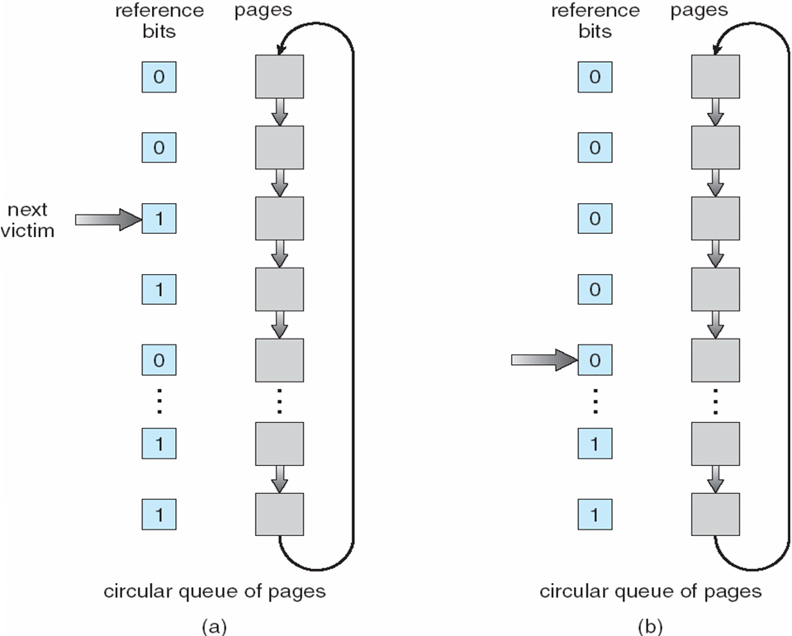
Second-Chance (clock) Page-Replacement Algorithm

Slide 9
Counting Algorithms
Keep a counter of the number of references that have been made to each page
  Not common
LFU Algorithm: replaces page with smallest count
MFU Algorithm: based on the argument that the page with the smallest count was probably just brought in and has yet to be used

Slide 10
Page buffering algorithms
Keep a pool of free frames, always
  Then frame available when needed, not found at fault time
  Read page into free frame and select victim to evict and add to free pool
  When convenient, evict victim
Possibly, keep list of modified pages
  When backing store otherwise idle, write pages there and set to non-dirty
Possibly, keep free frame contents intact and note what is in them
  If referenced again before reused, no need to load contents again from disk
  Generally useful to reduce penalty if wrong victim frame selected

Slide 11
Major and Minor page faults
Most modern OS refer to these two types
Major fault
  Fault + page not in memory
Minor fault
  Fault, but page is in memory
  For example shared memory pages; second instance of fork(), page already on free-frame list,
On Linux run
  $ ps -eo min_flt,maj_flt,cmd

Slide 12
Special rules for special applications
All of earlier algorithms have OS guessing about future page access
But some applications have better knowledge – e.g. databases
Memory intensive applications can cause double buffering
  OS keeps copy of page in memory as I/O buffer
  Application keeps page in memory for its own work
Operating system can given direct access to the disk, getting out of the way of the applications
  Raw disk mode
Bypasses buffering, locking, etc

Slide 13
Allocation of frames
Each process needs minimum number of frames
Example: IBM 370 – 6 pages to handle SS MOVE instruction:
  instruction is 6 bytes, might span 2 pages
  2 pages to handle from
  2 pages to handle to
Maximum of course is total frames in the system
Two major allocation schemes
  fixed allocation
  priority allocation
Many variations

Slide 14
Fixed allocation of frames
Equal allocation – For example, if there are 100 frames (after allocating frames for the OS) and 5 processes, give each process 20 frames
  Keep some as free frame buffer pool
Proportional allocation – Allocate according to the size of process
  Dynamic as degree of multiprogramming, process sizes change

Slide 15
Priority Allocation of frames
Use a proportional allocation scheme using priorities rather than size
If process Pi generates a page fault,
  select for replacement one of its frames
  select for replacement a frame from a process with lower priority number

Slide 16
Global Vs Local allocation
Global replacement – process selects a replacement frame from the set of all frames; one process can take a frame from another
  But then process execution time can vary greatly
  But greater throughput so more common
Local replacement – each process selects from only its own set of allocated frames
  More consistent per-process performance
  But possibly underutilized memory

