Slide 1
GIT : An Introduction
Abhijit A. M.
abhijit.comp@coep.ac.in
(C) Abhijit A.M.
Available under Creative Commons Attribution-ShareAlike License V3.0+

Slide 2
Credits
http://www.cse.cuhk.edu.hk/lyu/_media/groupmeeting/20110829_zacharyling_git.ppt
Presentation by Ruth Anderson
images from http://git-scm.com/book/en/
http://www.cs.washington.edu/390a/
Some of the figure are adopted from Pro GIT by Chacon, which is available at http://progit.org/book/

Slide 3
First time, it’s a mistake
Second time, it was a decision

Slide 4
Why know GIT ?
Version control is ubiquitous in code development today
GIT is the most popular tool, particularly in Free Software communities
NS3 is on gitlab https://gitlab.com/nsnam/ns-3-dev/
  Github repository is read only replica https://github.com/nsnam/ns-3-dev-git

Slide 5
You don’t need GIT
If you are not doing “serious coding”
: Large code,
Group project,
Working with github repos,
Long term work,
...

Slide 6
Issues with managing code
Multiple versions of the same file(s)
Remembering history
  Which change happened when, why
  In collaborative projects: change by whom
Handling ‘release’ of a project
  Bug fixes can happen across multiple ‘releases’
Combine changes done by different people

Slide 7
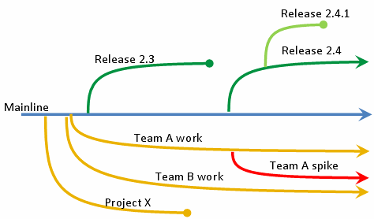
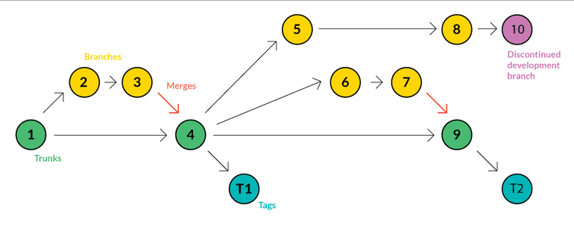
Key concepts of version control

Slide 8
Key concepts of version control systems
Every requested change to a code is recorded by the system
  With a comment (log), date, time, by whom, and the changes
Users can go back to any instance of the code
Multiple versions based on the same base
  Branches
Merge changes done by different people

Slide 9
Before we begin
GIT demands that
you change
the way you think
about
organizing your code

Slide 10
Before we begin
git reduces a lot of work
but
also increases some work : thinking using git!

Slide 11
Before we begin
Common mistake of those who learn git:
Learning commands, without theory of git

Slide 12
Version Control
Basic requirement for developing any software
Too Many Solutions
  Cvs, svn, Bitkeeper, Mercurial, Codeville, Etc.
Two approaches
  Centralised
  Distributed / Decentralised
See: https://en.wikipedia.org/wiki/Comparison_of_version_control_software

Slide 13
Version Control System
– What does it have in it?
Your files (data)
Information about the files (metadata)
All versions of your files
  Either copies of each version or
  Diffs
  Or something like that
Metadata about each version change for each file
  Who, when, what, why (comment)
Essentially: Data, Changes, Metadata

Slide 14
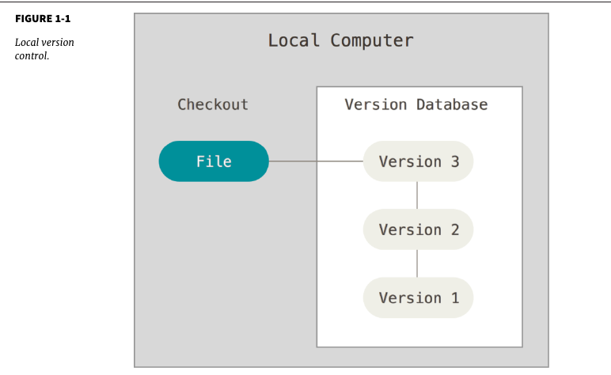

Slide 15
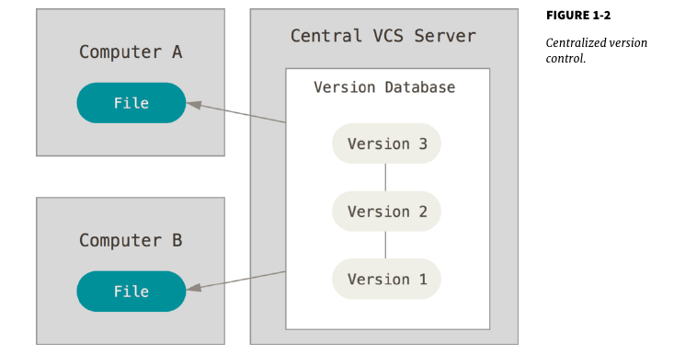

Slide 16
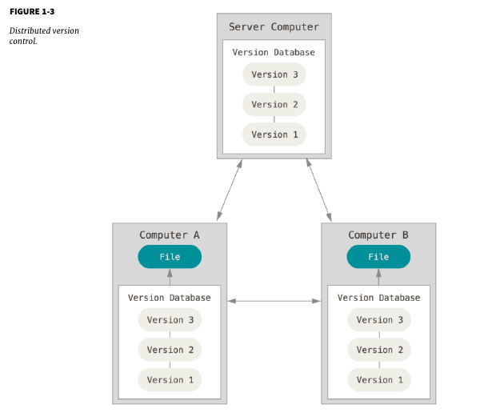

Slide 17
GIT
Goals
  Speed
  Support for non-linear development (thousands of parallel branches)
  Fully distributed
  Able to handle large projects like Linux efficiently
The most popular version control system today
  Particularly for FOSS projects

Slide 18


Subversion Vs Git
Subversion
Git
Git thinks about its data more like a stream of snapshots.

Slide 19

3 states of operation
Unmodified/modified
Files
Staged
Files
Committed
Files

Slide 20
Before we begin, some configuration
$ git config --global user.email "you@example.com”
$ git config --global user.name "Your Name"
This will create the file .gitconfig in your “Home Folder” on Linux, e.g.
  $ cat .gitconfig
  [user]
  email = test@test.com
  name = Test User
  You can also avoid commands, and just edit the file

Slide 21
Let’s get going. Run these commands to use git locally
> mkdir ~/gitdemo; cd ~/gitdemo
> git init
> vi program.c # now write some code in this file
> vi test.c # write some code into this
> git add program.c test.c
> git commit -m “first instance of my program”
> git log
> vi program.c # modify something
> git status ; git diff
> git log
> ls -a .git
> git add program.c
> git diff; git status
> git commit -m “modified program.c”
> git log

Slide 22
Let’s understand what we have done.
> mkdir ~/gitdemo
> cd ~/gitdemo
# You just created a folder and switched to it
> git init
# This way you created an empty “repository”. Run ls -a to see it.
> vi program.c # now write some code in this file
> vi test.c # write another code
# Nothing significant. You just created a file, in the ~/gitdemo folder. This has nothing to do with git
> git add program.c test.c
# Now you are telling git to “add” these files. Git will now “track” these two files.

Slide 23
Let’s understand what we have done (2)
> git commit -m “first instance of my program”
# commit – record the changes done to the “added” files. Git will create a checksum of all files, and create a “log entry”
> git log
# Shows you git log. Do you see the comment “first instance of my program” ?
> vi program.c # modify something
# Again, you have modified the file in the current folder. But this time, remember, git is tracking it

Slide 24
Understanding “git log”
$ git log
commit a6bbc0790e5efd366d1208e4beb57757dcb203d9
Author: Abhijit A.M <abhijit13@gmail.com>
Date: Thu Jan 26 15:04:45 2017 +0530
first instance of my program

Slide 25
Understanding “git status”
$ git status
On branch master
Changes not staged for commit:
(use "git add <file>..." to update what will be committed)
(use "git checkout -- <file>..." to discard changes in working directory)
modified: program.c
no changes added to commit (use "git add" and/or "git commit -a")

Slide 26
Let’s understand what we have done (3)
> git status
# Shows you that program.c is modified, and nothing for test.c
> git diff
# Shows you modifications to program.c
> git log
# Shows you only one log entry
> ls -a .git
# Shows you contents of the .git folderb

Slide 27
Let’s understand what we have done (4)
> git add program.c
# Now git will record changes to program.c / file is in “staging area”
> git diff; git status
# Nothing in diff output; status shows “staged for commit”
> git commit -m “modified program.c”
# Git will create another set of checksums and log record for changes done
> git log

Slide 28
Revisiting: 3 states of operation
Unmodified/modified
Files
Staged
Files
Committed
Files

Slide 29


Slide 30
Git uses checksums
Git generates a unique SHA-1 hash – 40 character string of hex digits, for every commit.
Refer to commits by this ID rather
than a version number. Often we only see the first 7 characters:
1677b2d Edited first line of readme
258efa7 Added line to readme
0e52da7 Initial commit

Slide 31
Removing Files
To remove a file
  First remove it from staging area using
    git rm filename
  Then
    git commit ...
If you just do a “rm filename”
  It removes from working folder only
  “git status” will show the file as changed but not updated, i.e. deleted
git rm --cached README
  Removes from git but does not delete from working folder

Slide 32
Moving/Renaming Files
First way
  git mv <from_file> <to_file>
  git commit ...
Second Way
  mv <from_file> <to_file>
  git rm <from_file>
  git add <to_file>
  git commit

Slide 33
Important git one-liners git log
#to show a shorter version, short cheksum, one line comment
git log --oneline
#to show only the 5 most recent update
git log -5
#Show 2 updates, with patches (diffs)
git log -p -2
# see log as a graph
git log --graph
# show log with some statistics
git log --stat
# show log with pretty one line comments, bigger checksum
git log --pretty=oneline

Slide 34
Advanced git log
git log --pretty="%h - %s" --author=gitster --since="2008-10-01" --before="2008-11-01" --no-merges -- t/
git log --since=2.weeks
git log --pretty=format:"%h %s" --graph
git log --pretty=format:"%h - %an, %ar : %s"

Slide 35
Configure your git
Set the name and email for Git to use when you commit:
> git config --global user.name “Abhijit A. M.”
> git config --global user.email abhijit13@disroot.org
> git config --global core.editor emacs #emacs/vim/nano/etc
See the file ~/.gitconfig
The commands have added entries to this file.
You can also manually edit this file
Run
> git config --list

Slide 36
Undoing commits
Mistakes happen
  Forgot to add a file before doing commit
  Did not write the comment properly
  Etc.
Not everything can be undone always
  Sometimes you may lose data
Command for undoing commits
  git commit --amend
    This will recommit the last commit, including staging area changes.
    If there were no changes in staging area, then only the comment will get modified

Slide 37
Undoing commits
> vim test.c try.c # write both files
> git add test.c
> git commit -m “added test .c”
# here you forgot to add try.c
> git log; git status
> git add try.c
> git commit --amend -m “added test.c try.c”
> git log; git status
> git commit --amend -m “added test.c try.c, with a new comment”
> git log; git status

Slide 38
Git commands so far: summary
command | description
git add files | adds file contents to the staging area
git commit | records a snapshot of the staging area
git status | view the status of your files in the working directory and staging area
git diff | shows diff of what is staged and what is modified but unstaged
git rm files | Remove a file from staging area
git mv files | Rename a file in staging area
git help [command] | get help info about a particular command

Slide 39
.gitignore
Files to be ignored by git
List them in the .gitignore file in the working directory

Slide 40
Important git one-liners / commands
#To unstage a change on a file before you commit it
git reset HEAD -- filename
#To unmodify a modified file
git checkout -- filename
# To see changes that will go in commit
git diff --staged

