Slide 1
GIT : An Introduction
Branching and Merging
Abhijit A. M.
abhijit.comp@coep.ac.in
(C) Abhijit A.M.
Available under Creative Commons Attribution-ShareAlike License V3.0+

Slide 2
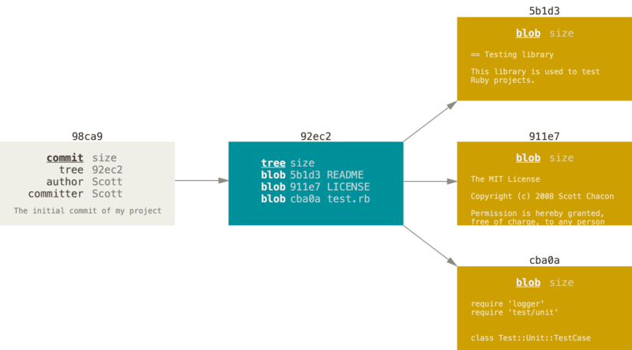
Understanding how git works
A commit and its tree
$ git add README test.rb LICENSE
$ git commit -m 'The initial commit’

Slide 3
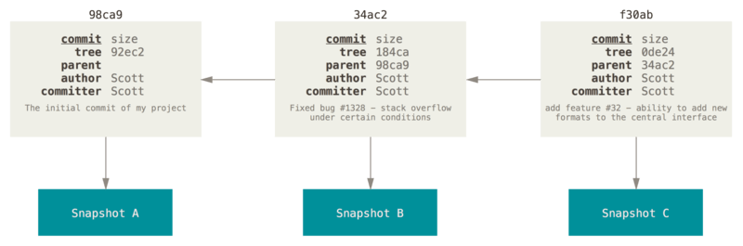
Understanding how git works
Commits build on each other
This diagram shows 3 commits one after another (MINUS the tree of blobs)

Slide 4
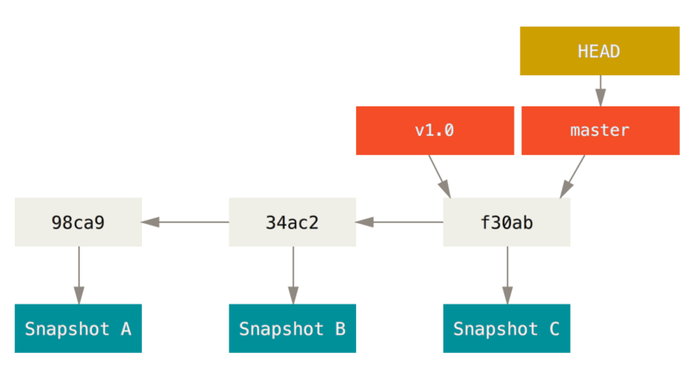
What is a branch?
A branch in Git is simply a lightweight movable pointer to one of the commits.
  The default branch name in Git is master.
  HEAD: a pointer to the current branch you are working on

Slide 5
What is a branch?
This diagram shows two branches
  master
  V1.0
The master branch is not a special branch, all branches are same for git
HEAD is at master branch
  All your work will go to the master branch

Slide 6
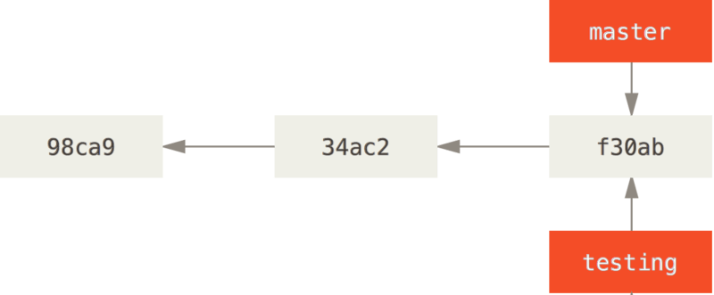
Creating branch
git branch testing
  Creates a new branch called testing at the latest commit
  Only creates a new branch (pointer) called testing, but HEAD is still at master
  All your “git commits” will still
  change the branch “master”
Run git log --oneline --decorate

Slide 7
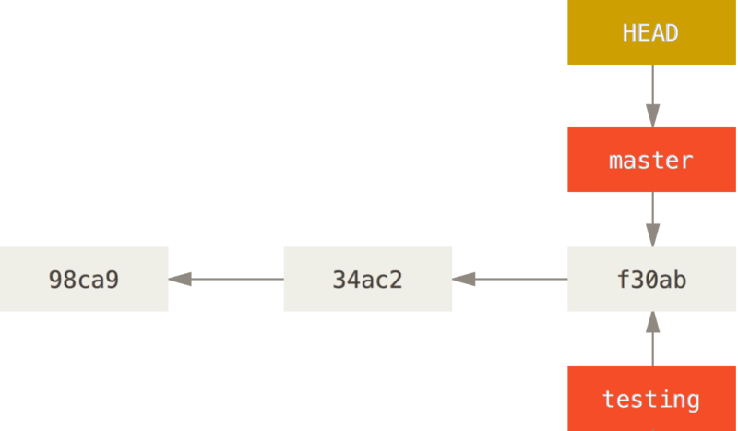
Switching Branch
git checkout testing
  Changes the HEAD pointer to the testing branch
  Now all your commits will go to the
  testing branch

Slide 8
Demo of Using Branch
> mkdir ~/gitdemo; cd ~/gitdemo
> git init
> vi program.c test.c try.c # now write some code in these three file and save them
> git add program.c test.c try.c
> git commit -m "initial commit"
> vi try.c # change something in this file
> git add try.c; git commit -m “changed try.c”
> vi test.c # change something
> git add test.c; git commit -m “changed test.c”
> git branch testing; git checkout testing
> vi program.c # change something
> git add program.c
> git commit -m “changed program.c in branch testing”
> git log --oneline --decorate

Slide 9
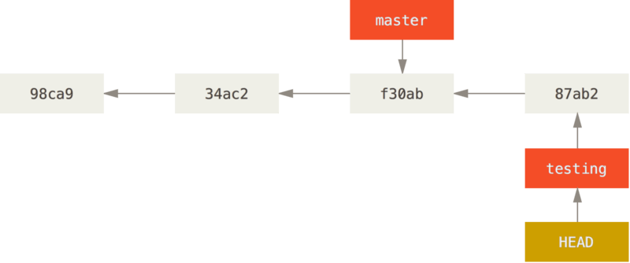
This is what you have at the end of the “Demo”

Slide 10
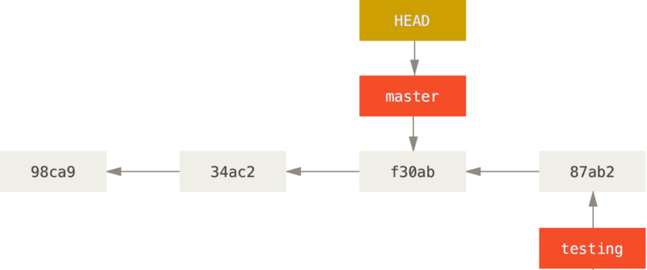
Switching branch
Run
  git checkout master
This is what you’ll get now

Slide 11
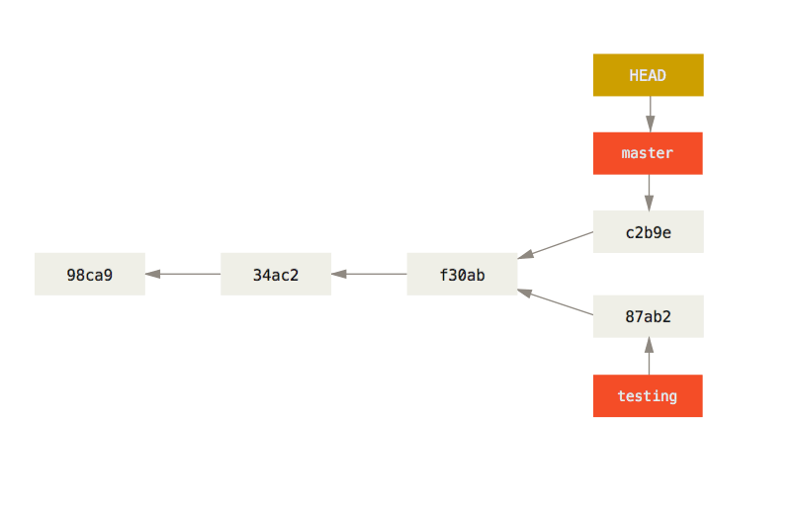
Branch, further experiments, in continuation
> git checkout master # which version of program.c did you get?
> vim program.c # now change something
> git add program.c
> git commit -m “program.c in master”
> git log --oneline --decorate --graph –all
> git checkout testing; vi program.c
> git checkout master; vi program.c

Slide 12
More on Branches
Branch is created “locally”
Branches are “cheap” to create
  Just a file with a checksum in it
“git branch branchname” only creates a pointer
You can easily switch between branches and work on them in parallel
  Normally you should commit your edits, before you switch to another branch

Slide 13
Merge
Perhaps the most important feature required for code development
Particularly distributed development and development in a team
Let’s see an example of merge

Slide 14
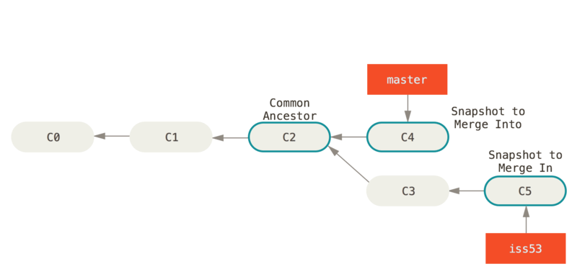
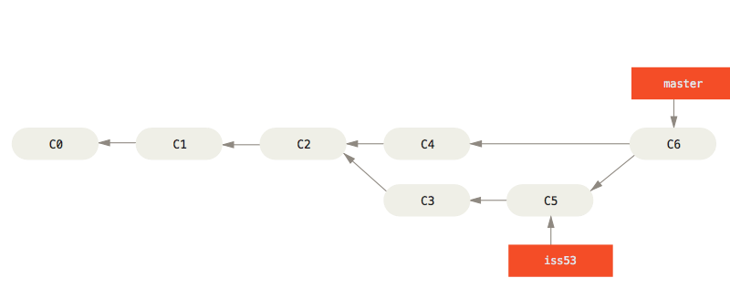
Typical example of what happens after merge
Merge

Slide 15
Merge (2)
Merge involves merging two branches of code into each other
  People develop code, starting at a base, parallely in different branches
  Then they merge the two codes together
  This is often a NON-TRIVIAL task
    Different files changed in different branches --> normally no issue, but
    Same files might have changed
    Same lines of code might have changed differently, requiring a new solution
    Conflicting files might have been added (say header.h added in both branches but with different content)
    More difficult scenarios are also possible
    Many times requires human intelligence
    Some merges can be “simple” with no work required

Slide 16
Demo of Using Merge
> mkdir ~/gitdemo; cd ~/gitdemo
> git init
> vi program.c test.c try.c # now write some code in these three file and save them
> git add program.c test.c try.c
> git commit -m "initial commit"
> vi try.c # change something in this file
> git add try.c; git commit -m “commit 2: try.c”
> vi test.c # change something
> git add test.c;git commit -m “commit 3: test.c”
> git branch testing; git checkout testing
# Now you have 3 commits, and both testing and master at the third commit.You are in testing
> git log --oneline --decorate --graph –all

Slide 17
Demo of Using Merge
> vi program.c # change something
> git add program.c
> git commit -m “commit 4: program.c in testing”
> git log --oneline --decorate --graph --all
# this created one commit in testing branch
> git checkout master
> vi program.c # make changes conflicting with changes in testing branch’s program.c
> git add program.c
> git commit -m “commit 5: program.c in master”
> git log --oneline --decorate --graph –all
> git merge testing #what’s the error message?
> git status #what’s the meaning of the output?
> vi program.c # make suitable changes
> git add program.c
> git commit -m “committ 6: merge of program.c”
> git log --oneline --decorate --graph --all

Slide 18
Merge conflicts
Git reflects the merge conflicts as follows in each file which had the conflict
<<<<<<< HEAD
int j;
return 3000;
=======
int i;
return 100;
>>>>>>> testing

Slide 19
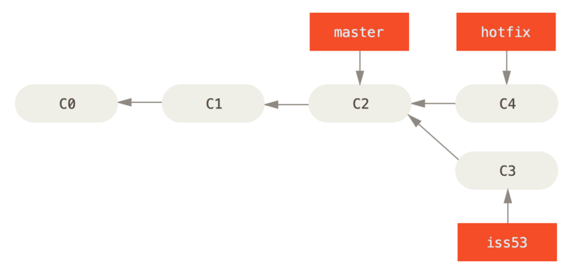
Simple Merge: Fast Forward
Suppose we merge hotfix into master now? What’s the result? How is it different from the earlier case?

Slide 20
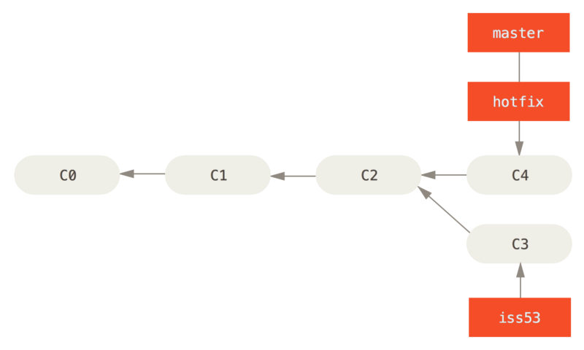
Simple Merge: Fast Forward

Slide 21
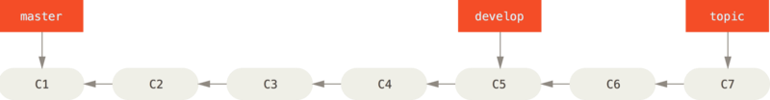
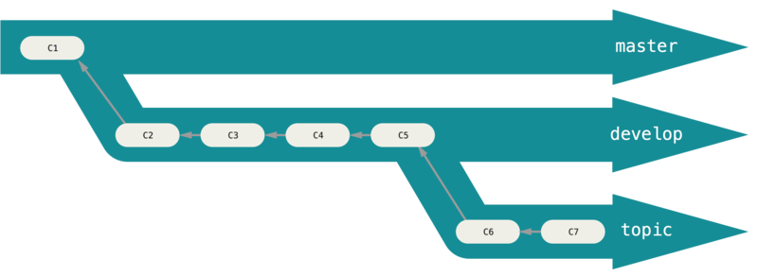
Branching Workflows: Progressive Stability Branching

Slide 22
Branching and Merging
Why this is cool?
  Non-linear development
clone the code that is in production
create a branch for issue #53 (iss53)
work for 10 minutes
someone asks for a hotfix for issue #102
checkout ‘production’
create a branch (iss102)
fix the issue
checkout ‘production’, merge ‘iss102’
push ‘production’
checkout ‘iss53’ and keep working

Slide 23
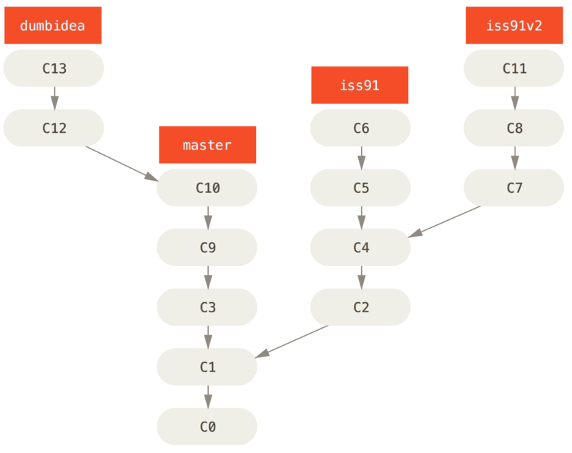
Branching Workflows:
Topic Branches (1)
Abandon iss91,
Use iss91v2
Fast-forward master on dumbidea
Merge iss91v2 into
master

Slide 24
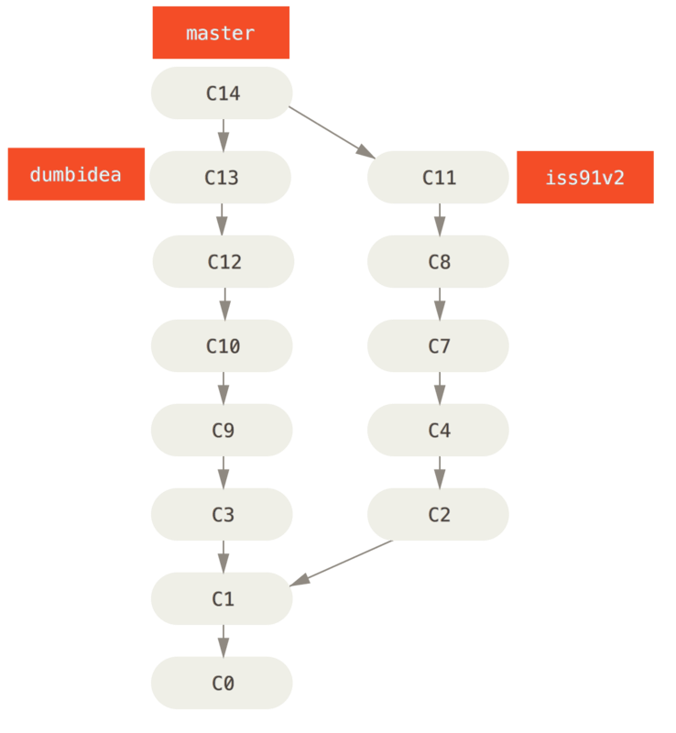
Branching Workflows:
Topic Branches (2)

Slide 25
Remote Branches
Distributed Development Using GIT

Slide 26
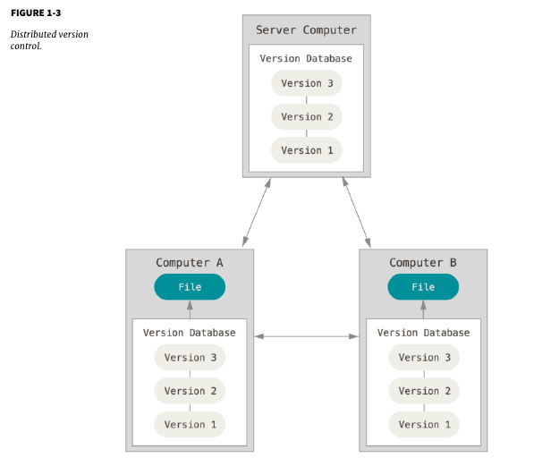
Distributed Version Control

Slide 27
Remote Branches: Commands
git clone
git push
git pull
git fetch
git remote

Slide 28
Remote Tracking Branches
Remote-tracking branches are references to the state of remote branches
  You can see where the remote branches are, but can’t modify them locally
  The only way to change a remote branch is by git push of a local branch into it
They’re local references that you can’t move
  Moved automatically on any network git communication.

Slide 29
Remote Tracking Branches
Bookmarks to remind
  where the branches in your remote repositories were the last time you connected to them.
  form (remote)/(branch)
Typical way to create a remote branch reference
  git clone https:////anonscm.debian.org/cgit/pkg-javascript/node-uglifycss.git
  run
    git remote -v
    git branch -vv
    git ls-remote
    git remote show

Slide 30
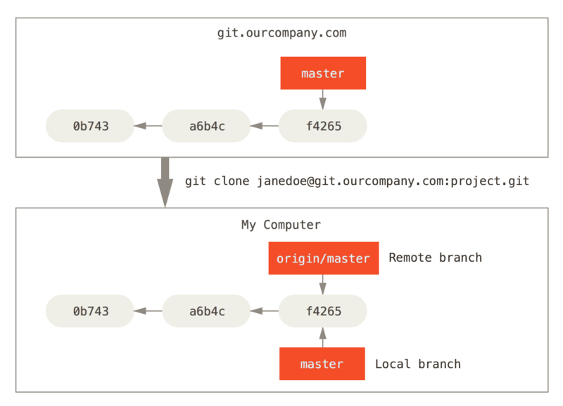
Remote Branches: Example
On Local Machine
Origin/master is a readonly pointer.
You can change the master pointer locally.
If you want to push your changes “upstream” then you can use “git push”

Slide 31
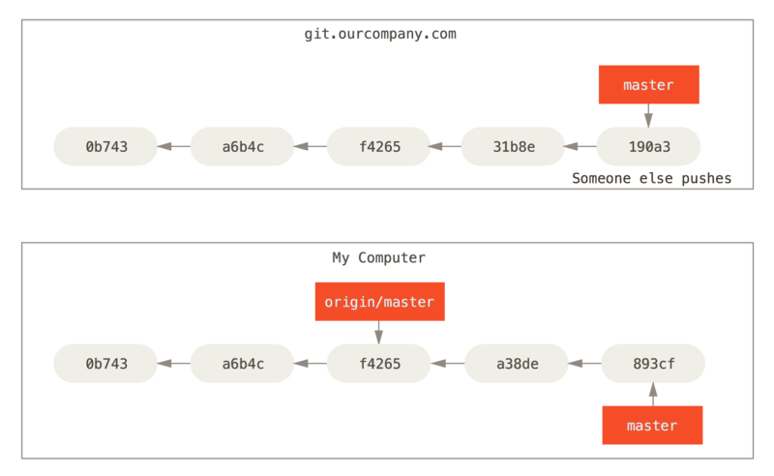
Local and Remote work can diverge

Slide 32
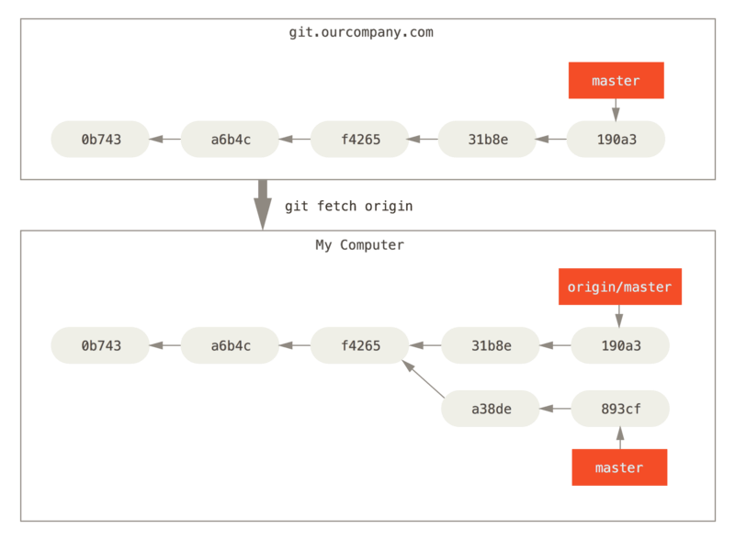
git fetch: updates remote references

Slide 33
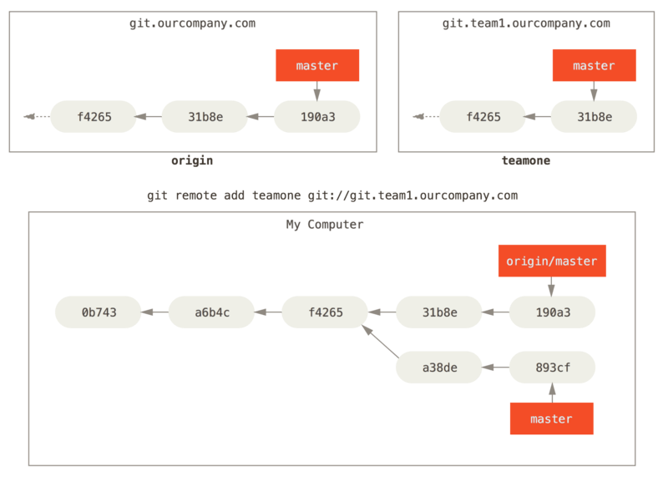
Multiple Remote Servers

Slide 34
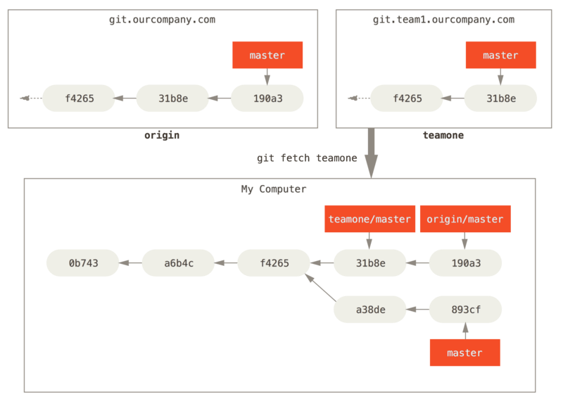
On git fetch teamone

Slide 35
fetch + merge
Normally we fetch a branch from another remote server and can use it to merge with a local branch
  This is the way people synchronize their work

Slide 36
git push
To “push” a local branch on a remote server
  git push origin bug1
The above command will “push” the local branch bug1 on the server identified by origin
The command actually stands for
  git push origin bug1/bug1
  That is: push the local branch bug1 as bug1 on server origin
  You could also say
  git push origin bug1/newbug1
  And the server will get a branch named newbug1

Slide 37
Local branch from a remote branch
git checkout -b serverfix origin/serverfix
This creates the local branch called serverfix from the remote branch serverfix on the remote machine origin
Both branches will have same logs
  Run log --oneline --graph --all --decorate
What will this command do ?
  git checkout -b trial remote1/bug1

Slide 38
Tracking Branches
git checkout --track origin/serverfix
Will create a branch called serverfix locally and this branch will be set to “track” the origin/serverfix branch
    Means, any push from this branch will automatically happen to origin/serverfix
    Any pull will pull from origin/serverfix
    Eliminating the need for few arguments to git pull and git push
If the remotes have only one branch called serverfix, then even this command will create a tracking branch
  git checkout serverfix

Slide 39
pull: fetch + merge
git pull is equivalent to a git fetch followed by merge of the fetched branch with tracking branch
Git pull can be more complicated
  just like merge
You may have to manually fix the merge after a git pull

Slide 40
One Liners for Remote operations
# delete the branch ‘serverfix’ on origin
git push origin --delete serverfix
# show details of all branches, including tracking
git branch -vv

Slide 41
Rebasing
Rebase is a different way of incorproating changes from one branch into another
  As opposed to traditional merge
Rebase throws away the log and branching history and creates a more linear tree
Merge works – using a 3 way merge by finding the best ‘base’
Rebase works by applying the ‘diff’ of the branch on top of target branch

Slide 42
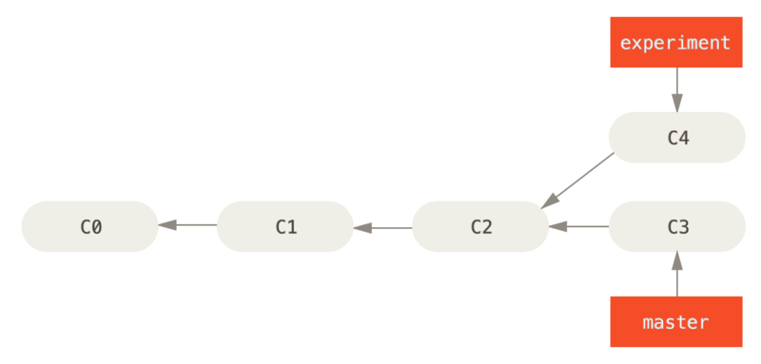
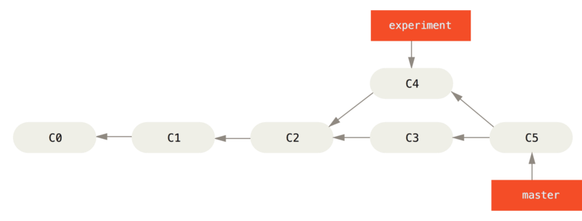
Traditional Merge

Slide 43
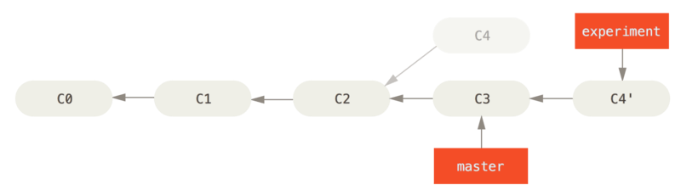
Rebase
Tree of experiment is gone
Diff of C2-C4 is applied on top of C3
Leads to a cleaner/straighter log/tree/history
$ git checkout experiment
$ git rebase master

Slide 44
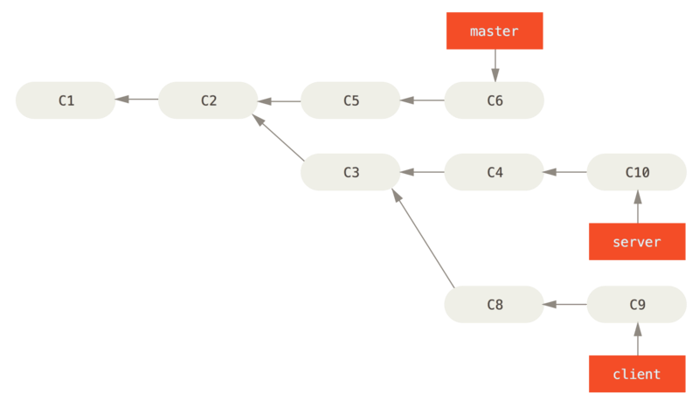
Interesting example of rebase
1. Existing history
You want to merge your client-side changes into your mainline for a release,
but you want to hold off on the server-side changes until tested further.
You can take the changes on client that aren’t on server (C8 and C9) and replay them on your master branch by using the --onto option

Slide 45
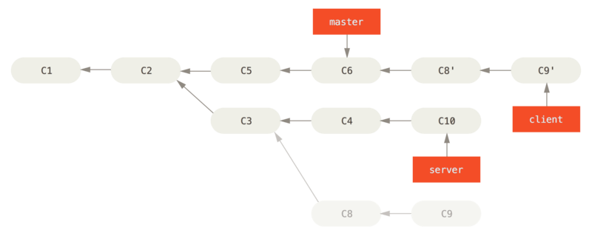
Interesting example of rebase
2. rebase client on master, avoiding server
Check out the client branch
figure out the patches from the common ancestor of the client and server branches
and then replay them onto master
$ git rebase --onto master server client

Slide 46
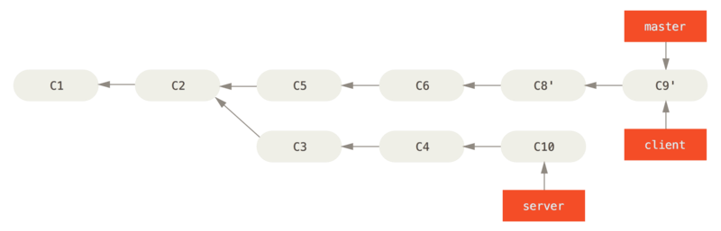
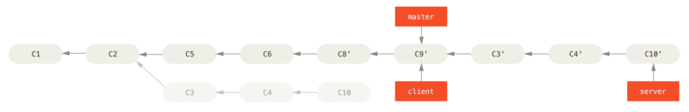
Interesting example of rebase
3. FF master + rebase on server
$ git checkout master
$ git merge client
$ git rebase master server

Slide 47
Merge Vs Rebase
Which one is better?
Rebase can lead to complicated situations
  Guidance: Do not rebase commits that exist outside your repository.
  Let’s see a problem case

Slide 48
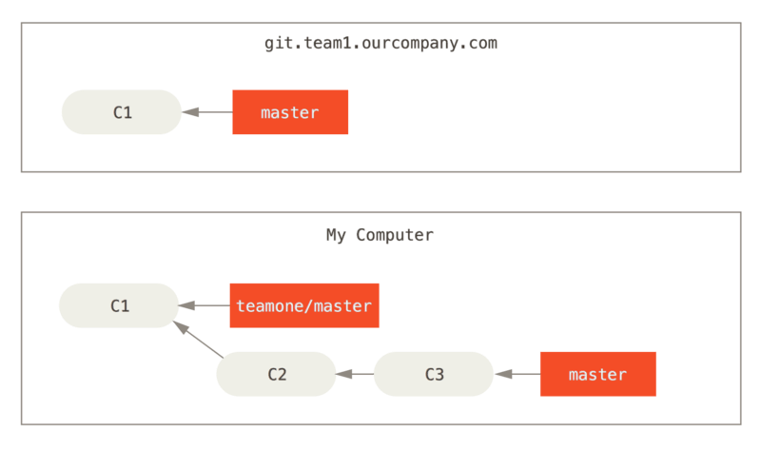
Rebase complications
1. Clone & Then do some work

Slide 49
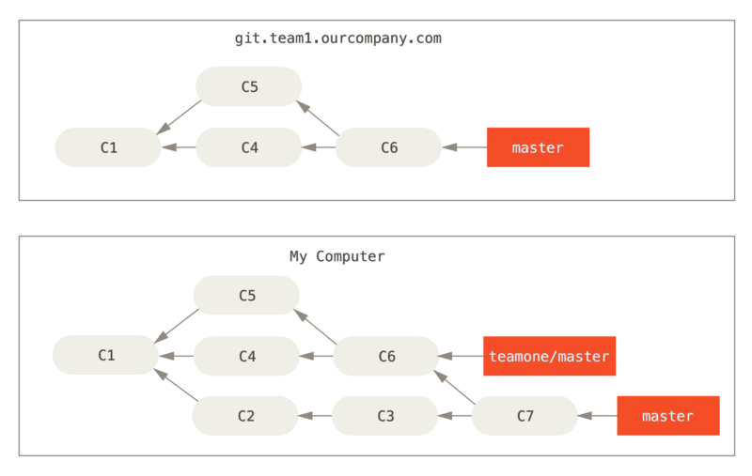
Rebase complications
2. Remote repo changes, has merges
3. You fetch remote, and merge with your work

Slide 50
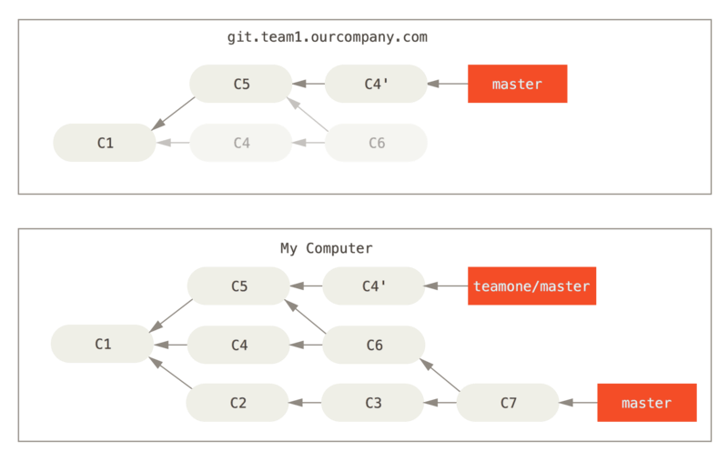
Rebase complications
4. Someone does a rebase on server
(by doing a rebase locally on her machine, and then doing a git push –force)
5. You do a git fetch

Slide 51
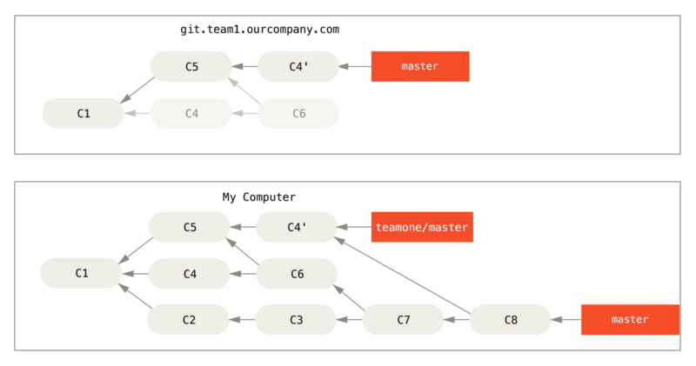
Rebase complications
6. Now if you do a “git pull”
Your repo looks like this:

Slide 52
Rebase complications
If you run a git log
  you’ll see two commits that have the same author, date, and message, which will be confusing.
Furthermore, if you push this history back up to the server, you’ll reintroduce all those rebased commits to the central server, which can further confuse people.

Slide 53
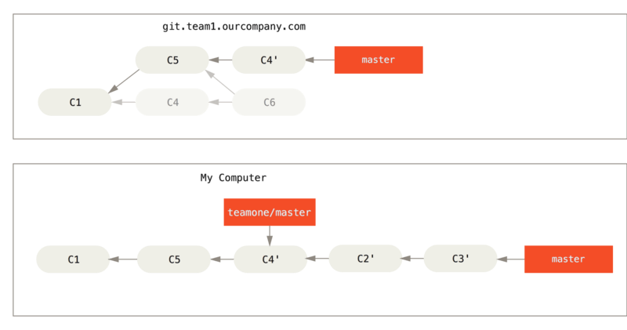
Git is smarter, better way to fetch is fetch with a rebase:
Rebase When You Rebase
git rebase teamone/master

Slide 54
Here git could
Determine what work is unique to our branch (C2, C3, C4, C6, C7)
Determine which are not merge commits (C2, C3, C4)
Determine which have not been rewritten into the target branch (just C2 and C3, since C4 is the same patch as C4')
Apply those commits to the top of teamone/maste

Slide 55
SVN vs GIT
SVN:
  central repository approach – the main repository is the only “true” source, only the main repository has the complete file history
  Users check out local copies of the current version
Git:
  Distributed repository approach – every checkout of the repository is a full fledged repository, complete with history
  Greater redundancy and speed
  Branching and merging repositories is more heavily used as a result

Slide 56
Git Advantages
Resilience
  No one repository has more data than any other
Speed
  Very fast operations compared to other VCS (I’m looking at you CVS and Subversion)
Space
  Compression can be done across repository not just per file
  Minimizes local size as well as push/pull data transfers
Simplicity
  Object model is very simple
Large userbase with robust tools

Slide 57
Some GIT Disadvantages
Definite learning curve, especially for those used to centralized systems
  Can sometimes seem overwhelming to learn
    Conceptual difference
    Huge amount of commends

Slide 58
Git is Not an SCM
Never mind merging. It's not an SCM, it's a distribution and archival mechanism. I bet you could make a reasonable SCM on top of it, though. Another way of looking at it is to say that it's really a content-addressable filesystem, used to track directory trees.
Linus Torvalds, 7 Apr 2005
http://lkml.org/lkml/2005/4/8/9

