Slide 1
GIT : An Introduction
Distributed Development
Abhijit A. M.
abhijit.comp@coep.ac.in
(C) Abhijit A.M.
Available under Creative Commons Attribution-ShareAlike License V3.0+

Slide 2
Remote Repository
Normally a bare repository
  No working directory associated
  People push to and pull from this repository
A collaboration Point
  By mutual agreement
Just the .git directory

Slide 3
4 Protocols
1. Local
Local Protocol
  In a directory on your machine
Commands
  git clone /var/abhijit/project.git
  git clone file:///var/abhijit/project.git
  git remote add local_proj /opt/git/project.git
Pros and Cons
  Simple
  For people who share a machine

Slide 4
4 Protocols
2. Https
Smart protocol
  can use various HTTP authentication mechanisms
Dump Protocol
  Just like a web page
Commands
  git clone https://github.com/schacon/simplegit
  Setup on your machine
    Cd /var/www/html
    git clone --bare /path/to/git_project gitproject.git
    cd gitproject.git
    mv hooks/post-update.sample hooks/post-update
    chmod a+x hooks/post-update

Slide 5
4 Protocols
3. ssh
SSH is nowadays a normal way of communication on network. If it’s already setup you can easily setup an SSH based git server
Commands
  $ git clone ssh://user@server/project.git
Pros and Cons
  Efficient
  No more anonymous access

Slide 6
4 Protocols
4. git protocol
Daemon at port 9418
No authentication
create the git-daemon-export-ok file
Either the Git repository is available for everyone to clone or it isn’t
  generally no pushing over this protocol.

Slide 7
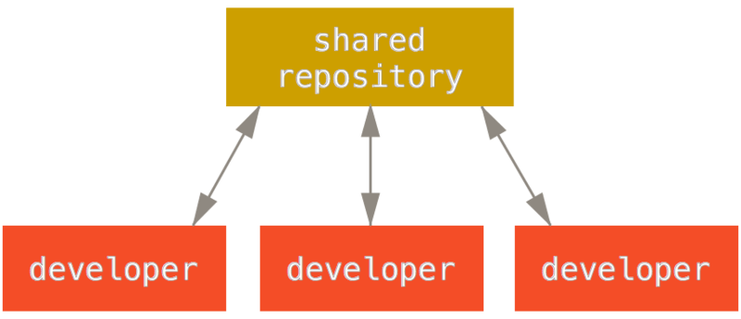
Centralised Workflow
first developer to push their changes back up can do so with no problems. The second developer must merge in the first. one’s work before pushing changes up, so as not to overwrite the first developer’s changes.

Slide 8
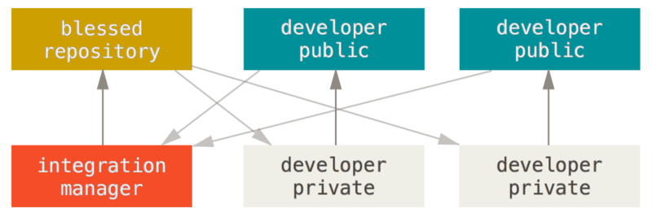
Integration-Manager Workflow
1. Manager pushes to their public (blessed) repository.
2a. A developer clones that repository and makes changes.
2b. The developer pushes to their own public copy.
2c. The developer sends the maintainer an email asking them to pull changes.
3a. The manager adds the contributor’s repo as a remote and merges locally.
3b. The manager pushes merged changes to the main repository.

Slide 9
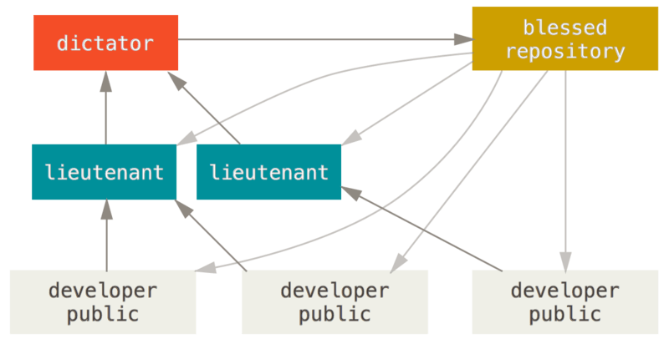
Benevolent dictator workflow

Slide 10
Benevolent dictator workflow
Regular developers work on their topic branch and rebase their work on top of master. The master branch is that of the dictator.
Lieutenants merge the developers’ topic branches into their master branch.
The dictator merges the lieutenants’ master branches into the dictator’s master branch.
The dictator pushes their master to the reference repository so the other developers can rebase on it.

Slide 11
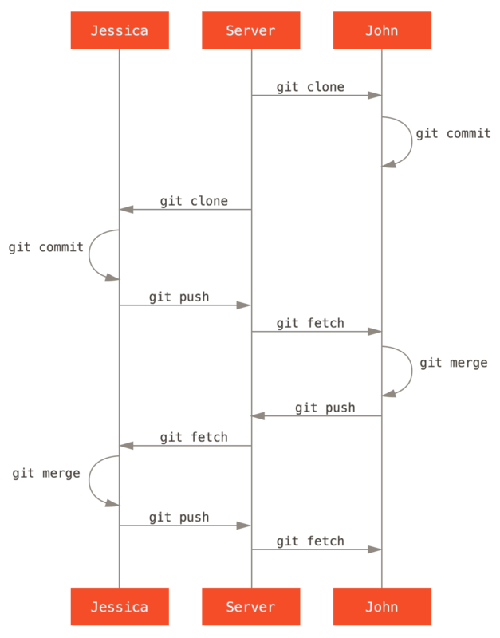
Multiple Developer Git workflow

Slide 12
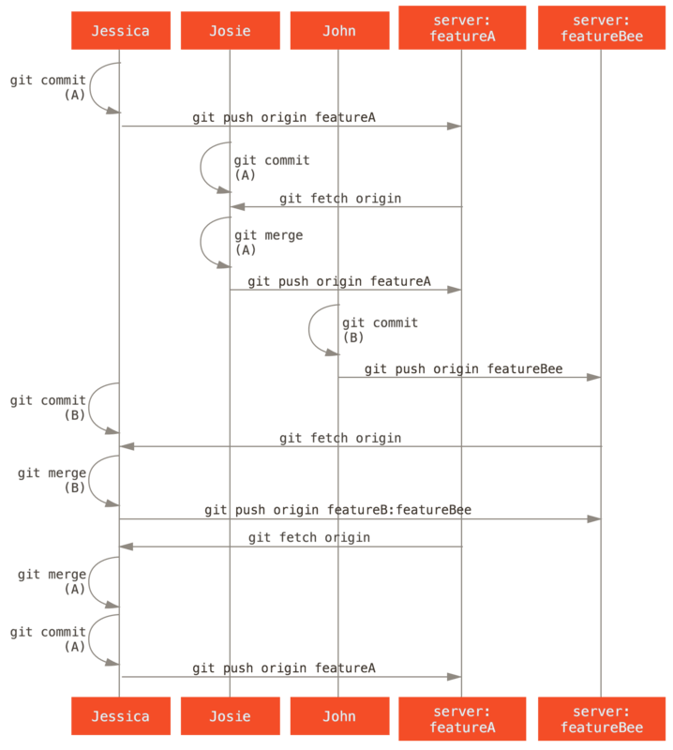
Managed
Team
Workflow

