Slide 1
PHOENIX LENS
FINAL PRESENTATION AND DEMO
Team Phoenix :
Bhavesh Motwani (Team Leader)
Nikita Gupta (GUI Designer)
Priyambada Jain (Technical Head)
Sovan Rath (Project Manager)

Slide 2
Content
Motivation and Business Model
Project Objective
Milestones Achieved
Risk Management
Data Source
Performance Matrix
Test scenario & acceptance criteria
Demo (Phoenix Lens)
Notes:
Good evening everyone. Today we have gathered for the final presentation and demo of our system Phoenix Lens.
First of all we will brief you on the product development cycle via this presentation followed by the Demo of the system.

Slide 3
Motivation and Business Model
A blood transfusion is a safe, common procedure in which blood is given to the patient through an intravenous (IV) line in one of your blood vessels.
Blood transfusions are done to replace blood lost during surgery or due to a serious injury.
The amount of external blood (in case of allogeneic blood transfusion) that will be required for successful surgery plays a pivotal role.
2
Notes:
What is blood transfusion ?
A blood transfusion is a safe, common procedure done to replace blood lost during surgery.
There are two types of blood transfusion :
1) Autologous - where pateient’s own blood is used.
2) Allogeneic - external comptable blood is used to replace.
Therefore the amount of external blood ordered plays a central role in successful surgery.

Slide 4
Project Objectives
Predict the requirement of allogeneic blood during the process of surgery.
The system gives an estimation of the parameter SN_BM_PRBC_Ordered.
Assisting the surgeon to limit the allogeneic blood requirement during the surgery.
Reduce the cost incurred during the surgery.
To ease the process of obtaining blood before surgery.

Slide 5
Milestones
During the project design we followed the Six-Sigma management techniques that comprises of DMAIC cycle.
DMAIC cycle comprises of the following phases along with the deliverables :
  Design Phase - Project Charter (Definition), Voice of Customer (VOC).
  Measure Phase - SIPOC, Process Map And Value Stream Map
  Analyse Phase - Root Cause Analysis(Fishbone Diagram)
  Improve Phase - Design,Development And Testing
  Control Phase - Control And Monitoring Plan
3) The final deliverable is a package that contains a web based GUI along with a specialized prediction algorithm at the back end.

Slide 6
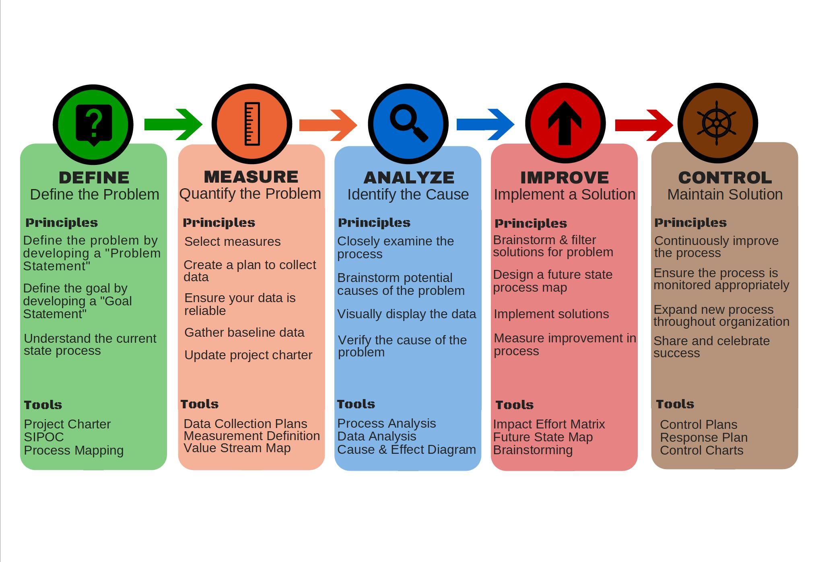
DMAIC Phases

Slide 7
DMAIC Phases
Define Phase - Phoenix Lens Project Charter
During this first phase, we analysed the VOC and presented the project charter to address the concern.
2) Measure Phase - SIPOC, Process Map and Value Stream Mapping.
Next Phase, we analysed the ongoing process of surgery management via SIPOC , process map and VSM.
3) Analyze Phase - Root Cause Analysis
Identified the root causes that could affect the performance of the performance.

Slide 8
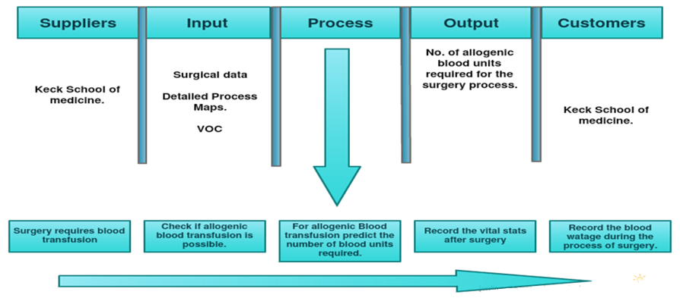
Measure Phase
SIPOC

Slide 9
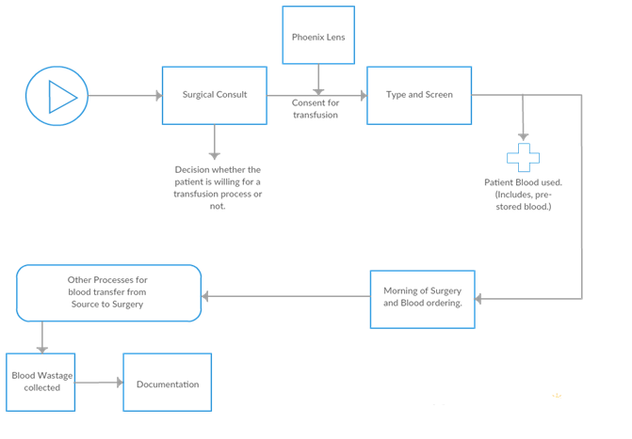
Measure Phase
Process Map

Slide 10
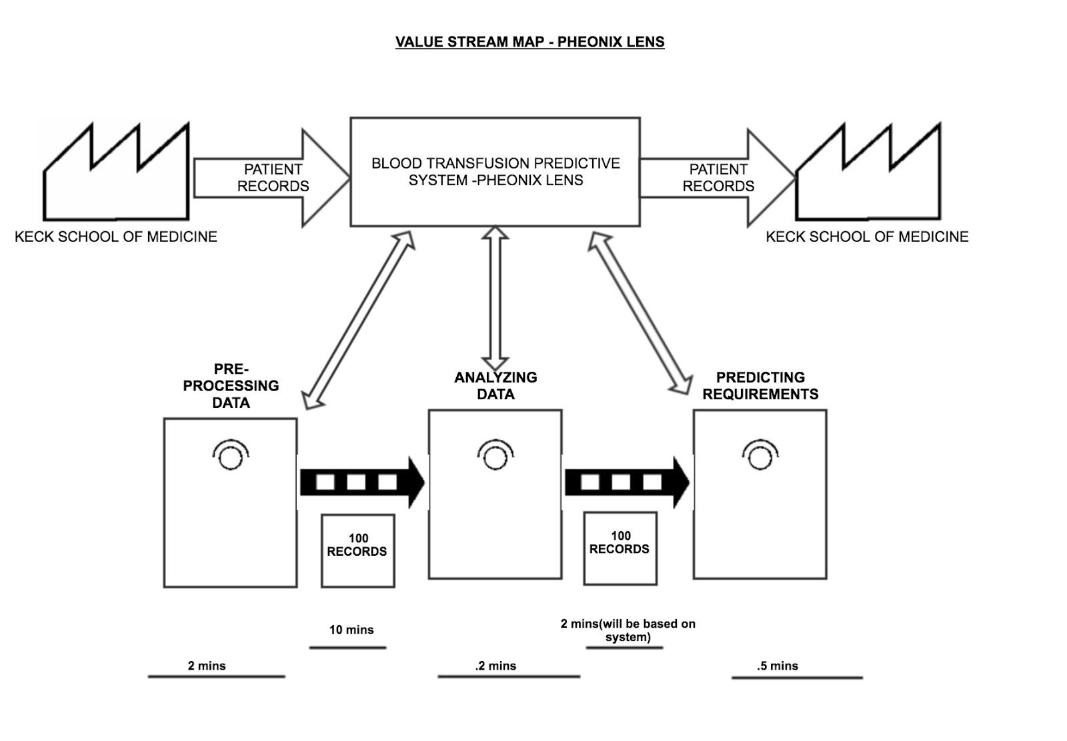
Measure Phase
VSM (VALUE STREAM MAPPING)

Slide 11
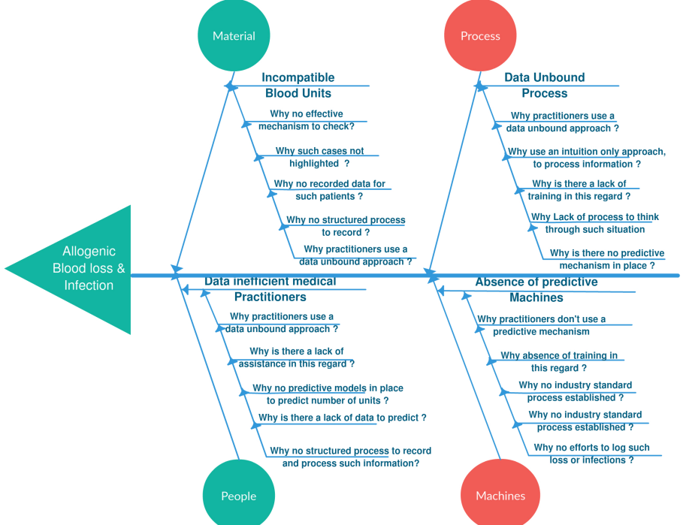
DMAIC Phases
FishBone Diagram

Slide 12
DMAIC Phases
4) Improve Phase - Design Development and Testing
Data Pre-processing - Cleaning and modeling of the data.
Data Visualization and Feature Engineering - This is one of the pivotal section where we decided the independent variables ( based on process and correlation).
Model Construction - Deployed various model as explained later and based on the performance matrix selected the best out of them.
GUI Interface : Now we designed the GUI interface where the surgeon can enter the input parameters and the model will predict the required PRBC to be ordered.
Integration : Once the interface was done our team progressed with the model connectivity with the GUI.
Testing : Based on the dataset provided by the Keck School of Medicine we examined the model for the predictions.

Slide 13
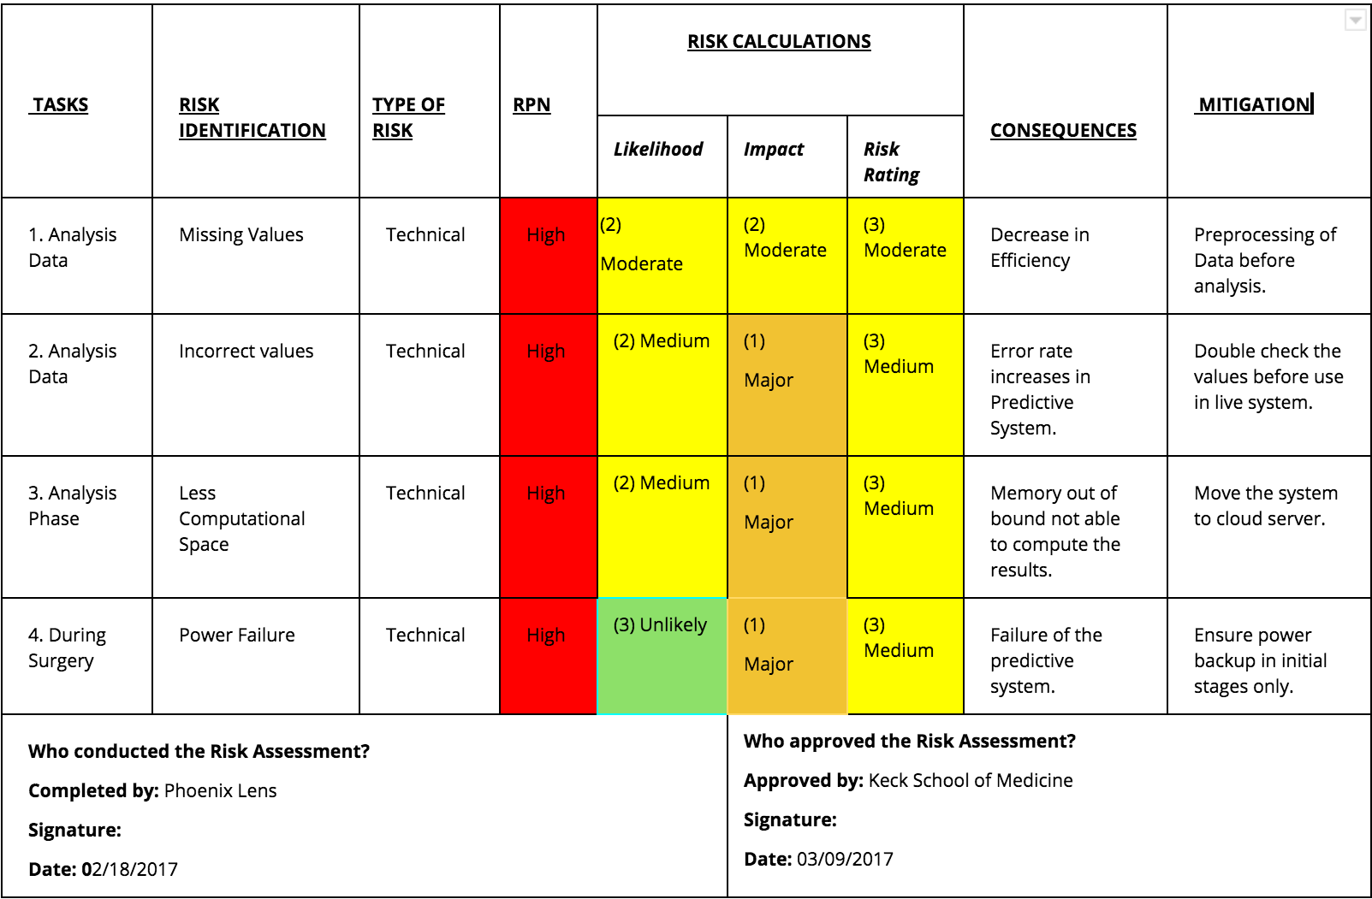
DMAIC Phases
Risk Assessment Template

Slide 14
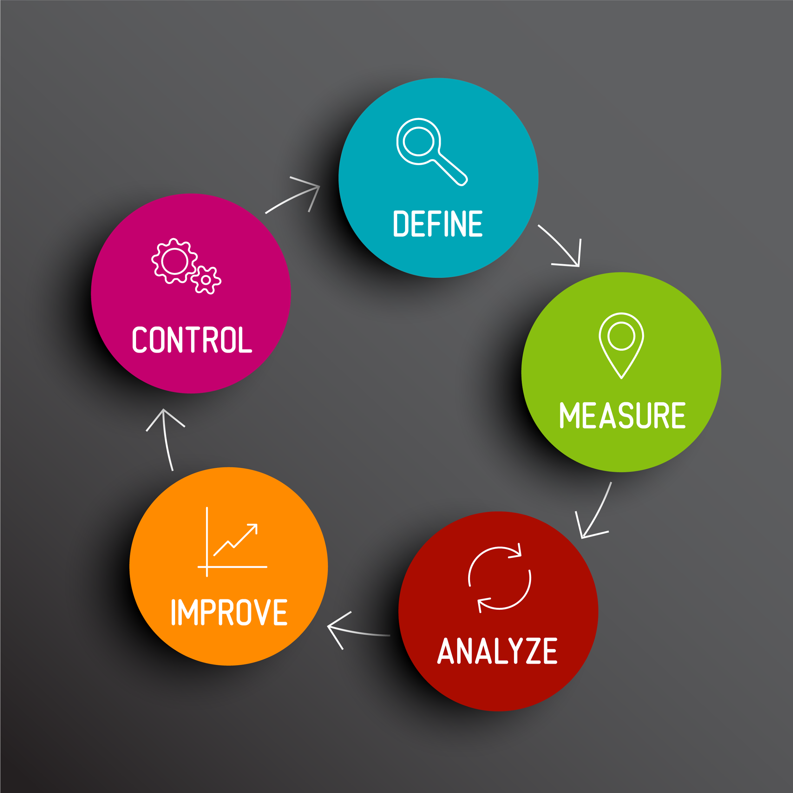
DMAIC Phases
5) Control Phase - Control and Monitoring Plan
This will include the improvements to the system based on the feedbacks provided by the stakeholders.

Slide 15
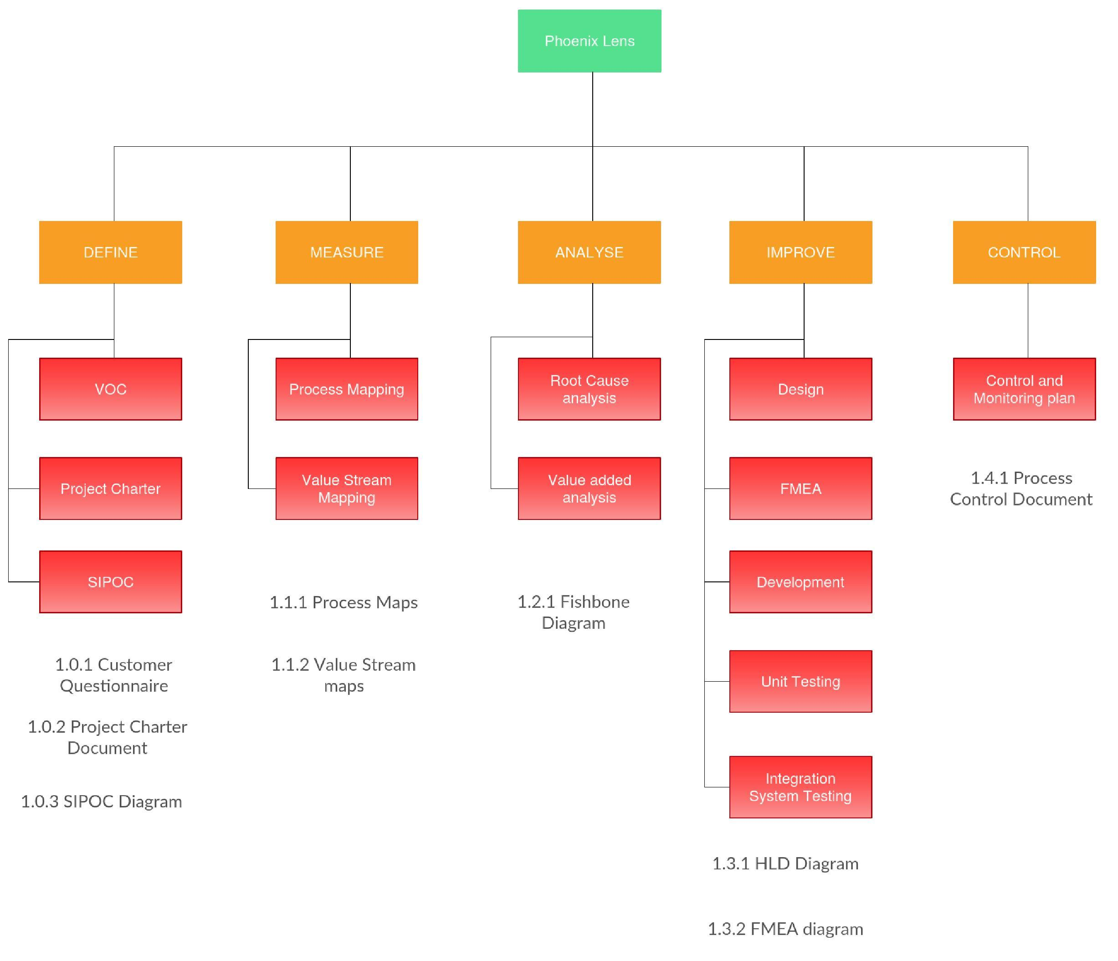
Work Breakdown Structure

Slide 16
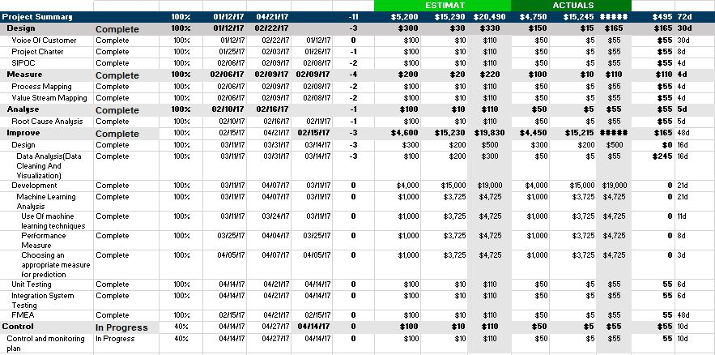
Gantt Chart

Slide 17
SYSTEM IMPLEMENTATION
During the system implementation we have utilized the following technology stack :
R - data cleaning and Data Visualization
Weka - Data Visualization
Python - pandas - data frames for processing
Python - scikit - machine learning library and model evaluation
Bootstrap, HTML, CSS, JavaScript, JQuery, Python,Flask:Graphical User Interface .

Slide 18
Data-Source
First things first for the system to be developed the foremost requirement is the data set followed by understanding the significance of variable.
Phoenix Lens is based on the dataset provided by the USC Keck School Of Medicine.
Description of the dataset : The data set contained the following fields:
Masked FIN
SN-BM-Pre-OP INR(international normalized ratio)
SN-BM-Pre-OP Platelet Count
SN - BM - PRBC Ordered
Masked SurgCaseID
SURG_PROCEDURE
SURGICAL_SPECIALTY

Slide 19
Data-Source
Surgeon Hash Name
PATIENT_TYPE
Allogeneic Blood Transfusion
SN - BM - Red Blood Cells
SN - BM - Fresh Frozen Plasma
SN - BM - Platelets
SN - BM - Cryoprecipitate
ResultsBeforeSurgery
ResultAfterSurgery
EBL: Estimated blood loss

Slide 20
Feature Engineering
The next important step is data cleaning .Based on the description provided by the stakeholder we examined and cleaned the data.
Data Collection Planning and Execution -
We developed a R script to clean the data and make it fit for the model construction.
Converted the string columns to float type
Converted the Surgical Procedure and Surgical Speciality to category and assigned the cat codes.
Removed the logical and statistical outliers.
Notes:
To be useful, data must be accompanied by context on how they are captured, processed, analyzed, and validated and other information that enables interpretation and use.

Slide 21
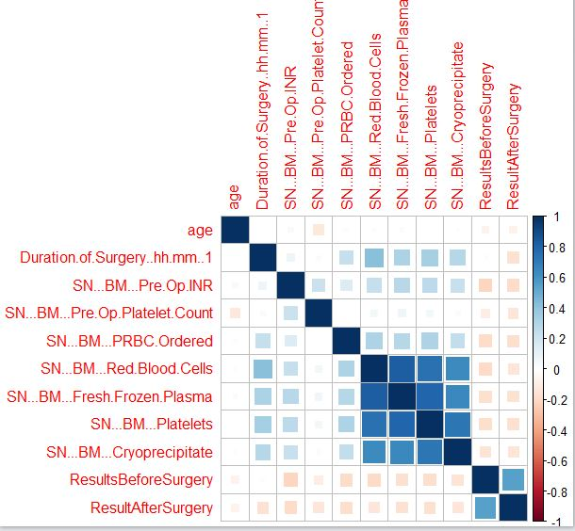
Feature Engineering
Correlation is a statistical measure that indicates the extent to which two or more variables fluctuate together.
Notes:
a mutual relationship or connection between two or more things.

Slide 22
Feature Selection
Independent Variables/Inputs:
Age,
Surgical_Procedure,
Surgical_Specaility,
SN_BM_Pre_OP_INR,
SN_BM_Platelet_Count,
ResultsBeforeSurgery(Hemoglobin before surgery)
Intermediate Result : SN_BM_Red_Blood_Cells
Dependent Variable/Output: SN_BM_PRBC_Ordered

Slide 23
Machine learning model
Linear Regression Model
We can use regression to determine the relation between ice cream sales and average temperature.
We need independent variables and one dependent variable.
In the example above, if change in temperature leads to change in ice cream sales then, temperature is independent variable and sales is dependent variable.
Dependent variables is also called as criterion, response variable or label. It is denoted by Y.
The independent variable is also referred as covariates, predictor or features. It is denoted by X.
Notes:
A Simple Linear Regression allows you to determine functional dependency between two sets of numbers.

Slide 24
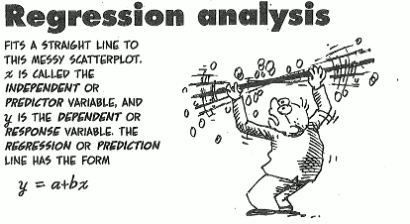
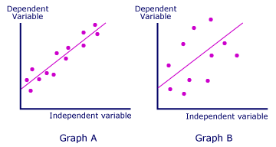
Machine learning model

Slide 25
Machine learning model
1) Linear Regression Model
Inputs :
Age, Surgical_Prod, Surgical_Specaility, SN_BM_Pre_OP_INR, SN_BM_Platelet_Count, ResultBeforeSurgery.
Output :
SN_BM_PRBC_Ordered
Approach :
Based on the parameters that are available with the surgeon before hand i.e prior the start of the surgery.

Slide 26
Machine learning model
Machine learning model
2) Random Forest Ensemble Model
Random forests or random decision forests are an ensemble learning method for classification, regression and other tasks, that operate by constructing a multitude of decision trees at training time and outputting the class that is the mode of the classes (classification) or mean prediction (regression) of the individual trees.
Random decision forests correct for decision trees' habit of overfitting to their training set.

Slide 27
Machine learning model
2) Random Forest Ensemble Model
Suppose you’re very indecisive, so whenever you want to watch a movie.
You ask your friend Willow if she thinks you’ll like it.
In order to get more accurate recommendations, you’d like to ask a bunch of your friends.
That is, instead of asking only Willow, you want to ask Woody, Apple, and Cartman as well, and they vote on whether you’ll like a movie .
i.e., you build an ensemble classifier, aka a forest in this case.

Slide 28
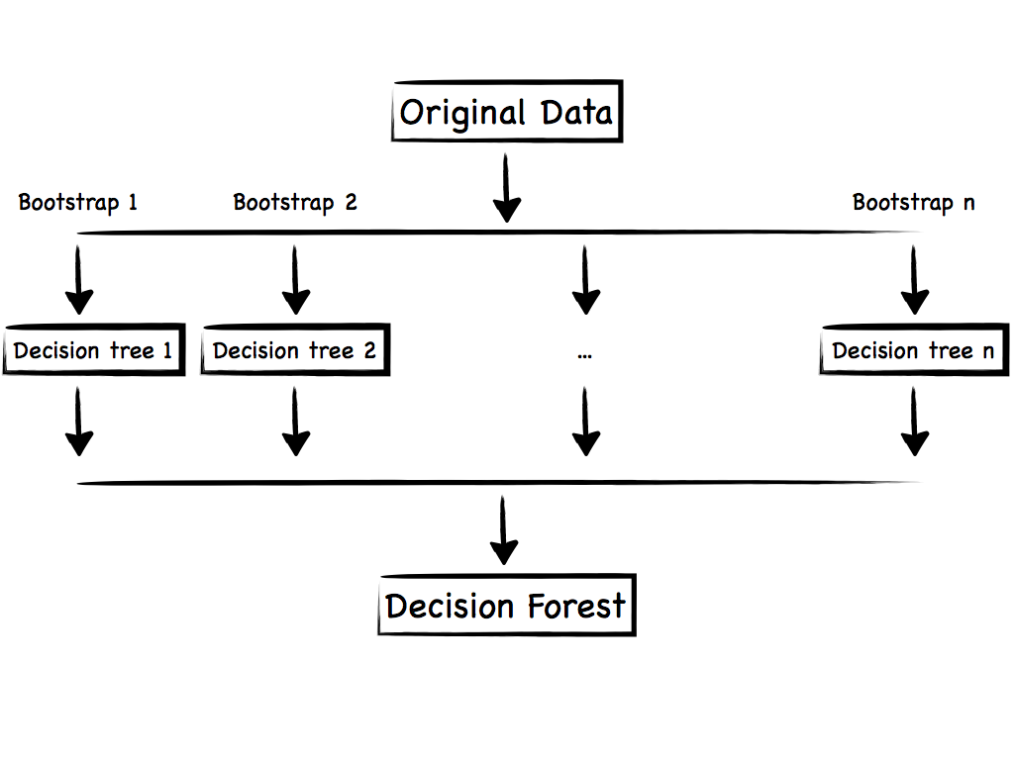
Machine learning model

Slide 29
Machine learning model
2) Random Forest Model Ensemble
Inputs :
Age, Surgical_Prod, Surgical_Specaility, SN_BM_Pre_OP_INR, SN_BM_Platelet_Count, ResultBeforeSurgery.
Output :
SN_BM_PRBC_Ordered, Red Blood Cells.
Approach :
Based on the parameters that are available with the surgeon before hand i.e prior the start of the surgery we created a pipeline of two models where the Red Blood Cells are predicted using the inputs followed by the prediction of PRBC_Ordered.

Slide 30

Performance Metrics
Mean absolute error - In statistics, the mean absolute error (MAE) is a quantity used to measure how close forecasts or predictions are to the eventual outcomes.
The mean absolute error is given by
where is the prediction and the true value.

Slide 31
Performance Metrics
Linear Regression
Linear Regression Model Mean Absolute Error : 1.8777
KNN Regression (5 Neighbours)
K Nearest Neighbour Mean Absolute Error : 1.42865
Decision Tree Algorithm
Decision Tree Algorithm (Single tree) : 1.2484
Random Forest Model
Random Forest Model Mean Absolute Error : 0.779642

Slide 32
Test Scenario and Acceptance Criteria
Challenges -
The most challenging task that we faced was to make our prediction as close as possible to the acceptance criteria.
Theoretical Acceptance -
~ 1.0 units (As the data grows it will reduce over the time.)
Current Acceptance -
0.78 units. of deviation for PRBC_Ordered.

Slide 33
Close Out
Challenges -
The prediction involved critical parameters that required a detailed analysis of the dataset.
Limitations of the attributes available before the surgery.
Best Practices - During the project we followed the Six Sigma for process improvement.It helped us to articulate the process precisely and also involved the timely development of the product.
Final Product - A web based Graphical user Interface named Phoenix Lens for the surgeon to interact and get the predictions.

Slide 34
Future Prospectives
Going live with the system to test it’s effectiveness with real time scenarios.
Integration of more train data generated from the system.
Iterating through the machine learning model designed to improvise the efficiency.
Incorporating the feedbacks provided by the user.

Slide 35
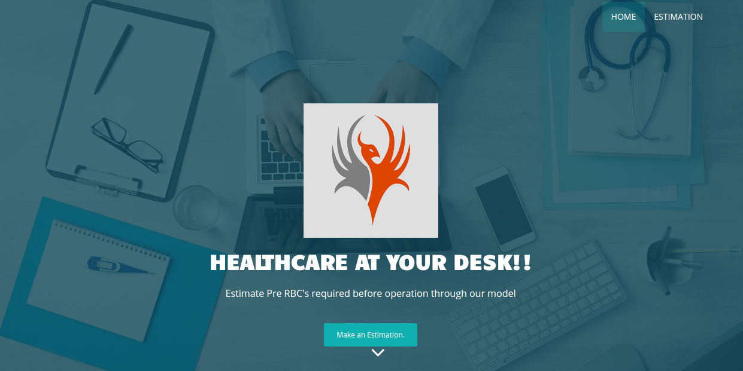
Demo

Slide 36
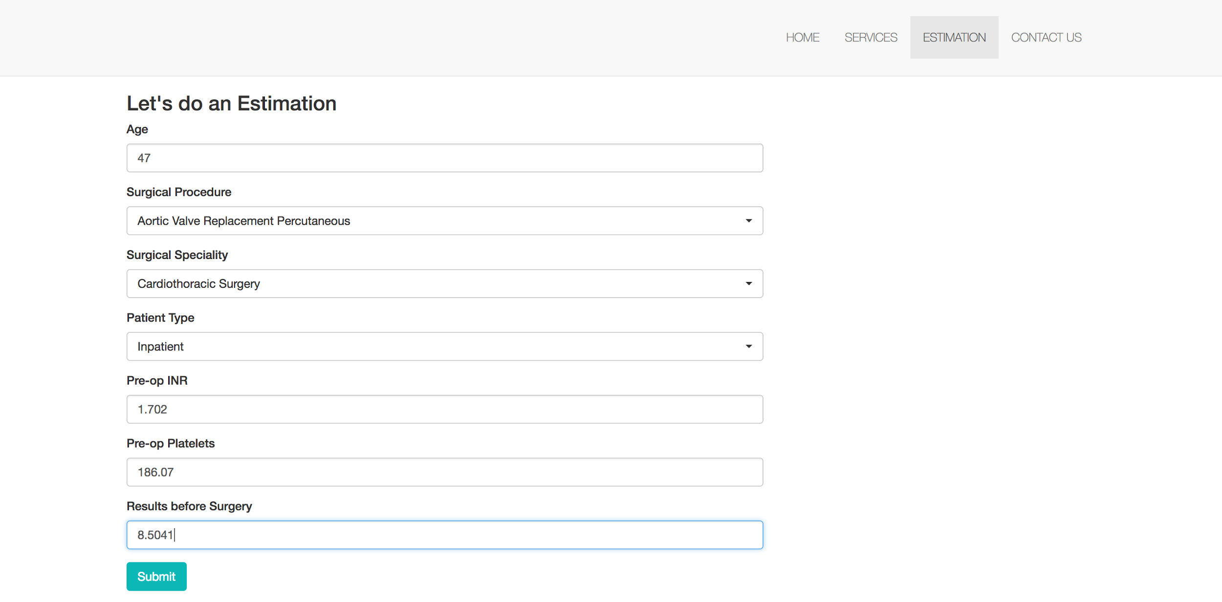
Demo (Input)
c

Slide 37
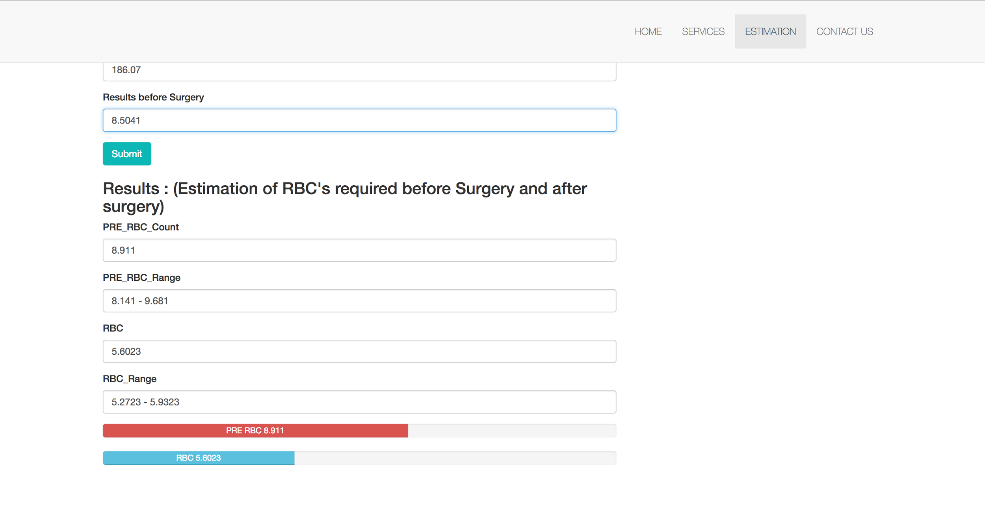
Demo (Output)

Slide 38
References
Project Charter https://drive.google.com/a/usc.edu/file/d/0B-rnx_dKiVzuMXZpdkN3YllITm8/view?usp=sharing
FishBone Diagram
https://drive.google.com/open?id=0B-rnx_dKiVzuVmk3YlA2LWFXc2M
Gantt Chart
https://drive.google.com/open?id=0B-rnx_dKiVzudUd3aXVUSlQ2ajA
Technical Report
https://drive.google.com/open?id=0B-rnx_dKiVzuWWh2dl9vSTFBMm8
Process Map for Patient Blood Ordering
https://blackboard.usc.edu/bbcswebdav/pid-4605998-dt-content-rid-13344286_2/courses/20171_inf_560_32429/Process%20Map.pdf
Measure Phase Analysis
https://drive.google.com/open?id=0B-rnx_dKiVzuX0ttZ0NXNkg4dGc
Analyse Phase
https://drive.google.com/open?id=0B-rnx_dKiVzuVmk3YlA2LWFXc2M

Slide 39
References
Improve Phase
https://drive.google.com/open?id=1NcfXMNVY7RqX5up4ybtthrrVbevkuM27IVaEnUpokpc
Linear Regression
http://scikit-learn.org/stable/modules/generated/sklearn.linear_model.LinearRegression.html
Random Forest
http://scikit-learn.org/stable/modules/generated/sklearn.ensemble.RandomForestClassifier.html
MAE
http://scikit-learn.org/stable/modules/generated/sklearn.metrics.mean_absolute_error.html

Slide 40


Thank You !

