Slide 1
IBM SKILLSBUILD × AICTE 2026
ARIA
AI Readiness Interview Agent
Your Personal AI-Powered Mock Interview Coach
Meta Llama 3.3 70B
IBM watsonx.ai
FastAPI
Streamlit
Voice Input
Resume-Aware
IBM Bob
Problem Statement #22 — Interview Trainer Agent

Slide 2

PROJECT SUBMISSION
Student Details
Project Title
ARIA — AI Readiness Interview Agent
Domain
Education / Career Development / Conversational AI
Student Name | Recent Passport Photo | Email ID | Mobile Number (WhatsApp)
Bhavesh Nayak |  | bhaveshnayak934@gmail.com | 9340087041
Mentor / Guide: IBM SkillsBuild Program Institution: Edunet Foundation — IBM University Engagement Problem Statement: #22 — Interview Trainer Agent
ARIA — AI Readiness Interview Agent
IBM SkillsBuild × AICTE 2026 | 2/17

Slide 3
THE PROBLEM
Problem Statement
⚠️ The Challenge
Every year, thousands of students and freshers struggle in job interviews — not due to lack of knowledge, but due to lack of structured, personalised interview practice. Generic YouTube videos and static PDFs don't adapt to an individual's skill set, role, or target company. Without real-time, adaptive feedback, many candidates walk in underprepared and underconfident.
🎯 The Objective
Build an AI-powered Interview Trainer Agent that delivers structured, personalised mock interviews with real-time evaluation for IT job seekers targeting companies like TCS, Infosys, Wipro, Accenture, and Cognizant.
🧩 Role & Company-Specific Qs
Technical, HR & Situational questions tailored to role, experience & target company.
📊 Real-Time Answer Evaluation
Score each answer out of 10, highlighting strengths and missing concepts instantly.
💡 Confidence Tracking
Measures candidate confidence before and after the session to show real growth.
📈 Adaptive Difficulty
Increases question difficulty as the candidate performs well.
📄 Resume-Aware Personalisation
Draws questions from the candidate's actual projects & skills, not just their role.
📋 Final Report Card
Scores, strengths, resume alignment & a 7-day study roadmap.
ARIA — AI Readiness Interview Agent
IBM SkillsBuild × AICTE 2026 | 3/17

Slide 4
OUR SOLUTION
Proposed Solution — ARIA
ARIA is a conversational AI-powered Interview Trainer Agent built using FastAPI, Streamlit, and IBM watsonx.ai (Meta Llama 3.3 70B Instruct). It uses IBM watsonx.ai's structured Chat Completion API — explicit system/user/assistant roles rather than raw text completion — so the model reliably respects turn boundaries and evaluation format.
The Interview Flows Through Four Structured Stages
STAGE 1
STAGE 2
STAGE 3
STAGE 4
Onboarding & Confidence Baseline
Collects name, role, experience, skills & target company; captures starting confidence (1-10).
Resume-Aware Adaptive Engine
Generates 5 Technical, 3 HR (STAR) & 2 Situational Qs tied to role + resume, harder as you go.
Real-Time Evaluator
Scores every answer /10 with what was good, what was missing, and the ideal answer.
Report Card Generator
Final scores, confidence growth, resume alignment score & a 7-day study roadmap.
The candidate interacts through a clean chat-based Streamlit interface, with optional voice input via the browser's Web Speech API. FastAPI orchestrates the conversation flow and prompt engineering, while IBM watsonx.ai handles model hosting and inference. IBM Bob (IBM's AI coding agent) was used throughout development to architect the backend, debug hallucination and token issues, build the voice + resume features, and optimise the codebase end-to-end.
ARIA — AI Readiness Interview Agent
IBM SkillsBuild × AICTE 2026 | 4/17

Slide 5
UNDER THE HOOD
Technology Stack
🧠 Meta Llama 3.3 70B Instruct
Interview agent brain — question generation, real-time scoring, report card, via IBM watsonx.ai.
☁️ IBM watsonx.ai
Hosted inference platform. Chat Completion API, project management, token usage tracking.
⚙️ FastAPI + Uvicorn
REST backend — session management, resume parsing, prompt engineering.
💬 Streamlit
Chat UI, sidebar controls, voice widget & resume uploader — real-time display.
🎙️ Browser Web Speech API
Microphone-to-text voice input — zero external dependencies, native Chrome/Edge.
📄 PyMuPDF + python-docx
Server-side resume text extraction from PDF and DOCX files.
🔌 ibm-watsonx-ai SDK
Official Python SDK for ModelInference, chat completion calls & credentials.
🐍 Python 3.10+
Core language across the entire backend and frontend.
ARIA — AI Readiness Interview Agent
IBM SkillsBuild × AICTE 2026 | 5/17

Slide 6
WHAT ARIA DOES
Key Features
🎯 Role-Based Questions
Tailored questions for any IT role and target company.
📄 Resume-Aware Interviews
Upload PDF/DOCX/TXT — ARIA asks about your real projects & achievements.
📊 Real-Time Evaluation
Score (X/10) + concise feedback after every single answer.
💡 Confidence Tracking
Measures confidence growth from start to finish.
📈 Adaptive Difficulty
Questions get progressively harder as you perform better.
🎙️ Voice Input
Speak your answers using your microphone — Chrome/Edge.
📋 Final Report Card
Scores, strengths, improvement areas + Resume Alignment score.
🗺️ 7-Day Study Roadmap
Personalised preparation plan based on your performance.
⚡ Token-Optimised
Server-side session store — flat token cost regardless of length.
ARIA — AI Readiness Interview Agent
IBM SkillsBuild × AICTE 2026 | 6/17

Slide 7
HOW IT WORKS
System Workflow
USER
Browser (Chrome / Edge) Voice input supported
STREAMLIT
Frontend :8501 Chat UI + Voice + Resume uploader
FASTAPI
Backend :8000 Session store + Prompt engine + Resume parser
WATSONX.AI
Meta Llama 3.3 70B via ibm-watsonx-ai SDK (Dallas region, Lite tier)
🗂️ Key Design — Server-Side Sessions
The frontend never sends conversation history. Only { session_id, message } travels over HTTP. The backend holds all history, trims it to a rolling window, and sends a fixed-size context to the LLM — keeping token cost flat at every turn.
📄 Resume Design — One-Shot Digest
The raw resume is never stored or re-sent. One LLM call converts it to a ~120-word structured digest on upload (~130 tokens), injected into the system prompt on every subsequent call — keeping the raw file off the wire entirely.
Request flow: POST /session/new creates a session → POST /resume/upload (optional) parses and digests the resume → each POST /chat retrieves session history, builds a trimmed message list, calls the LLM, sanitises the reply, and returns it to the UI.
ARIA — AI Readiness Interview Agent
IBM SkillsBuild × AICTE 2026 | 7/17

Slide 8
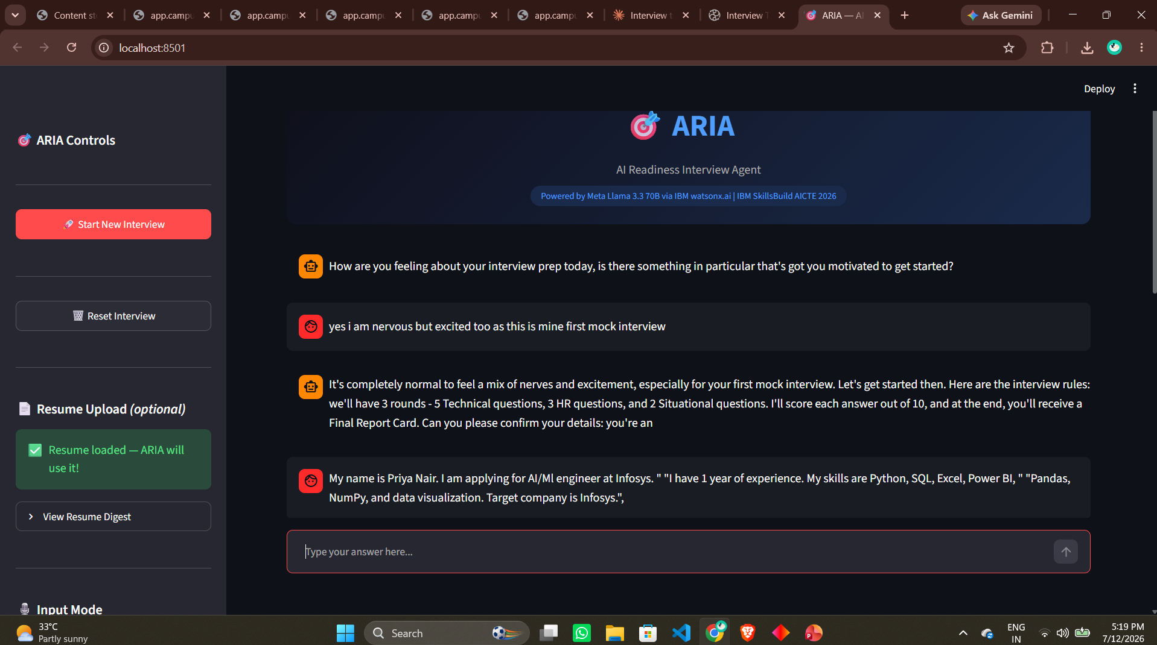
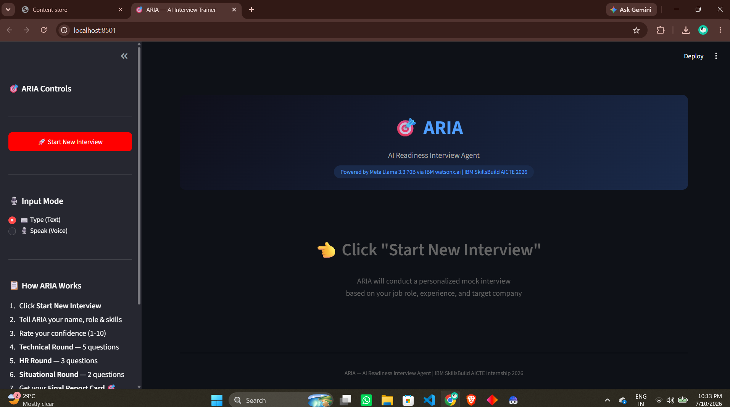
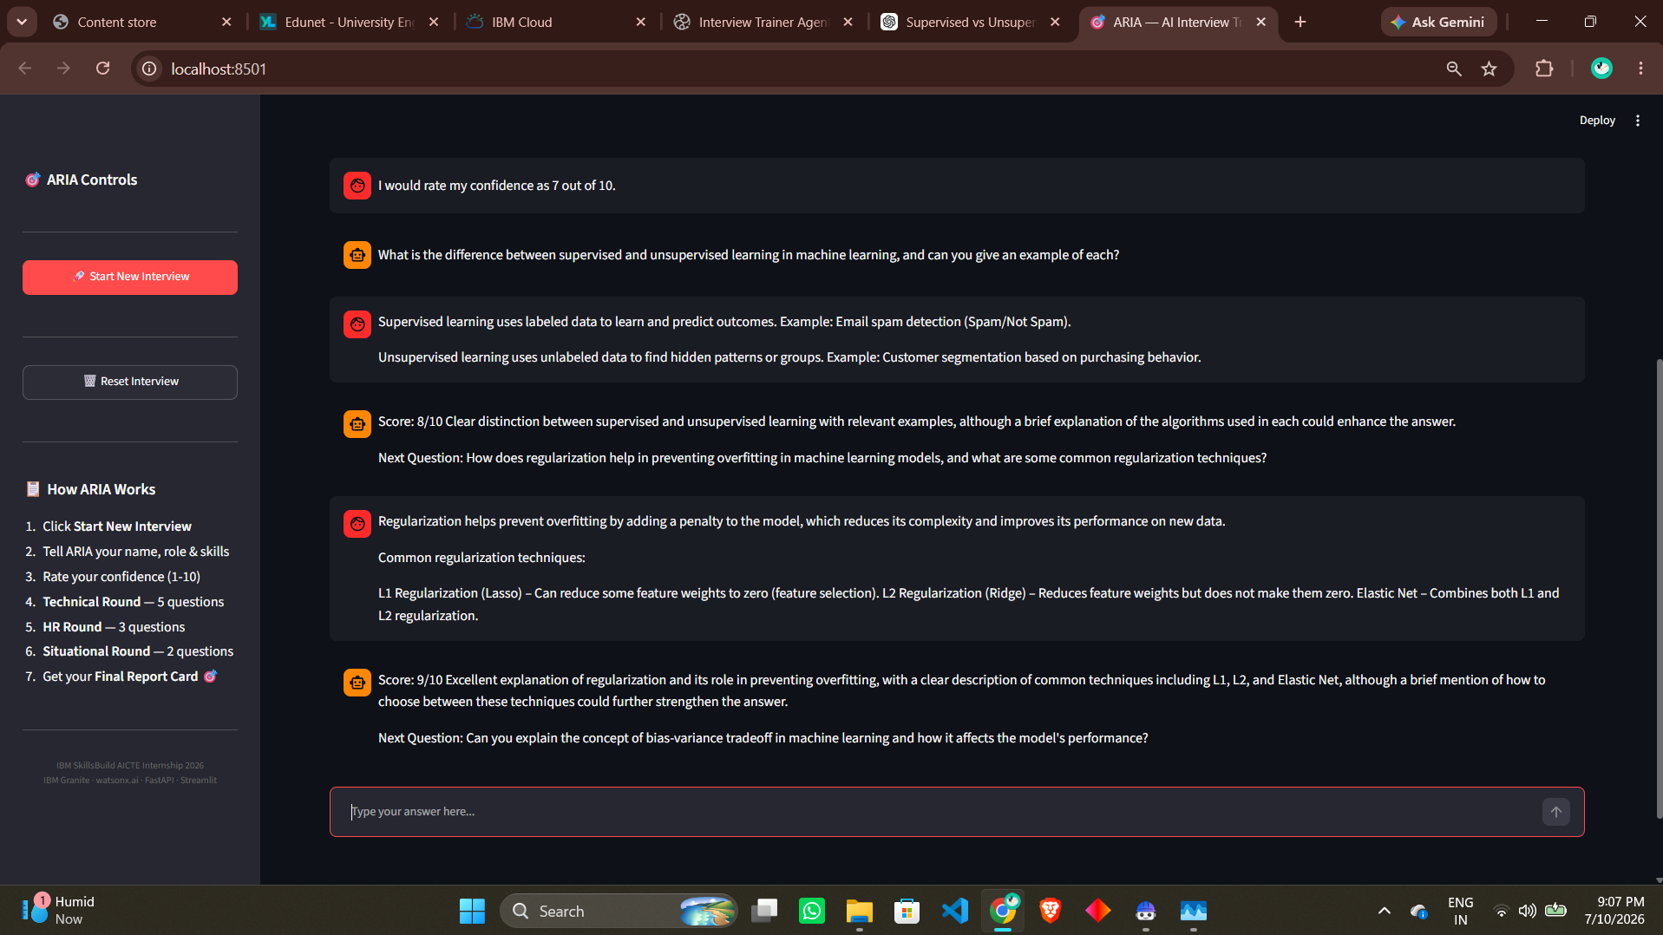
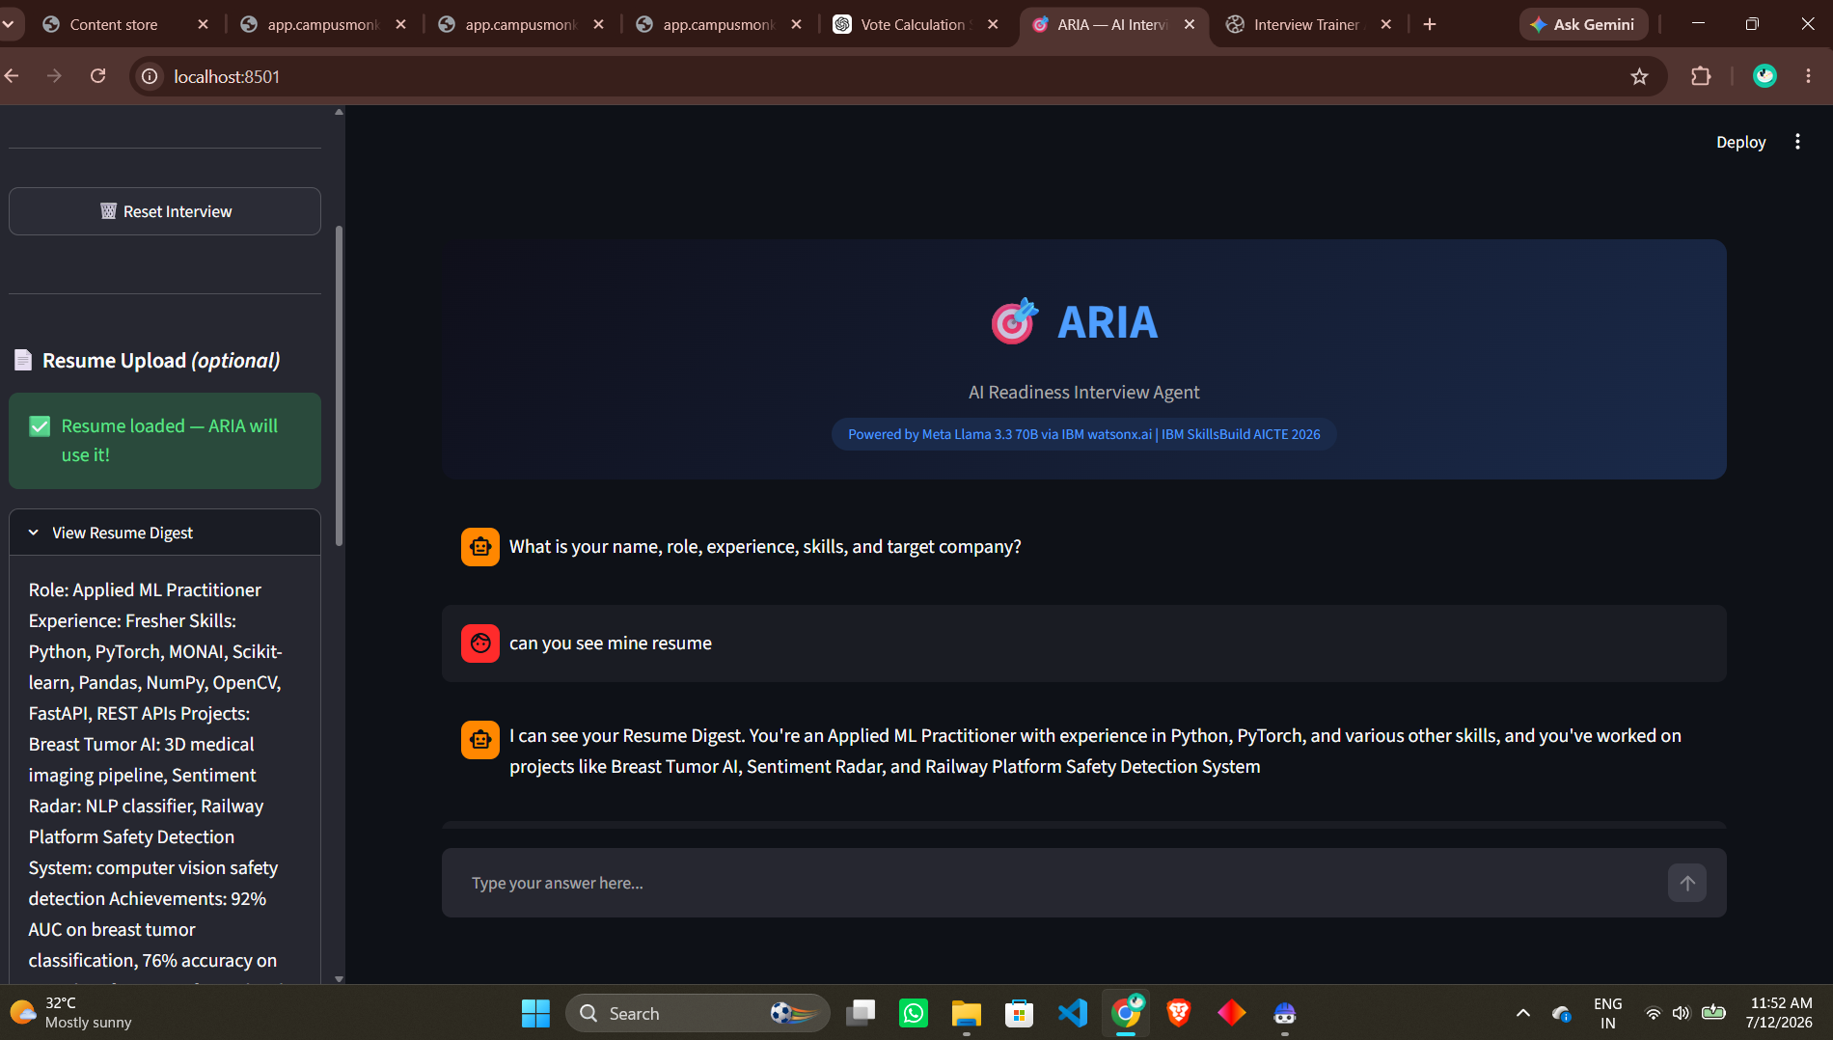
SEE IT IN ACTION
Feature Highlights
💬 ARIA Chat Interface
📄 Resume Upload
ARIA — AI Readiness Interview Agent
IBM SkillsBuild × AICTE 2026 | 8/17

Slide 9
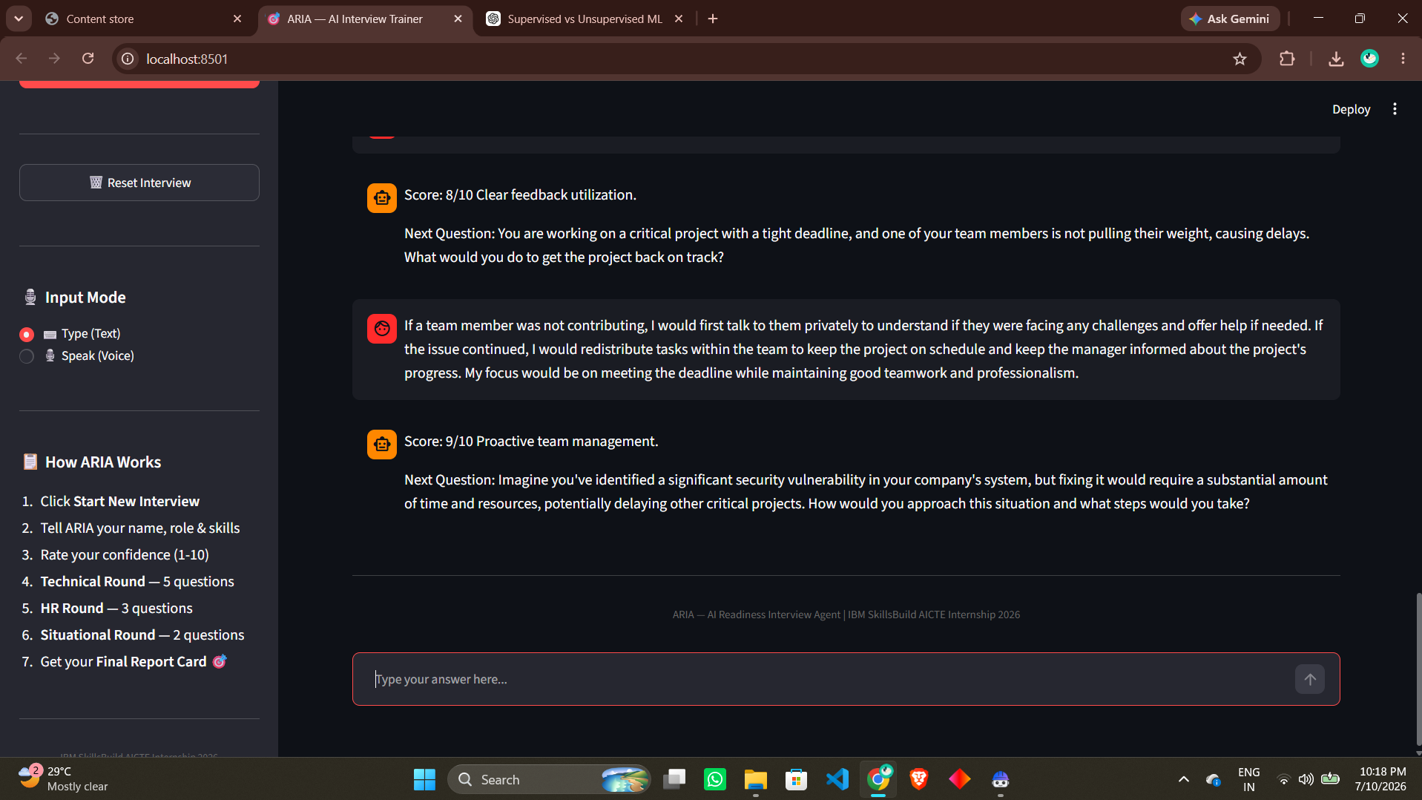
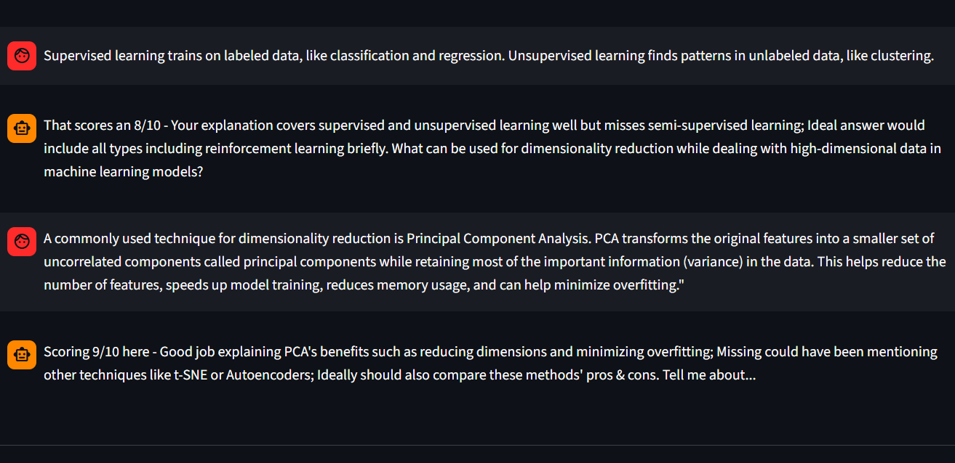
Feature Highlights

Slide 10
BEYOND A CHATBOT
Role of ARIA in the Solution
ARIA functions as an autonomous, multi-step interview agent rather than a simple Q&A chatbot. Using IBM watsonx.ai (Meta Llama 3.3 70B), it reasons through the entire interview lifecycle on its own — from onboarding, to resume-aware adaptive questioning, to real-time scoring, to the final report card — without the candidate needing to direct each step.
🤖 Self-Directed Reasoning
ARIA autonomously decides what to do next at every stage — which question to ask, how to score an answer, and when to move to the next round — the same structured chat-completion architecture consistently produces correct, on-format behaviour.
🧭 Context Awareness
Remembers name, role, skills, target company & resume digest throughout the session.
📈 Real-Time Adaptation
Increases question difficulty as the candidate answers well — just like a real interviewer.
🛡️ Defense-in-Depth
sanitize_reply() works alongside the model, catching rare formatting slips without limiting autonomy.
Overall, ARIA is proactive, personalised, and goal-driven — acting like a genuine mock interview coach guiding a candidate from onboarding through to a completed, evaluated interview, grounded in their own resume where available.
ARIA — AI Readiness Interview Agent
IBM SkillsBuild × AICTE 2026 | 9/17

Slide 11
ENGINEERING FOR EFFICIENCY
Token Optimisation
ARIA was heavily optimised to stay within IBM watsonx.ai's free Lite tier limits.
~1,400 → ~505
Input tokens / call
before → after
~18,000 → ~6,500
Full session cost (tokens)
before → after
~2-3 → ~7-8
Sessions / month (free tier)
before → after
~650 tok
One-time resume digest cost
then +~130 tok/call
Key Changes Applied
🗂️ Server-Side Session Store
History held server-side, never sent from the browser — fixed-size window every call.
✂️ Compressed System Prompt
~650 tokens → ~200 tokens, without losing any behavioural rules.
📏 Word-Count Truncation
Switched from character-count (inaccurate) to word-count (token-accurate) trimming.
🎚️ Dynamic Output Caps
50 / 180 / 400 tokens depending on interview phase, instead of one fixed cap.
💬 Structured Chat API
Moved from raw text-completion to system/user/assistant roles — fewer wasted retries.
🔥 Background Model Warmup
Model warms up at startup — no cold-start lag on the candidate's first message.
ARIA — AI Readiness Interview Agent
IBM SkillsBuild × AICTE 2026 | 10/17

Slide 12
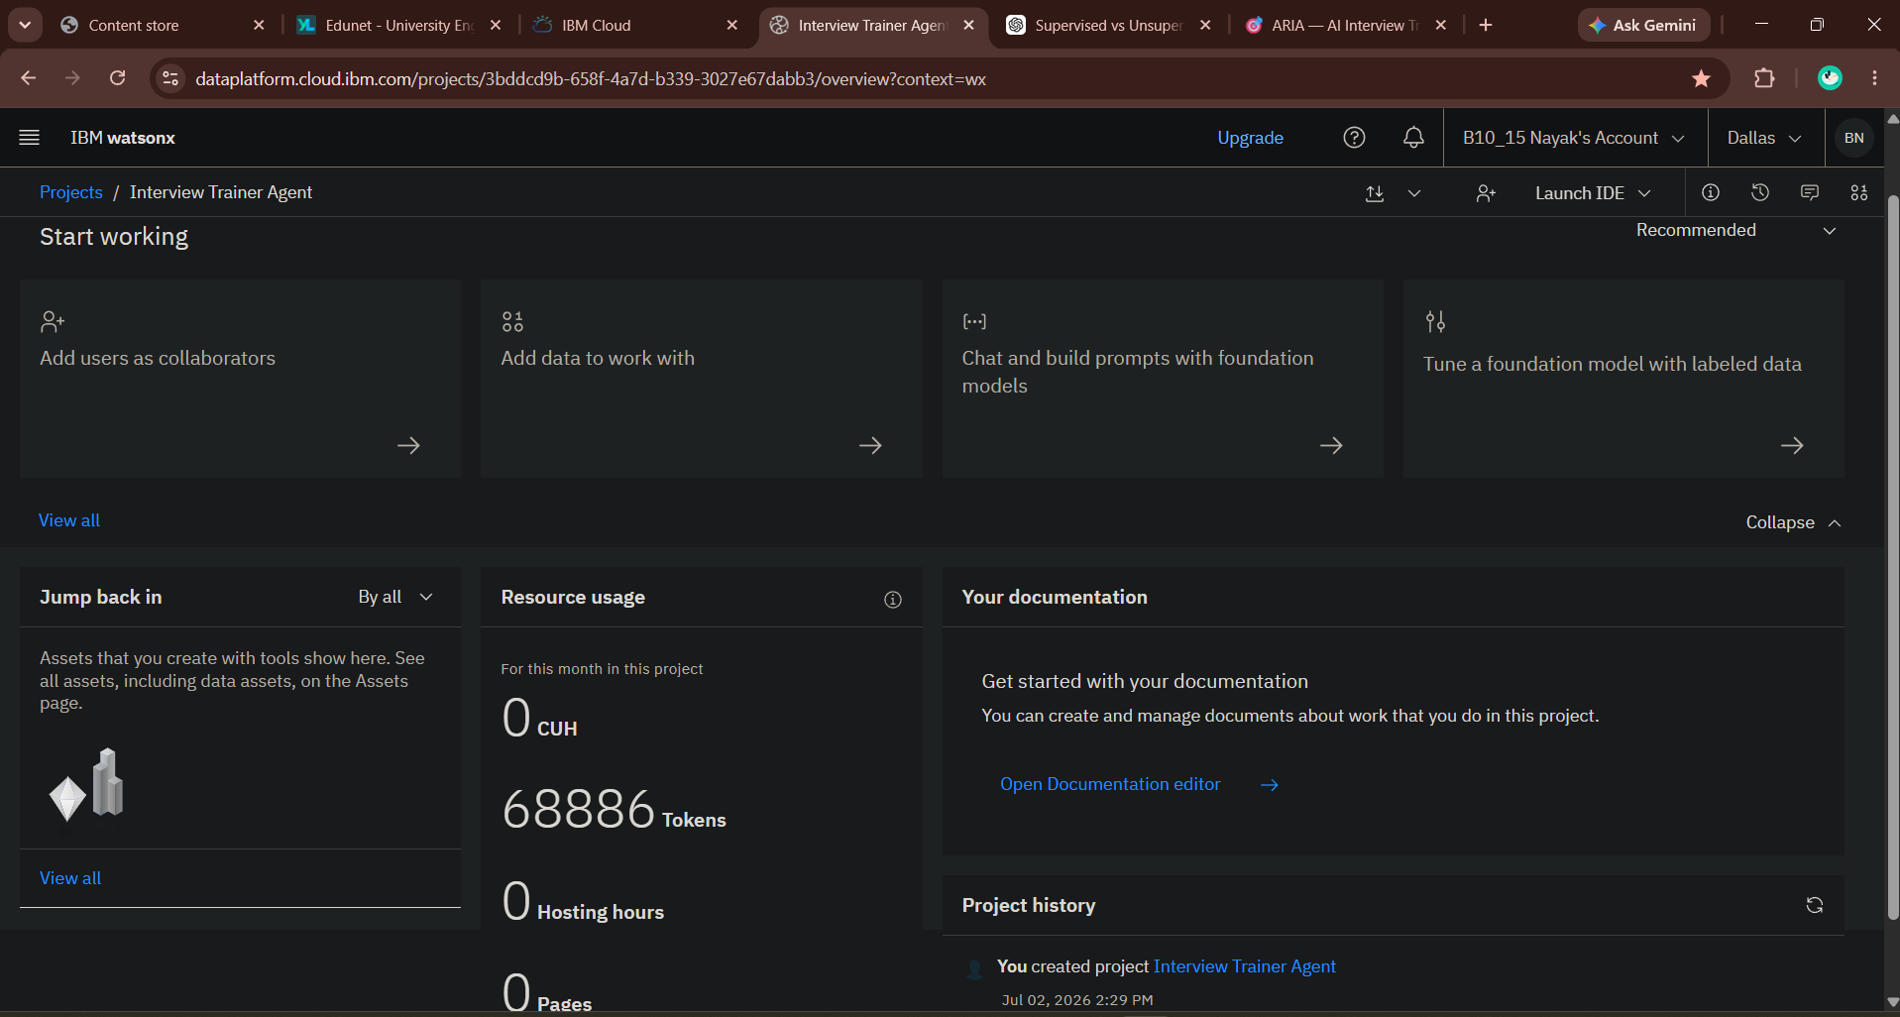
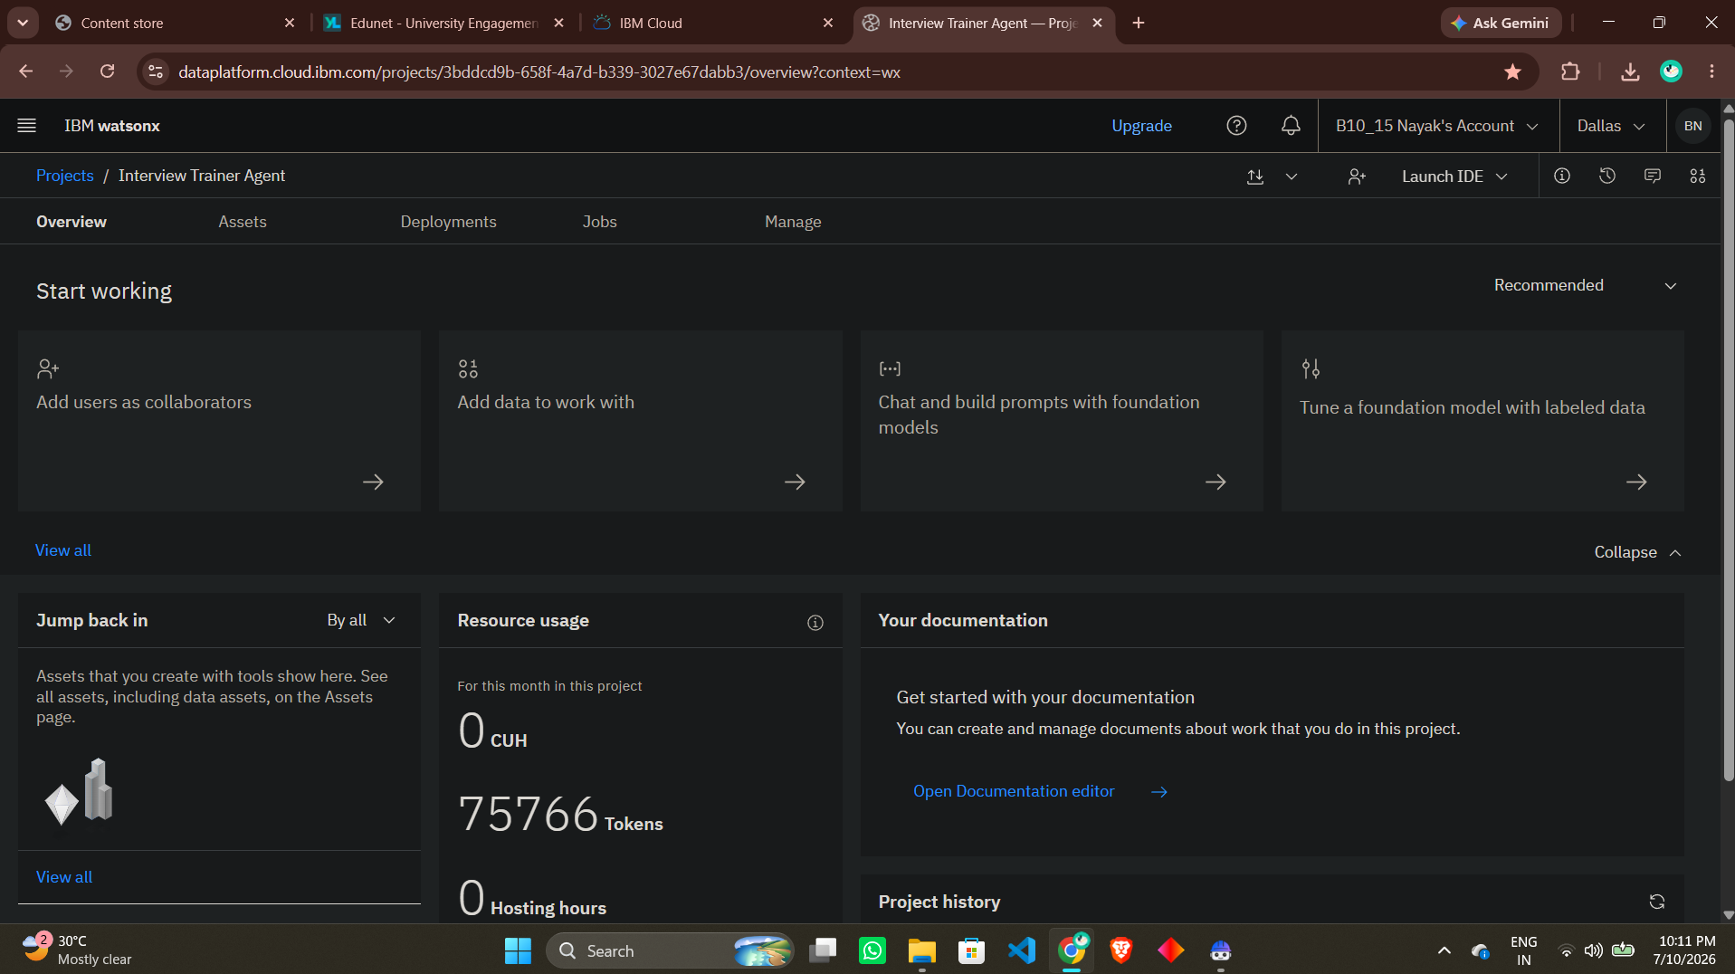
Token Usage
Before Prompt
After the Prompt

Slide 13
WHAT SETS ARIA APART
Novelty & Unique Features
📄 Resume-Aware Interviews
Questions drawn from your actual projects & achievements, not just your job title — most trainers can't do this.
💡 Confidence Growth Tracking
Measures candidate confidence BEFORE and AFTER the interview, showing tangible, measurable growth.
🎙️ Voice-Native Interaction
Speak answers naturally via the browser's built-in Web Speech API — zero external dependencies.
💬 Chat-Completion Architecture
Structured system/user/assistant roles eliminate the hallucinated-turn bug found in raw text completion.
🗂️ Server-Side Session Design
Token cost stays flat regardless of interview length — history never grows the request payload.
🎯 Resume Alignment Scoring
The Final Report Card scores how well your spoken answers matched your CV's actual claims.
Together, these make ARIA a genuinely adaptive, evidence-based interview coach — not just a static question bank with a chat window wrapped around it.
ARIA — AI Readiness Interview Agent
IBM SkillsBuild × AICTE 2026 | 11/17

Slide 14
HONEST RETROSPECTIVE
Results & Challenges Overcome
An honest account of what works well and what was fixed along the way, based on iterative testing.
✅ What Works Well
ARIA reliably flows through Onboarding → Technical → HR → Situational → Report Card without hallucinating extra turns.
✅ Clean Formatting
Score, feedback, and the next question render on clearly separated lines for readability.
✅ Reduced Token Cost
Per-exchange token usage dropped noticeably after compressing the prompt and adding session storage.
🔧 Challenges Overcome
The agent initially hallucinated fake candidate answers; fixed by switching to structured chat-completion.
🔧 Rate-Limit Handling
IBM's free-tier concurrent request cap occasionally triggers a 429; addressed with retry-with-backoff logic.
⚠️ Known Limitation
Aggressive history truncation briefly caused context loss during testing — since corrected with a tuned window.
🔍 Still To Verify
Full 10-question sessions under concurrent multi-user load have not yet been exhaustively tested; the figures on the Token Optimisation slide reflect iterative single-user testing, not a formal benchmark suite — add real production metrics here once measured.
ARIA — AI Readiness Interview Agent
IBM SkillsBuild × AICTE 2026 | 12/17

Slide 15
SOURCE CODE
GitHub Repository
🔗 Repository URL
https://github.com/BhaveshN1015/Interview_Agent.git
Make sure the following are pushed to your repository:
🐍 main.py
FastAPI backend — ARIA agent, session store, resume upload, LLM calls
🎨 app.py
Streamlit frontend — chat UI, voice input, resume uploader
📘 README.md
Full setup guide, architecture, demo GIFs & deployment steps
📦 requirements.txt
Pinned Python dependencies
🔐 .env.example
Safe credentials template (never commit the real .env)
🎬 good_interview.gif / bad_interview.gif
Demo recordings embedded in the README
ARIA — AI Readiness Interview Agent
IBM SkillsBuild × AICTE 2026 | 13/17

Slide 16
WHAT'S NEXT
Future Scope
🌐 Multilingual Support
Conduct interviews in Hindi, Tamil, Telugu & other regional languages for wider accessibility.
📚 Company-Specific RAG
A lightweight RAG layer with real, verified past interview questions per company.
🗄️ Redis Session Store
Replace the in-memory session dict with Redis for true multi-worker production scaling.
🔊 ARIA Text-to-Speech
ARIA speaks the questions aloud for a fully spoken, hands-free interview simulation.
📈 Analytics Dashboard
Track performance trends across multiple practice sessions over time.
📱 Mobile-Optimised UI
A responsive layout for practicing interviews directly from a phone.
ARIA — AI Readiness Interview Agent
IBM SkillsBuild × AICTE 2026 | 14/17

Slide 17
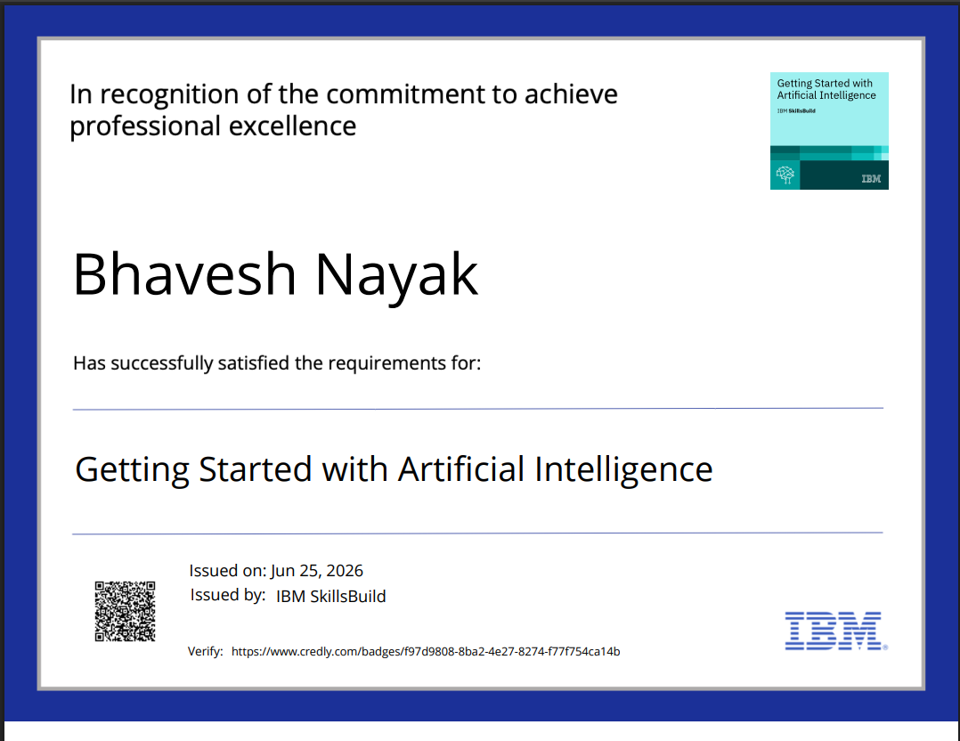
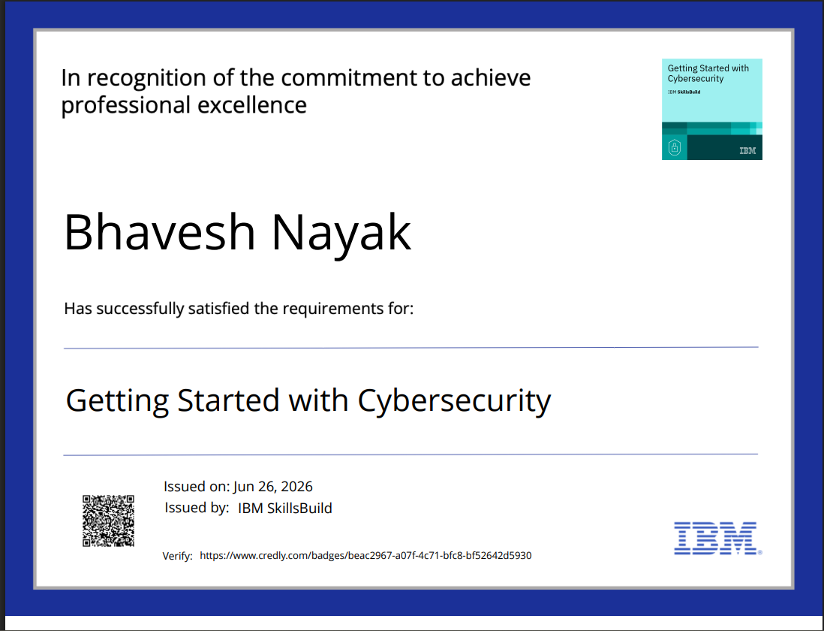
CERTIFICATIONS
Certificates Earned — IBM SkillsBuild
ARIA — AI Readiness Interview Agent
IBM SkillsBuild × AICTE 2026 | 15/17

Slide 18
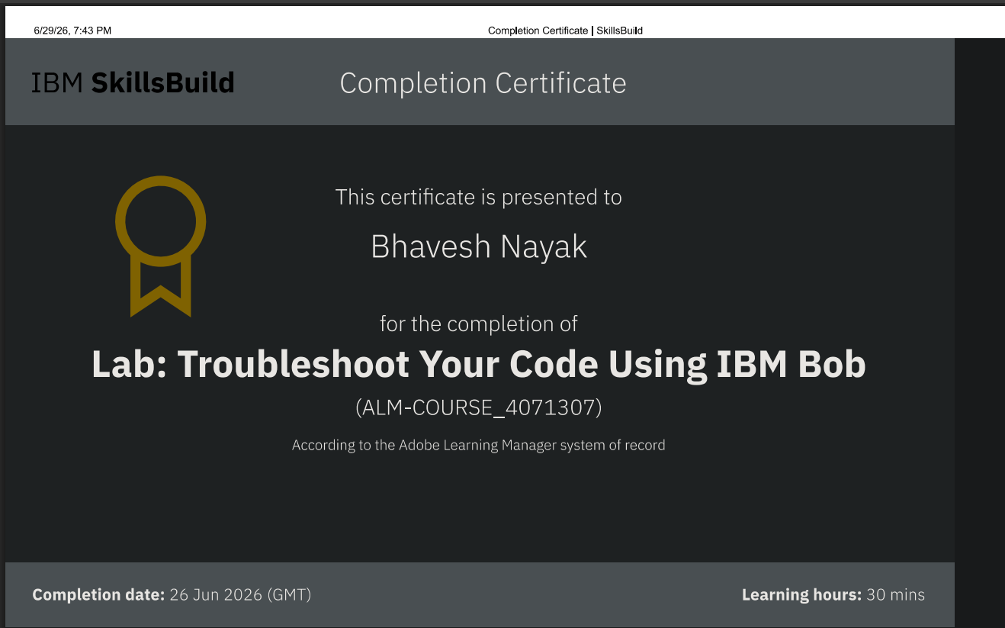
CERTIFICATIONS
Certificates Earned — IBM Bob
ARIA — AI Readiness Interview Agent
IBM SkillsBuild × AICTE 2026 | 16/17

Slide 19
Thank You!
ARIA — AI Readiness Interview Agent
IBM SkillsBuild × AICTE Internship 2026 | Problem Statement #22
Meta Llama 3.3 70B
IBM watsonx.ai
FastAPI
Streamlit
Voice Input
Resume-Aware
IBM Bob
Student: [ Bhavesh Nayak ] | Edunet Foundation — IBM University Engagement
GitHub: https://github.com/BhaveshN1015/Interview_Agent.git

