Slide 1
Machine Learning Project for Real Estate
Bhavesh Narayan
Hemant Singh Dangi
Group 4
Notes:
<number>

Slide 2
Agenda
1. Group Member details
2. Objective
3. About Dataset
4. Solution
5. Evaluation matrix
6. Conclusion
7. Reference

Slide 3
Group Member Details
Bhavesh Narayan
Hemant Singh
Dangi
1. Data Collection
2. Data Analysis
3. Coding
4. Model design
5. Testing
6. Evaluation
7. Conclusion
1. Data Collection
2. Data Analysis
3. Coding
4. Model design
5. Testing
6. Evaluation
7. Conclusion

Slide 4
Objective
To solve the Real Estate house prediction problem.
A set of features have been given that describes a house in Boston.
We will be building the machine learning model which should predict the house price.
To train our model with Boston housing data we will be using different
libraries :
pandas
NumPy
Matplotlib
Scikit-learn

Slide 5
About Dataset of Boston Housing
1. Domain : Real Estate
2. Source :
(a) Origin: This dataset was taken from the StatLib library which is
maintained at Carnegie Mellon University.
3. Data Description :
The Boston data has 506 instances and 14 columns. There are 13 features and 1 label.

Slide 6
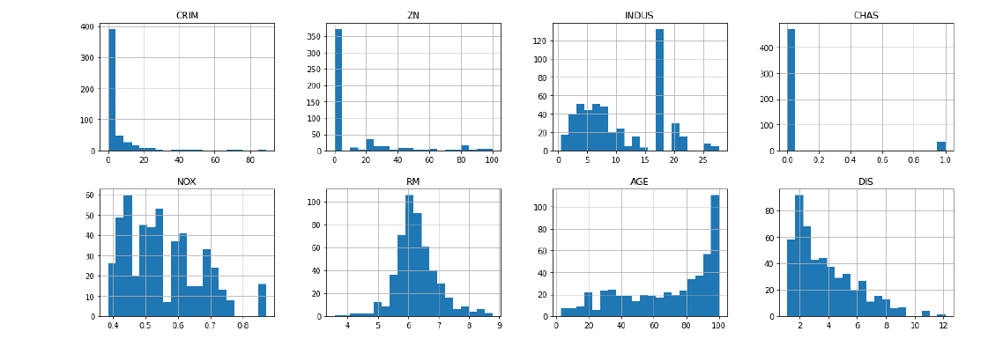
Histogram plot
Notes:
<number>

Slide 7
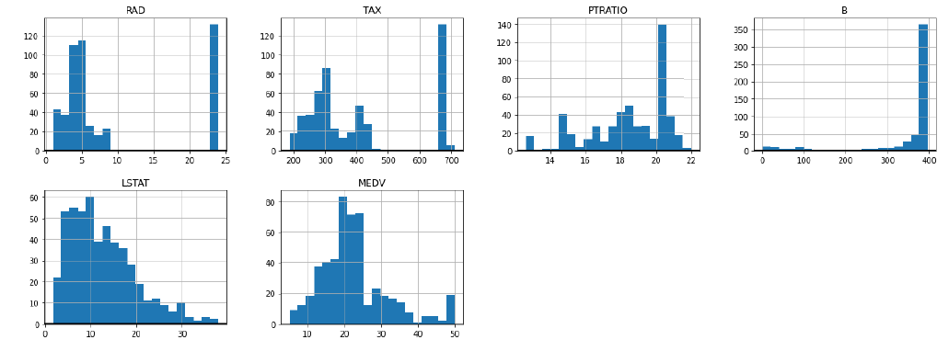
Histogram plot
Notes:
<number>

Slide 8
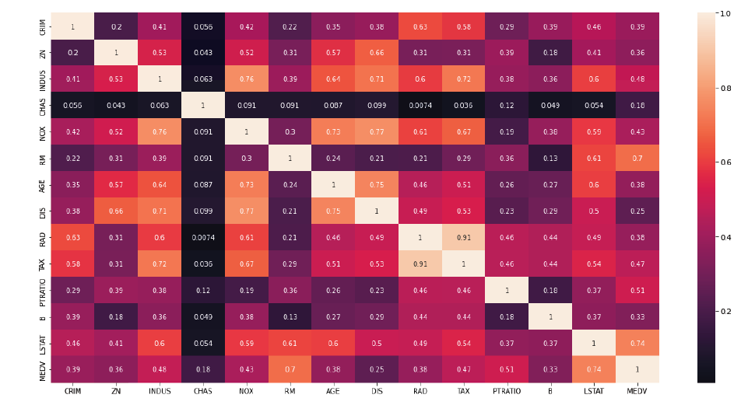
Correlation matrix
Notes:
<number>

Slide 9
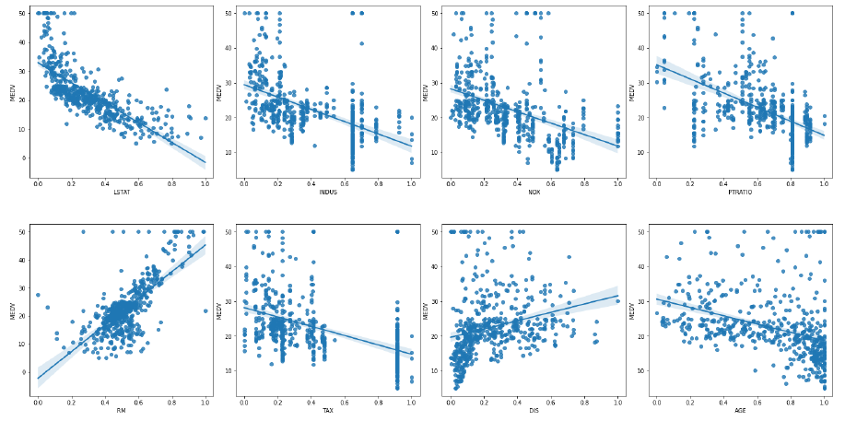
Plot columns against MEDV
Notes:
<number>

Slide 10
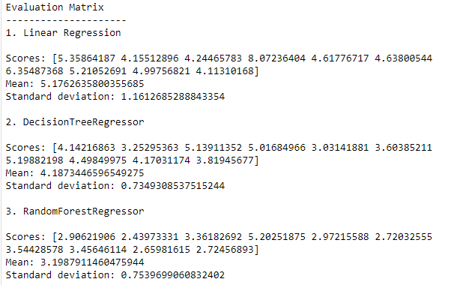
Evaluation Matrix Summary

Slide 11
Conclusion
We can see from the evaluation matrix, Random Forest Regression Machine learning algorithm has performed best among all other used model (Linear Regression and Decision Tree Regression).

Slide 12
Kaggle Path
https://www.kaggle.com/code/mejbahahammad/statistical-analysis-housing-data/data?select=housing.data
https://www.kaggle.com/code/mejbahahammad/statistical-analysis-housing-data/data?select=housing.txt
Notes:
<number>

Slide 13
Thank You
Notes:
<number>

