Slide 1

Comprehensive Cryptocurrency Dataset Analysis Report
Analysis and Insights on Cryptocurrency Market Trends

Slide 2
DATASET OVERVIEW
The dataset contains historical data of cryptocurrencies up to 2021. It includes:
• Key Metrics: Opening and closing prices, market capitalization, trading volume, and daily high/low values.
• Structure: No null values, clean, and ready for analysis.
• Source: Merged from individual datasets provided by CoinMarketCap.
Explanation of the Columns in the Dataset and Their Relevance:
1. Sno:
• Unique row identifier.
• Not crucial for analysis but helpful for indexing or referencing specific records.
2. Name:
• The name of the cryptocurrency or asset (e.g., Bitcoin, Ethereum).
• Used to identify and filter the data for specific cryptocurrencies during analysis.
3. Symbol:
• A shorthand identifier for the cryptocurrency (e.g., BTC for Bitcoin, ETH for Ethereum).
• Useful when working with multiple cryptocurrencies, allowing for quick lookup and categorization.
4. Date :
• The date of the recorded data.
• Relevance: Key for time-series analysis, such as tracking trends, calculating returns, and identifying patterns over time.
5. High:

Slide 3
• The highest price the cryptocurrency reached on a given day.
• Relevance: Indicates peak trading activity and helps analyze volatility.
6. Low:
• The lowest price the cryptocurrency reached on a given day.
• Relevance: Used alongside the high price to measure the daily price range, providing insights into market volatility.
7. Open:
• The price of the cryptocurrency at the start of the day.
• Relevance: Useful for understanding daily price movement when compared to the close price.
8. Close:
• The price of the cryptocurrency at the end of the day.
• Relevance: Used to calculate daily returns and monitor overall price trends.
9. Volume:
• The total amount of cryptocurrency traded during the day (typically in units or currency terms).
• Relevance: Indicates market activity and interest. High volume may signal strong investor interest or significant price changes.
10. Marketcap(Market Capitalization):
• The total value of the cryptocurrency's circulating supply (calculated as Marketcap = Close Price x Circulating Supply).
• Relevance: Represents the overall market size of the cryptocurrency, useful for comparing different assets.

Slide 4
Drint(data.dtypes)
^Filtering out non-numeric columns ensures that only valid data is included in the correlation computation. numeric_data^ data.select_dtypes{include^[np. number])
v/ 0.1s
Sno | int64
Name | object
Symbol | object
Date | datetime64[ns]
High | float64
Low | float64
Open | float64
Close | float64
Volume | float64
Marketcap | float64
Daily Return | float64
dtype: object
POTENTIAL USES
1. Trend Analysis: By examining opening and closing prices along with volume traded, analysts can identify bullish or bearish trends in the cryptocurrency market.
2. Volatility Assessment: The highest and lowest daily prices can be used to calculate volatility metrics for each cryptocurrency, aiding in risk assessment.
3. Comparative Analysis: The dataset allows for comparisons between different cryptocurrencies to identify which are performing better relative to others.
4. Market Capitalization Insights: Analyzing changes in market cap over time can provide insights into the growth or decline of specific cryptocurrencies.
INSIGHTS from DATA ANALYSIS
Using tools like Pandas in Python, you can easily manipulate and visualize this data. Here are some potential analytical approaches:
• Time Series Analysis: Conducting time series analysis can help in forecasting future prices based on historical trends.
• Correlation Studies: Investigating correlations between different cryptocurrencies can reveal how they move in relation to one another, which is crucial for portfolio diversification strategies.

Slide 5
Machine Learning Applications: Implementing machine learning models to predict price movements based on historical data could yield actionable trading strategies.
ANALYTICAL APPROACHES
1. Monitor Price Volatility: Calculate daily fluctuations
• Purpose: Assess how much the price fluctuates over time.
• Method: Calculate daily price range using High - Low and measure percentage volatility as:
• Volatility = (High - Low) / Open x 100
2. Calculate Investment Returns: Measure profit/loss over time.
• Purpose: Determine profit or loss over a specific period.
• Method:
1. Use the daily return formula:
2. Daily Return = (Close_t - Close_t-1) / Close_t-1
3. Trends and Patterns: Use moving averages for noise reduction.
• Purpose: Identify long-term growth or decline.
• Method:
1. Plot Close prices over time.
2. Use moving averages (e.g., 7-day, 30-day) to smooth out noise and highlight trends.
4. Correlation Studies: Identify relationships between cryptocurrencies.
• Purpose: Explore relationships between multiple cryptocurrencies.
• Method: Compute a correlation matrix using columns like Close or Volume to identify patterns.
5. Seasonal Patterns: Detect periodic behaviors.
• Purpose: Detect patterns related to time (e.g., bull or bear markets).
• Method:
1. Group data by month or day of the week.
2. Analyze average price changes to identify periodic behavior.

Slide 6
6. Identify Trading Patterns:
Purpose: Understand market behavior during specific conditions.
• Method:
1. Check the relationship between Volume and price changes.
2. Analyze High and Low to detect periods of extreme volatility.
7. Market Health:
• Purpose: Determine the asset's significance in the market.
• Method:
1. Use Marketcap to assess the overall size.
2. Compare Volume with Marketcap to understand liquidity.
KEY VISUALIZATIONS
1. Line Charts: Track trends over time.
2. Candlestick Charts: Represent daily price actions.
3. Heatmaps: Explore correlations.
4. Bar Charts: Highlight trading volume.
Python Libraries: pandas, matplotlib, seaborn, plotly
CODES

Slide 7
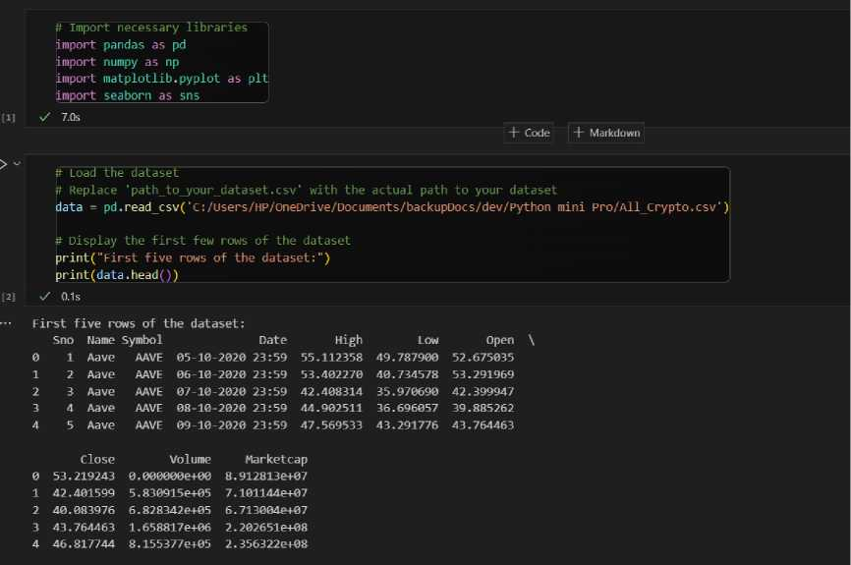
• Import neded libraries from the virtual environment(.venv). Load dataset via pandas library
• Summary of entire dataset

Slide 8
D> -1 ^{[5]} | ft Summary statistics print("\nSummary statistics:") print(data.describe()) x/ 0.1s
 | Summary Statistics:
 |  | Sno | High | Low | Open | Close \
 | count | 37082.000000 | 37082.000000 | 37082.000000 | 37082.000000 | 37082.000000
 | mean | 18541.500000 | 1016.058015 | 952.987707 | 985.323755 | 987.120511
 | std | 10704.795678 | 5249.503670 | 4907.932082 | 5088.101367 | 5093.703878
 | min | 1.000000 | 0.000089 | 0.000079 | 0.000086 | 0.000086
 | 25% | 9271.250000 | 0.075664 | 0.069536 | 0.072456 | 0.072648
 | 50% | 18541.500000 | 1.008733 | 0.999850 | 1.001157 | 1.001138
 | 75% | 27811.750000 | 31.916399 | 28.996246 | 30.459673 | 30.512205
 | max | 37082.000000 | 64863.098910 | 62208.964370 | 63523.754870 | 63503.457930
 |  | Volume | Marketcap
 | count | 3.708200e+04 | 3.708200e+04
 | mean | 3.022470e+09 | 1.542868e+10
 | std | 1.190924e+10 | 7.058381e+10
 | min | 0.000000e+00 | 0.000000e+00
 | 25% | 4.937190e+06 | 2.395955e+08
 | 50% | 8.512805e+07 | 1.405335e+09
 | 75% | 9.388489e+08 | 5.159305e+09
 | max | 3.510000e+ll | 1.190000e+12
• Shape of dataset and list of names of all the crpto currencies

Slide 9
# Print the shape of the dataset print(f"Dataset Shape: {data.shape}")
# List unique cryptocurrency names brvDtocurrencies = data['Name'].unique()
Click to add a breakpoint ptocurrencies ({len(cryptocurrencies)}): ") 1=0
(for currency in cryptocurrencies: i+=l
print(i,currency)
v/ 0.0s
Dataset Shape: (37082, 10)
List of Cryptocurrencies (23):
1 Aave
2 Binance Coin
3 Bitcoin
4 Cardano
5 Chainlink
6 Cosmos
7 Crypto.com Coin
8 Dogecoin
9 EOS
10 Ethereum
11 IOTA
12 Litecoin
13 Monero
14 NEM
15 Polkadot
16 Solana
17 Stellar
18 Tether
19 TRON
20 Uniswap
21 USD Coin
22 XRP
23 Wrapped Bitcoin
• Using plotly to create an interactive plot

Slide 10
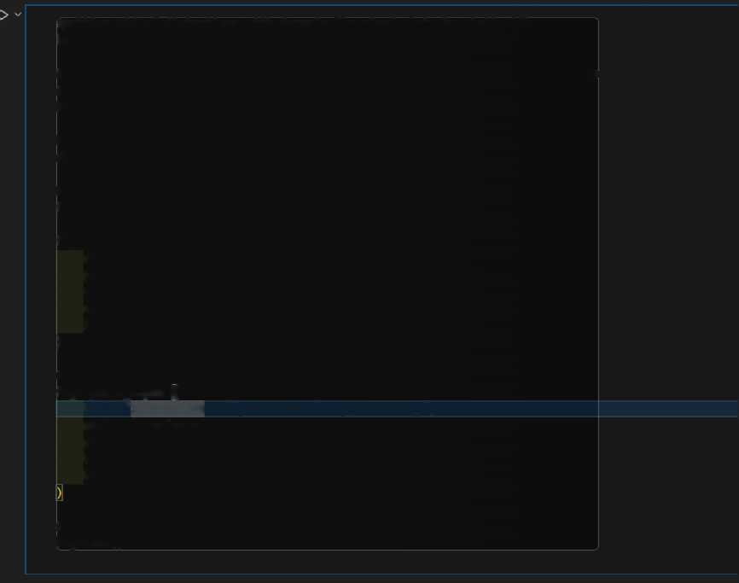
^getting rid of distortions with dynamically sized plots by plotly lib import plotly.graph_objects as go
fr Example: Assuming ’data’ is a DataFrame with 'Date' and 'Daily Return' columns
I Convert 'Date' to datetime if it isn’t already
data[’Date¹] = pd.to_datetime(data['Date'], errors^¹coerce’)
# Remove rows with NaT in ’Date' data = data.dropna(subset=[‘Date¹])
# Create an interactive plot fig = go.FigureQ
fig.add_trace(go.Scatter( x=data[’Date¹], y=data[¹Daily Return¹], mode='lines*, name='Daily Return', line=dict(color=’blue’)
))
# Customize layout fig, update_layout|(]
title=”Interactive Daily Returns of Cryptocurrency",
xaxis_title="Date",
yaxis_title="Daily Return",
template=’,plotly_dark"j # Optional: Use a dark theme hovermode="x unified" # Show tooltip for x-axis values
ft Show the plot fig.show()
[7] V 4.0s
• Monitor price volatility
Daily Price Volatility
 |  |  |  |  |  |  |  |  | -— | _ Daily Volat | _ lity
 |  |  |  |  |  | i— .
 |  |  | A |  |  | Iff
2013 2014 2015 2016 2017 2013 2019 2020 2021 2022
Date

Slide 11
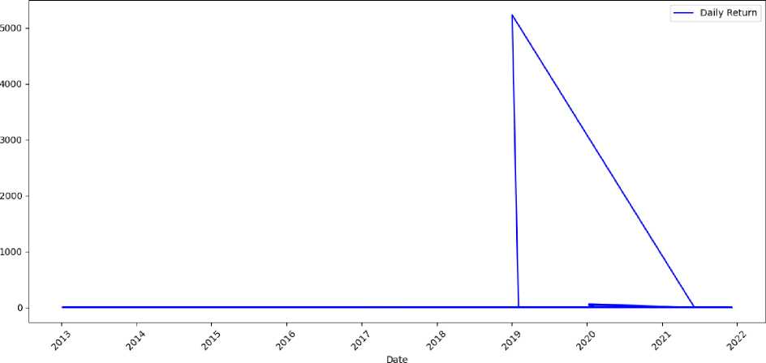
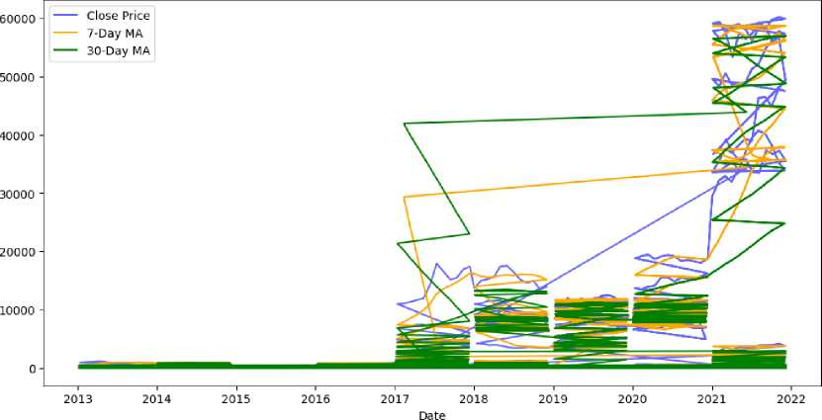
• Calculate Investment Returns
Daily Returns of Cryptocurrency
Analyze trends
Cryptocurrency Price and Moving Averages
• Study Correlations

Slide 12
Correlation Matrix | Sno | High Low | Open Close | Volume \
Sno | 1.000000 | 0.006858 -0.006862 | -0.006990 -0.006937 | 0.011620
High | -0.006858 | 1.000000 0.999278 | 0.999562 0.999600 | 0.283701
Low | -0.006862 | 0.999278 1.000000 | 0.999406 0.999477 | 0.281449
Open | -0.006990 | 0.999562 0.999406 | 1.000000 0.999007 | 0.282826
Close | -0.006937 | 0.999600 0.999477 | 0.999007 1.000000 | 0.283078
Volume | 0.011620 | 0.283701 0.281449 | 0.282826 0.283078 | 1.000000
Marketcap | -0.179541 | 0.686372 0.685900 | 0.685915 0.686735 | 0.484596
Daily Return | 0.013766 | 0.003804 0.003985 | 0.003887 0.003890 | -0.002172
Daily Price Range | -0.005752 | 0.856333 0.836097 | 0.848273 0.847844 | 0.270770
Daily Volatility | -0.040146 | 0.024519 -0.026834 | -0.025613 -0.025521 | -0.042678
Volatility (%) | -0.040146 | 0.024519 -0.026834 | -0.025613 -0.025521 | -0.042678
7-Day MA | -0.009367 | 0.993024 0.993080 | 0.993482 0.992617 | 0.277744
30-Day MA | -0.020761 | 0.947086 0.947802 | 0.948398 0.946201 | 0.256683
 | Marketcap | Daily Return Daily Price Range \
Sno | -0.179541 | 0.013766 | -0.005752
High | 0.686372 | 0.003804 | 0.856333
Low | 0.685900 | 0.003985 | 0.836097
Open | 0.685915 | 0.003887 | 0.848273
Close | 0.686735 | 0.003890 | 0.847844
Volume | 0.484596 | -0.002172 | 0.270770
Marketcap | 1.000000 | -0.001833 | 0.587449
Daily Volatility | 1, | .000000 1.000000 -0.024269 -0.021127
Volatility (%) | 1, | .000000 1.000000 -0.024269 -0.021127
7-Day MA | -0. | .024269 -0.024269 1.000000 0.966785
30-Day MA | -0. | .021127 -0.021127 0.966785 1.000000
Output is truncated. View as a scrollable element or open in a |  |  | text editor. Adiust cell output settinas...

Slide 13
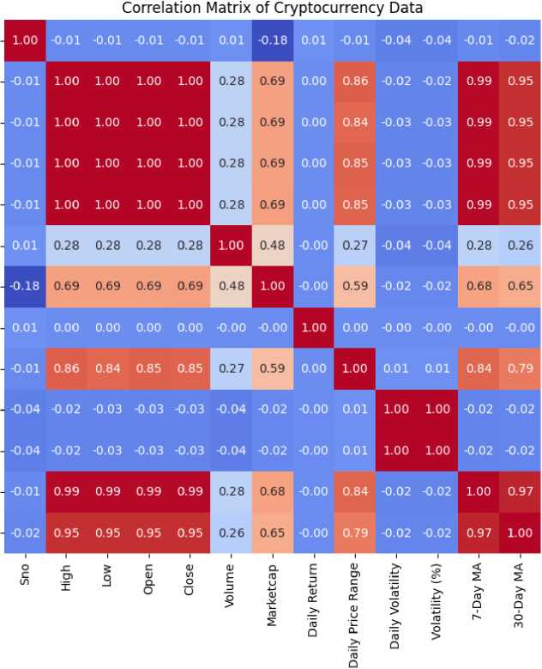

Sno High Low Open Close \falume Marketcap Daily Return Daily Price Range Daily Volatility Volatility (%) 7-Day MA 30-Day MA
• Seasonal or Periodic Patterns

Slide 14
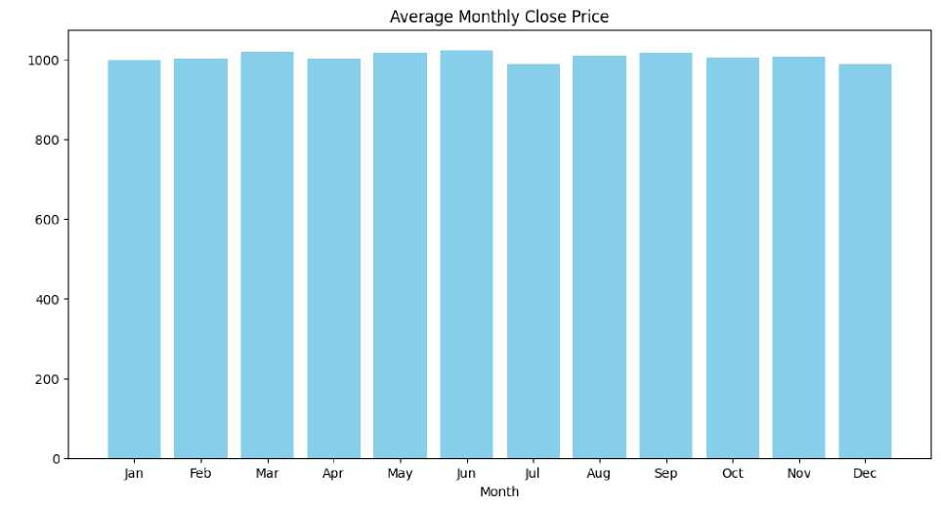
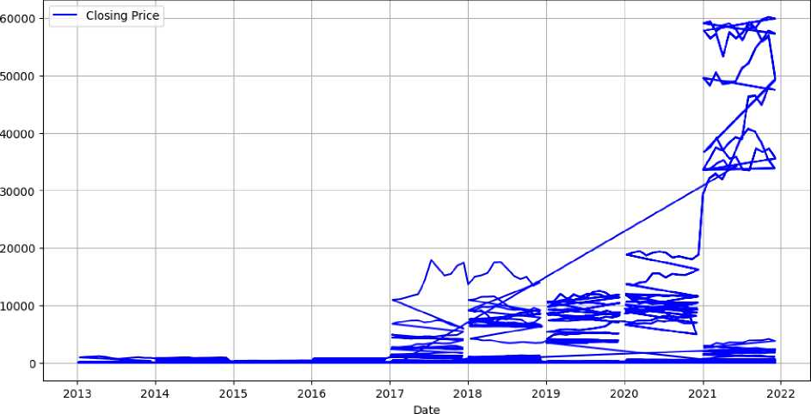
Analyze trends in closing prices
Trends in Daily Closing Prices
• Save processed data in a file

Slide 15
# Save Processed Data (Optional) ft-------------------------------
processedfile = ’C:/Users/HP/OneDrive/Documents/backupDocs/dev/Python mini Pro/Processed_Crypto_Data.csv' data.to_csv(processed_filej index=False)
print(f'Processed data saved to {processed file}")_J
>/ 0.8s
Processed data saved to C:/Users/HP/OneDrive/Documents/backupDocs/dev/Python mini Pro/Processed_Crypto_Data.csv
Processed_Ciypto_Data.csv X
C:\Users\HP\OneDrive\Documents\backupDocs\dev\Python mini
).ii ly Kct urn, I).;! 1 y i'r.i c K,irij;e ,l).i i ly Vol.lt i I i t y, V<>! .st I 1 !ty (%) , / Day MA, i0 D.iy MA,Month
3,55.1 17 1584/,49.78/8999/,57.0/501496,51.71974790,0.0,89178178.86,,5. 1/4458549999990,0.1010817'> S7/18 1/ 14, IH. 10817'. 17 3,5 1.4077/007,40. / I45//01 ,51. 791959 11,47.401 59801 ,583091.4S98, /1011441.7'.. 0.701/650501165/41/,17.00/09/110000004,0. 3,47.408 11 104, 15.0/0080/5 ,47. HWM/11,40.08 l«l/'if. 1 ,682834.1863,1/1 100 16.9, 0.054058869004/5009,0.41/0/ 1890000005,0.15 3,44.90751114, Mi.69(4356/7, 19.885757 14,4 1. 7(>44(> 10<., 1658816.923,770755147.1 ,0.09181947145184 11,8.700454 1/000000 1,0.705 3,4/5595 17/4,4 1.791 7/58,4 1. /6445 105,45 81 7/4415,815537 6608, 7 15517708 7 ,0.059/557184455 1/8,4.7/7/559 19099995,0 09//.
3.51 .4050548,45./0117/68,46.81814 .’>4,40.1 11/1 /(,/, 1074627.028,74/788478.8,0.04946/8580108 19194,4. /07 17/17,0.1004 181 17
3.51 .4511/4 11,48. /1601054,49.1 111 7951,49.660/75 / 1,692150.6009, 74994084 1.4,0.010/7599601641 1447,7 . / 1 / 114 / 70000004,0.0
Pro\Processed_Crypto_Data.csv
2 JL, Aave,AAVE,2020-05-10 23:59:
3 2,Aave,AAVE,2020-06-10 23:59:
4 8,Aave,AAVE,2020-07-10 23:59:
5 k,Aave,AAVE,2020-08-10 23:59:
6 f>,Aave,AAVE,2020-09-10 23:59:
7 b,Aave,AAVE,2020-10-10 23:59:
8 y,Aave,AAVE,2020-11-10 23:59:
8 A. AAX/I_7-7.' I, I ;• ./l 717 1/11/51 48 . 7540 / 708.49.501 5/ 1 79.5 7 71X1.9777 1354836 055 7>,7'i .. - 0.0519115750 1448 74.5 l. / .1,1 0.114

