Slide 1
Medical Questions
Project
CUS 635
Jessica Gunther
Bhavesh Ahluwalia
Shreya Shrestha
Chris Balingcongan

Slide 2
Structure of deliverables
We each worked on data sourcing and cleaning separately and worked together on the preprocessing and presentation
‘Medical_Qs_Jessica.ipynb’
scraped and cleaned questions from multiple websites
‘Medical_Qs_Bhavesh.ipynb’
scraped and cleaned questions from multiple websites
‘Pres_Project_Part 1’
This powerpoint
‘Questions_Concat.ipynb’
Notebook which concatenates all of our different questions into one dataframe and exports as a CSV
‘Medical_Qs_Shreya.ipynb’
scraped and cleaned questions from multiple websites
‘Preprocessing.ipynb’
Shared notebook containing preprocessing done on the dataset
‘Medical_Qs_Chris.ipynb’
Cleaned and formatted Kaggle dataset
‘CombinedMedicalQuestions.csv’
Output of ‘Questions_Concat.ipynb’

Slide 3
Why analyze medical questions?
Healthcare professionals receive many medical questions in their daily clinical practice
and this information is stored in many diverse sources and, generally, in textual form.
When analyzing medical questions, one can find relevant and useful information which can be transformed into knowledge.
Clinical questions contain medical vocabulary which can be analyzed.
Analyzing these questions can ease the labor of healthcare professionals that read each and every question therefore reducing time and decreasing costs.
Medical question text analysis can result in great support for both patients and health care professionals in terms of improvement in the quality of care services, reduction in the number of medical errors, prevention and detection of diseases, treatment identification, etc.

Slide 4
Objective

Slide 5
Methodology

Slide 6
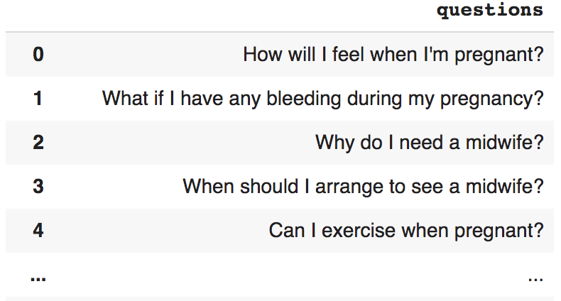
Data Understanding & Acquisition
Data Sources
Kaggle Dataset
https://www.kaggle.com/xhlulu/covidqa
Web Scraping
We scraped from multiple different websites, each of which are referred to in their respective notebooks
Each source contains different types of medical questions which were then preprocessed and combined.

Slide 7
Metadata
Each question has a specific medical domain associated with it
Medical Domains
Pregnancy
Hospice Care
Accident, First Aid
Caring, Carers
Children’s Health
Dental Health
Food & Diet
Infections
Lifestyle
Medicine
Men’s Health
Services & Treatments
Operations, Tests, & Procedures
Sexual Health
Women’s Health
Headache
Flu
Diseases
Cancer
Mental Health
Coronavirus
Genetic Disorder
Allergy
DIgestive Issues
Condition
Miscellaneous

Slide 8
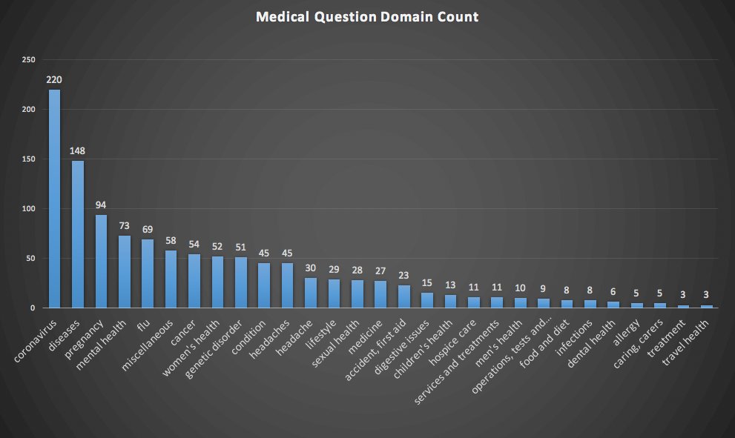
Metadata Continued

Slide 9
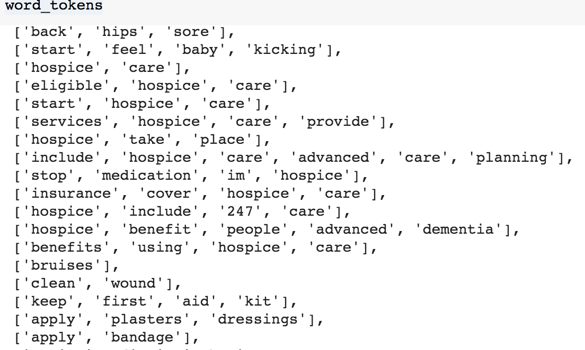
Data Cleaning
Removal of Punctuations
Punctuations are not necessary to include in text analysis.
Stop-Wording
Words that don’t have much meaning in the medical question are removed. (ex. How, I, if, is, my)
Tokenization
Token words are created. (ex. Pregnant, covid19, virus, bleeding.
These tokens will be used to help understand the medical questions and produce useful insights.

Slide 10
Continued Preprocessing
Lemmatization
Analyzing forms of medical tokens as a single item
Lexical Diversity - .6679
Measurement of how many different lexical words there are in the questions
Finding Important Words
Frequent medical terms found in the questions
Collocations
Group of two or more medical words that go together
N-grams

Slide 11
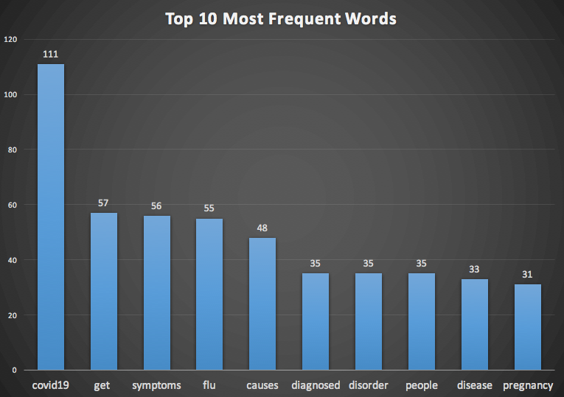
Frequency Distribution

Slide 12
Lemmatization

Slide 13
Lexical Diversity

Slide 14
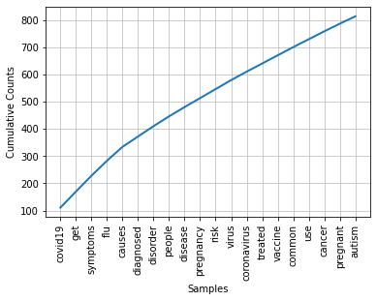
Finding Important Words

Slide 15
Collocations
kidney stone; brain tumor; healthcar provid; femal infertil; alcohol
intoler; flu vaccin; anal cancer; alopecia areata; alcohol
cardiomyopathi; vitamin defici; substanc use; question ask; genet
mutat; optic nerv; outlook peopl; abnorm menstruat; influenza flu;
autism spectrum; eat disord; side effect

Slide 16
N-Grams
Frequent 2 Grams
('optic', 'nerv'), ('alopecia', 'areata'), ('abnorm', 'menstruat'), ('give', 'birth'), ('question', 'ask'), ('prognosi', 'outlook'), ('femal', 'infertil'), ('brain', 'tumor'), ('menstruat', 'period'), ('healthcar', 'provid'), ('kidney', 'stone'), ('vitamin', 'defici'), ('ask', 'doctor'), ('side', 'effect'), ('genet', 'mutat'), ('someon', 'els'), ('autism', 'spectrum'), ('anal', 'cancer'), ('alcohol', 'cardiomyopathi'), ('hospic', 'care')
Frequent 3 Grams
('abnorm', 'menstruat', 'period'), ('question', 'ask', 'doctor'), ('autism', 'spectrum', 'disord'), ('genet', 'mutat', 'caus'), ('substanc', 'use', 'disord'), ('viru', 'caus', 'covid19')

Slide 17
LDA

Slide 18
KNN

Slide 22
Thank You!
Presented by Jessica Gunther, Shreya Shrestha, Bhavesh Ahluwalia, and Chris Balingcongan

