Slide 1

Security Scanner
~Bhavesh malik

Slide 2

Introduction
• Security Scanner is a tool used to find open ports on a target system.
• It is useful in cybersecurity to identify potential weaknesses.
• Ethical hackers use scanners in the first phase of penetration testing.

Slide 3

Objective
• Develop a basic Python-based security scanner.
• Identify open and commonly vulnerable ports on a given IP.
• Gain understanding of network reconnaissance techniques.

Slide 4

Technologies Used
• Python 3
• socket module (for network communication)
• Command Line Interface (CLI)
• Windows/Linux OS

Slide 5

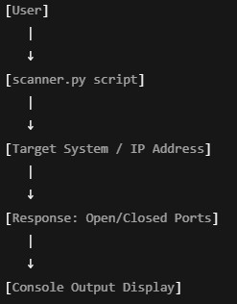
Architecture Diagram

Slide 6
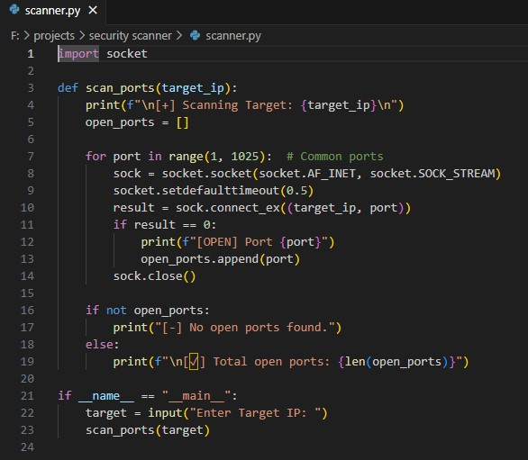

Slide 7

Conclusion
• The project scans open ports on a target system.
• It demonstrates basic cybersecurity reconnaissance.
• Can be extended to check service banners and detect known vulnerabilities.

Slide 8


