Slide 1

Password Strength Checker
~Bhavesh malik

Slide 2

Introduction
In today’s digital world, passwords play a crucial role in protecting user data and accounts.
However, many users choose weak and predictable passwords, making them easy targets for cyber attacks.
This project helps users check the strength of their passwords based on multiple rules such as length, digits, uppercase, lowercase, and special characters.
It aims to create awareness about strong passwords and improve personal cybersecurity practices.

Slide 3

Problem Statement
Many users create weak or common passwords like "123456", making their accounts easy targets.
Such passwords are vulnerable to brute-force and dictionary attacks.
Most people don’t know what makes a strong password.
This project provides a simple tool to check password strength and help users create stronger, safer passwords.

Slide 4
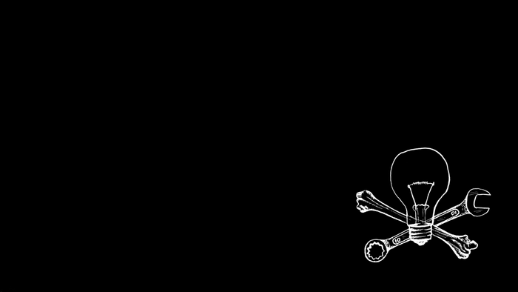
Technologies Used
• Python – Core programming language used
• re module – Used for regular expressions (to check password rules)
• Optional for Future:
– tkinter: For GUI version
– hashlib: For password hashing
– streamlit: For web interface

Slide 5

Password Strength Rules
A password is considered “Strong” if it contains:
• At least 8 characters
• At least one lowercase letter (a–z)
• At least one uppercase letter (A–Z)
• At least one digit (0–9)
• At least one special character (!@#$%^&* etc.)
Based on how many rules are matched:
→ Strong, Medium, or Weak label is shown

Slide 6
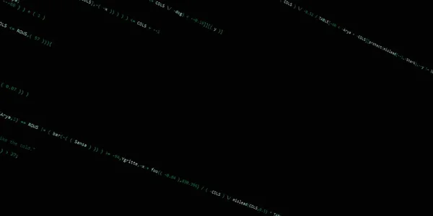
Code Flow
1. User enters a password as input.
2. Program checks the password using regular expressions for:
– Length (minimum 8 characters)
– Lowercase letters
– Uppercase letters
– Numbers
– Special characters
3. Conditions matched are counted.
4. Based on count:
– All matched → Strong
– 3–4 matched → Medium
– Less than 3 → Weak
5. Output shows: Password Strength: Strong / Medium / Weak

Slide 7

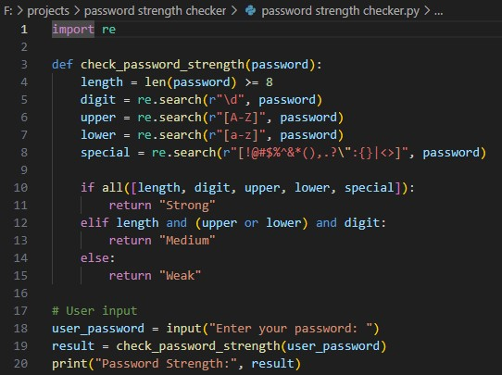
CODE:

Slide 8

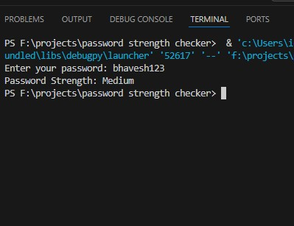
OUTPUT

Slide 9

Future Scope
• Add a GUI using Tkinter for better user interface
• Make a web version using Streamlit or Flask
• Integrate with user signup/login forms
• Store passwords securely using hashing (e.g., hashlib)

Slide 10

Conclusion
This tool checks if a password is strong, medium, or weak based on key rules.
It helps users create better passwords and avoid common security risks.
The project is simple but useful for promoting safe password habits.

Slide 11

THANK YOU

