Slide 1





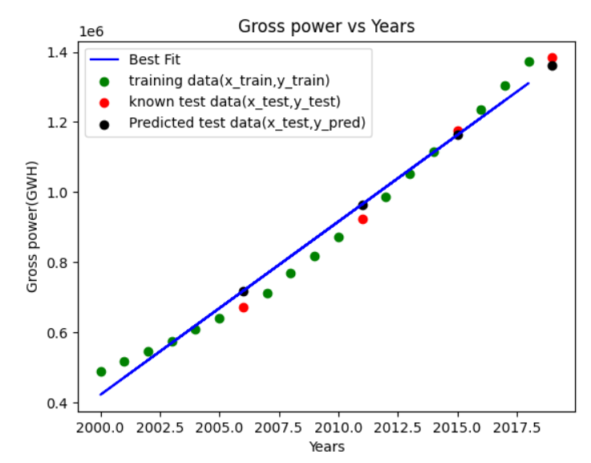
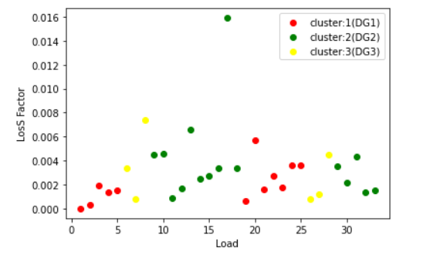
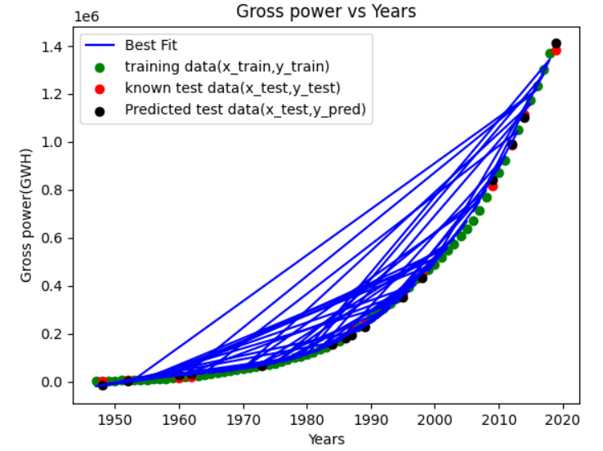
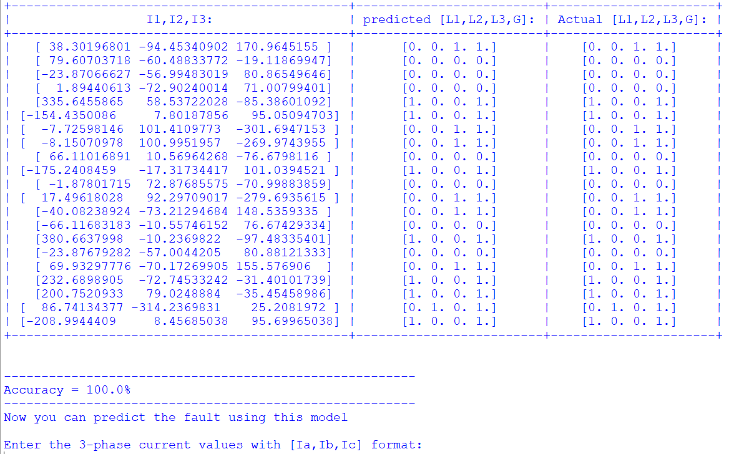
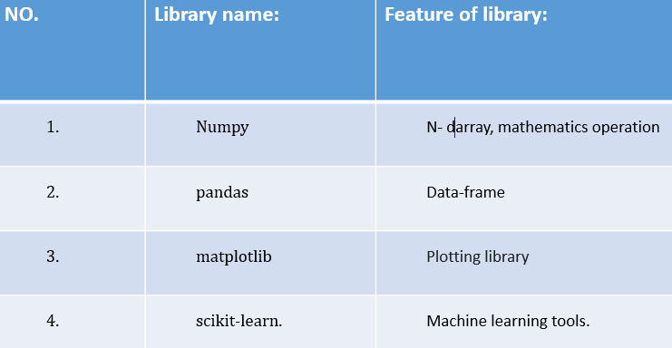
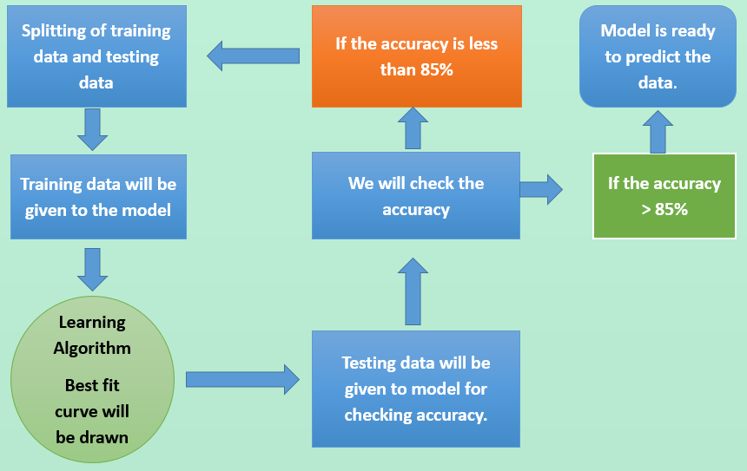
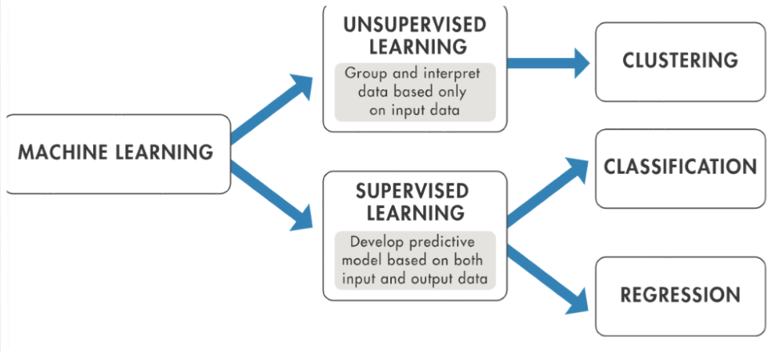
BIRLA VISHVAKARMA MAHAVIDYALA ENGINEERING COLLEGE V. V. NAGAR
Electrical Engineering Department
PROJECT EXPO 2021
AI AND MACHINE LEARNING APPLICATION TO ELECTRICAL ENGINEERING
INTRODUCTION
OUTPUT OF THE DIFFERENT MODELS:-
RESULTS AND ANALYSIS
Artificial intelligence and Machine learning include a broad range of algorithms and different libraries that make it possible for systems to predict the future data and find the specific patterns from the given dataset.
In polynomial regression, when we change the degree of polynomial regression we will get different curve with different accuracy. In this model we have set degree = 3 and got 100% accuracy to predict the power generation in India.
In k-means clustering model, When we change the k value ,we will get different clusters.
To select this we can use ELBOW method. We got k=3. It means we should use 3 D.G. units for the given load data.
In KNN classification , There is no particular way to determine the best value for "K", so we need to try some values to find the best out of them. We have set k=5 and got above 95% accuracy
for fault classification.
PROJECT DEFINITION
In this project, we have made five ML models. With the help of Linear regression & polynomial regression we can predict the future power generation in India with specific accuracy. With the help of K-means clustering and Hierarchical clustering model we can identify the optimal location for the installation of DG(Distributed Generation ) units in the Distribution Systems. Last model is KNN for load classification and fault classification in power system.
LITERATURE REVIEW
CONCLUSION AND FUTURE SCOPE
Model Name: | Linear and polynomial regression: | K-means and Hierarchical clustering: | KNN classification:
Title of research paper: | Internet | Clustering Analysis and its Application in Electrical Distribution. | Fault detection and classification in electrical power transmission system .
Authors: | - | K.M.Rosalina, N.P. Kumar | Majid Jamil, Rajveer Singh
Input : Output: | Feature: years(1950-2019) Label: Electricity generation of the given year(GWH) We will get the best fit curve with accuracy. | Voltage(p.u.) and power loss of different load. We will get the cluster of DG(Distributed Generation) units for different load. | Feature: current values:(I1,I2,I3) Label : Fault (L1-G,L2-G,L3-G) We will get trained model With specific accuracy.
Advantages: | exceptionally well for linearly data and Polynomial basically fits a wide range of curvature. | If variables are huge, then K-Means most of the times computationally faster than hierarchical clustering. | Very simple implementation.
Limitation : | The presence of outliers in the data can seriously affect the results of the model. | The user has to specify k (the number of clusters) in the beginning. | Require high memory – need to store all of the training data.
If the datasets are arranged in a non-linear fashion, then we should use the Polynomial Regression model instead of Simple Linear Regression to get higher accuracy (above 95%).
The output of the Hierarchical clustering is almost similar to the K-means clustering, so we can say that our model is reliable. So we can identify the optimal location for the installation of DG units in Distribution System. We can also find the location of capacitor bank.
With the help of KNN model ,we can differentiate among three phases which phase of a three phase power system is experiencing a fault with specific accuracy.
DIFFERENT ML LIBRARIES AND ALGORITHMS FOR THIS PROJECT:
BLOCK DIAGRAM
REFERENCES
https://www.javatpoint.com/machine-learning
https://www.coursera.org/learn/machine-learning
https://www.youtube.com/user/krishnaik06 (K-means & Hierarchical clustering ,Regression)
https://www.youtube.com/c/sentdex (KNN classification.)
https://www.youtube.com/watch?v=HVXime0nQeI&list=PLblh5JKOoLUICTaGLRoHQDuF_7q2GfuJF&index=38 (KNN classification)
http://irdindia.in/journal_ijraet/pdf/vol8_iss6/6.pdf
https://springerplus.springeropen.com/track/pdf/10.1186/s40064-015-1080-x.pdf
Students: SAMANI BHAVESH(17EE055) Faculty Guide:
YADAV JAGDISH(17EE057) Dr. Rashesh P. Mehta and Prof. Jaydeepsinh C. Baria

