Slide 1
E-Commerce Sales Performance Dashboard
Elevate Labs – Data Analyst Internship
Bhavishya Priyadarshini V
June 2025

Slide 2
Dashboard Objective & Key Metrics
Objective:
To design an interactive dashboard for business stakeholders using e-commerce sales data across 12 months.
Key KPIs Tracked:
Total Revenue
Total Units Sold
Average Review Score
Top Revenue-Generating Products
Revenue by Category

Slide 3
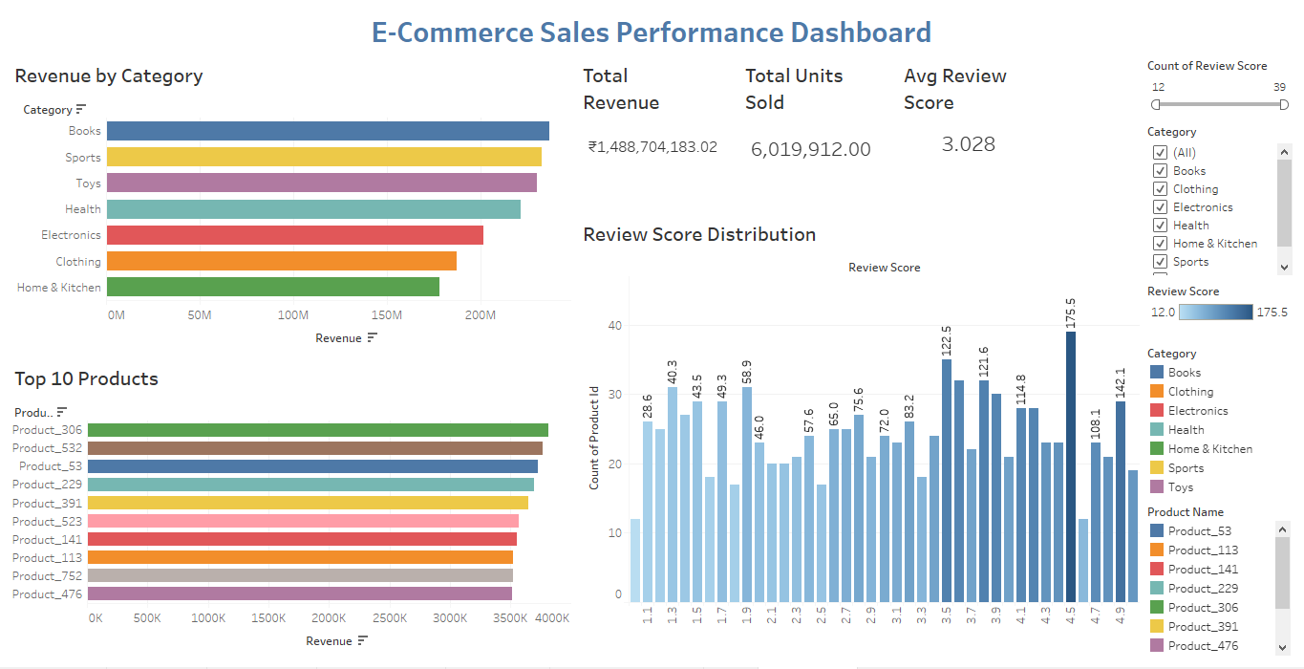
Interactive Dashboard Overview

Slide 4
Business Insights from the Dashboard
• The Books category generated the highest revenue.
• Average review score is around 3.0, with most products between 2.5 and 4.5.
• Product_306 is the top revenue-generating product.
• Categories like Sports and Toys also show strong performance.
• Review Score distribution shows wide variation among products.

