Slide 1
ELECTVIZ
Infosys Virtual Internship 6.0
ELECTION DATA VISUALIZATION FOR MEDIA
Group :1
Batch :11
Mentor : Mrs. Nityashree S J
Presentation by : BHAVISHYA PRIYADARSHINI V

Slide 2
Introduction
  ElectViz – Election Data Visualization for Media is an interactive data analytics project developed using Microsoft Power BI, aimed at analyzing Indian National-level General Election data from kaggle.
  The project focuses on transforming large and complex election datasets into visually engaging and interactive dashboards.
  These dashboards help users explore voting patterns, voter turnout, party performance, candidate participation, and gender representation across different states, regions, and election years.

Slide 3
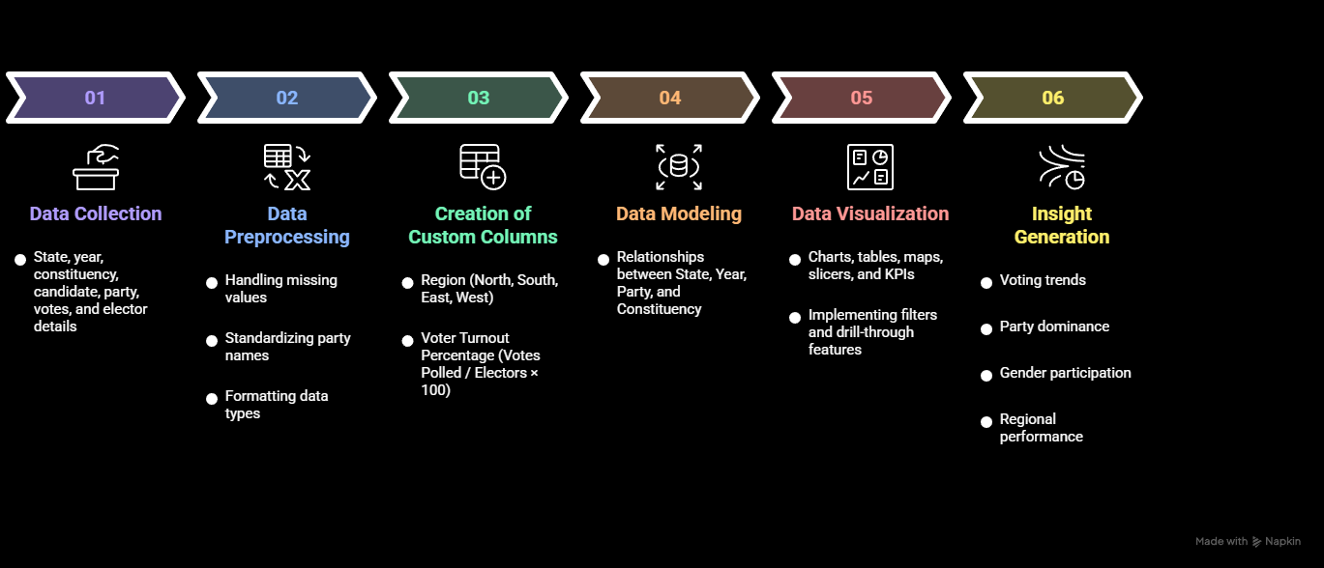
System Design and Workflow

Slide 4
Milestones
Milestone 1: Data Collection & Preprocessing
Collected Indian General Election dataset from Kaggle
Cleaned and standardized data using Power Query
Milestone 2: Initial Dashboard Development
Designed Election Overview dashboard
Developed Gender Analysis and Regional Analysis pages
Implemented slicers and interactive visuals
Milestone 3: Core Trend & Participation Analysis
Built State-Wise Voting Trend dashboard
Developed Candidate Participation Analysis
Milestone 4: Advanced Insights & Performance Evaluation
Created Voter Turnout Analysis dashboard
Designed Top Party Performance dashboard

Slide 5
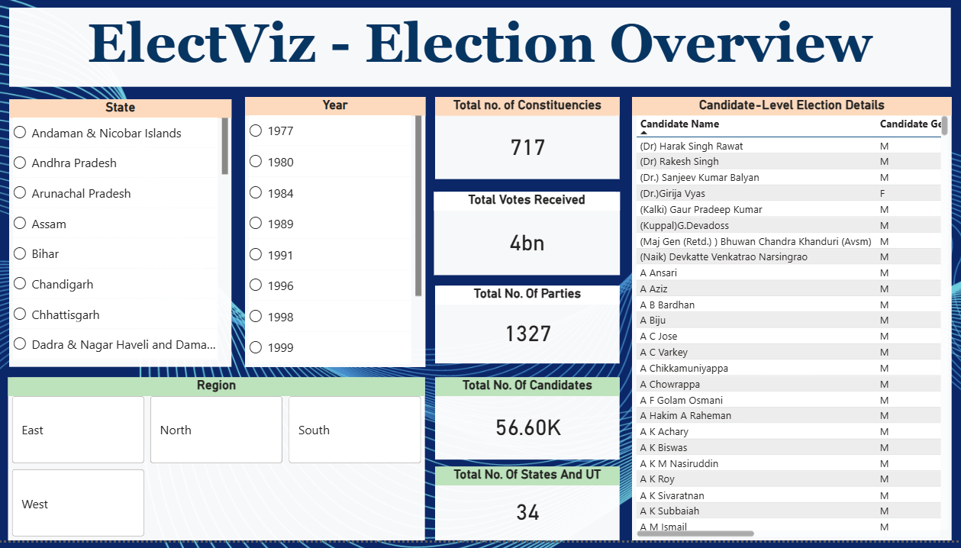
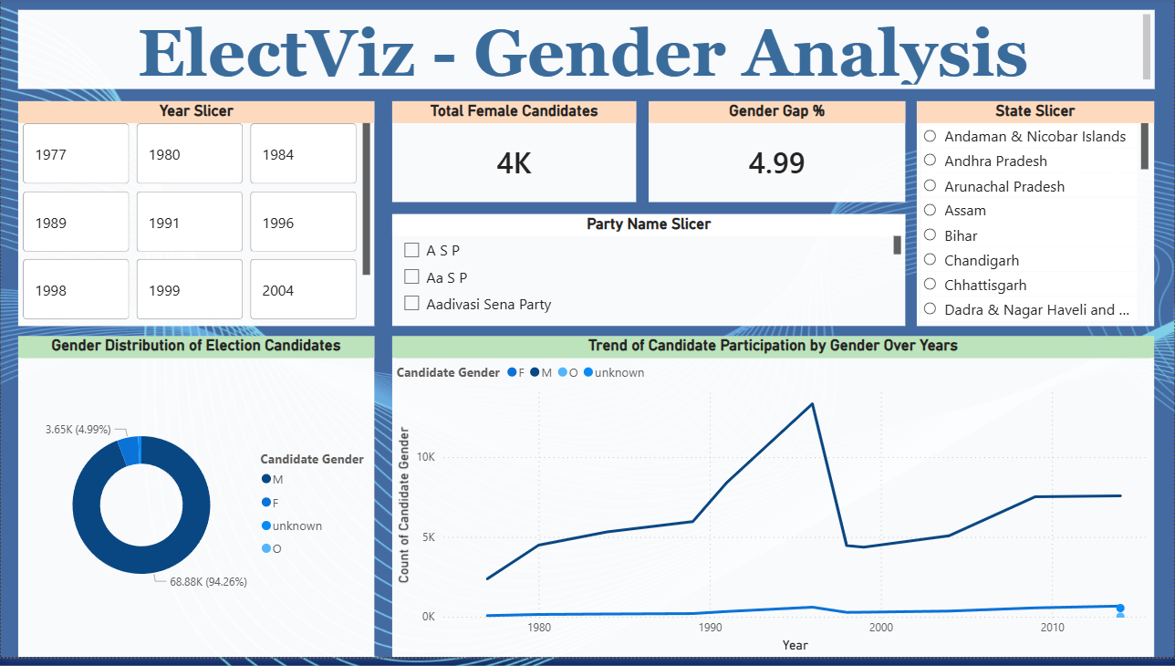
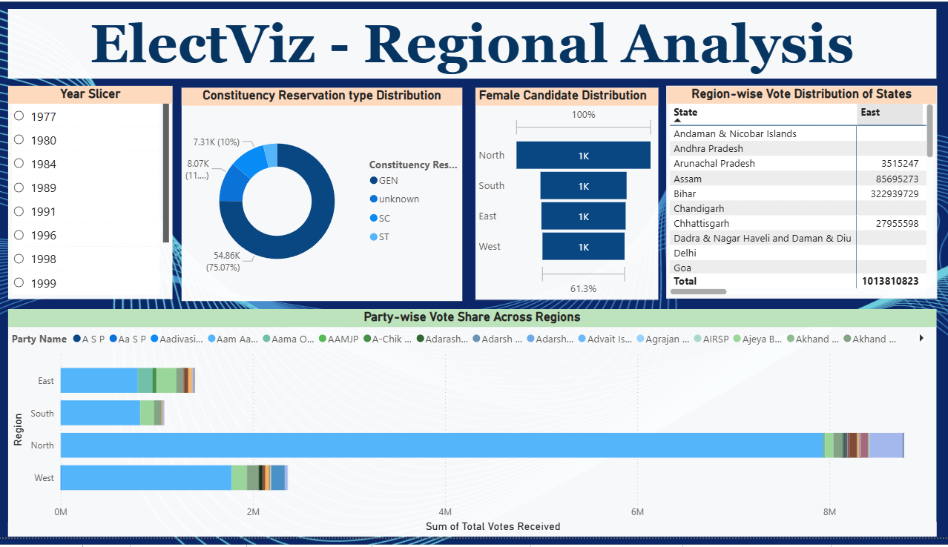
Dashboard

Slide 6
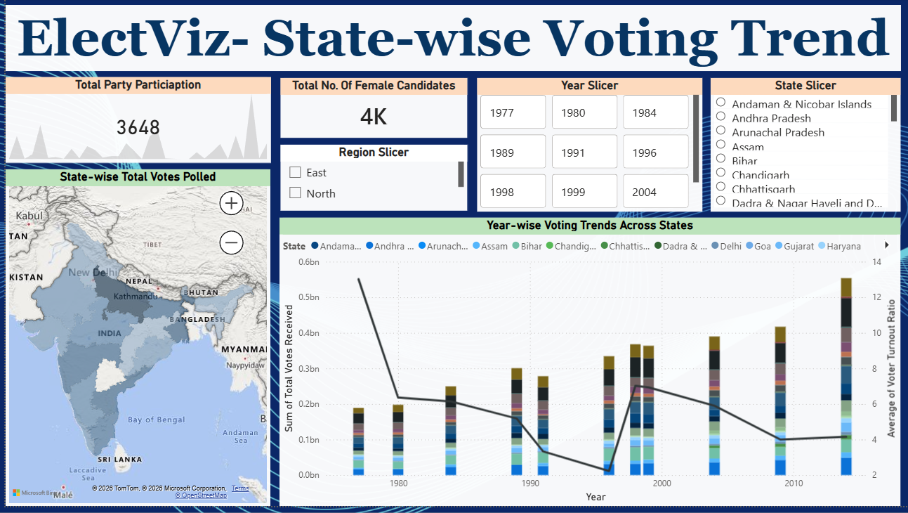
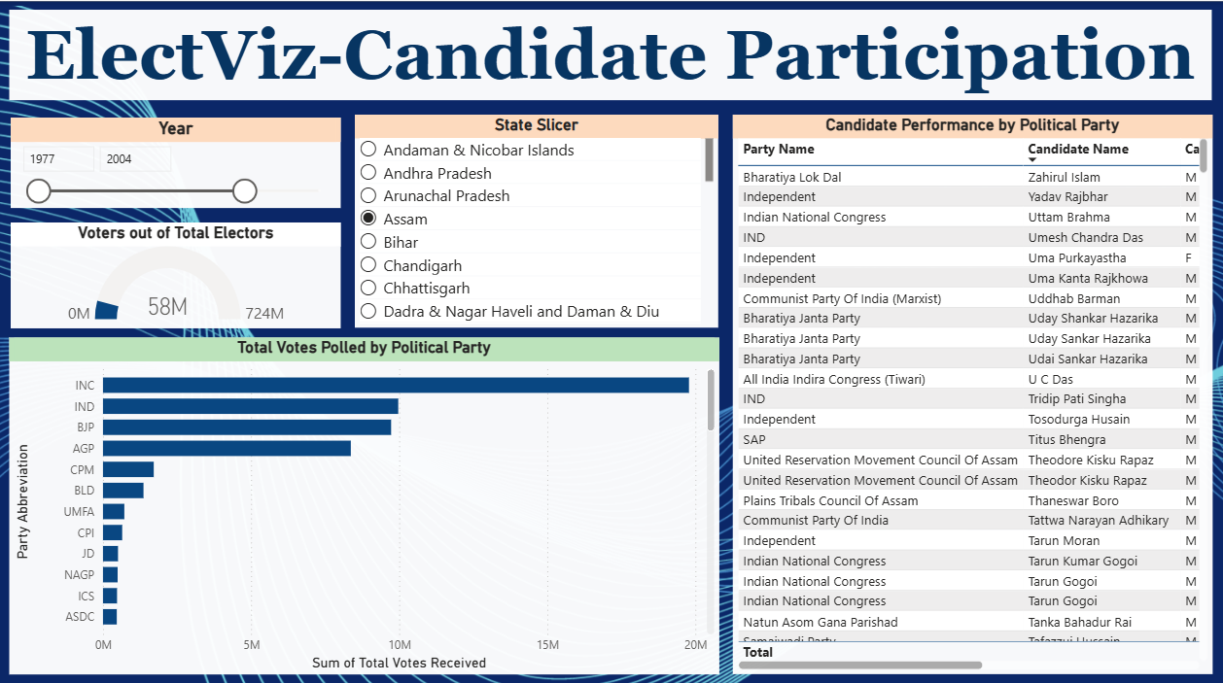
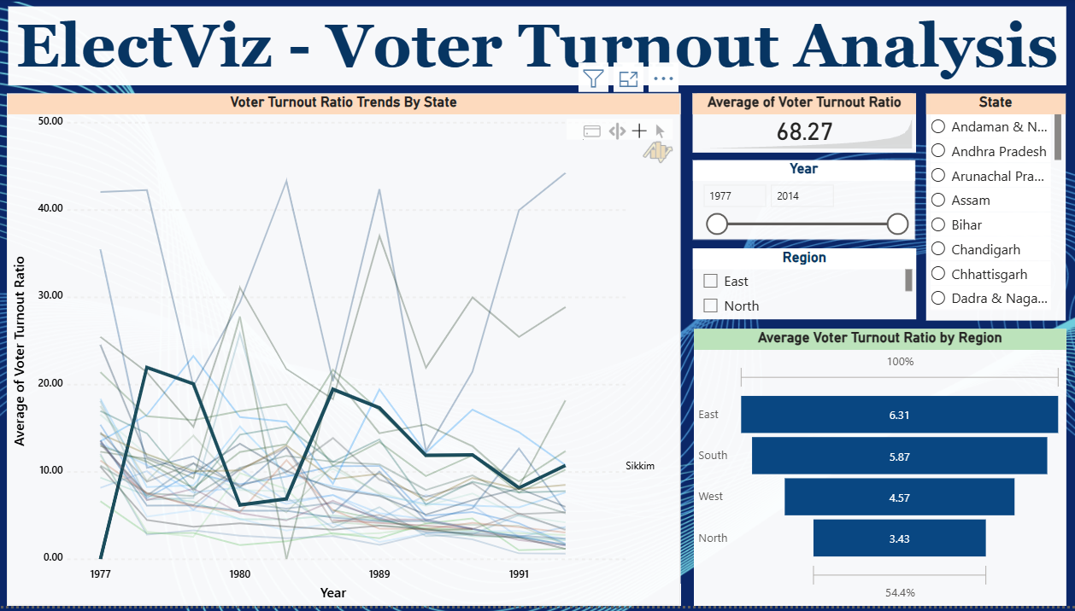
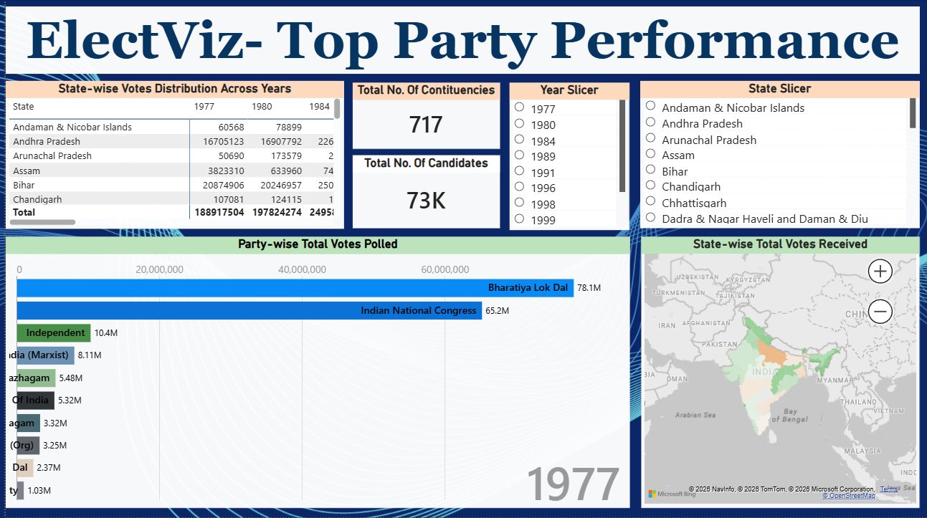

Slide 7
Future Enhancement
Real-Time Election Data Integration – Incorporate live election data feeds to provide real-time updates and dynamic dashboards.
Predictive Analysis – Apply machine learning techniques to forecast voter turnout and party performance trends.
Constituency-Level Deep Analysis – Expand the dashboard to include more granular constituency-wise insights and comparisons.
Advanced Comparative Analytics – Enable multi-year and multi-state comparative visualizations for deeper trend analysis.

Slide 8
Conclusion
  The ElectViz project effectively transforms complex Indian election data into clear and interactive visual insights using Power BI.
  It enables meaningful analysis of voting patterns, voter turnout, party performance, and candidate participation.
  The dashboards support data-driven storytelling for media, analysts, and the general public.
  Overall, the project demonstrates the real-world impact of data analytics and visualization in understanding democratic processes.

Slide 9
Acknowledgements and References
We would like to express our heartfelt gratitude to:
Infosys Springboard Team – for organizing this valuable internship opportunity.
Our Mentor – for her continuous support and feedback.
My Teammates – for collaboration, encouragement, and insights This internship has been a significant step in our professional growth and technical journey.
References:
Election Dataset (Election Commission of India / Kaggle source)
Microsoft Power BI Documentation
Infosys Springboard Virtual Internship course materials

Slide 10
Thank You

