Slide 1

INFOSYS SPRINGBOARD VIRTUAL INTERNSHIP 2026
ELECTVIZ
ELECTION DATA VISUALIZATION FOR MEDIA BATCH 11 GROUP 1
Mentor: Mrs. Nityashree S J
Submitted by: Jasleen Kaur

Slide 2

INTRODUCTION
ElectViz is an interactive election data visualization project developed as part of our internship. The project focuses on analyzing and presenting large-scale Indian election data using Power BI to uncover meaningful patterns and trends.
The primary objective of ElectViz is to transform complex election datasets into clear, intuitive, and visually engaging dashboards.
By combining data analytics with effective visualization techniques, the project demonstrates how data-driven insights can enhance political reporting and support informed interpretation of election out

Slide 3






DATA COLLECTION
Historical Indian general election dataset containing state, year, constituency, candidate, party, votes, and elector details collected from Kaggle.
DATA PREPROCESSING
Data cleaning and transformation performed in Power BI Power Query where we Handled missing values, standardized party names, and formatted data types.
DATA MODELING
SYSTEM DESIGN AND
WORKFLOW
CREATION OF CUSTOM COLUMNS
Added Region (North, South, East, West) and Voter Turnout Percentage (Votes Polled / Electors × 100)
DATA VISUALIZATION
DATA MODELING
Establishing relationships between fields such as State, Year, Party, and Constituency
DATA VISUALIZATION
Designing interactive dashboards using charts, tables, maps, slicers, and KPIs while implementing filters and drill-through features for detailed analysis.
INSIGHT GENERATION
Identification of voting trends, party dominance, gender participation, and regional performance.

Slide 4
FUTURE ENHANCEMENT
•Extend the project to include real-time and post-election data integration, enabling timely analysis and live election monitoring.
•Enhance dashboards with demographic and socio-economic indicators such as population, literacy rate, and urban–rural distribution to provide deeper electoral context.
•Improve interactivity by enabling deeper drill-down capabilities from national-level summaries to state, constituency, and candidate-level insights.
•Implement AI-powered insight generation to automatically highlight key patterns, anomalies, and significant changes in election outcomes.
•Expand accessibility through mobile-responsive dashboards and role-based views for analysts, media professionals, and the general public.
•Strengthen data validation and governance mechanisms to ensure accuracy, consistency, and scalability as datasets grow.

Slide 5
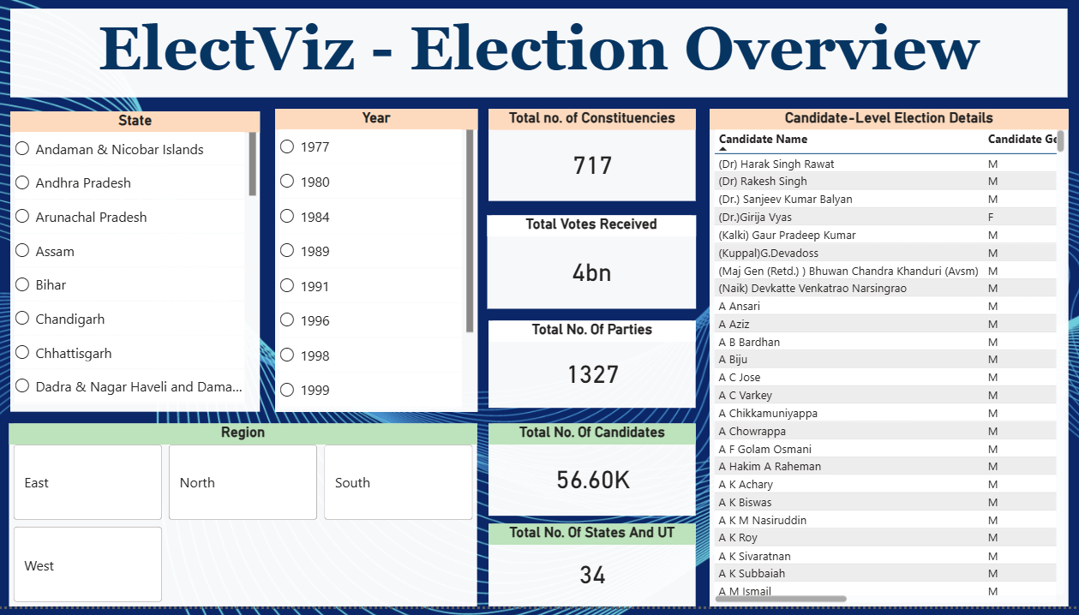
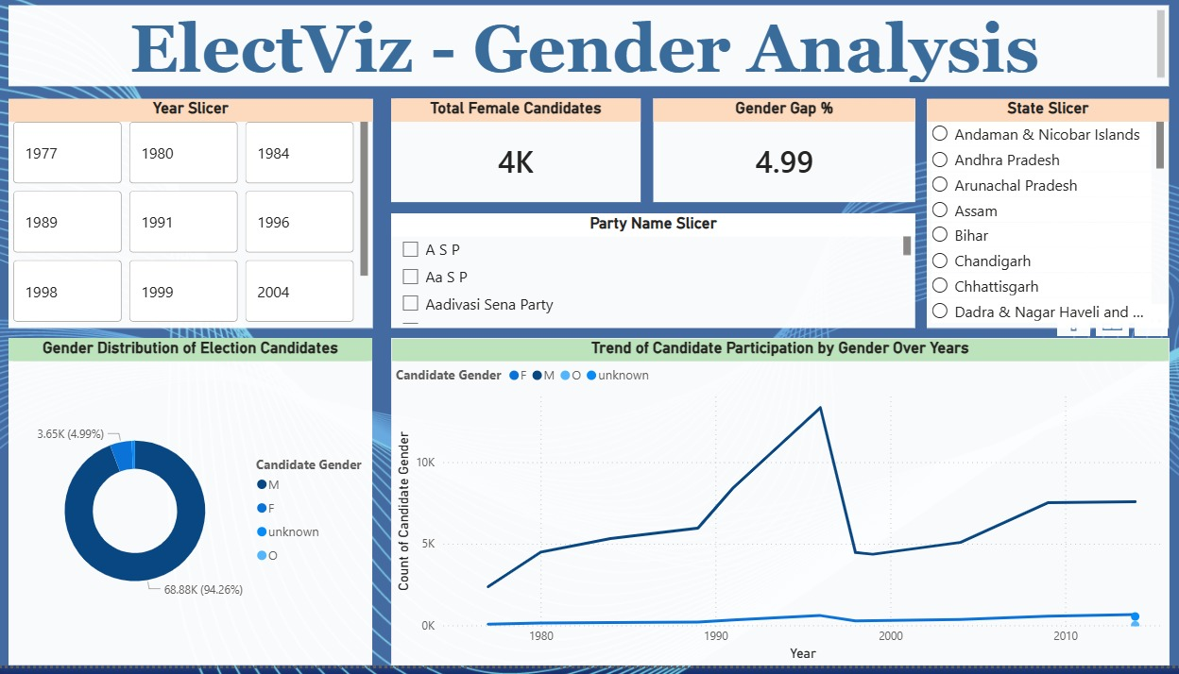
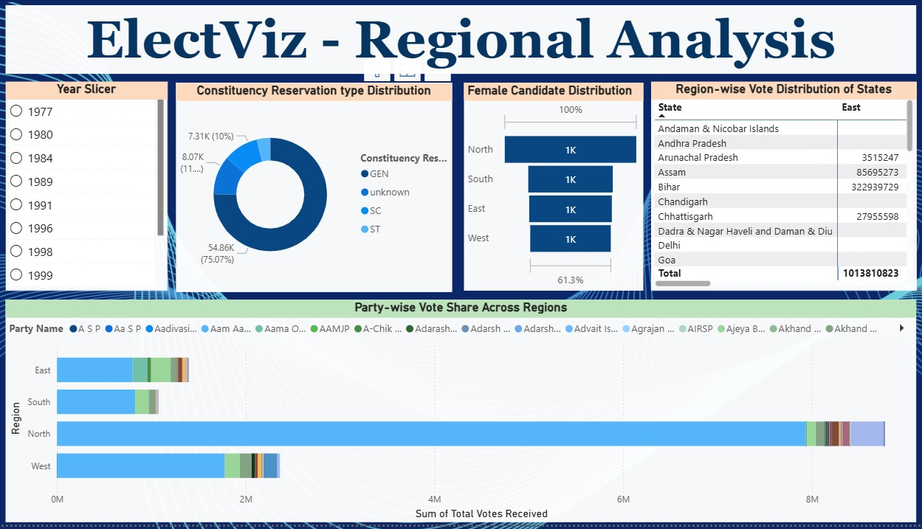
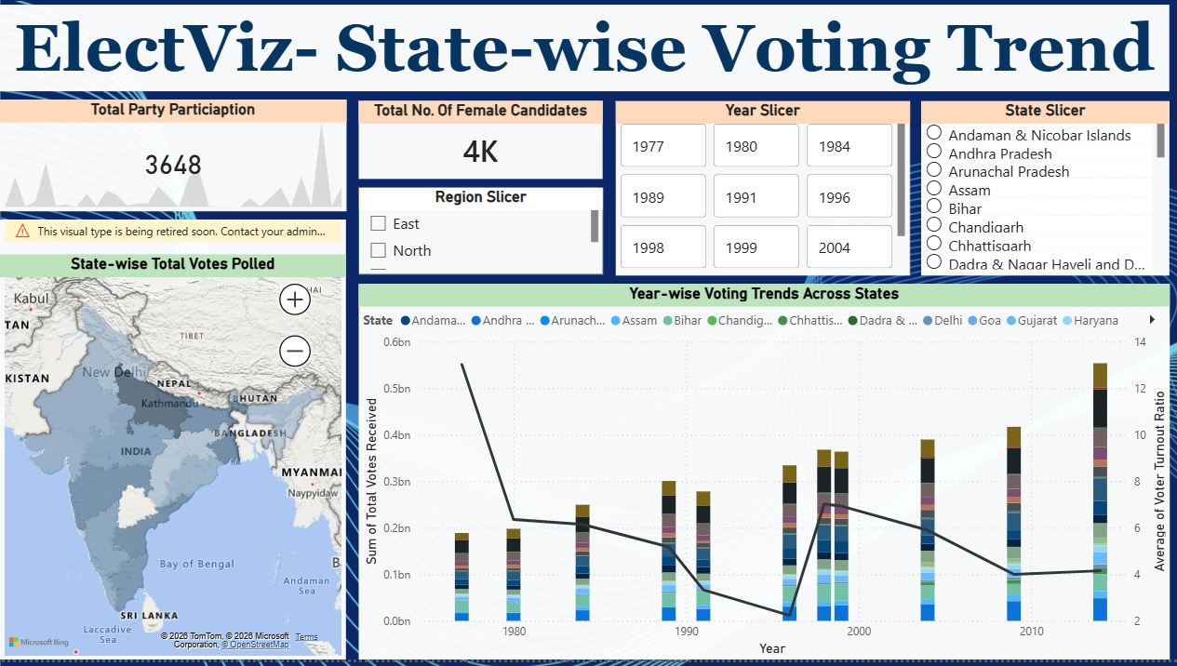
SNAPSHOTS

Slide 6
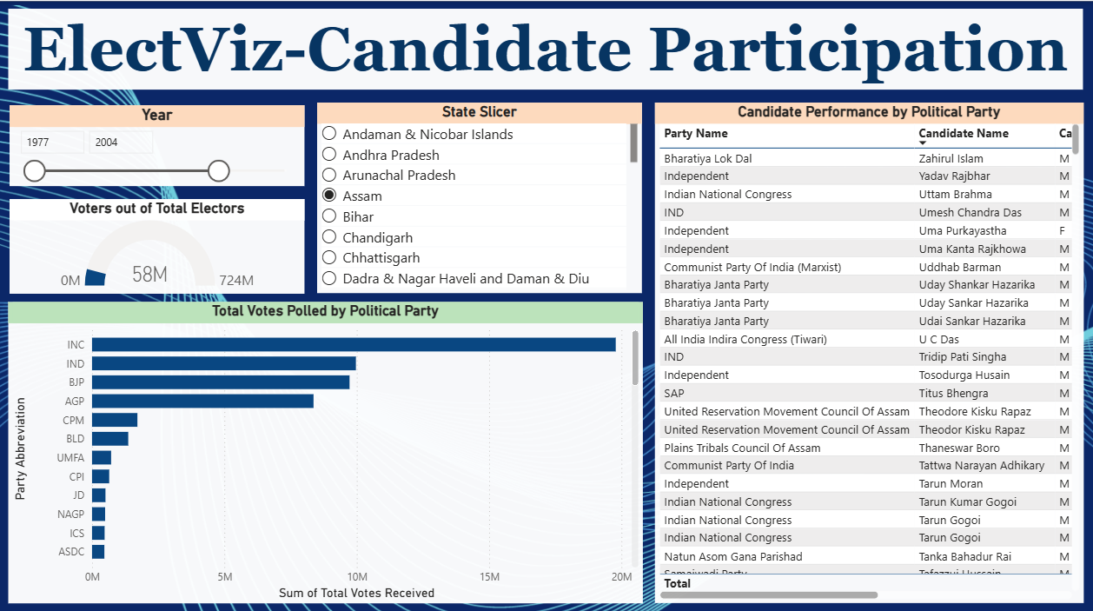
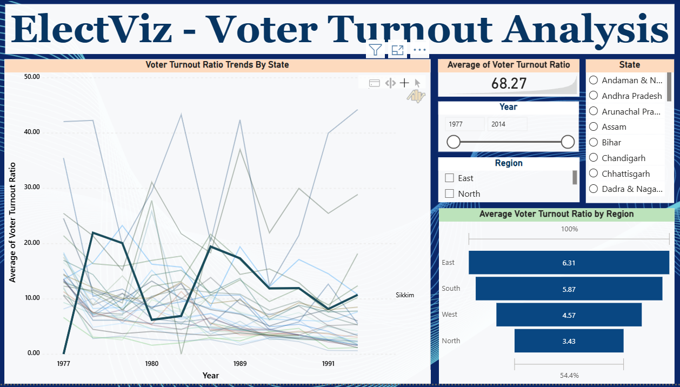
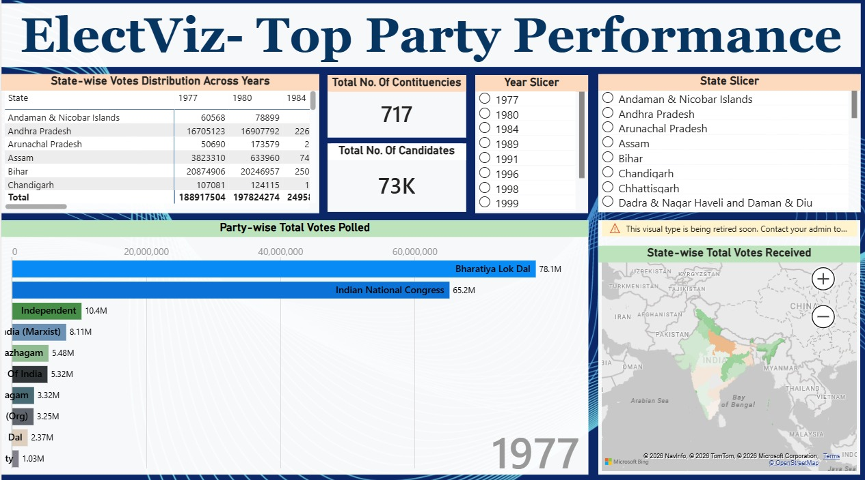
SNAPSHOTS

Slide 7
PROJECT EXECUTION MILESTONE
MILESTONE – 1
Data Cleaning and Data Pre-Processing
MILESTONE – 2
Initial Dashboard Development
  Collected Indian General Election dataset from Kaggle
  Dataset covers national-level election data of the last 10 years
  Performed data cleaning and preprocessing using Power BI Power Query
  Handled missing and inconsistent values
  Standardized state and party names
  Converted data types and removed duplicates
  Outcome: Clean, structured dataset ready for analysis
Created 3 analytical dashboard pages:
  Election Overview – Overall snapshot of votes, parties, candidates, and states
  Gender Analysis – Male vs female candidate participation
  Regional Analysis – Election behavior across North, South, East, and West
  Outcome: High-level insights into participation and regional trends

Slide 8
PROJECT EXECUTION MILESTONE
MILESTONE – 3
Core Visual & Trend Analysis
MILESTONE – 4
Advanced Insights & Performance Analysis
Developed 2 detailed analytical pages:
  State-wise Voting Trend – Voting patterns across states and years
  Candidate Participation – Party-wise and candidate-level analysis
  Outcome: Interactive dashboards showing voting and participation trends
Created 2 advanced insight-driven pages:
  Voter Turnout Analysis – Year-wise and region-wise turnout comparison
  Top Party Performance – Identification of dominant parties and vote share
  Outcome: Deep insights into voter engagement and party dominance

Slide 9

CONCLUSION
The ElectViz: Election Data Visualization for Media project successfully demonstrates how data analytics and visualization canconvert complex election datasets into meaningful and actionable insights. By leveraging Power BI, the project transforms large-scale Indian election data into interactive dashboards.
Overall, ElectViz enhances political reporting by enabling fact-based storytelling and informed interpretation of election outcomes. It lays a strong foundation for future extensions such as real-time election tracking and predictive analysis

Slide 10
ACKNOWLEDGEMENT
We would like to express our sincere gratitude to:
  Infosys Springboard Team for organizing this valuable virtual internship opportunity
  Our Mentor for continuous guidance, constructive feedback, and support
  My Teammates for their collaboration, encouragement, and shared insights
This internship has been a meaningful step in enhancing our professional growth and technical expertise.
REFERENCES
  Election Dataset – Kaggle
  Microsoft Power BI Official Documentation
  Infosys Springboard Virtual Internship Course Materials

Slide 11
THANK YOU

